Slide 1

CS 5 Nightly Wrapup
College Canceled
Claremont (The Student Life): The administrators of Harvey Mudd College announced today that the entire institution had been canceled. Classes will terminate immediately.
“We realized that there is a much better economic model,” explained President G. Reedy. We will continue to accept students, and the tuition will remain the same. After four years of paying tuition, the students will be awarded a degree, just as in previous years. The only difference will be that we won’t hold classes. That will give the students more time for the pursuits they love, like video gaming, dancing, partying, and setting things on fire, without harming their chances of getting a lucrative job after they get their degree.”
When asked what the faculty would be doing, President Reedy smiled. “That’s the best part!” he exclaimed. “We’ll finally be rid of the pesky critters.”
No penguins could be reached for comment.
Notes:
Theory3
Worksheet: Kolmogorov complexity of several numbers.
Demo: egrep/examplesForEgrep…cat it in console window, and demo it in visible window.

Slide 2

Reminders of Countability
Last time we showed:
  Programs are countable
  Real numbers are not countable
So what?

Slide 3
Functions
Consider all the constant mathematical functions f(N) = x, where x is a real number from 0 to 1:
  f(N) = 0.5
  g(N) = 0.707107…
  h(N) = 0.314159…
I can do that math in my head!
Wait…that means those functions are uncountable!

Slide 4
Functions
Consider all the constant mathematical functions f(N) = x, where x is a real number from 0 to 1:
  f(N) = 0.5
  f(N) = 0.707107…
  f(N) = 0.314159…
I can do that math in my head!

Slide 5
Reminders of Countability
We know that programs are countable...
…and even simple functions are uncountable…
…so there must be more functions than programs…
…and therefore there are functions that can’t be computed!

Slide 6
Reminders of Countability
We know that programs are countable...
…and even simple functions are uncountable…

Slide 7
What Can’t’ Be Computed?
But are all the uncomputable functions as boring as f(N) = x?
Show me something interesting!

Slide 8
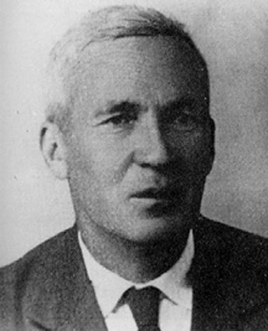
Measuring the “Complexity” of Data
10⁵⁰⁰⁰
versus
15623410342347958394180745…2123975
Andrei Kolmogorov
1903-1987
5001 digits long
Notes:
Soviet mathematician, “published” a “discovery” (sum of odds is perfect square) at age five.

Slide 9

Measuring the “Complexity” of Data
10⁵⁰⁰⁰ = 1000000000000000000…0000000000000
5001 digits long
Program takes no arguments!
def a():
return 100000000000000000…000000000000
Program returns desired number and halts!
I sorta think we can do much better!
Total length: 5017

Slide 10
Measuring the “Complexity” of Data
10⁵⁰⁰⁰
def a():
result = "1"
for d in range(0, 5000):
result += "0"
return int(result)
Program takes no arguments!
Program returns desired number and halts!
Maybe we could do even better!
Total length: 100
Notes:
Yes, the length is 100. I checked.
We can certainly do better, but don’t develop improvements.

Slide 11
Measuring the “Complexity” of Data
15623410342347958394180745…2123975
5001 digits long
Program takes no arguments!
def a():
return 1562341034234745…2123975
Program returns desired number and halts!
I sorta doubt we can do much better!
Total length: 5017
Notes:
But what if the number can be factored?

Slide 12
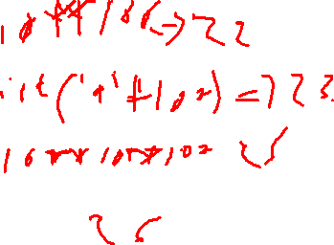
What is the Complexity Of…?
def f():return ...
1
2
3
4
5
6
7
8
9
10
11
12
13
14
15
16
Python has at least 15 bytes of “overhead”
kc(1000000000) = 20 = 15 + 5
10**9
(1 followed by 9 0’s)
kc(100…000) =
This is called a googol
(1 followed by 100 0’s)
kc(999…999) =
(100 9’s)
kc(100…000) =
This is a googolplex
(1 followed by a googol 0’s)
kc(1010…) =
(10 a billion times…try using a string)
kc(314159265…) =
(2 billion digits of pi)
Worksheet!
Notes:
Ask them to just estimate the last one (pi)
kc(googol) = 22
kc(100 9’s) = 24 (googol minus 1)
kc(googolplex) = 26 (10**googol)
kc(1010…) = int('10‘*10**9) = 15+15 = 30

Slide 13
Measuring the “Complexity” of Data
Objective…
10⁵⁰⁰⁰
complexity
100
Result: The length of the
shortest Python program
that:
-Takes no arguments
-Runs
-Returns the integer n
Argument: An integer n
Did Kolmogorov explicitly specify Python?
def a():
result = "1"
for d in range(5000):
result += "0"
return int(result)
length 100
Notes:
Note that this isn’t actually the shortest. 10**5000 can be done in 24 characters (including trailing newline).

Slide 14
Measuring the “Complexity” of Data
We will show that complexity is uncomputable
Specifically, we will show that any implementation of complexity must necessarily contain a bug:
There is at least one number for which it will return the wrong answer!
Notes:
The animation shows the alien’s comment on the bug.

Slide 15
Measuring the “Complexity” of Data
Our key insight:
For any value k, there is a number n whose complexity is greater than k (why?)
Notes:
You can find complexity greater than k because there are always primes whose digits are truly random. Or proof by contradiction: assume there is a maximum complexity. There is only a finite number of programs of that length, but an infinite number of integers.

Slide 16
Measuring the “Complexity” of Data
By Way of Contradiction (“BWOC”), assume we have a “Complexity” function…
complexity
def Complexity(number):
# code goes here
return complexity
10⁵⁰⁰⁰
100
def BFF():
def complexity(number):
# code goes here
return calculated_complexity
counter = 0
while complexity(counter) <= 50000 + 200:
counter = counter + 1
return counter
Assume the length of this code is 50000
BFF?
Bug Finding Function!
Look at the value returned by BFF. What can you say about this value?
Notice that BFF takes no arguments, returns a number, and halts!

Slide 17
Measuring the “Complexity” of Data
By Way of Contradiction (“BWOC”), assume we have a “Complexity” function…
Complexity
def Complexity(number):
# code goes here
return complexity
10⁵⁰⁰⁰
100
def BFF():
def complexity(number):
# code goes here
return calculated_complexity
counter = 0
while complexity(counter) <= 50000 + 200:
counter = counter + 1
return counter
Assume the length of this code is 50000
Look at the value returned by BFF. What can you say about this value?
Notice that BFF takes no arguments, returns a number, and halts!
Notes:
The “scaffolding” code is actually 119 characters, not 200. But being high is OK.
The alleged complexity of the value is at least 50201…but the program is less than 50201 characters long!

Slide 18

The Alien’s Life Advice
Chew with your mouth closed.
Your parents were right.

Slide 19
Here’s a Way to Do Complexity
That would work, right?
How about this?
There are countably many programs
Order them from shortest to longest
Check each in order to see if it returns n
The one that we find first is the shortest that can return n!

Slide 20
Here’s a Way to Do Complexity
How about this?
There are countably many programs
Order them from shortest to longest
Check each in order to see if it returns x
The one that we find first is the shortest that can return x!
x = 0
while True:
x = x + 1
Can’t be done!
Notes:
We can’t do this because of infinite loops.

Slide 21
Halt Checking Is Uncomputable
The code for a Python function
def hc(f):
# Clever stuff here
It is impossible to write a bug-free function hc(f) that decides whether f halts, i.e.,
Returns True if f() halts, or
Returns False if f() loops forever
Dang!

Slide 22
Halt Checking Is Uncomputable
Suppose hc(f) works for all zero-argument functions f. Write this zero-argument BFF:
Double dang!
def BFF():
if hc(BFF):
while True:
print('Ha!’)
else:
return 42
Should hc(BFF) return True or False?

Slide 23
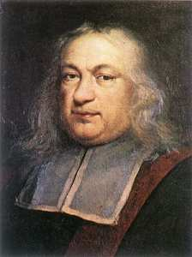
The Halting Problem and Famous Open Problems
Fermat’s Last Theorem: There exists no
integer n > 2 s.t. a^{n} + b^{n} = c^{n} for non-zero
integers a, b, and c
Pierre de Fermat 1601-1665
We have a nice proof of this theorem but there’s not enough room for it in this little box.
Notes:
Fermat’s Last Theorem proved by Andrew Wiles in 1995. The story of his 9-year search for the proof recalls Huffman: he had written a trial proof but reviewers spotted a flaw; in September ‘94 he was ready to give up when he had an insight that made the proof possible—358 years after it was first conjectured.

Slide 24
The Halting Problem and Famous Open Problems
Goldbach’s Conjecture: Every positive even integer >= 4 can be written as the sum of two primes.
4 = 2 + 2
6 = 3 + 3
8 = 3 + 5
10 = 3 + 7 = 5 + 5
12 = 5 + 7
14 = 3 + 11 = 7 + 7
Verified up to 4 x 10¹⁸
42 = 5 + 37

Slide 25
The Halting Problem and Famous Open Problems
Goldbach’s Conjecture: Every positive
even integer >= 4 can be written
as the sum of two primes.
$1,000,000 has been offered!

Slide 26
The Halting Problem and Famous Open Problems
Goldbach’s Conjecture: Every positive
even integer >= 4 can be written
as the sum of two primes.
at most 300,000
(Schnilerman, 1939)
Getting from 300,000 down to 2 shouldn’t be so hard!
Notes:
A 2013 proof demonstrated that it can be done with at most 4 primes.

Slide 27
Using a Halt Checker to Prove or Disprove the Goldbach Conjecture…
def prime_split(n):
"""Takes an EVEN POSITIVE integer argument
n and returns True if n can be
written as the sum of two primes and
False otherwise."""
def goldbach(current):
while True:
if not prime_split(current):
return # DONE!
else current = current + 2
Consider… goldbach(4)
Who needs chocolate when there are proofs this sweet?
Yowza this is cool!
Notes:
Note that prime_split can be done with brute force, if you have infinite time.

Slide 28
Halt Checking in the Real World
The impossibility of halt checking implies you can’t write a program that will understand other programs
So don’t waste your time trying!
But wait!
You can write one that understands some other programs…

Slide 29
Regular Expressions
10
Examples of three regular expressions and overall "regex" syntax.
(10)*
1* | 10*
A regular expression is composed of three operations:
Kleene Star a* “0 or more a’s”
high precedence
Concatenation ab “a then b”
Union a | b “a or b”
low precedence
where a and b can be any character strings—or regular expressions
base case
recursively defined !
Notes:
The next slide talks about what these REs match, so just say these are examples and move on to the next.
http://www.cs.duke.edu/csed/jflap/new/DOCS/gui.regular.EditorPane.html
The Regular Expression Editor The editor for a regular expression is essentially just a single text field. Operators in a regular expression are the Kleene star (*), the "or'' operator (+), parentheses are also usable, and concatenation is accomplished by making symbols adjacent. In Haiku: To make expressions /for this program to work with/ type them in the field. Adjacent symbol s imply concatenation. No symbol is used. Many or nothing, Asterisk (*) is the Kleine star. What precedes repeats. Additionally, if you want an "or" symbol the plus (+) should be used. Screaming nothingness , exclamations (!) are special. They act as lambda. Formatting errors will be reported to you when you choose actions.

Slide 30
Regular Expressions
10
Matches the string 10, which is the language { 10 }
…or L = { w | w is 10 }
(10)*
What strings are in the other two REs' languages?
1* | 10*
A regular expression is composed of three operations:
Kleene Star a* “0 or more a’s”
high precedence
Concatenation ab “a then b”
Union a | b “a or b”
low precedence
where a and b can be any character strings—or regular expressions
base case
recursively defined !

Slide 31
Regular Expressions
Here is a fairly complex regular expression.
What strings are in (and out of) this language?
(01* | 10)*
A regular expression is composed of three operations:
Kleene Star a* “0 or more a’s”
high precedence
Concatenation ab “a then b”
Union a | b “a or b”
low precedence
where a and b can be any bit strings—or regular expressions
base case
recursively defined !
Notes:
Accepts lambda, 0, 01111, 011110, 10, 1010, 10000011110. Rejects 101, 1011*. Anything starting with 0 is accepted. Anything starting with 1 is accepted if either 0’s and 1’s alternate, or there are two 0’s in a row after the alternation.

Slide 32
Try It!
Operator Name
Example
Description
Kleene Star a* “0 or more a’s”
Concatenation ab “a then b”
Union a | b “a or b”
Description of a formal language
Equivalent RE
L = { w | w contains at least one 0 }
1*0(0|1)*
L = { w | w’s second-to-last character is a 1 }
(0|1)*1(0|1)
L = { w | every 1 in w has a 0 after it }
0*(100*)* or (0|10)*
(1(0|1)*1)|(0(0|1)*0)
L = { w | w’s first and last bits are the same }
one or more as
a+
How could you implement other operators?
strings not matching 11
~(11)
strings not matching a
~a
Try writing these REs in terms of the original three…
Is there an equivalent RE to this one that avoids the nested * operators?
(01* | 10)*
Extra: can every RE avoid nested *'s ?
Notes:
The answers here are animated.
a+ is aa*.
~(11) is 0*|0*(10+)*|0*(10+)*1 (I think).
~a is (b|c|d…)*.
(01*|10)* is 0*|0(0|1)*|(10)*.
The avoid-nesting question is still open.

Slide 33
Try It!
Operator Name
Example
Description
Kleene Star a* “0 or more a’s”
Concatenation ab “a then b”
Union a | b “a or b”
Description of a formal language
Equivalent RE
L = { w | w contains at least one 0 }
1*0(0|1)*
L = { w | w’s second-to-last character is a 1 }
L = { w | every 1 in w has a 0 after it }
L = { w | w’s first and last bits are the same }
one or more as
a+
How could you implement other operators?
strings not matching 11
~(11)
strings not matching a
~a
Try writing these REs in terms of the original three…
Is there an equivalent RE to this one that avoids the nested * operators?
(01* | 10)*
Extra: can every RE avoid nested *'s ?
Notes:
The answers here are animated.

Slide 34
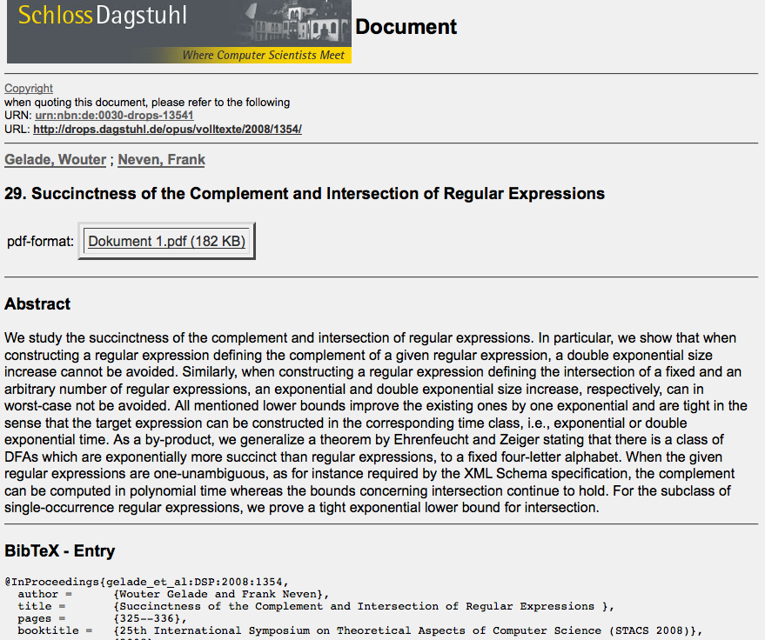
L.C. Eggan, 1963
star height problem solved
still open…
gen. star height problem - star height with ~ operator
2008
Notes:
34
The point of this slide and the next is that REs are still being studied. The star height problem shows that there are languages requiring an arbitrary number of nested stars, for any value n. The general problem is still open; it involves the star height problem when the ~ operator is available. Nobody knows whether introducing the ~ allows a nesting depth of 1 for any language, and if so, whether there is a way to determine the minimum star height.

Slide 35
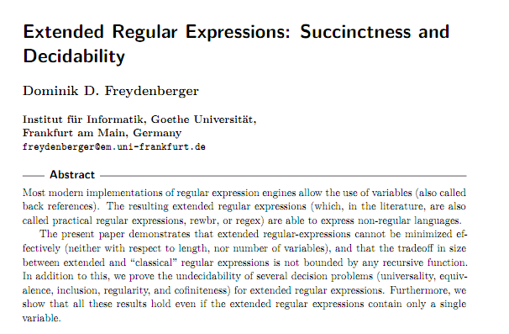
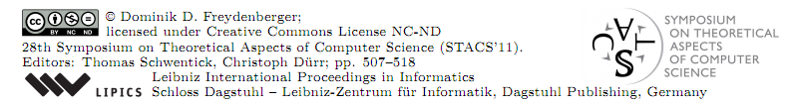
2011
Notes:
35
This 2011 paper shows that extended expressions (e.g., egrep) can't be reduced to simple ones in all cases.

Slide 36
REs in Practice
Almost all languages have an RE library…
Unix’s egrep does a line-by-line search for a regex:
egrep 'hh'
egrep 'y.*y'
egrep '(xq|hq)'
egrep '^y.*y$'
/usr/share/dict/words
symbol for start of a line
symbol for any character—a shortcut for (a|b|c|…|z|0|1|…|9|…)
symbol for end of a line
good for crosswords !
U
vowel
vowel
with first and last the same?
not always obvious …
egrep '^(0|1(01*0)*1)(0|1(01*0)*1)*$' binStr
knuth: ~cs60/egrep
egrep –f regexFile matchingStringFile
Notes:
Demo! Bring up egrep/examplesForEgrep in a window not visible to students, and then do them in a visible window.

Slide 37
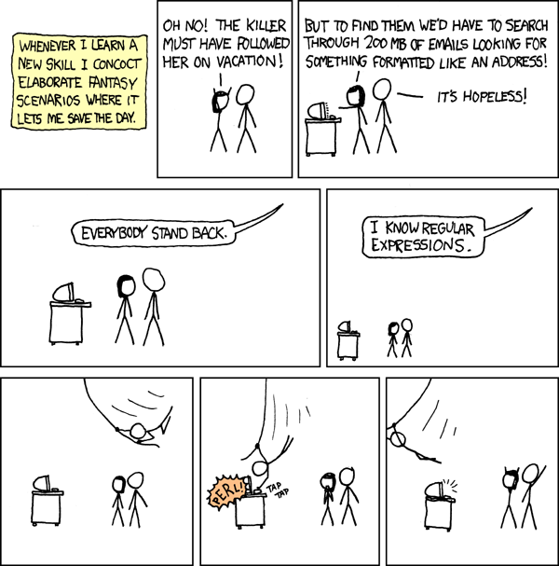
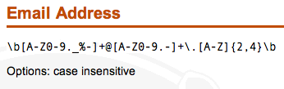
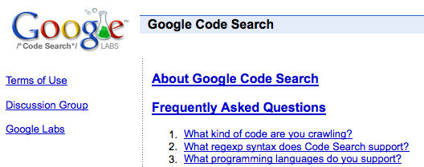
REs to the Rescue!
xkcd to the rescue, perhaps?
practical extraction and report language
PERL
WRONG!
www.regular-expressions.info/regexbuddy/email.html
lang:java goooo*gle
But how does regular expression matching actually work... ?
Notes:
37
PERL and “WRONG” are (separately) animated.
The e-mail address regex is wrong in several ways. Most simply, you can't validity-check the text to the left of the @ sign because it's interpreted by the mail recipient. For example, the given regex prohibits plus signs in user names, but plus signs are legal and used (including in gmail). In addition, the end of the regex tries to validate the top-level domain by requiring it to be 2-4 characters long (e.g., .uk, .com, .info). But that ignores the fact that there are now longer top-level domains (e.g., .museum). The moral here is that you shouldn't write a regex that tries to match some real-world rule unless you (a) clearly understand what the rules actually are and (b) can predict what the rules will be in the future.

