Slide 1
CS 5 Herald
Penguin Honoured by Queen
London (Antarctic News Service)—A revered Scottish citizen of the penguin persuasion was knighted today by Queen Elizabeth II. “This bold and brave bird has backed British battalions in both Bolivia and Bangladesh,” she announced. “Bruce Burns has blown on his bagpipes in barracks and barns, brought blessings to bombardiers, and basically been the best brother a Briton could beg for.
Penguin Burns was modest in his acceptance of the honour. “I appreciate the Queen’s approbation,” he commented. “All of this adulation and these awards have been acquired because of my awesome army of associates. I always appreciate their amazing additions to my academic accomplishments, and they always accept my accent. Accolades to all!”
Notes:
No demos, no worksheet.

Slide 2
Late-in-Week Help
Today: Help in CS labs 1-8 PM
Friday: LAC, 1-4 PM

Slide 3
What We Hope You’ve Learned
Big picture: CS is broad and rich
Artificial intelligence
Proofs of uncomputability
Robotics
Graphics
Security
Usability
…and lots more!

Slide 4
All About the Final
3 hours long
Tuesday, December 14th, 2-5 PM*
Here in Beckman B126
Bring two 8.5x11” sheets, double-sided
Contents are up to you
Hmmm reference will be provided
*Or see me about alternatives
Notes:
Things to put on the cheat sheet: minterm expansion for sure, maybe Hmmm Fibonacci

Slide 5
What Will Be Covered?
Comprehensive exam (entire semester)
Some things are more important than others
Want to be sure you understand basics of CS

Slide 6
Exam Coverage
The high-level view:
Functional programming
Computer organization
Imperative and object-oriented programming
Theory of computation

Slide 7
Functional Programming
Be sure you know (and command):
List indexing and slicing (including ::-1)
Recursion (multiple base cases)
Functions that return functions
List comprehensions:
[x**2 for x in L if x < 100]
map, reduce, and filter
lambda
Especially lambda!

Slide 8
Functional Challenge
Write knapsack(target, L), where target is a number and L is a list of pairs: (utility, weight). knapsack returns the maximum utility that can be achieved without exceeding target.
Example:
knapsack(50, [(20,30), (30,20), (40,15)]) = 70

Slide 9
Functional Challenge
def knapsack(target, L):

Slide 10
Functional Challenge
def knapsack(target, L):
if L == []:
return 0
else:
loseIt = knapsack(target, L[1:])
if L[0][1] > target:
return loseIt
else:
useIt = L[0][0] + \
knapsack(target - L[0][1], L[1:])
return max(useIt, loseIt)
Notes:
This slide has three animations. The base case is already there. The first animation shows the loseIt case; the second is calculating useIt; the third is the full solution.

Slide 11
Fancy Knapsack
Modify knapsack so that L is a triple: (utility, weight, name) and name is a string. knapsack should now return (total_utility, total_weight, [list-of-names]).
Example:
knapsack(50, [(20, 30, 'gorp’),
(30, 20, 'tent'), (40, 15, 'spam')])
= (70, 35, ['spam', 'tent'])

Slide 12
Fancy Knapsack
def knapsack(target, L):
if L == []:
return ?

Slide 13
Fancy Knapsack
def knapsack(target, L):
if L == []:
return (0, 0, [])
else:
lutil, lwt, lnm = knapsack(target, L[1:])
wt = L[0][1]
if wt <= target:
uutil, uwt, unm = knapsack(target - wt, L[1:])
uutil += L[0][0]
uwt += wt
unm += [L[0][2]]
if uutil >= lutil:
return (uutil, uwt, unm)
return (lutil, lwt, lnm)

Slide 14
A Bit of Python Cuteness
Remember memoization?
memo = {}
def fastFunc(x):
if x in memo:
return memo[x]
else:
# slow stuff to find answer
memo[x] = answer
return answer

Slide 15
A Bit of Python Cuteness
from functools import lru_cache
@lru_cache(maxsize = 32)
def fastFunc(x):
# slow stuff to find answer
return answer
It’ll remember the last 32 answers!

Slide 16
Computer Organization
Important things:
Binary numbers (can you count in binary?)
Boolean equations
Minterm expansion principle
Hmmm programming
Be sure you understand function calls and how r13, r14, and r15 are used
Understand Hmmm recursion

Slide 17
Minterm Expansion
Be systematic!
0 0 0 0
0 0 1 0
0 1 0 1
0 1 1 1
1 0 0 0
1 0 1 1
1 1 0 0
1 1 1 1
What does this compute?
Notes:
It recognizes prime numbers.

Slide 18
A Hmmm Problem
What does this program do?
00 read r1
01 setn r2 0
02 jltzn r1 06
03 add r2 r2 r1
04 addn r1 -1
05 jgtzn r1 03
06 write r2
07 halt
Is there anything ADDitional needed here?
Oooh, that’s awful!
Notes:
It adds the numbers from 1 to r1.

Slide 19
The Alien’s Life Advice
Don’t assume you’re stupid just because somebody else is showing off.
Show-offs are insecure too!

Slide 20
Imperative Programming
What to know:
Nested for loops
Alignment of code following loop!
for i in range(len(L)) vs. for i in L
try/except
Deep and shallow copy
What NOT to study:
Huffman coding

Slide 21
Loop Exercise
Consider a matrix (list of lists) M, containing strings or integers. For elements not on the diagonal, if they are numbers, convert them into their (floating-point) reciprocals. All other elements stay the same.
Example: [[1, 2, “spam”], [[1, 0.5, “spam”],
[3, “hi”, 5], ⇒ [0.33, “hi”, 0.2],
[7, 4, 9]] [0.14, 0.25, 9]]
Notes:
Some of them haven’t studied matrices. Remind them that in matrix theory there is only one diagonal, not two.

Slide 22
Loop Exercise
for i in
for j in

Slide 23
Loop Exercise
for i in range(len(M)):
for j in range(len(M[0])):
if i != j:
try:
M[i][j] = 1.0 / M[i][j]
except:
pass

Slide 24
Object-Oriented Programming
What to know:
__init__, __str__, __repr__
self
__add__, __mul__, etc.
Methods, getters, setters
Inheritance
Notes:
Inheritance depends on whether we covered it

Slide 25
Object-Oriented Exercise
Implement the __add__ function for a Rational class. The numerator is in self.n, the denominator in self.d. Assume self.gcd(a, b) will return the greatest common divisor of a and b.

Slide 26
Object-Oriented Exercise
class Rational:
# ...
def __add__(

Slide 27
Object-Oriented Exercise
class Rational:
# ...
def __add__(self, other):
n = self.n * other.d + other.n * self.d
d = self.d * other.d
gcd = self.gcd(n, d)
return Rational(n // gcd, d // gcd)
Notes:
The important detail here is that you must return a new Rational.

Slide 28
Theory of Computation
What to know:
Finite state machines
FSMs can’t count arbitrarily high
Existence of uncomputable functions
Uncomputability of halting problem
What NOT to study:
Turing machines
How to prove uncomputability

Slide 29
FSM Exercise
Draw an FSM that accepts strings in which each 1 is immediately followed by two or more 0’s.
Extra challenge: draw an FSM that accepts strings in which each 1 is immediately followed by two or more 0’s, or strings in which each 0 is immediately followed by two or more 1’s.
Notes:
In solving this one, it can help to think more about what to reject than what to accept.

Slide 30
FSM Exercise (1)

Slide 31
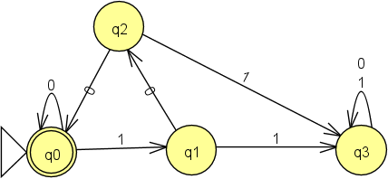
FSM Exercise (1)

Slide 32
FSM Exercise (2)

Slide 33
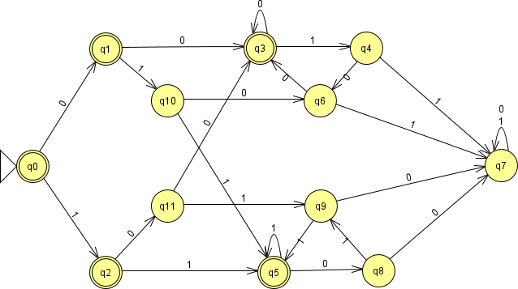
FSM Exercise (2)
Notes:
Don’t spend time on this; it’s a mess.

