Slide 1
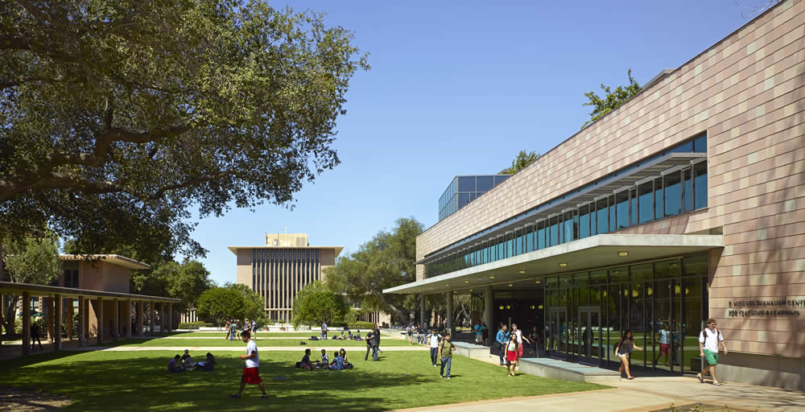
CS for All
Interventions and lessons learned at HMC
Zachary Dodds, Harvey Mudd College
IT University of Copenhagen May 29, 2017 Gender Diversity in IT

Slide 2
CS for All
Interventions and lessons learned at HMC
HMC
Zachary Dodds, Harvey Mudd College
IT University of Copenhagen May 29, 2017 Gender Diversity in IT

Slide 3
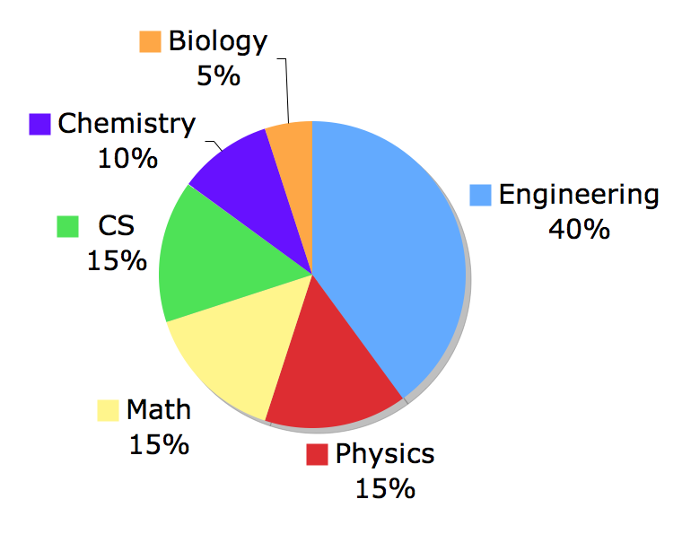
HMC ~ Harvey Mudd College
southern california engineering + technical school of 850 students
ages 18-23, full-time
(mostly)
CS == IT
IT University of Copenhagen May 29, 2017 Gender Diversity in IT

Slide 4
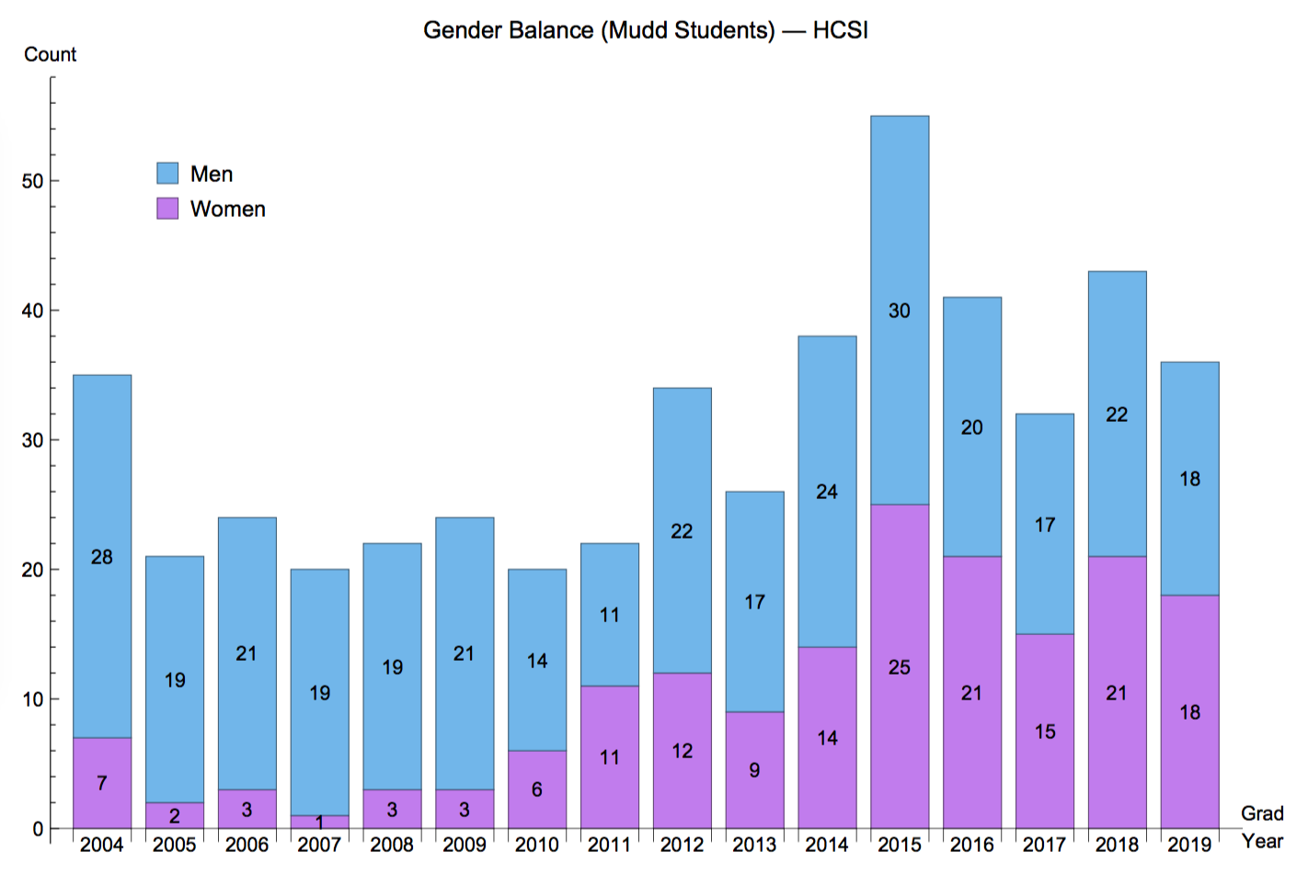
Mudd's story
Number of CS majors at HMC, by graduating year

Slide 5
Several deliberate accidents…
Our goal in 2005:
to change our CS balance
Curriculum
Community
Collaboration

Slide 6
Several deliberate accidents…
Our goal in 2005:
Lessons
to change our CS balance
Curriculum
Conceptual Breadth
Community
Sharing Support
Collaboration
Above all, CS is Social
CS for All

Slide 7
Curriculum
We deliberately changed one course: CS1
what is learned = what is taught
Java course
Programming as a professional skill
Meant to bring students one semester closer to creating software for other people to use
but use for what?
Python course
with detours into all corners of CS
Means to show students that CS amplifies the paths and projects they choose
Whatever you are, be a good one. CS can help!
2005
2006
Every student takes CS1 in their first semester

Slide 8
Curriculum
what is learned = what is taught
Java course
Programming as a professional skill
Meant to bring students one semester closer to creating software for other people to use
but use for what?
Python course
with detours into all corners of CS
Means to show students that CS amplifies the paths and projects they choose
Whatever you are, be a good one. CS can help!
lots of facts
a small fraction of a much larger world
2005
2006
Every student takes CS1 in their first semester

Slide 9
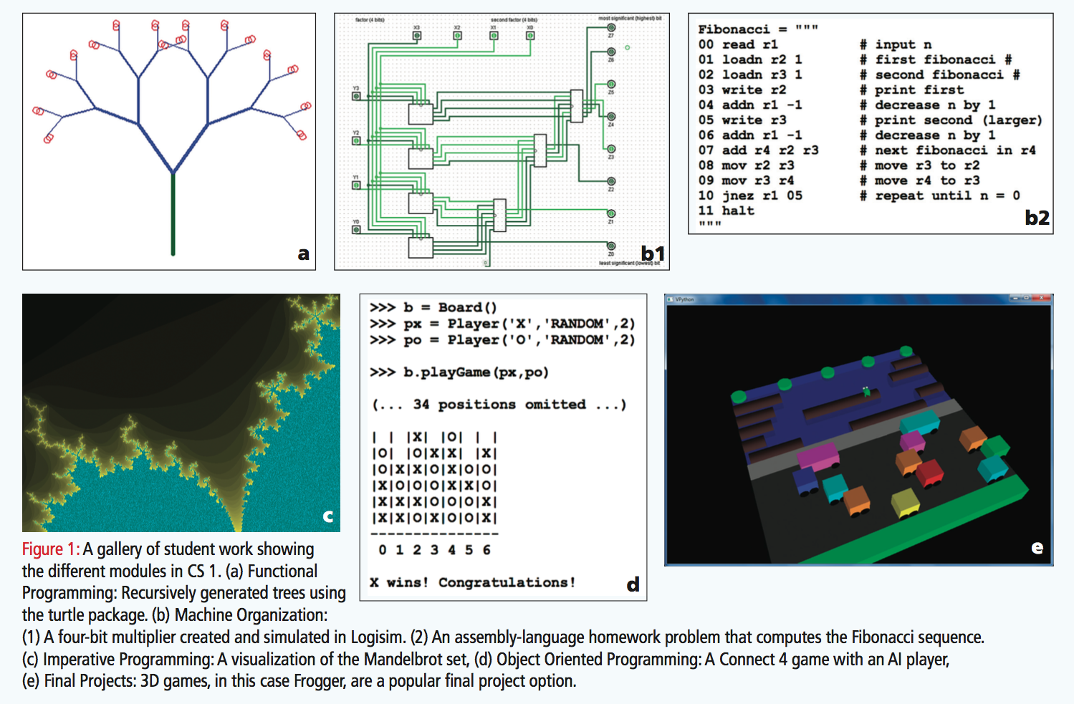
Lesson:
Conceptual breadth over trendiness
Curriculum content
Fashion turns heads. Substance grows roots.

Slide 10
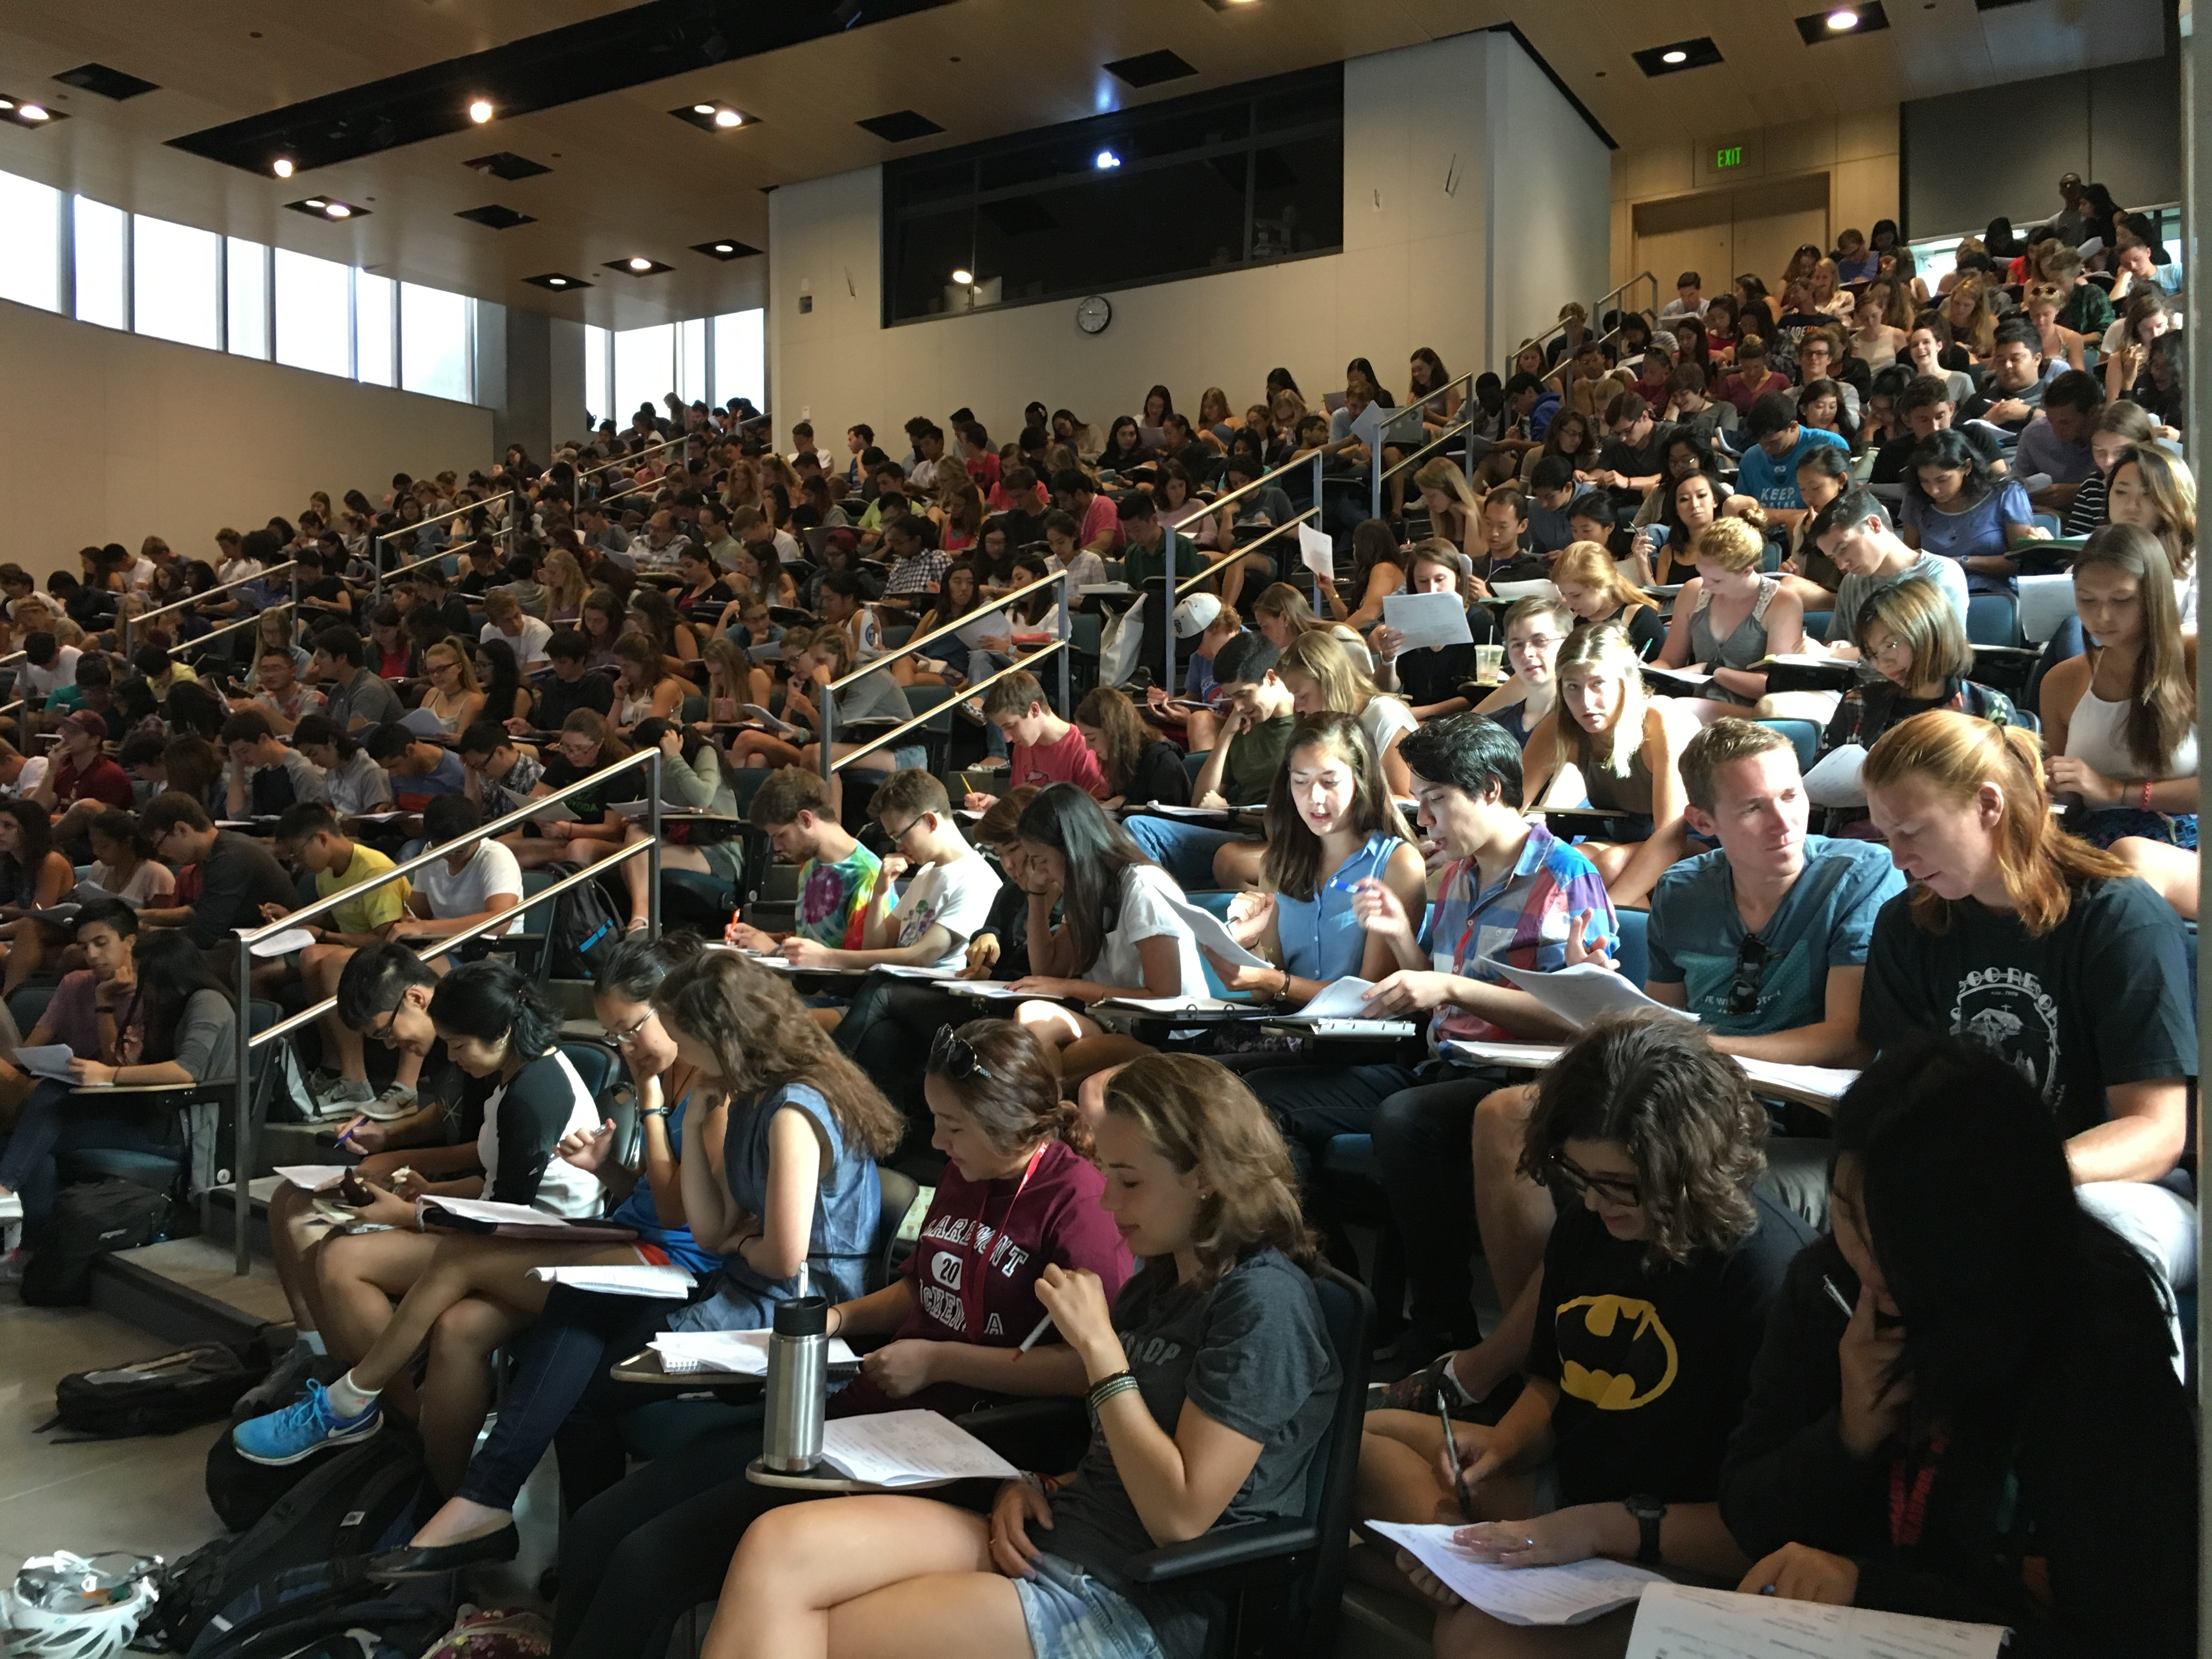
Curriculum context
First day in CS1: together
Experience != talent nor enjoyment.
In fact, Experience != Experience!
CS experience often must be un-taught. We unteach it.
Got experience? This way, please…

Slide 11
Curriculum context
Second day in CS1 ?!
Lesson: 8:10am is early whether you're 19 or 49

Slide 12
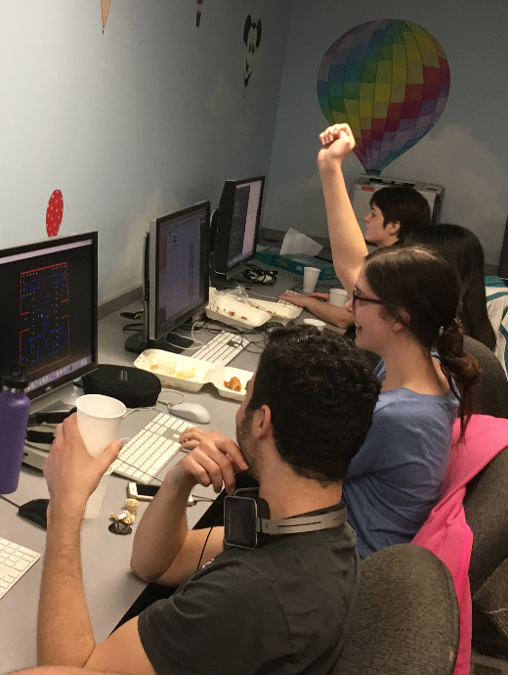
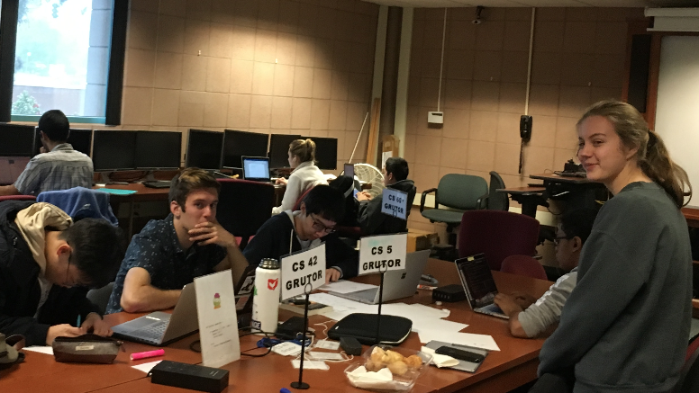
Community
every Thursday evening
Are large introductory classes a problem? Or an opportunity…
for students to help grade / tutor their peers
afternoons ~ tutoring
evenings ~ grading

Slide 13
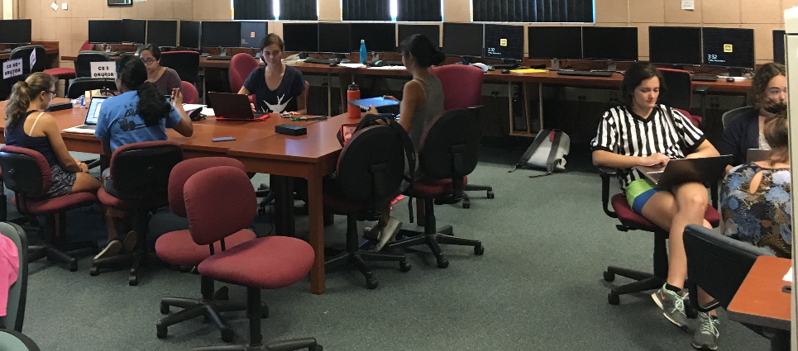
Community
Friday afternoons' open hours to work on assignments…
Lesson: define CS community contributions through self-support
Lesson: offer lots of internal opportunities for outreach + shared experience

Slide 14
Community
every Saturday afternoon
every Monday evening
every Sunday afternoon
every Tuesday evening
every Sunday evening
every Wednesday evening
Friday afternoons' open hours to work on assignments…
Lesson: define CS community contributions through self-support
Lesson: offer lots of internal opportunities for outreach + shared experience

Slide 15
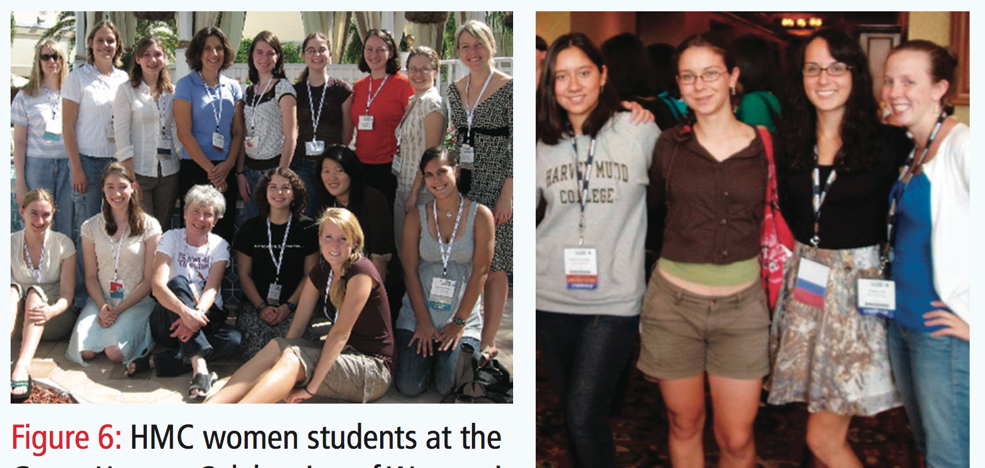
Community
our CS community is only a small fraction of a much larger world
student trips to Grace Hopper Celebration of Women in Computing, 2006-2017

Slide 16
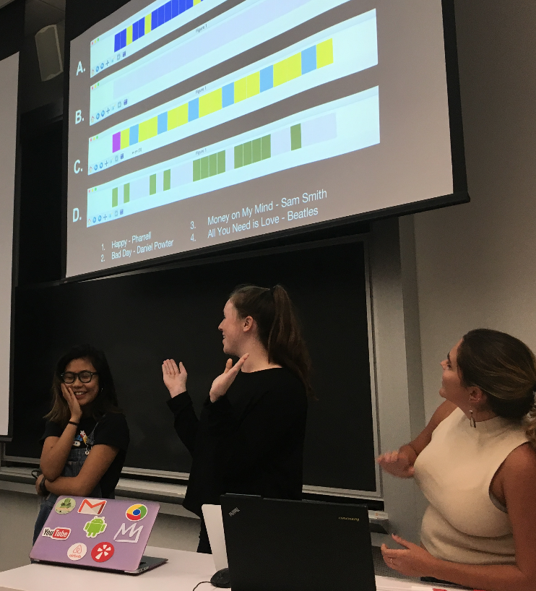
Collaborations
Pairing/teaming encouraged for all work (except some exams)
At several points, teaming is required -- and forcefully framed
Not working well in a team is by definition not successful
All senior-year capstones are in teams of 4-5
Lesson: CS is social.

Slide 17
Collaborations ~ Summer
Ten week research/independent-study opportunities
Approach: design, develop, prepare, travel, present together
Funding ~ up to 10 first-year women students, in teams

Slide 18
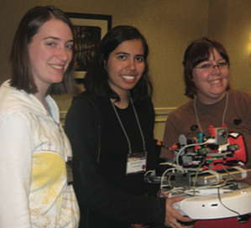
Collaborations ~ Summer
Ten week research/independent-study opportunities
Approach: design, develop, prepare, travel, present together
Funding ~ up to 10 first-year women students, in teams

Slide 19
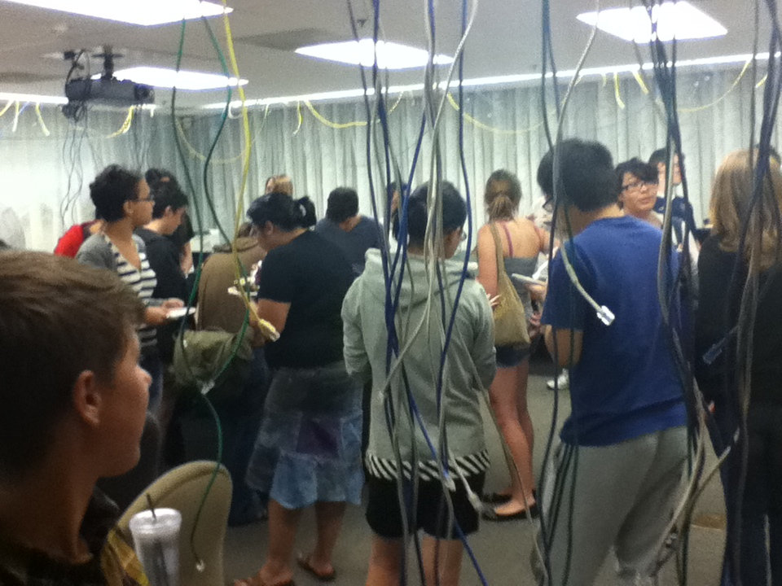
It's summer!

Slide 20
It's summer!
The growth in interest in more CS was surprisingly strong
This effort was key to bootstrapping the community…
After 2011? We stopped the program. But it kept itself going…

Slide 21
Celebrate when you can…

Slide 22
Celebrate when you can…

Slide 23
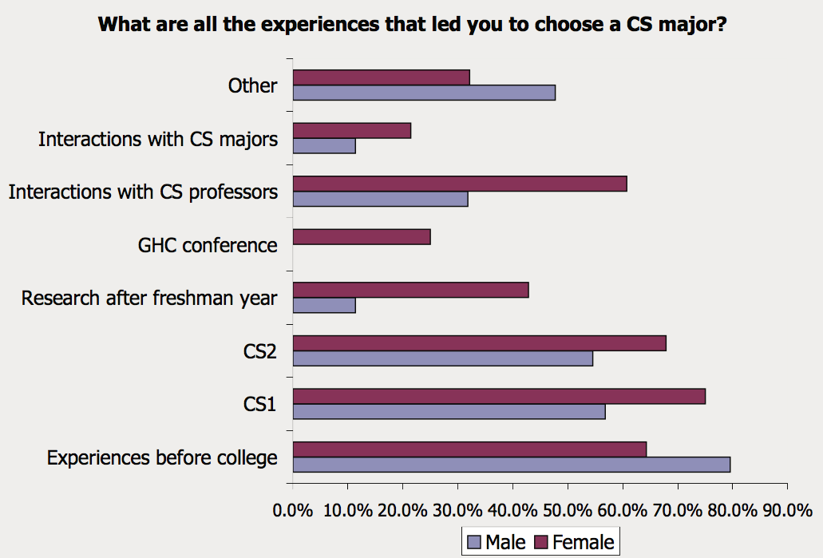
Influences in choosing CS
n = 449 alums

Slide 24
What's next?
students of other fields embracing CS…

Slide 25
What's next?
students of other fields embracing CS…
Computing is much larger than CS or IT.
We are the advocates, the coaches, the guides…
… which is an ideal role to have!

Slide 26
Our Biology 1 course
In Biology 1, all HMC students use computing to gain insight into the processes that direct and define life.
Each week, students submit programs they write from scratch:
wk2
Here you will create a simple evolutionary simulator with drift, natural selection and mutation.
wk4
In this problem you will implement the neighbor-joining algorithm for phylogenetic reconstruction and use it to reconstruct the relationships between a set of HIV/SIV sequences.
To find genes in a novel genome sequence, we must find all the open reading frames, and then determine which of these are really genes. In this assignment, you will write a series of short Python functions to find open reading frames in a bacterial genome sequence.
wk6
Some bacteria cause disease, and others don't. In fact, closely related strains often differ greatly in this respect. What separates a pathogenic bacterium from a harmless one? Often it is just a handful of protein coding genes.
In this assignment you will identify how proteins differ in closely related pathogenic (N16961) and non-pathogenic (PS15, 2740_80) strains of Vibrio cholerae.
wk8
https://sites.google.com/a/g.hmc.edu/bio52/
Note that Bio1 does not teach computing, just as Physics1 does not teach math.

Slide 27
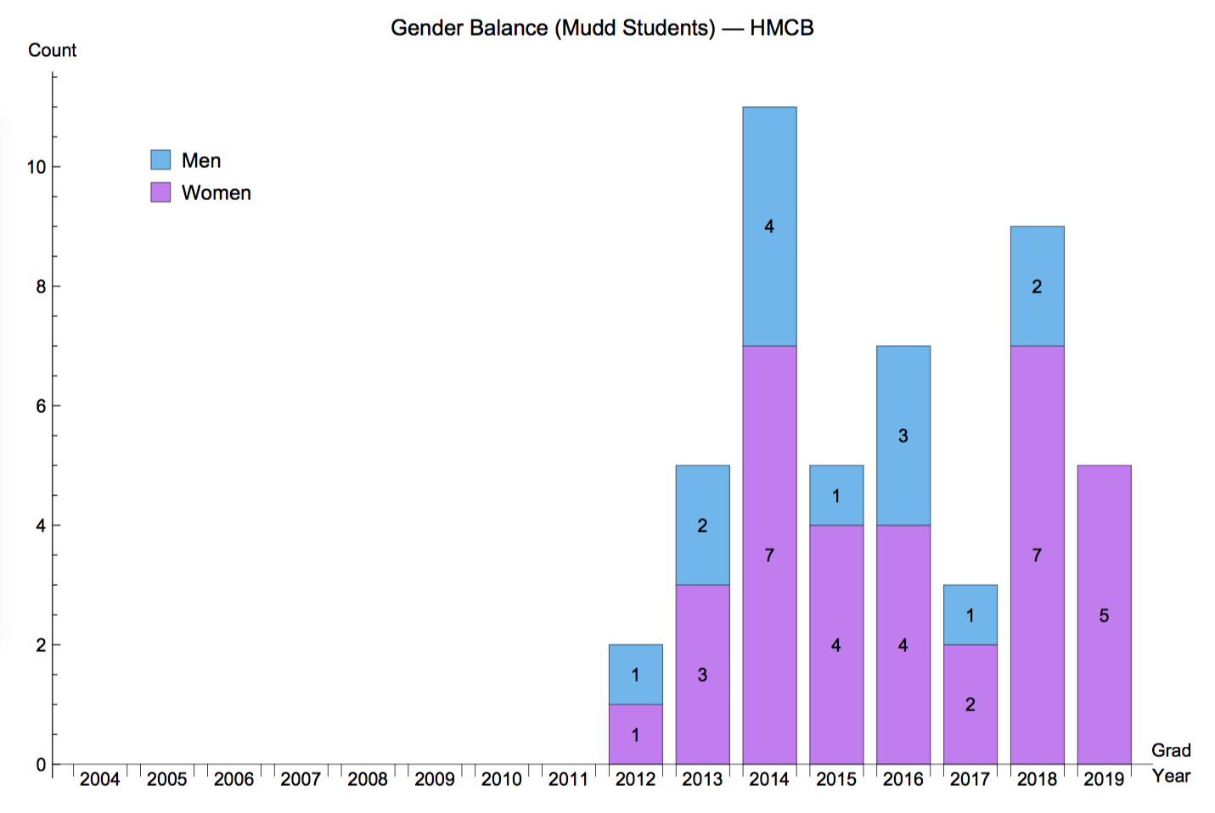
Biology CS
Computational Biology
Headlines!?
Every student must take this course.

Slide 28
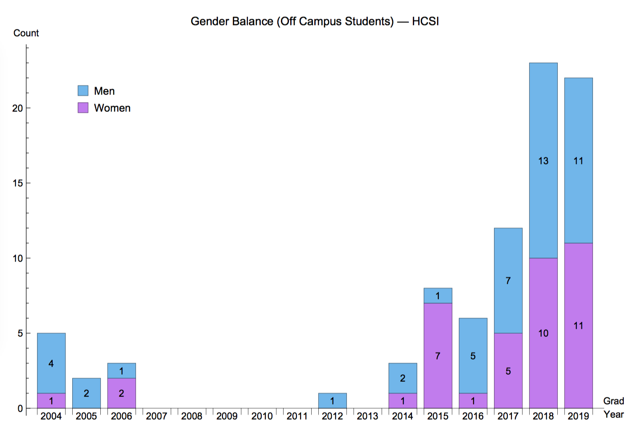
True everywhere…
These are not HMC students
These are not engineering-school students

Slide 29
Community >> Content
Computing is not owned by CS + IT
But CS + IT should be its strongest supporters
And CS + IT benefit from being a pathway to computing for everyone
Lesson learned
We don't strive to bring any individual into CS for CS's sake.
Rather, we bring CS out to the problems and projects that women - and men - care about. Women (and men) are already there!
Only 1 thing?
Like writing, require CS1 of all students.
They won't all love it, but many will.
… and they'll all share it, either way!

Slide 31
Later slides are extras – and not part of the planned presentation.

Slide 32
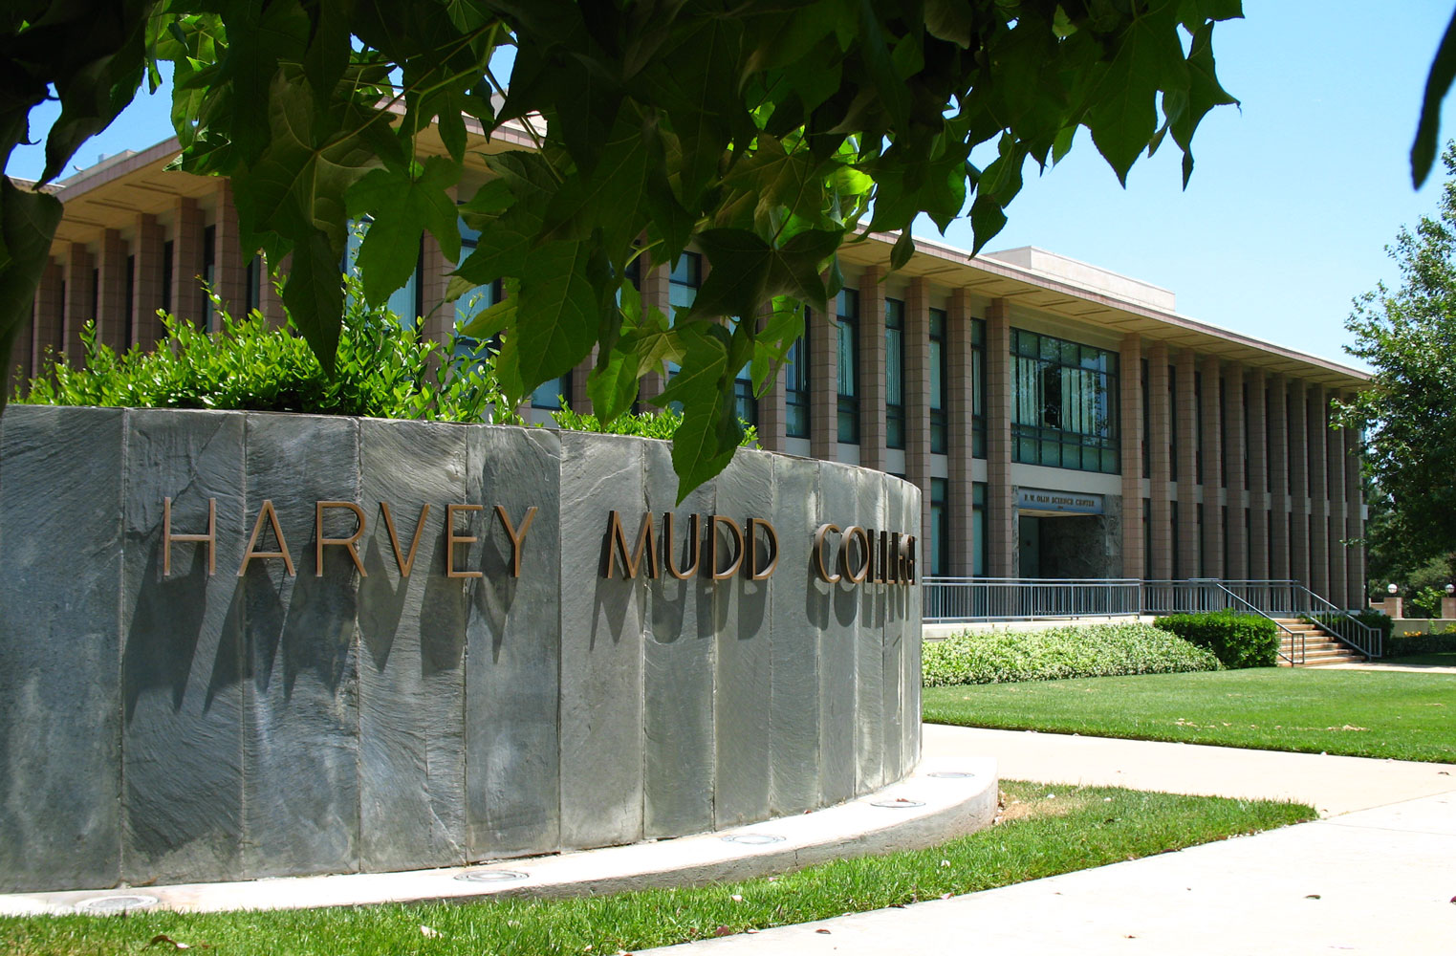
CS for All
Interventions and lessons learned at HMC
HMC
Zachary Dodds, Harvey Mudd College
IT University of Copenhagen May 29, 2017 Gender Diversity in IT

Slide 33
CS 1 for scientists
platforms
2-3 lectures per week
schedule
two hours of closed lab per week
Weeks | Paradigm | Samples of the labs and assignments
1-3 | functional | integration, random walks, ciphers
4-6 | hardware | recursion in assembly, 4-bit multiplier
7-9 | imperative | Markov text generation, Conway's life
10-12 | objects/classes | Connect Four player, Date calculator
13-15 | CS theory | uncomputability, finite-state machines
curriculum
Notes:
no IDE
any OS
any paradigm

Slide 34
Three deliberate accidents
Our goal in 2006:
Curriculum
Change our CS community
Community
Collaborations
Curriculum: Conceptual breadth
Experience != Talent or Enjoyment in fact, Experience != Experience!
Re-education rooms
Partnering; depth of understanding
Fashion turns heads. Substance grows roots.
Defining CS community as CS-community service
Learned == Taught
Opportunities for outreach
Grace Hopper
make sure we're
Require CS of everyone
Community >> Content
CS for All

Slide 35
Five deliberate accidents
√
Goal:
Change our CS community
Curriculum: Conceptual breadth
Experience != Talent or Enjoyment in fact, Experience != Experience!
Re-education rooms
Partnering; depth of understanding
Fashion turns heads. Substance grows roots.
Curriculum
Community
Collaborations
Defining CS community as CS-community service
Learned == Taught
Opportunities for outreach
Grace Hopper
make sure we're
Require CS of everyone
what is internalized = what is experienced
Community >> Content
CS for All

