Slide 1

Undergraduate pilot course with ROS and MiniMax: enthusiasm gained & lessons learned
Dr. Sharon Gower Small
Director Siena College Institute for Artificial Intelligence
www.siena.edu/SCIAI
SIGCSE February 29, 2012

Slide 2
Agenda
MiniMax
ROS challenges
Course Design
ROBOSHOW 2011
Fall 2012
  Course will be offered again
  Changes to be made

Slide 3
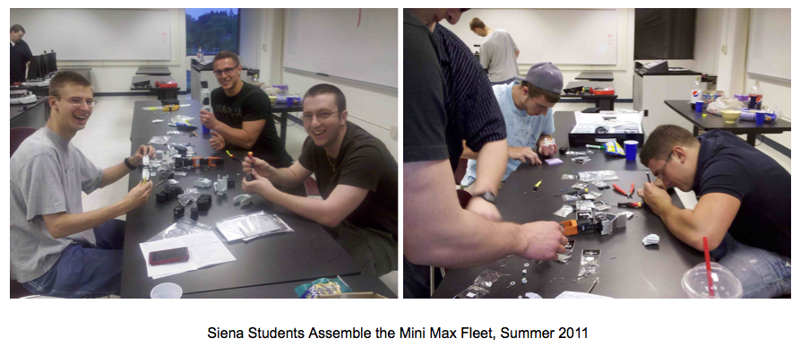
MiniMax comes to life

Slide 4
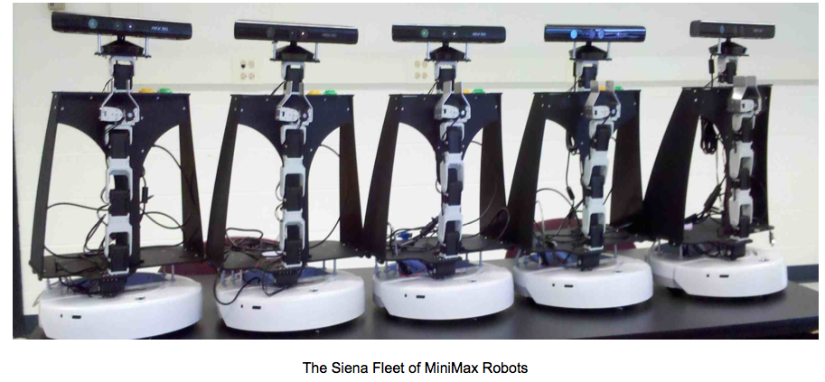
MiniMax

Slide 5
Main Challenges
Operating System
  Linux was new to a majority of the students
ROS File System & Communication
  Packages, Nodes, Topics, Messages, etc.
    Publishing messages to a topic
    Subscribing to topics
Class Size

Slide 6
Course Design
Very Fast Paced
  Nothing -> fully functional demos in 13 weeks
Linux
ROS
  Used the Online ROS tutorials
    Tested their knowledge
      post tutorial worksheets
      applied work

Slide 7
Course Design
Team Projects
  Teams of 4 students
  Professor Selected Teams
    Balanced GPA
  Self Selected Projects
    Team proposals
  3 Project Checkpoints
Round Table Research
  Individual presentations to the class
  Second half of the semester

Slide 8
ROBOSHOW 2011
https://www.siena.edu/pages/179.asp?item=321056
http://www.youtube.com/user/SCIAIRobotics
Excellent community turnout
  Student body, local media, College President and other administrators, etc.
Formal Event
Post Videos Required

Slide 9
Fall 2012
Limiting Enrollment
Repeat for Credit
  More experienced teams take their demo further
Solve teaming issues
Ramp up faster
  More upper level students
  Biweekly homework assignments

Slide 10
Fall 2012
Repeat Round Table Research
Repeat RoboShow
Require Video
Require project documentation
Require nodes uploaded to ROS website

Slide 11
Fall 2012
Expand on vision capabilities
Expand on dialogue capabilities
Better arms/grippers?

Slide 12
QUESTIONS?

