Slide 1
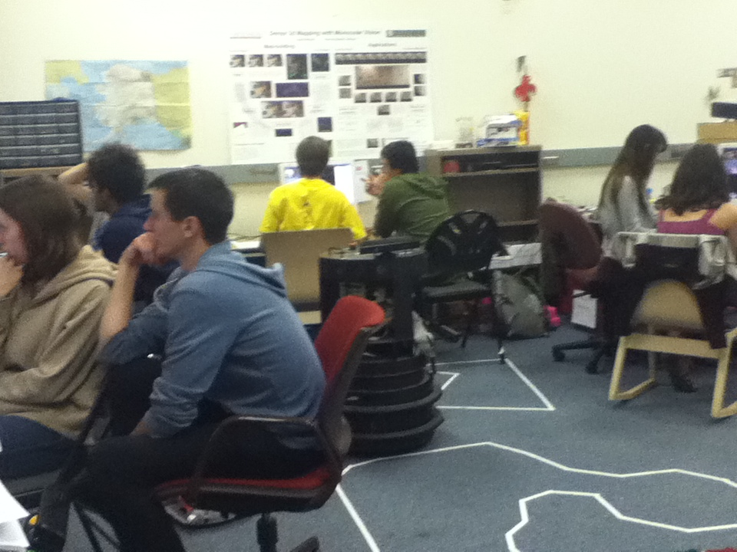
A ROS-based lab at HMC
map of Alaska…
a twofold experiment:
ROS-based curriculum
Flipped classroom (lab course)

Slide 2
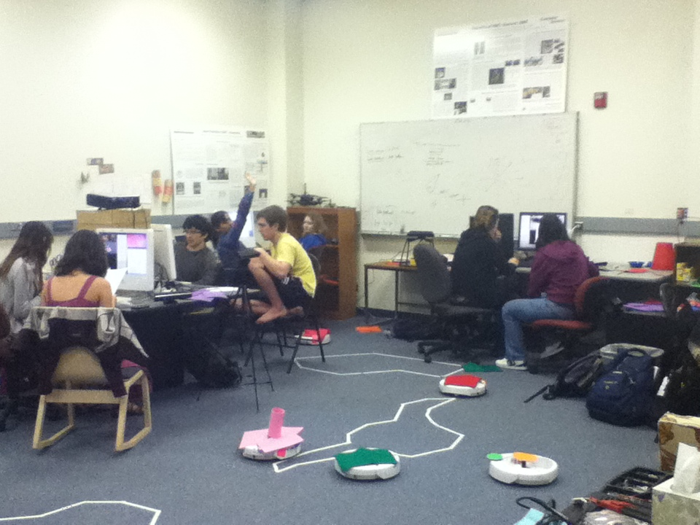
Robots and ROS after CS1?
6 Creates, 6 quadcopters, 6 Kinects, 60 students
Goal: to build CS and AI skills with ROS and robots but without lectures
The curriculum

Slide 3
The labs
weekly, 2-3 hrs.; 1 hr. for write-up; no other work
Week
Lab challenge
New hardware
CS Topics Emphasized
1
Line-following
creates
command-line & Python
2
Color segmentation
Kinects: RGB
event-handling
3
Finite-state control
-
finite-state machines
4
Visual servoing
-
understanding vs. implementing
5
Wall-angle estimation
Kinects: Depth
6
Robot minion!
-
proportional control
7
Wall-following
-
larger-scale integration
9
Gestural control
quadcopters
GUI/visualization
10
Autonomous flight
-
defensive programming
11-14
(Open-ended projects)
all/any
self-defined problems

Slide 4
The labs
weekly, 2-3 hrs.; 1 hr. for write-up; no other work
Week
Lab challenge
New hardware
CS Topics Emphasized
1
Line-following
creates
command-line & Python
2
Color segmentation
Kinects: RGB
event-handling
3
Finite-state control
-
finite-state machines
4
all situations are different… this may seed ideas
Visual servoing
-
understanding vs. implementing
5
Wall-angle estimation
Kinects: Depth
6
Robot minion!
-
proportional control
7
Wall-following
-
larger-scale integration
9
Gestural control
quadcopters
GUI/visualization
10
Autonomous flight
-
defensive programming
11-14
(Open-ended projects)
all/any
self-defined problems

Slide 5
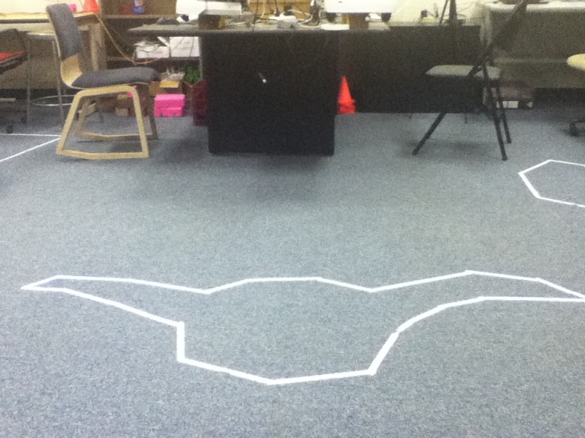
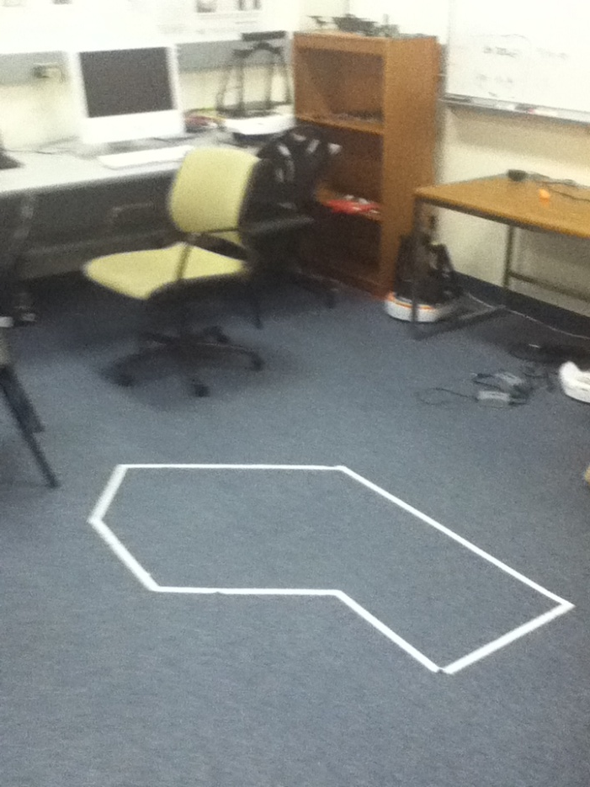
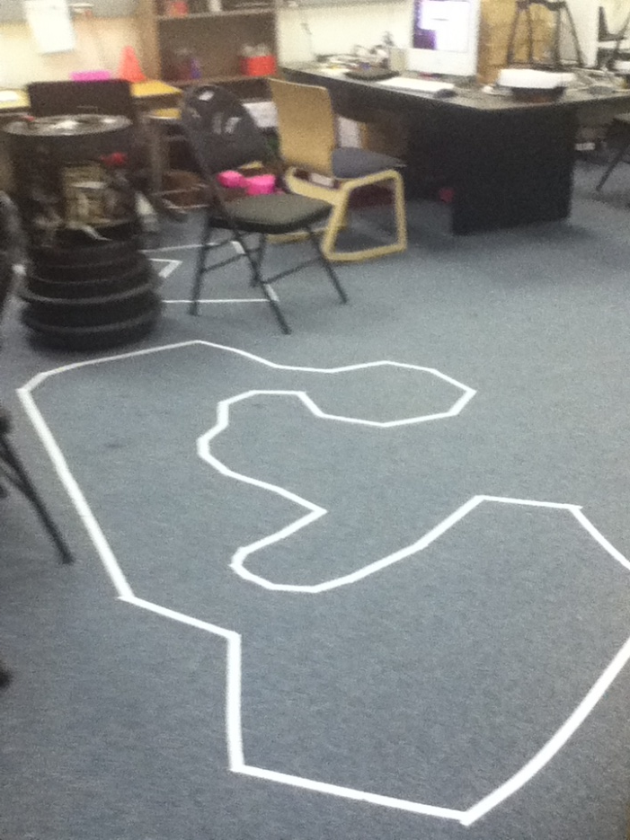
Week 1
Task: line following
difficult
one team (of 30) succeeded!
easy
medium
thanks: Matt Boutell
Notes:
students in four of the five sections expressed – unsolicited – that they were surprised and/or happy to actually get the robots to "do something" in their first lab...

Slide 6
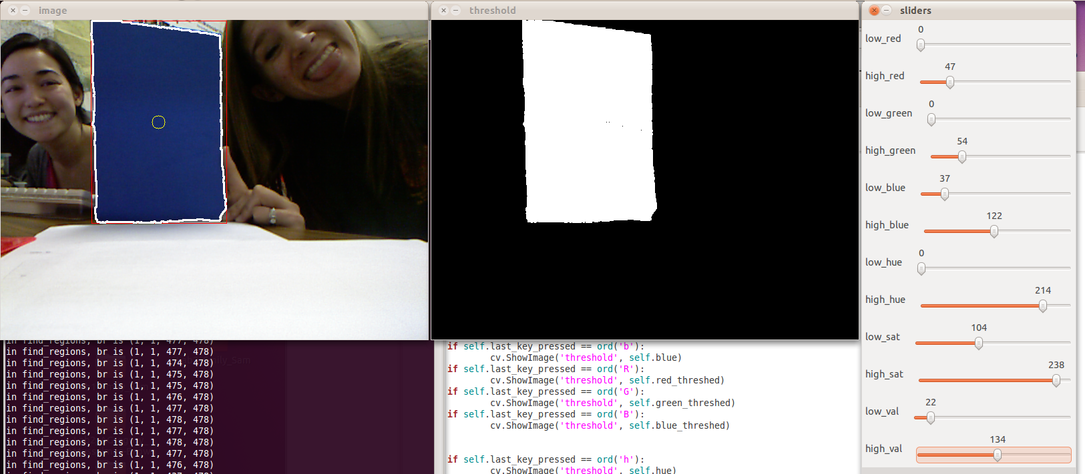
Week 2
Task: color segmentation
RGB and HSV
original image (+ overlay)
Notes:
key presses; image acquisition and display; students' display; connected components (library) – finding the largest by area – naive algorithm

Slide 7
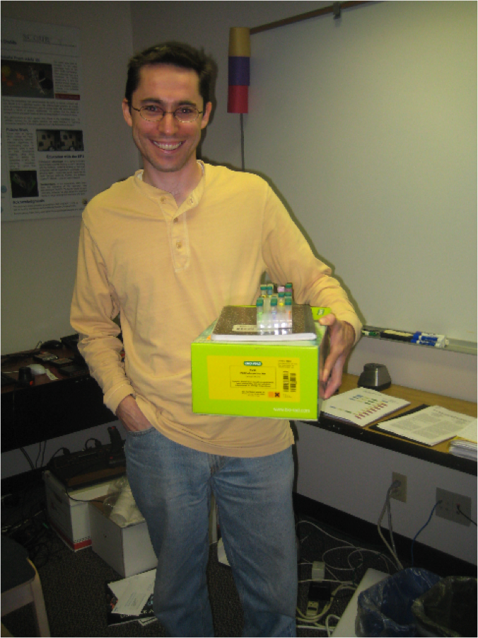
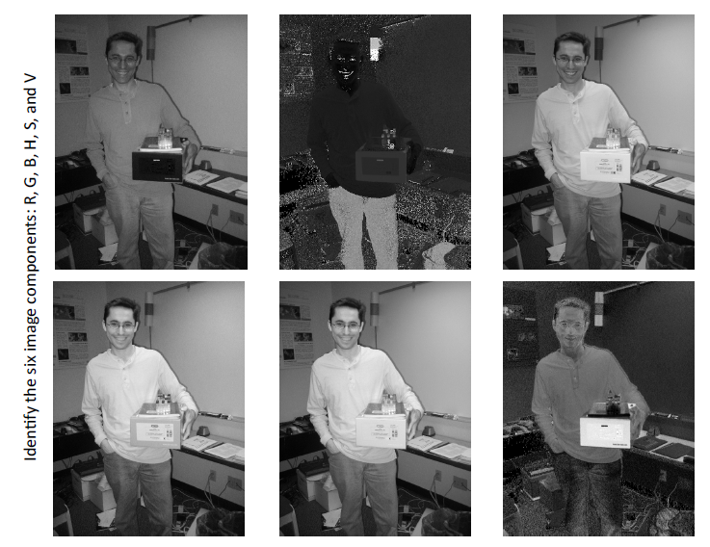
Week 2
challenging (!) warm-up activity
... to identify RGB and HSV components
Notes:
key presses; image acquisition and display; students' display; connected components (library) – finding the largest by area – naive algorithm

Slide 8
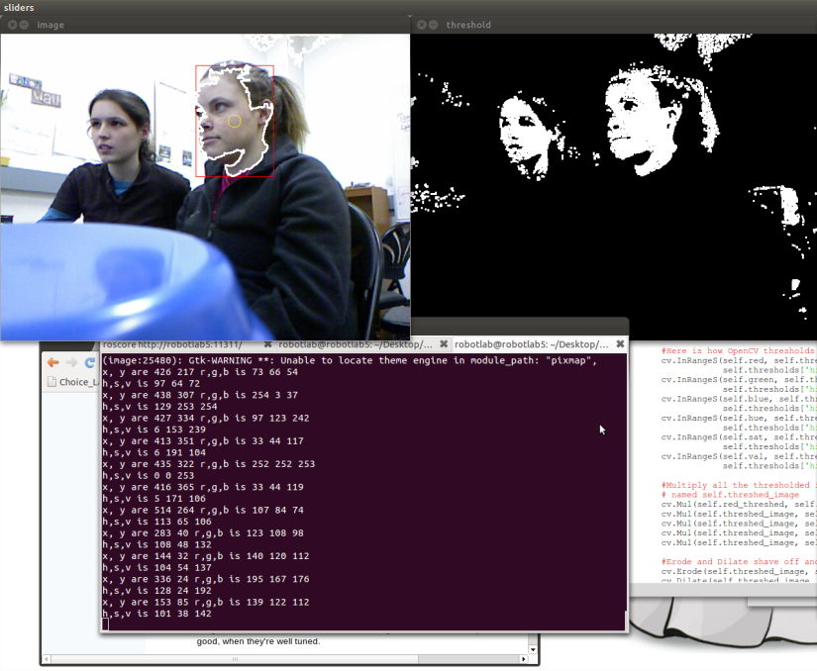
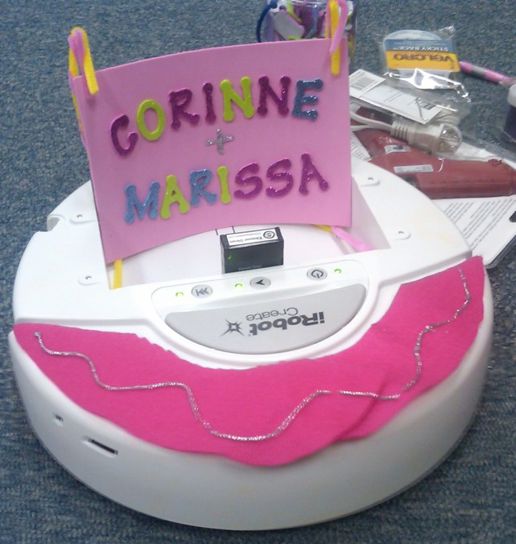
Week 3
Task: compose state-machines
'F' key
keybd
forward
+ Kinect images...
2 seconds
bump!
back
getting at the sensitive side of our robots…
Notes:
creating your own thread of execution... – fun because it combines sound, motion, visual sensing, and local sensing (bump...) for the first time (play Mario tune!)

Slide 9
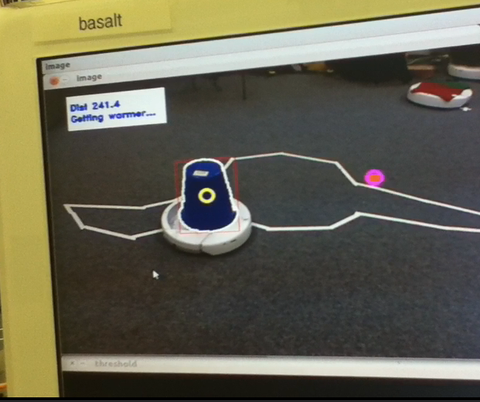
Week 4
Task: Drive the robot to any point clicked in the Kinect's image
Extra! then get back again...
Notes:
ask how to do it!?!

Slide 10
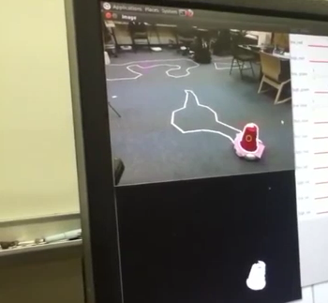
Week 4
Long-range example
To here…
And back.
From here…
Notes:
ask how to do it!?!

Slide 11
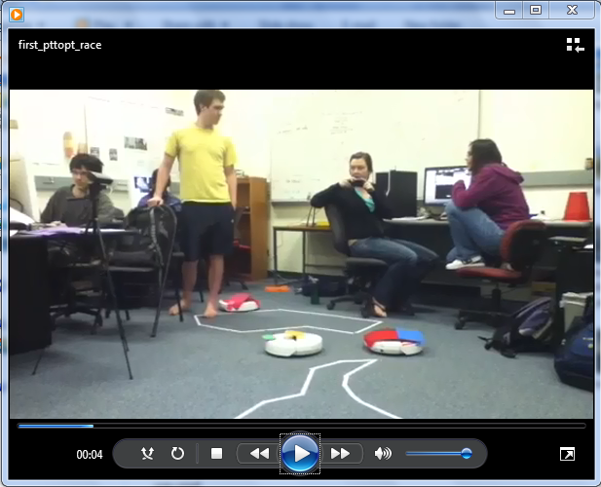
Week 4
The race!
Notes:
ask how to do it!?!

Slide 12

Week 5
Task: range-image geometry
What if this pixel at (42,240) reads 1 meter "deep"?
What are that point's coordinates in meters?
Notes:
ask how to do it!?!

Slide 13
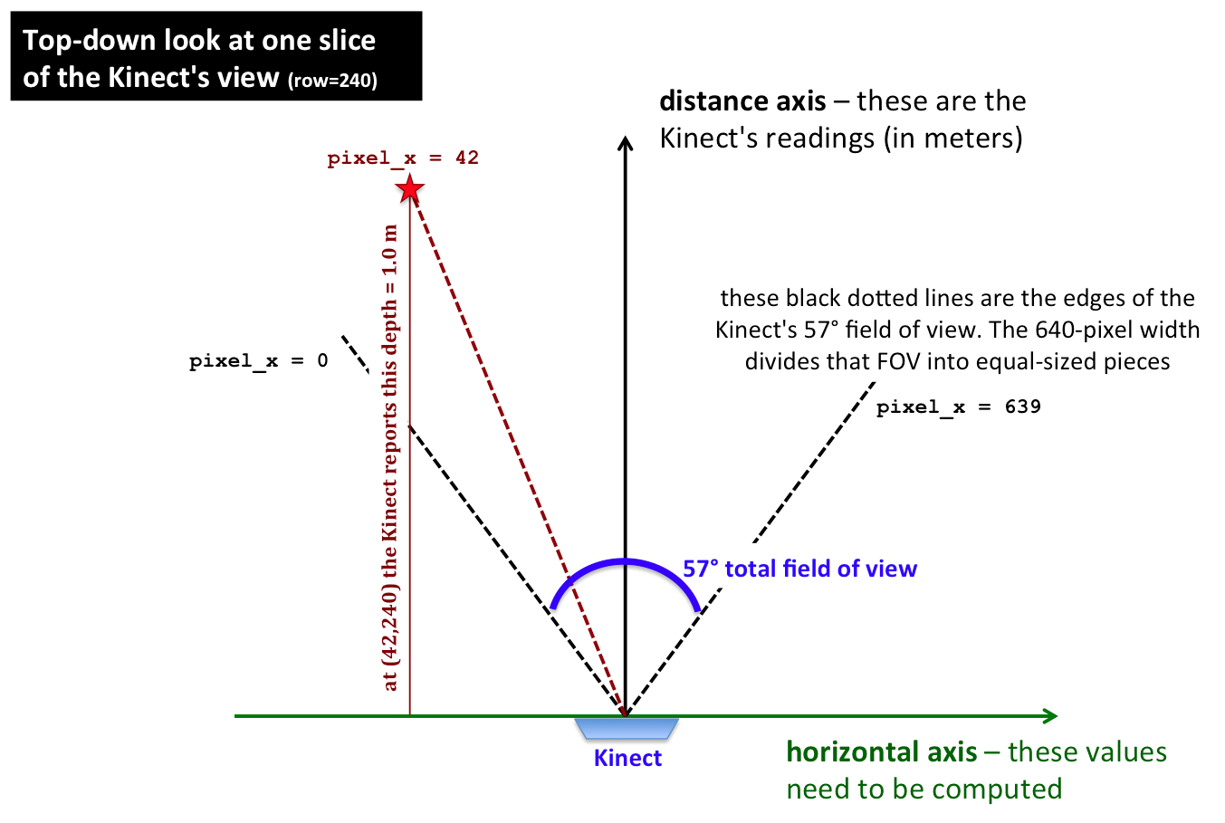
Week 5
Notes:
ask how to do it!?!

Slide 14
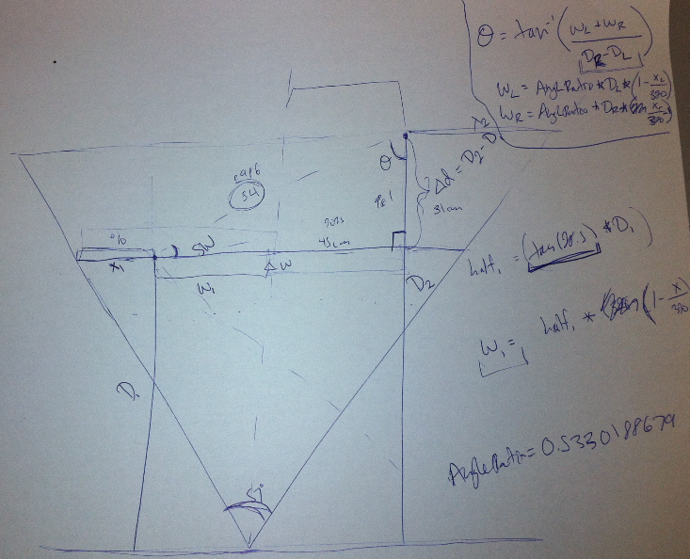
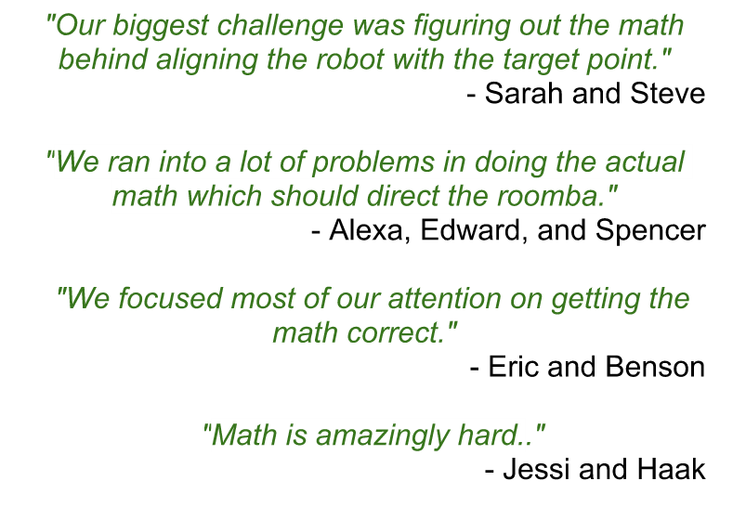
Many diagrams later…
Notes:
ask how to do it!?!

Slide 15
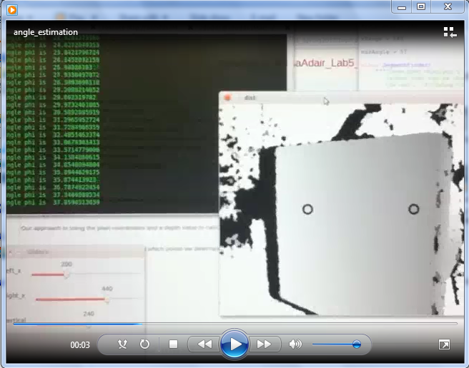
Week 5
What is this angle, in depth?
Notes:
ask how to do it!?!

Slide 16
Feedback on labs 3-5...
Notes:
ask how to do it!?!

Slide 17
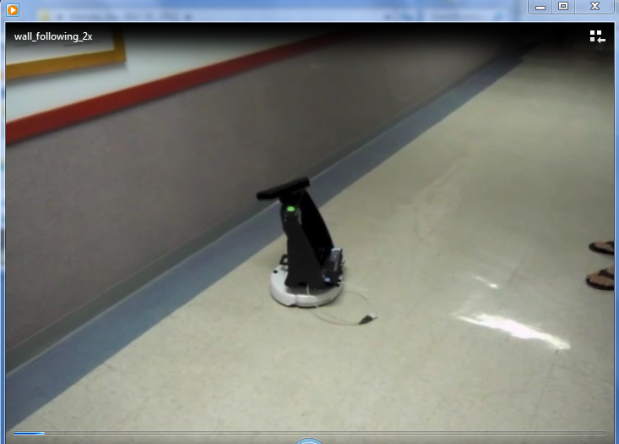
Weeks 6-7
Task: traverse the halls...
Notes:
ask how to do it!?!

Slide 18
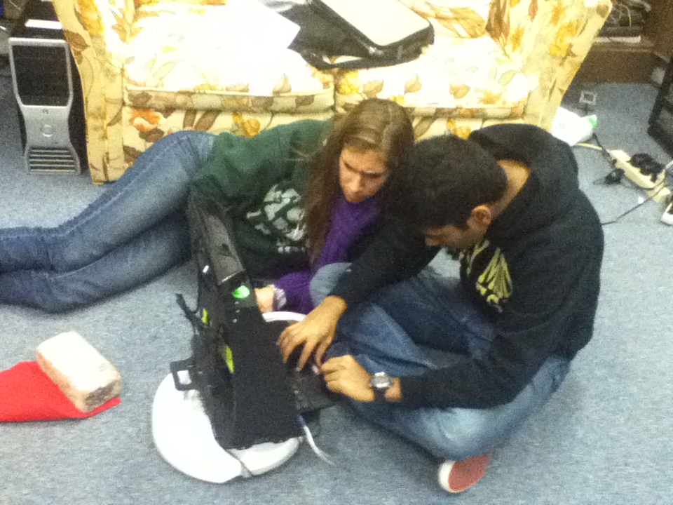
Weeks 6-7
Task: untethered wall-following
Notes:
ask how to do it!?!

Slide 19
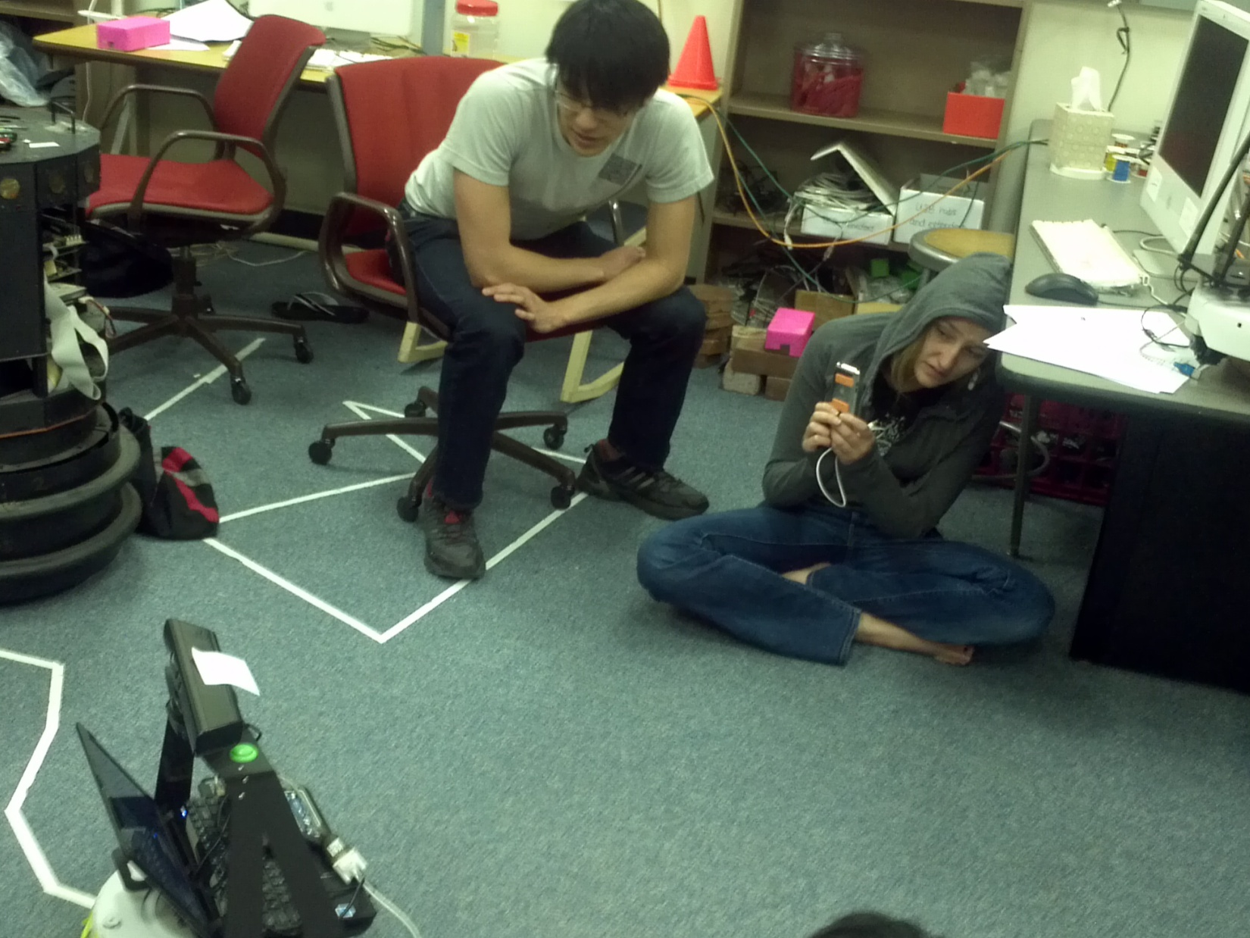
Weeks 6-7
lots of floor time
even when it does work
Notes:
ask how to do it!?!

Slide 20
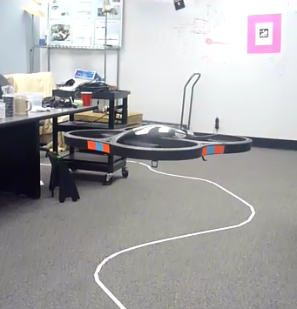
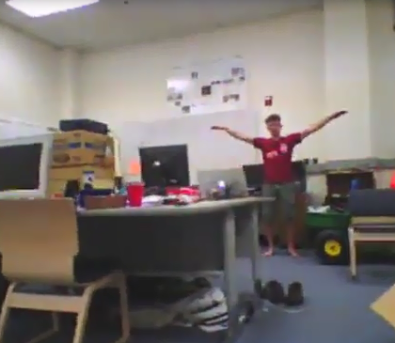
Weeks 9-10
Wk9: Supermanning the drone
Wk10: Autonomous flight
Weeks 11-14: projects
Notes:
ask how to do it!?!

Slide 21
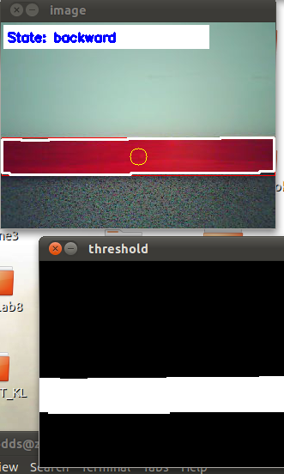
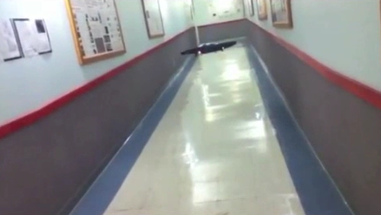
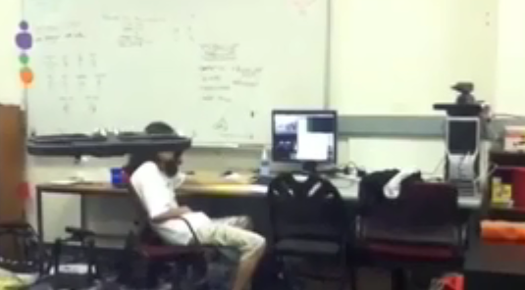
Final drone projects
Hallway line-following
2x
Nerf missiles vs. drone
student-built interface to the drone's video
2x
Several others
navigating a hula-hoop
brainwave control of a drone
following a Create with a drone

Slide 22
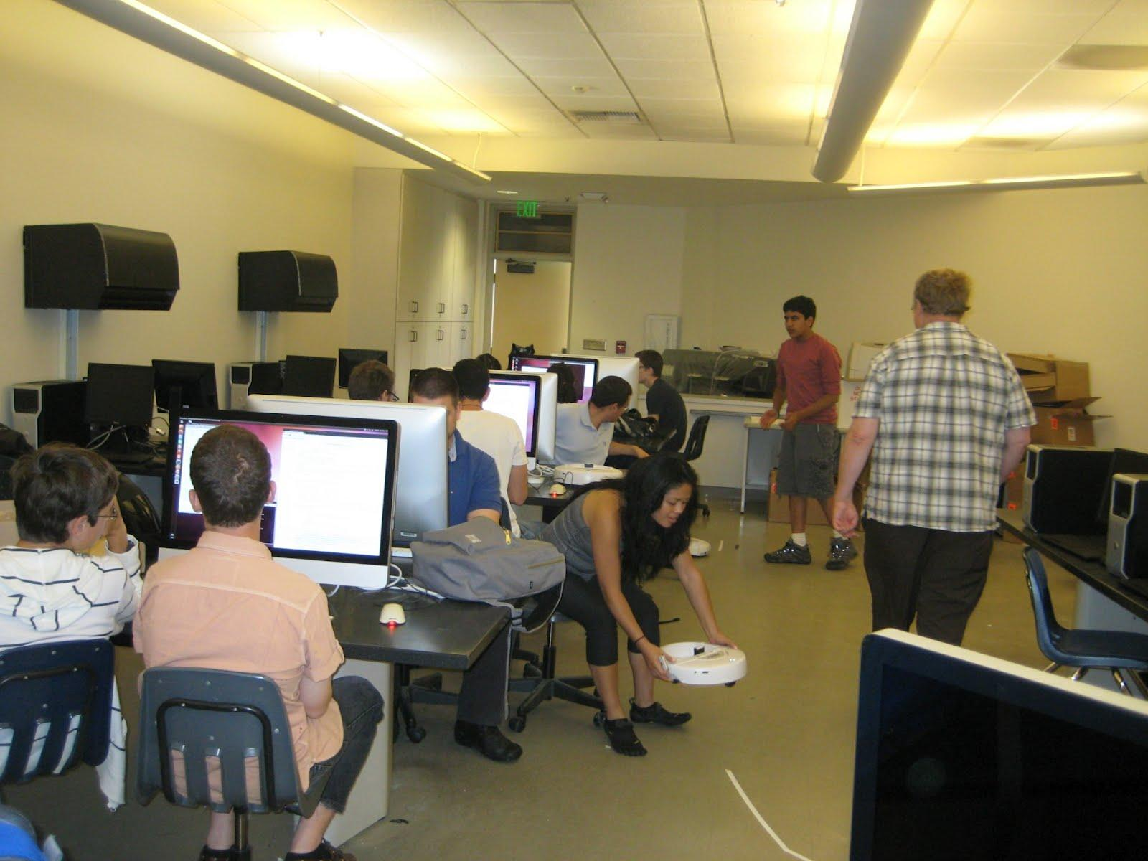
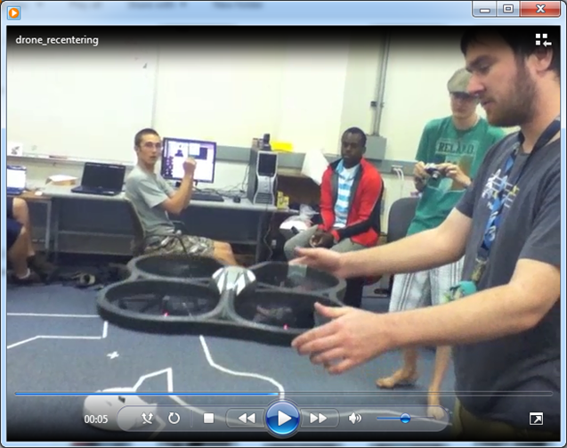
Adapted by…
Western State College (for AI)
leading to open-ended problems
Glendale College ~ for CS1, leading to a robotics concentration
Notes:
ask how to do it!?!

Slide 23
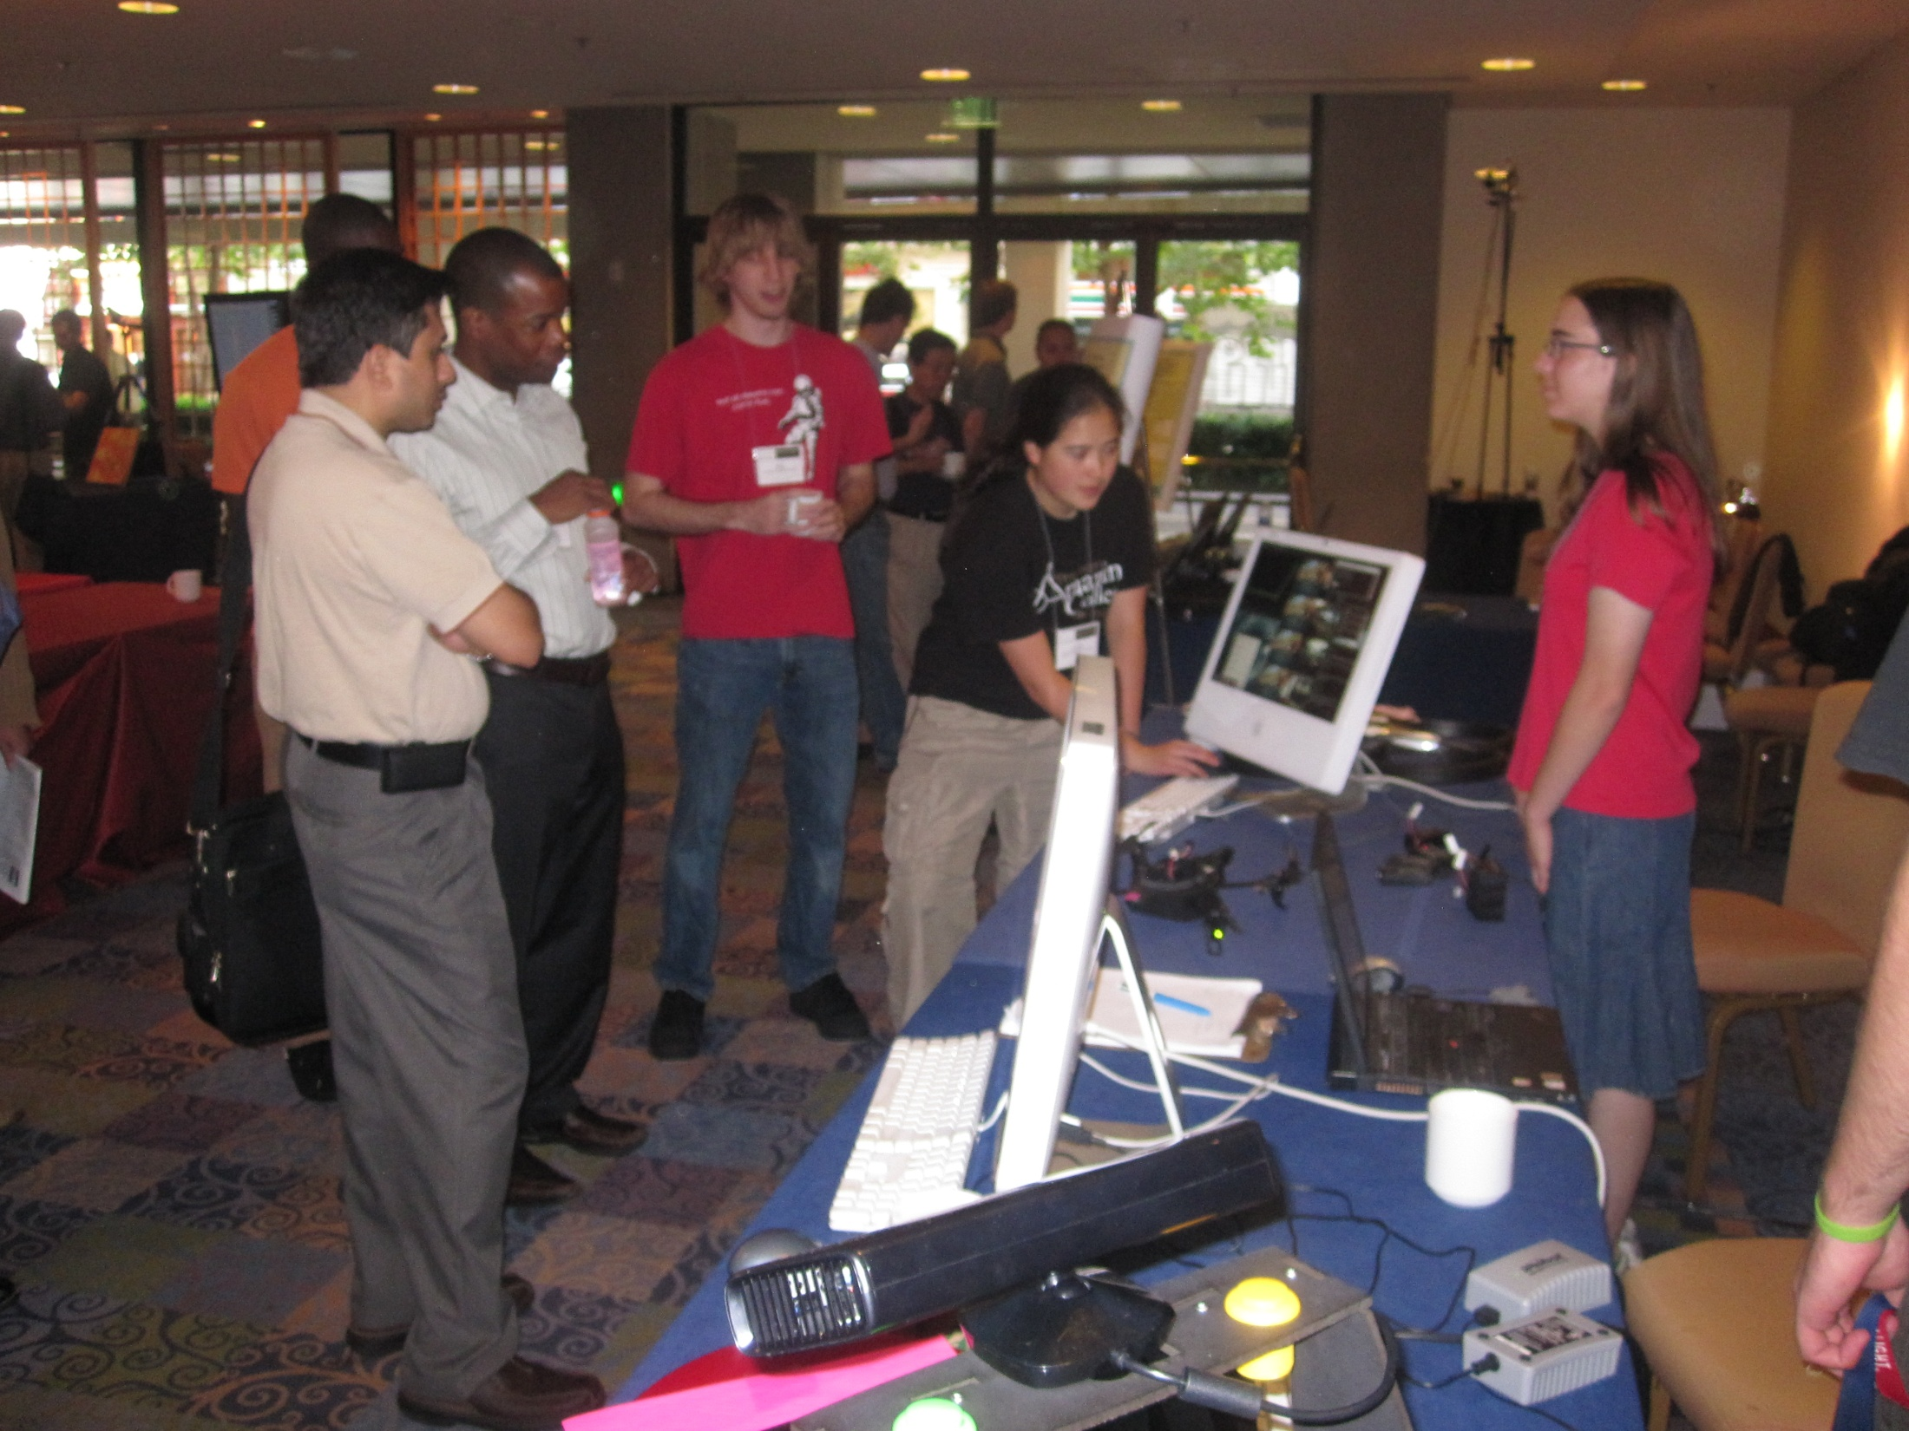
Scales well:
projects
Notes:
ask how to do it!?!

Slide 24
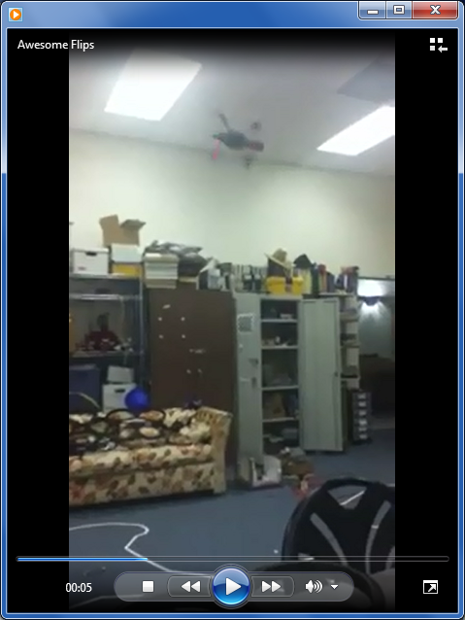
Scales well:
new robots
The AR.Drone 2.0 does flips…
Notes:
ask how to do it!?!

Slide 25
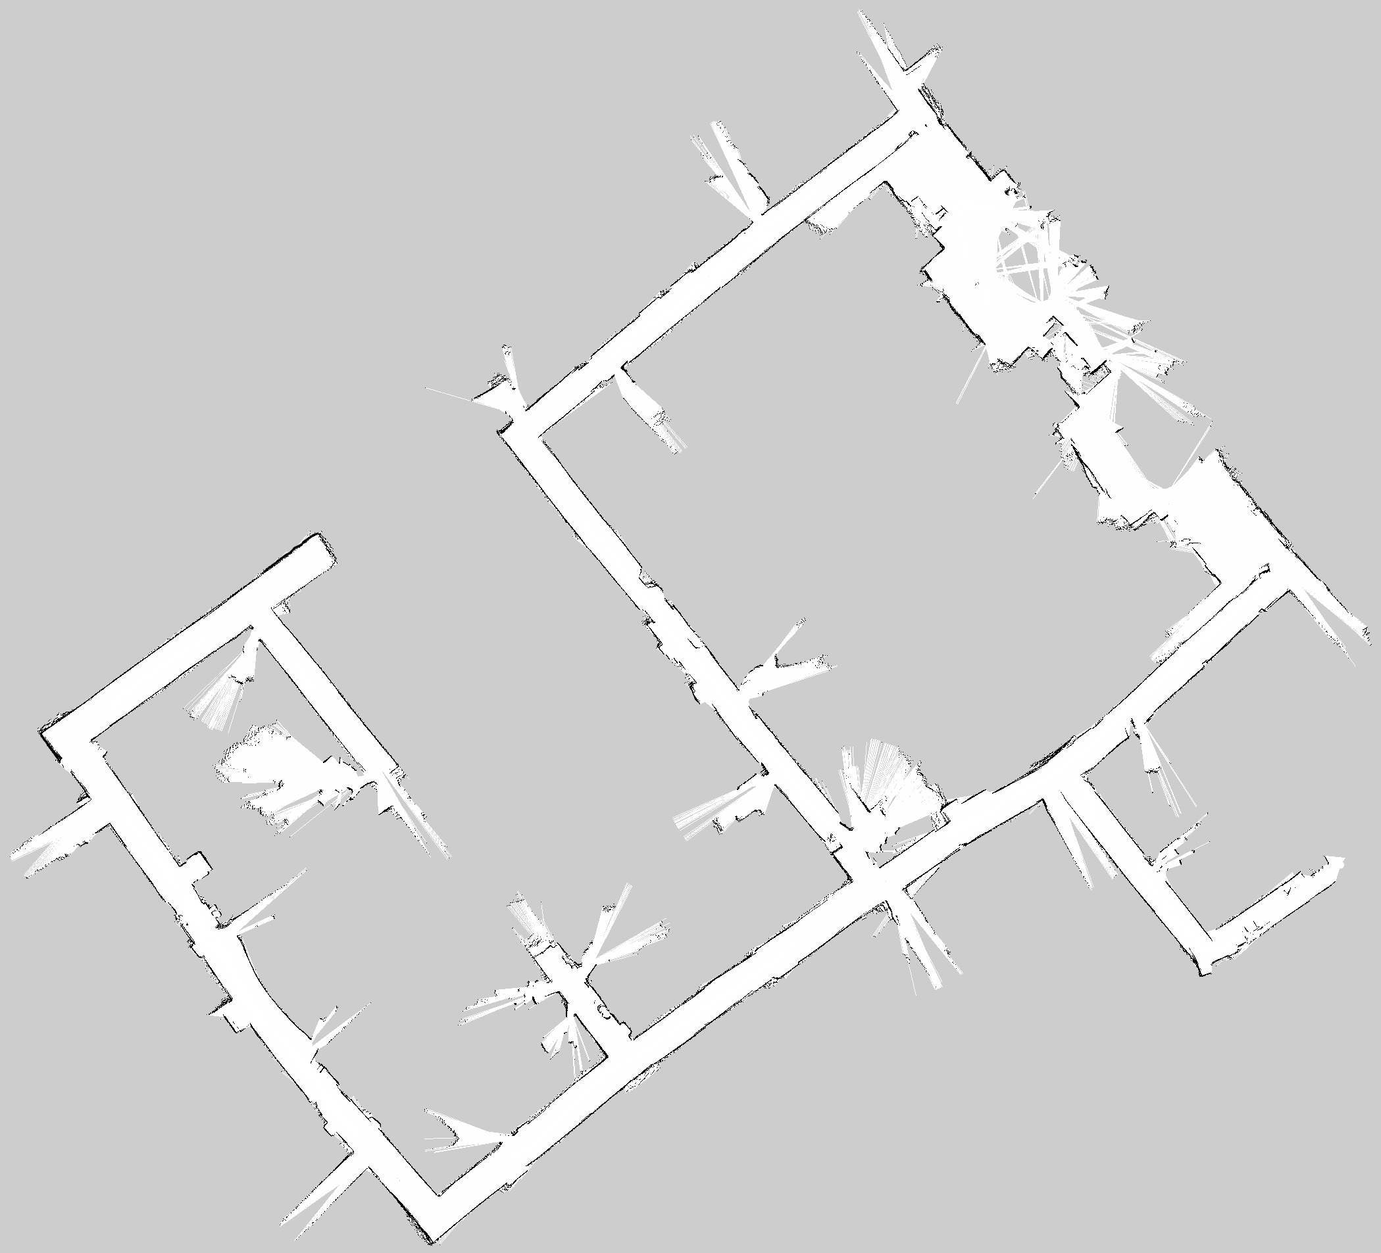
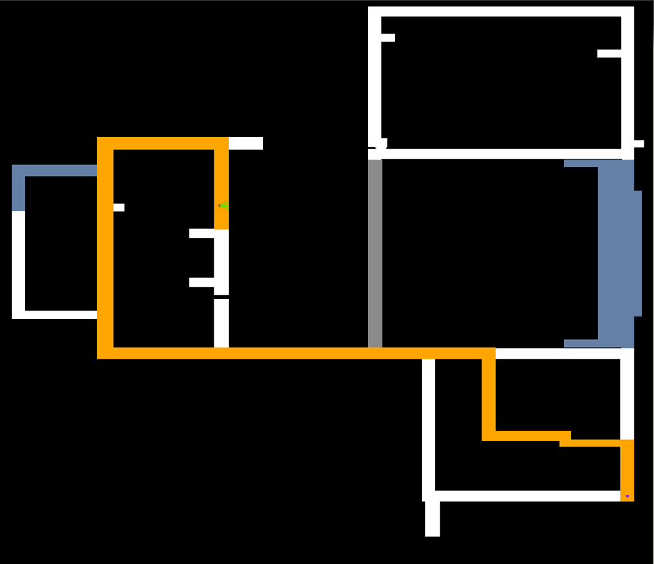
Everything ROS offers…
N
N
Map built by our Create + Kinect platforms w/ ROS
100m
Hand-built
Notes:
ask how to do it!?!

Slide 26
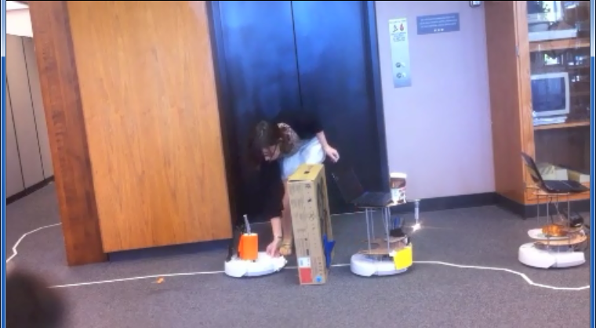
Scales well: more robots
MuddBots in convoy: Snack Train
2:54
Notes:
ask how to do it!?!

Slide 27
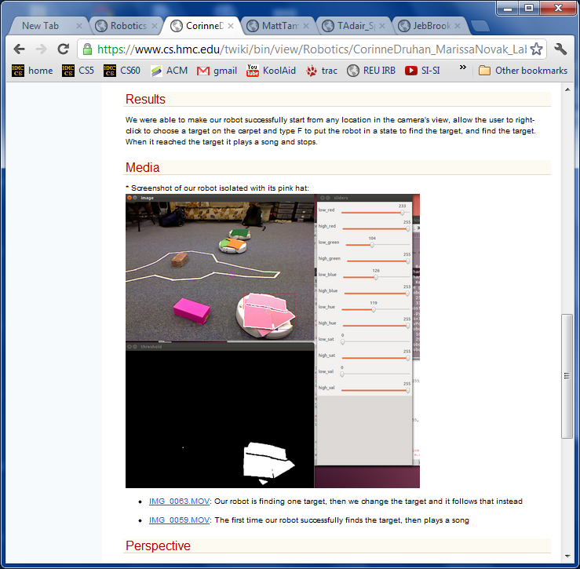
Verdict…
Computational confidence- building right after CS1
explicit HW challenges
fun applications
using ROS, but not ROS per se
Self-directed portfolio of results (and failures)
10-20 page write-up with screenshots, videos, descriptions, and reflection
Getting beyond DWIC...
Notes:
ask how to do it!?!

Slide 29
Verdicts?
Robots + ROS scale well, even into early CS.
A flipped class seems well-suited to new tools…
… hands-on assistance when things go wrong
… especially no-ceiling tools that can push students!
We're continuing this/next year
Spring 2013 @ Glendale
Spring 2014 @ Mudd
Notes:
ask how to do it!?!

Slide 31
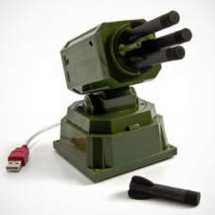
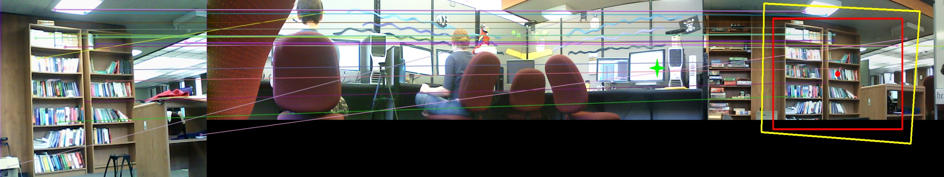
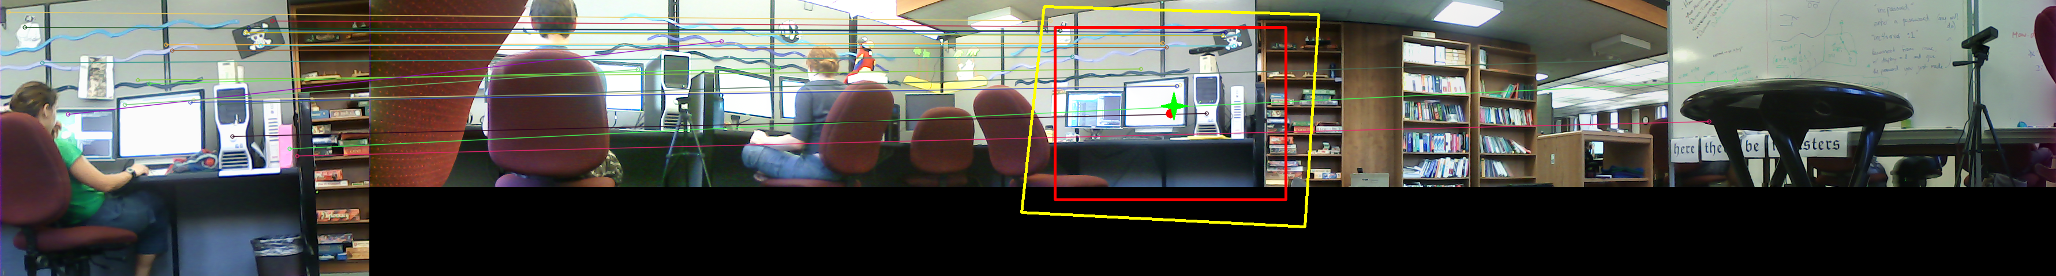
SURF-based localization
Target chosen
New image
Panorama map, SURF matches, and best match
Navigation result
Nerf missile-launcher and webcamera ($40)
Notes:
ask how to do it!?!

Slide 32
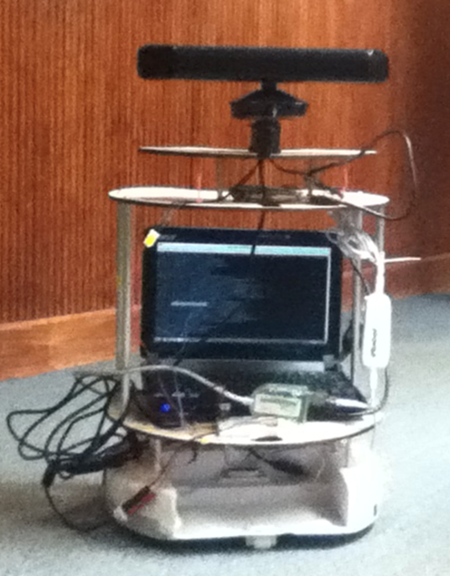
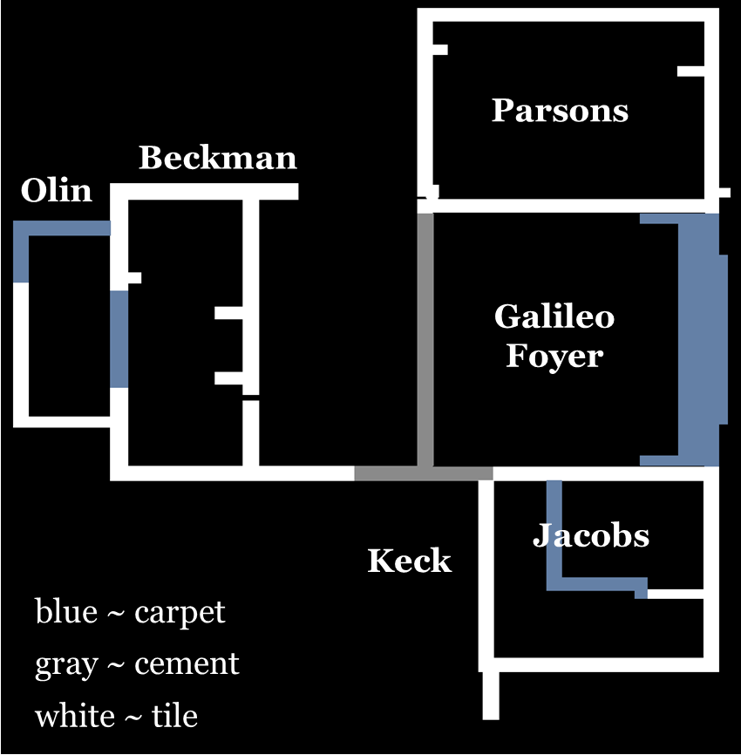
Map-based navigation
MuddBot
its (hand-built) map
Notes:
ask how to do it!?!

Slide 33
Discussion
Questions
How and where do you use robots pedagogically?
Do – or should – robots have a place in your “AI course”?
Details
What about robot costs? models? overhead? contests?
Is ROS a reasonable educational resource?
Larger ideas
Do robots have a role in the evolution of educational practice?
Could commodity excellence in lectures diminish their importance?
Notes:
ask how to do it!?!

Slide 38
6 Creates + 6 Kinects + 6 netbooks + 6 drones ≈ $6,000
Goal: to increase students' computational sophistication via ROS/robot labs
Notes:
How would ROS fare as a tool for computational outreach to engineers, mathematicians, and scientists from other disciplines... ?

Slide 39
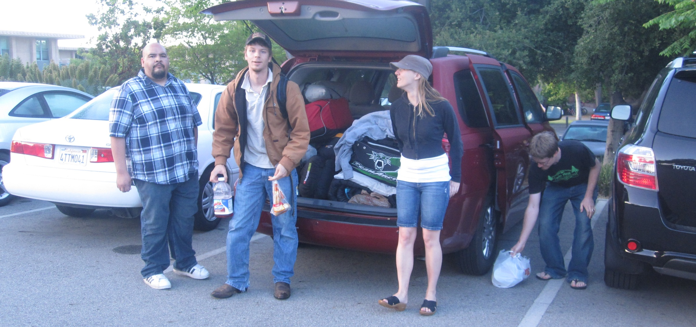
Western State College
15 hours later
from visiting last summer...

Slide 40
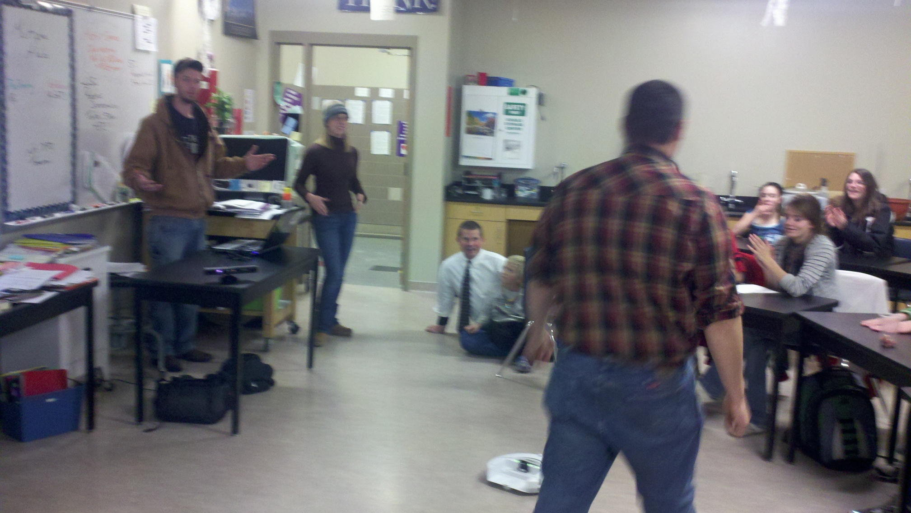
Western State College
... to outreach this winter

Slide 41
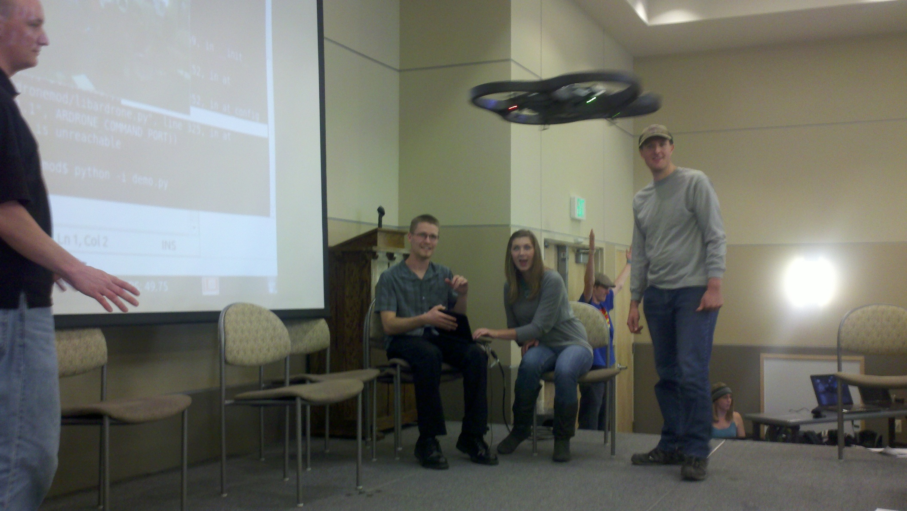
Western State College
... to outreach this winter

Slide 42
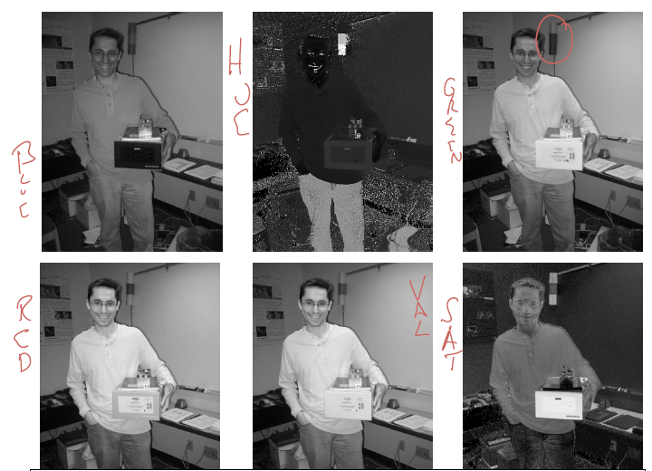
Week 2
challenging (!) warm-up activity
... to identify RGB and HSV components
Notes:
key presses; image acquisition and display; students' display; connected components (library) – finding the largest by area – naive algorithm

Slide 43

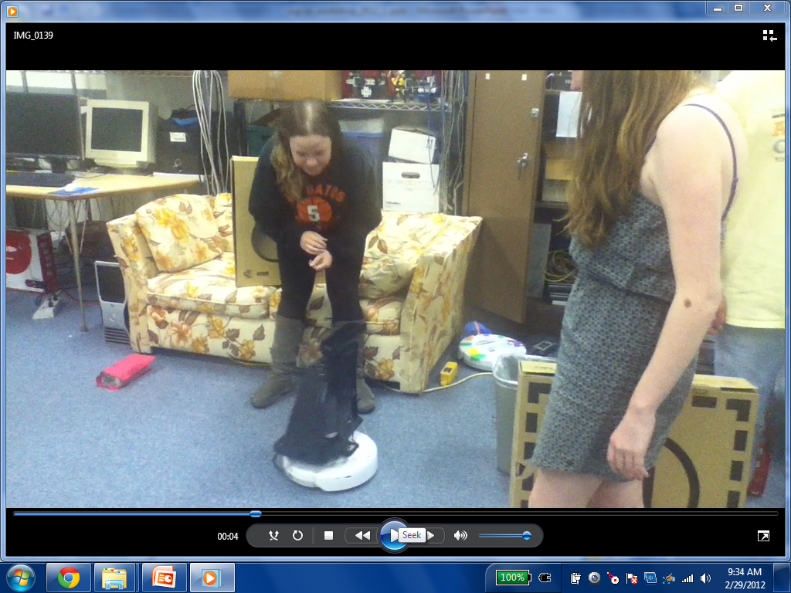
Week 6
Robot follower
Kinect: Depth
proportional control
things can always be worse...?
Challenge: lead your robot out the door, into another room, and back
Notes:
ask how to do it!?!

Slide 44
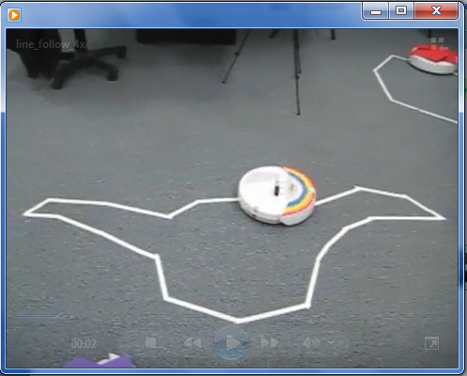
Week 1
Line following
Create
command-line and Python
made it! (the video is 4x)
Notes:
students in four of the five sections expressed – unsolicited – that they were surprised and/or happy to actually get the robots to "do something" in their first lab...

Slide 45
Week 2
challenging (!) warm-up activity
... to identify RGB and HSV components
Notes:
key presses; image acquisition and display; students' display; connected components (library) – finding the largest by area – naive algorithm

Slide 46
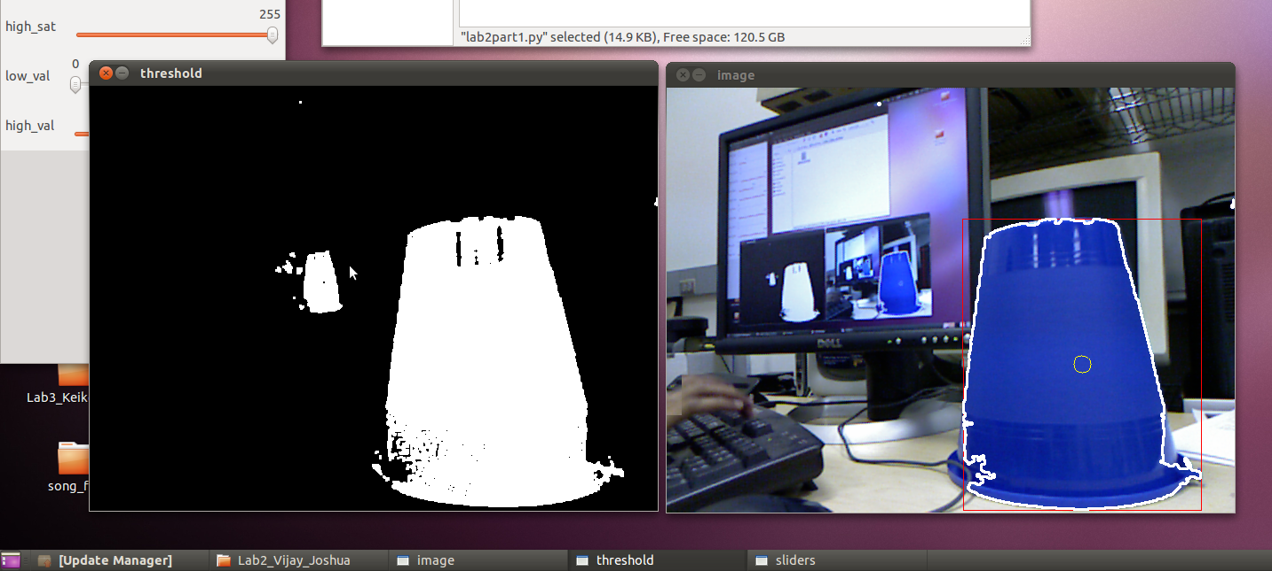
Week 2
Color segmentation
Kinect: RGB
keyboard/mouse events
Creativity? Recursion!
Notes:
key presses; image acquisition and display; students' display; connected components (library) – finding the largest by area – naive algorithm

Slide 47
Week 5
understanding vs. implementation
Wall-angle estimation
Kinect: Depth
Kinect's range images
Notes:
ask how to do it!?!

Slide 48
Week 5
understanding vs. implementation
Wall-angle estimation
Kinect: Depth
Notes:
ask how to do it!?!

Slide 49
Feedback on labs 3-5...
understanding vs. implementation
Notes:
ask how to do it!?!

Slide 50
Feedback on labs 3-5...
understanding vs. implementation
Notes:
ask how to do it!?!

Slide 51
Week 6
Robot follower
Kinect: Depth
proportional control
success... (at 2x)
Notes:
ask how to do it!?!

Slide 52
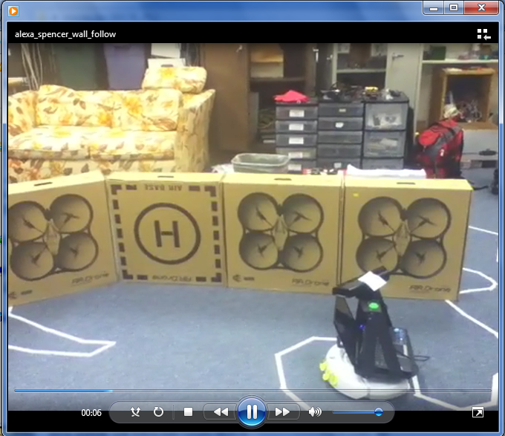
Week 7
integration and debugging
Wall follower
Kinect: Depth
moving-wall following (2x)
Notes:
ask how to do it!?!

Slide 53
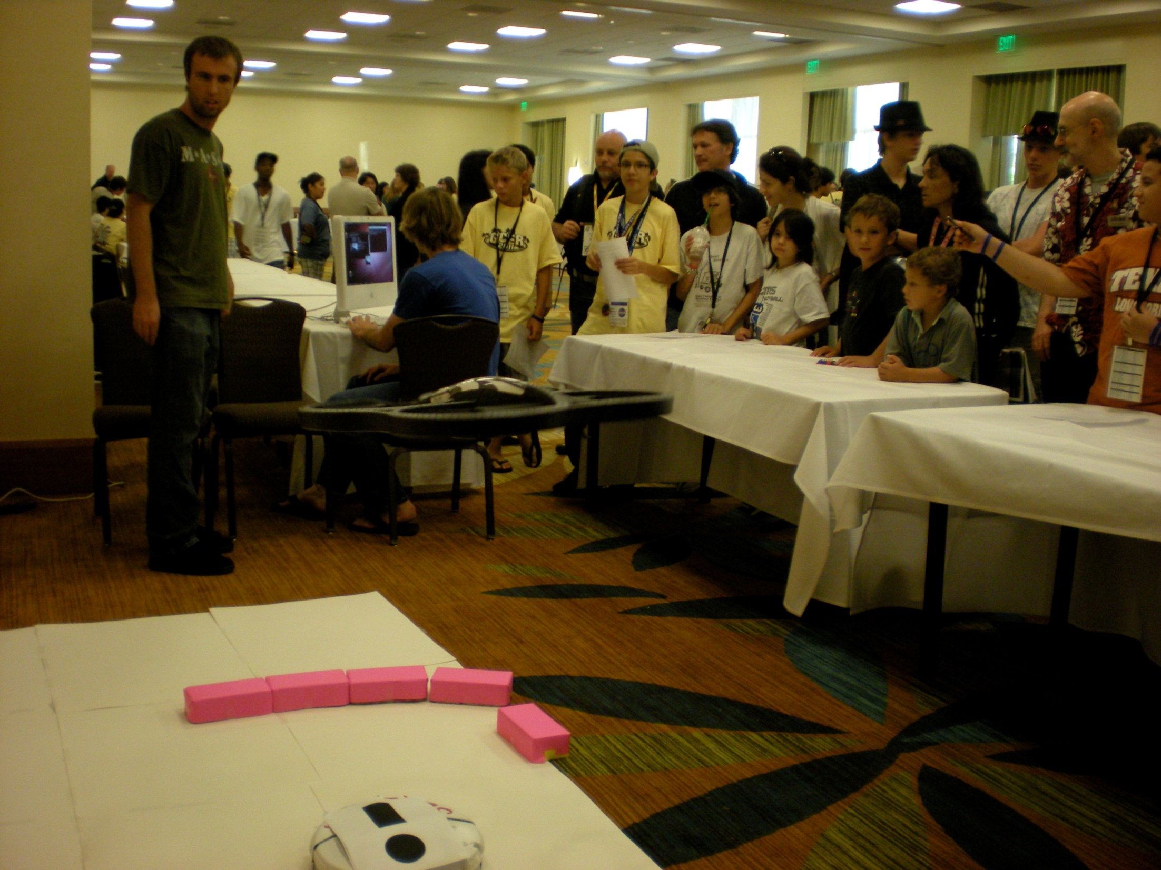
Summer!
Notes:
ask how to do it!?!

Slide 54
Summer!
Notes:
ask how to do it!?!

Slide 55
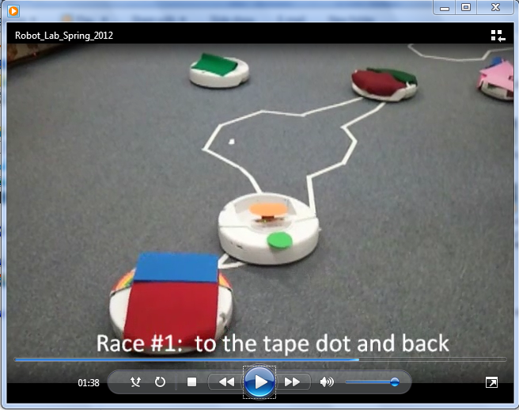
Week 4
understanding vs. implementation
Finite-state control
Kinect: RGB
The race: a more polished view...
Notes:
ask how to do it!?!

Slide 56
The labs
Week
Lab challenge
New hardware
CS Topics Emphasized
1
Line-following
creates
command-line & Python
2
Color segmentation
Kinects: RGB
event-handling
3
Finite-state control
-
finite-state machines
4
Visual servoing
-
understanding vs. implementing
5
Wall-angle estimation
Kinects: Depth
6
Robot minion!
-
proportional control
7
Wall-following
-
larger-scale integration
9
Gestural control
quadcopters
GUI/visualization
10
Autonomous flight
-
defensive programming
11-14
(Open-ended projects)
all/any
self-defined problems

