Slide 1
Celebrating over 50 years of Clinic
The Harvey Mudd College Clinic Program
Notes:
Depending on whether those in the room are familiar with Harvey Mudd, I like to start with some context on the school as a whole.

Slide 2
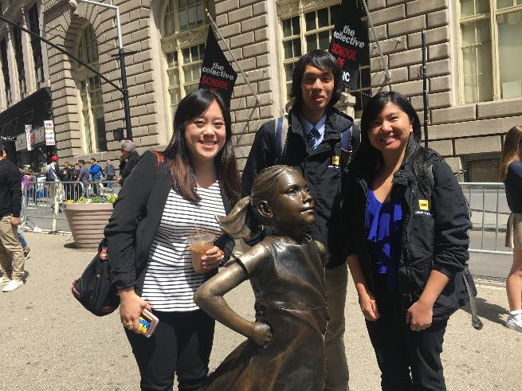
Students: Bright, Inventive, Fearless
¾ of 2017's
AmEx team…

Slide 3
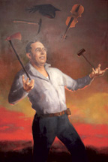
Students: Bright, Inventive, Fearless
Most selective Liberal Arts College based on ACT/SAT
829 students 12% admit rate
Competition: Stanford, MIT, Caltech
Valedictorian or Salutatorian: 47%
45% go on to attain advanced degree
Ranked #2 for Ph.D. pursuit
Mathematical and Interdisciplinary Contests in Modeling ( MCM / ICM )
Most “Outstandings” in the contests' history
ACM International Computer Programming Competition ( ACM )
Most recent US, only undergraduate school to win
Harvey S. Mudd, mining engineer

Slide 4
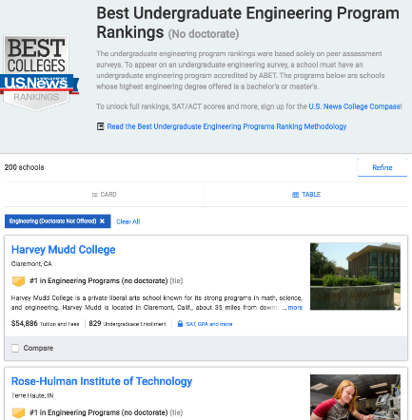
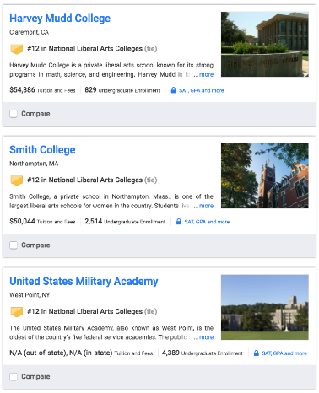
Harvey Mudd College: prioritizing both Engineering and the Liberal Arts

Slide 5
Clinic Program ~ founded in 1963 as an Engineering Education Innovation
Over 1,500 projects completed to date…
Directors:
Engineering Profs. Kash Gokli & Qimin Yang
Mathematics Prof. Weiqing Gu
Physics Prof. Peter Saeta
Global Clinic Prof. Susan Martonosi
Computer Science Prof. Zach Dodds
Director of Corp. Relations Colleen Coxe

Slide 6
What is Clinic?
Sponsored Capstone-Project Course
starts in September, delivers in May
team of 4 - 5 students & faculty advisor
10 hours/student/week: 1,200 - 1,500 hours total
Fee is $50,000
Sponsor owns all IP

Slide 7
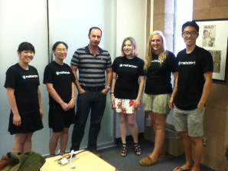
Sponsor Benefits
Project deliverables
All IP, patents, products
Mid-year and final report
All software, prototypes, documentation, hardware, …
Opportunities for recruiting
Shaping student-education & -paths
for Matterport: a custom-designed 3d game

Slide 8
Sponsor Obligations
Provides project idea / description
We invite iteration on details, if you’d like…
Provides liaison (~1-2 hrs/week)
Provides fee ($50k, split into 3 payments)
Business agreement (~3 pages)
Feedback at end of project

Slide 9
Clinic's timeline
Fall, Winter, Spring — Contact potential sponsors. Gather and iterate on project ideas
Jan. to April — Prepare 1-2 page project statement, execute business agreement
by 1 July — PS and BA due
July/August — Post project statement for students, prepare for student teams
1st Tuesday in Sept. — Projects start
1st Tuesday in May — Projects Day

Slide 10
First Step: Identify a Project
Sponsor provides a written project statement
tuned, if desired, with Clinic Director, for scope-matching to students’ background, interests; 9-month academic span
Recipe ~ well-scaffolded start / MVP ; open-ended onward
Sponsor appoints a liaison to
Monitor team progress, ~1 hr/week
Provide domain expertise, and
Ensure the path taken is of value to sponsor
Sponsor and HMC sign business agreement
Faculty assigned, via interest and expertise
Students assigned, via preferences and abilities

Slide 11
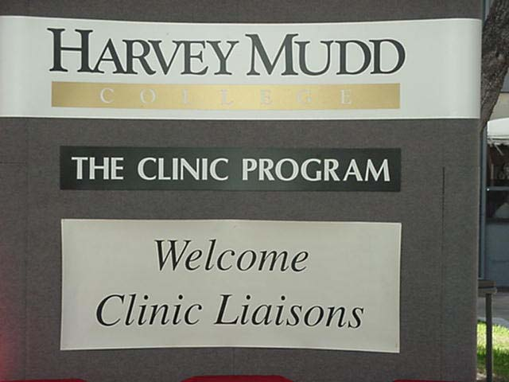
Year’s Start: Orientation Day
Liaisons invited to campus
Meet with Clinic Director
Strategies and tips
Meet with team and faculty advisor
Cover problem in detail
Discuss confidentiality
Establish communication routine
Email/Slack/other
Weekly teleconferences
Jumpstart the project, face-to-face
Recruiting / internship opportunity

Slide 12
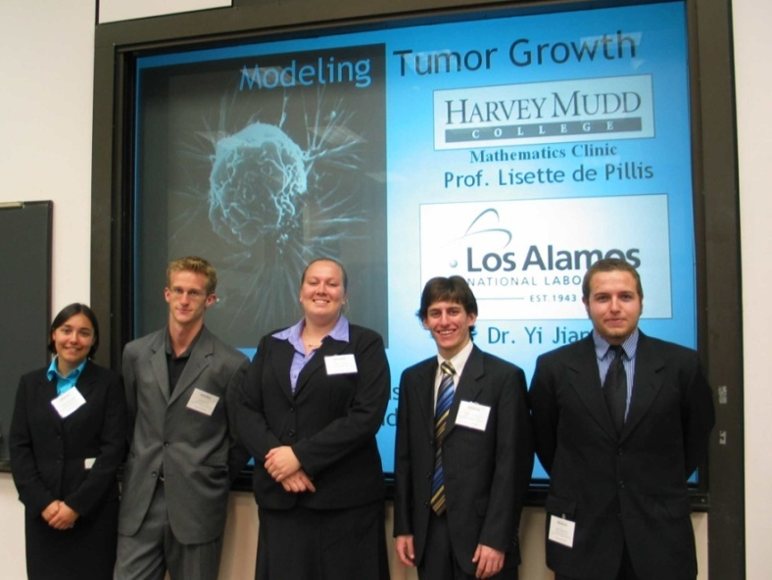
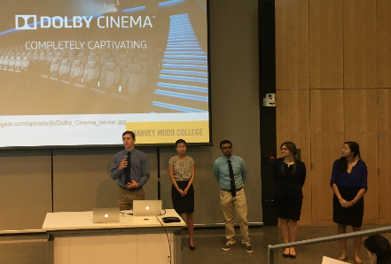
Year’s End: Projects Day
Sponsoring organizations invited to campus
Presentations and poster sessions by all teams
Celebration of student work and the year's progress
2006
2017
Notes:
Statement of Work
- Defines scope of project and
deliverables.
Additionally, we encourage each Clinic team to visit the sponsor’s site early in the project to gain a better sense of the goals and purpose of the project.
Early in the spring semester, the Clinic Director, faculty advisor and project liaison meet via teleconference to discuss the progress of the team and the sponsor’s satisfaction with the project.

Slide 13
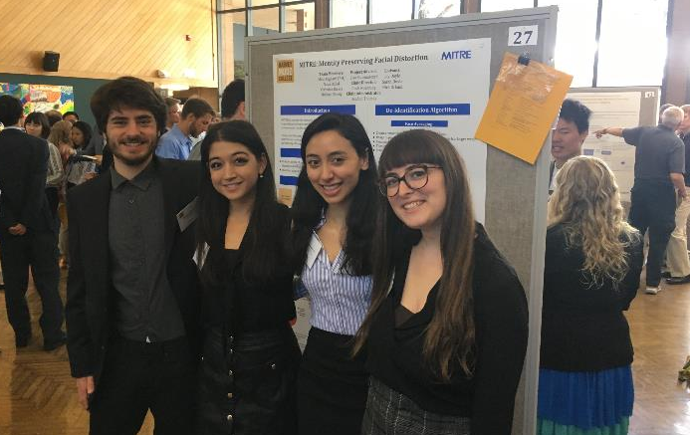
Year’s End: Projects Day
MITRE team @ poster, 2017
Notes:
Statement of Work
- Defines scope of project and
deliverables.
Additionally, we encourage each Clinic team to visit the sponsor’s site early in the project to gain a better sense of the goals and purpose of the project.
Early in the spring semester, the Clinic Director, faculty advisor and project liaison meet via teleconference to discuss the progress of the team and the sponsor’s satisfaction with the project.

Slide 14
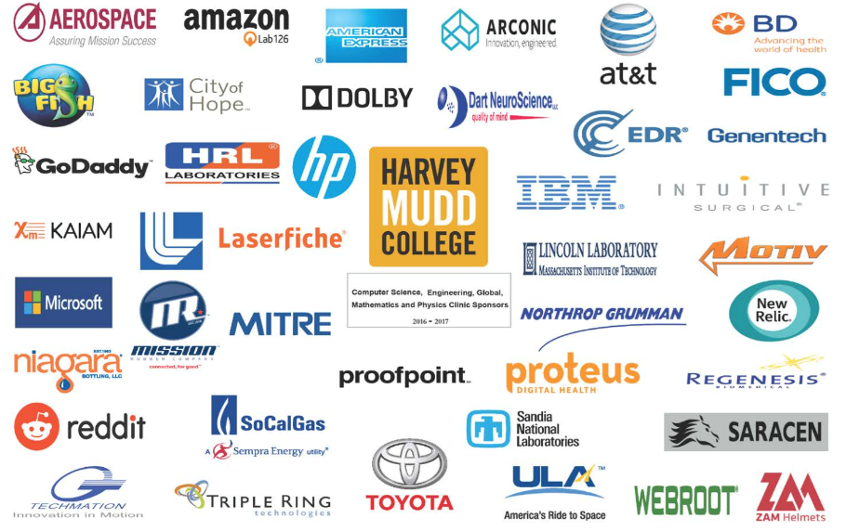
2017 Clinic Sponsors

Slide 15
Project? Recommendations:
Sponsor value greater than fee
Valuable, rather than critical …
Job jar ~ speculative opportunities
" If I had one more FTE"
No typical Clinic project:
" R + D for our R & D "
" Optimizing – on a new axis..."
" Piloting hackathons’ 2-5% "
Thoughts?

Slide 16
2017 Clinic Sponsors

Slide 17
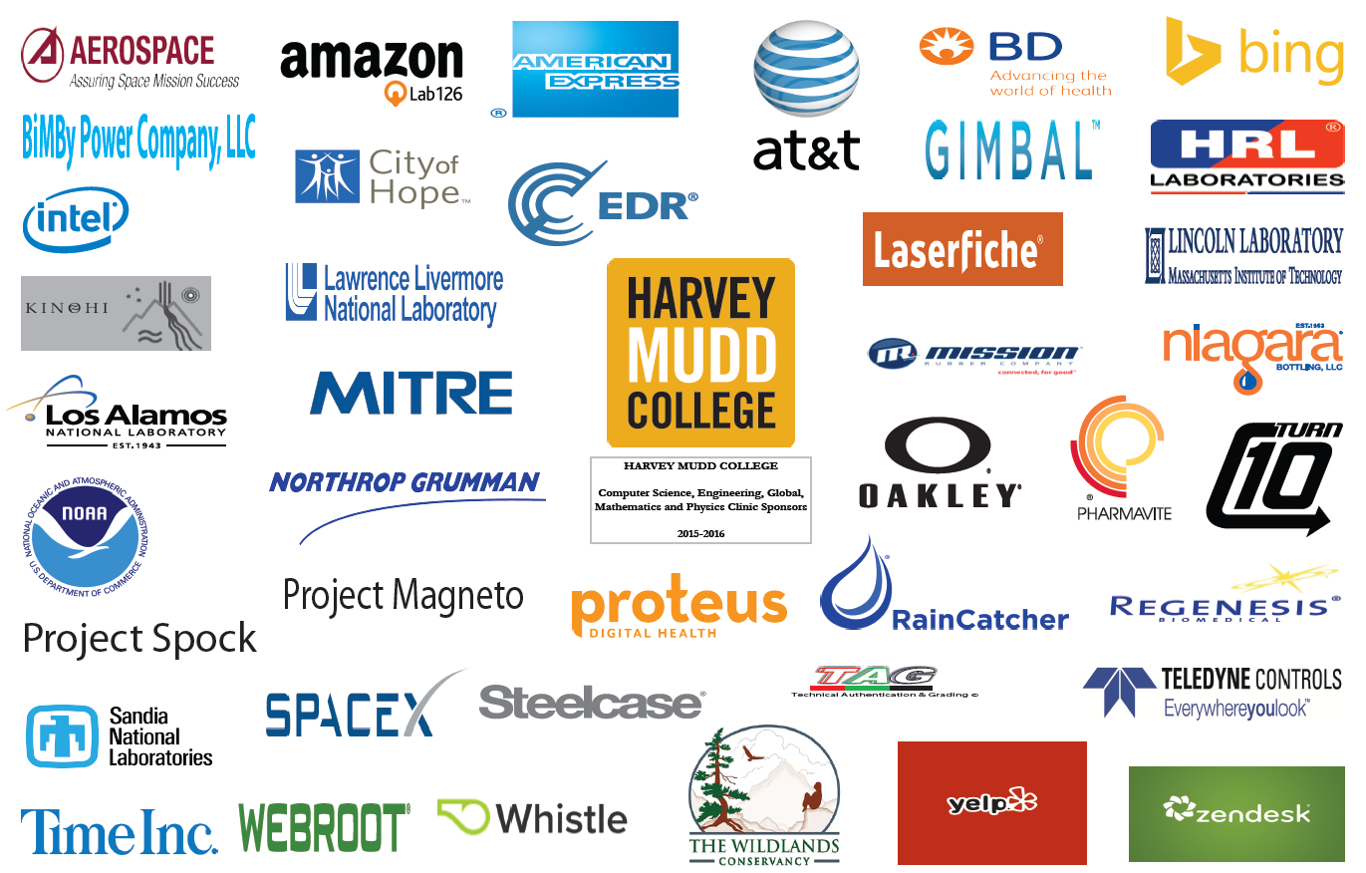
2016 Clinic Sponsors

Slide 18
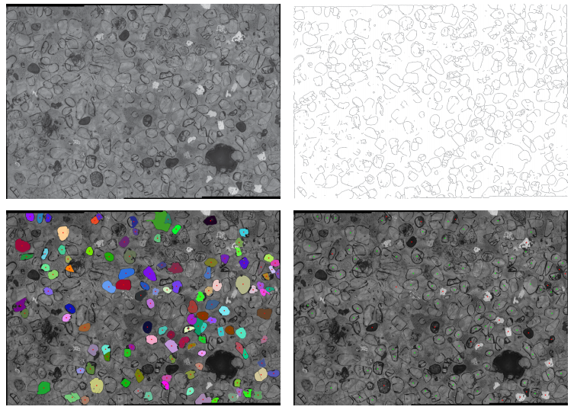
Example clinic projects...
Apatite to Zircon, 2015

Slide 19
Remaining slides are extra...

Slide 20
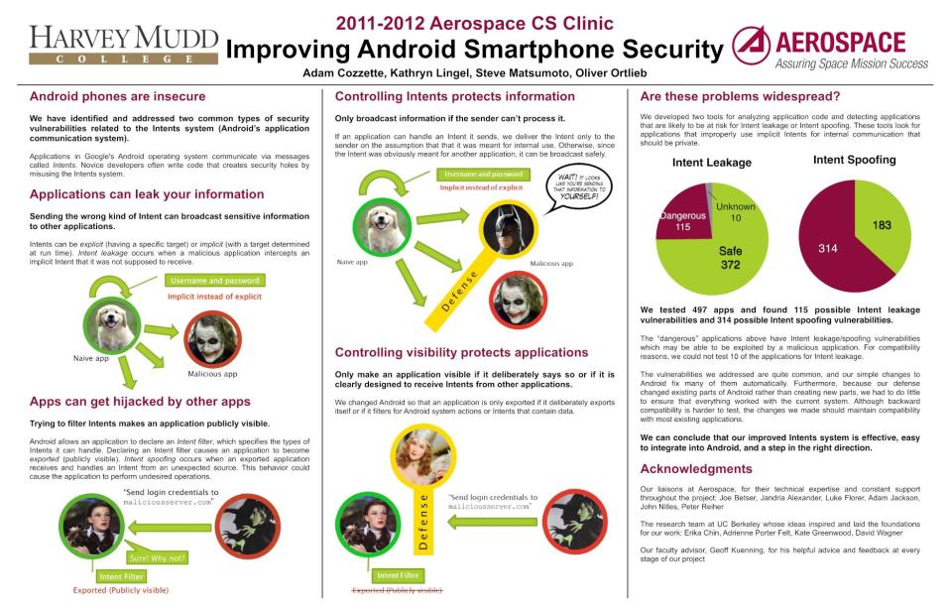
Computer Security (CS)

Slide 21
Silicon Wafer Conditioner (Engineering)

Slide 22
IV Pump Control (Mathematics)

Slide 23
Tagged-Neutron Calibration Source (Physics)

Slide 24
Prior Sponsor Recommendations Are Strong: You Can Ask Them
Becton, Dickinson and Company (BD): Robert D. Butterfield, Research Fellow, Infusion and Respiratory Systems, (858) 617-5787
Honeywell: James Van Ackeren, Manager, Performance Analysis, (310) 512-4832
Lawrence Livermore National Laboratory: Adam Bernstein, Advanced Detector Group, I-Division, (925) 422-5918
Northrop Grumman Corporation: Charles Volk, Vice President and Chief Technologist, (818) 719-7765
Notes:
And prepares them for interdisciplinary work

Slide 25
Prior Sponsor Recommendations Are Strong: You Can Ask Them (cont.)
Opto 22: Mark Engman, President and CEO, (951) 695-3000
Oregon Biomedical Engineering Institute: Kenton Gregory, President, (503) 216-5210
The Aerospace Corporation: Joseph Betser, Senior Project Leader, Business Development, (310) 336-0577
Notes:
And prepares them for interdisciplinary work

Slide 26
Harvey Mudd College was first and still sets the standard
Clinic gives Sponsor fresh ideas on an important problem
Team of sharp, motivated and creative students working for a whole year
Joint projects across specialties common
Many projects lead to patents
Many results are implemented
Many sponsors return in subsequent years
Student recruiting opportunities

Slide 27
Project Areas
Engineering strengths in:
General Engineering
Biomedical Engineering
Computer Engineering, Embedded Processors
Systems & Signals, Controls
Conceptual Design

Slide 28
Project Areas (cont.)
Computer Science strengths in:
User Interfaces
Data Mining
Artificial Intelligence / Robotics
Distributed Systems / Parallel Processing
Algorithms
Computer Vision
Graphics / Visualization
Computer Games
Systems and Networking

Slide 29
Project Areas (cont.)
Math strengths in:
Operations Research/Statistical Models
Algorithms
Dynamic Models
Bioinformatics
Mathematical modeling and optimization
Statistics and machine learning
Fluid dynamics
Numerical methods

Slide 30
Project Areas (cont.)
Physics strengths in:
Nuclear
Optics & E&M
General Physics

Slide 31
HMC's Common Core Makes Our Students Even Better
Calculus: Required prior to admission
Mathematics: 3 semesters (multivariate calculus, linear algebra, differential equations, probability and statistics)
Physics: 2-1/2 semesters with lab
Chemistry: 1-1/2 semesters with lab
Biology: 1 semester
Engineering: 1 semester (systems engineering)
Computer Science: 1 semester
Writing: ½ semester (Intro to Academic Writing)
Choice Lab: Emphasizing experiential learning
Humanities, Social Sciences and Arts: 11 semesters
Notes:
And prepares them for interdisciplinary work

Slide 32
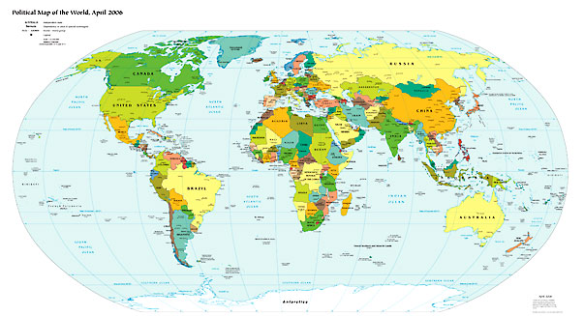
Global Clinic at Harvey Mudd College
Partnerships with universities and sponsors in Puerto Rico, Singapore, Iceland, India, Japan & Israel since 2006

Slide 33
Wastewater Treatment System Design (Global Clinic)

Slide 34
For More Information
https://www.hmc.edu/clinic
Director of Corporate Relations: Colleen Coxe
(909) 607-7015
colleen_coxe@hmc.edu
Corporate Relations Coordinator: Kelly Barker
(909) 607-0898
Fax: (909) 607-0900
kelly_barker@hmc.edu

Slide 35
The Year’s End: Projects Day
GoDaddy team’s presentation
Notes:
Statement of Work
- Defines scope of project and
deliverables.
Additionally, we encourage each Clinic team to visit the sponsor’s site early in the project to gain a better sense of the goals and purpose of the project.
Early in the spring semester, the Clinic Director, faculty advisor and project liaison meet via teleconference to discuss the progress of the team and the sponsor’s satisfaction with the project.

Slide 36
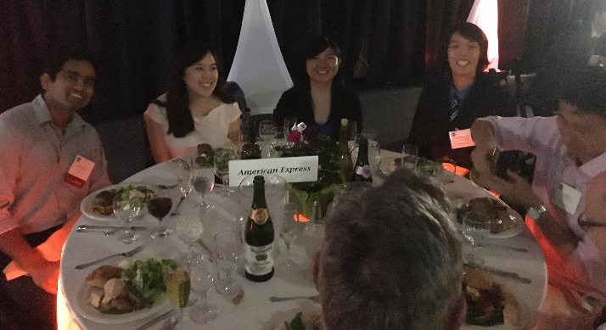
Year’s End: Projects Day
AmEx
team’s dinner
Notes:
Statement of Work
- Defines scope of project and
deliverables.
Additionally, we encourage each Clinic team to visit the sponsor’s site early in the project to gain a better sense of the goals and purpose of the project.
Early in the spring semester, the Clinic Director, faculty advisor and project liaison meet via teleconference to discuss the progress of the team and the sponsor’s satisfaction with the project.

Slide 37
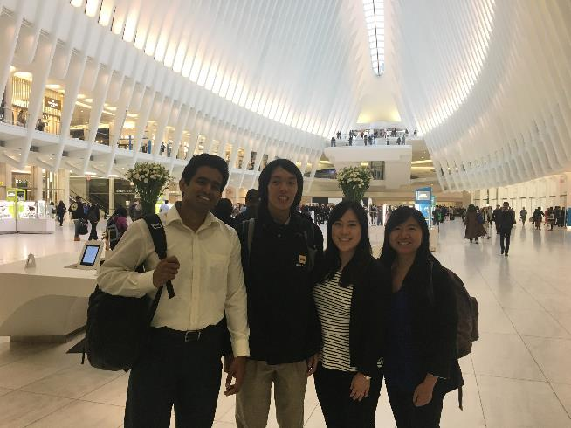
and beyond…
AmEx
team’s visit
Notes:
Statement of Work
- Defines scope of project and
deliverables.
Additionally, we encourage each Clinic team to visit the sponsor’s site early in the project to gain a better sense of the goals and purpose of the project.
Early in the spring semester, the Clinic Director, faculty advisor and project liaison meet via teleconference to discuss the progress of the team and the sponsor’s satisfaction with the project.

Slide 38
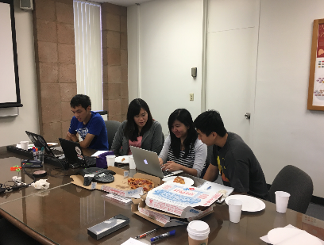
The Year’s Start: Orientation Day
Liaisons invited to campus
Meet with Clinic Director
Strategies and tips
Meet with team and faculty advisor
Cover problem in detail
Discuss confidentiality
Establish communication routine
Email/Slack/other
Weekly teleconferences
Jumpstart the project, face-to-face
Recruiting / internship opportunity
inside a weekly telecon

