Slide 1
Celebrating more than 50 years of Clinic
The Harvey Mudd College Clinic Program

Slide 2
What is Clinic?
Sponsored capstone-project course (taken by all senior CS majors)
10+ hrs / student / week (1200-1500 hours in total)
Starts in September, ends in May
Sponsors own all IP
Team of 4-5 students, delivering on an open-ended project with a faculty advisor, sponsor, and sponsor’s liaison(s).

Slide 3
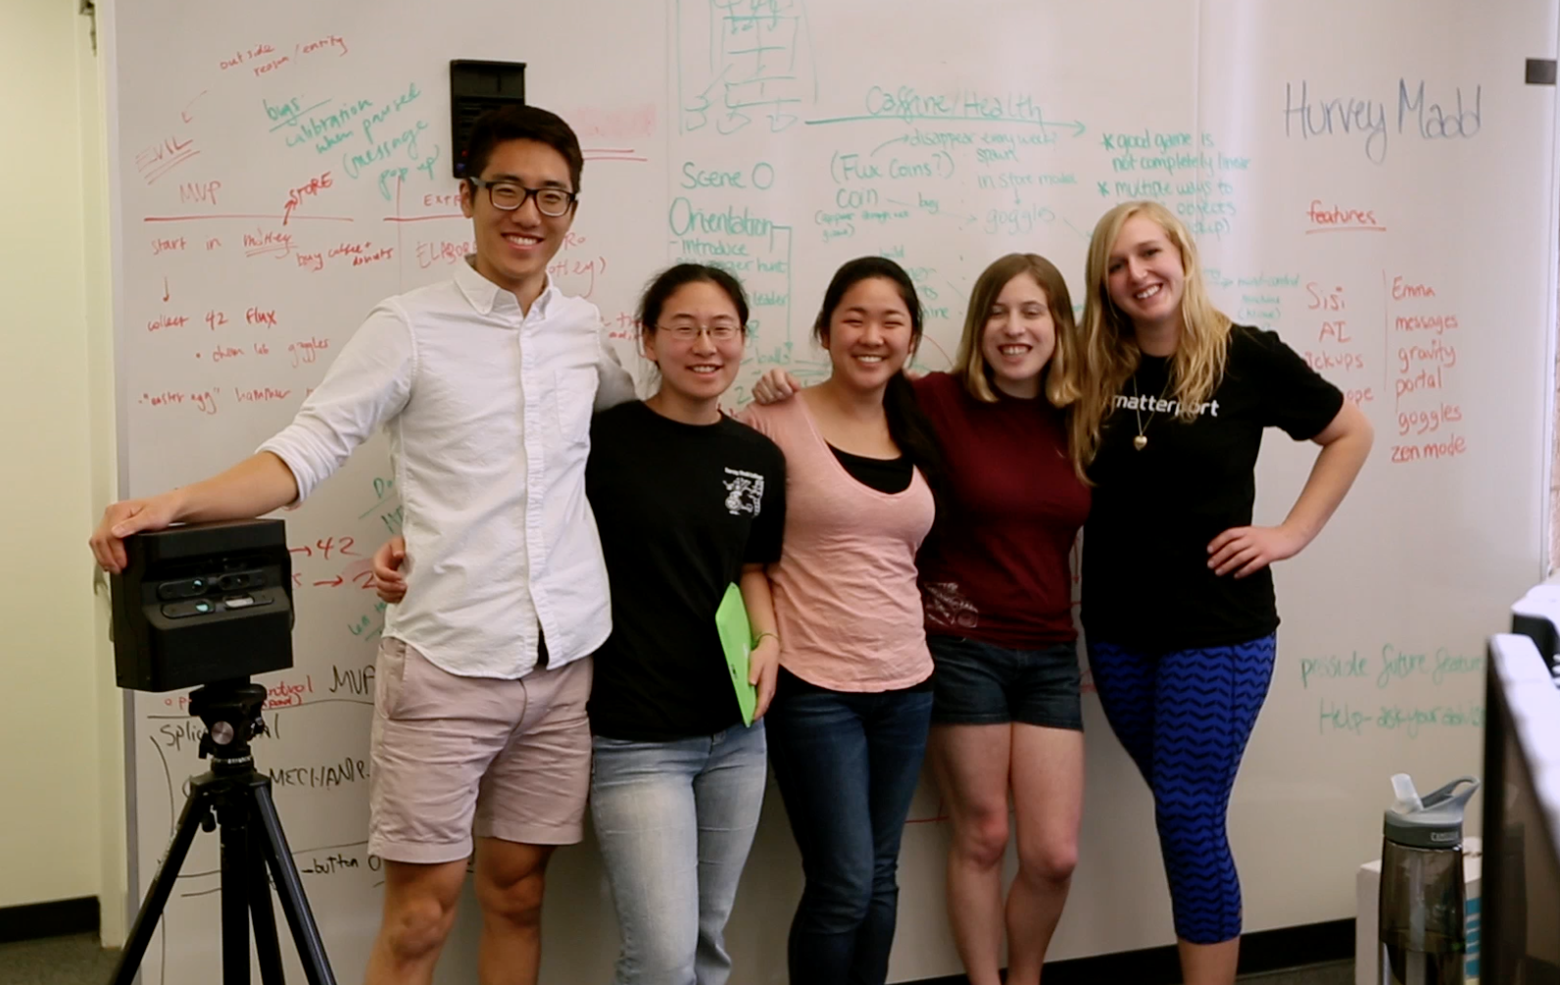
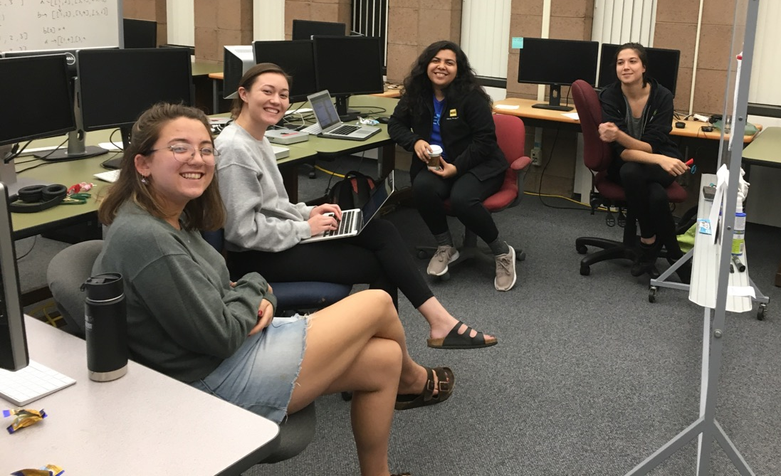
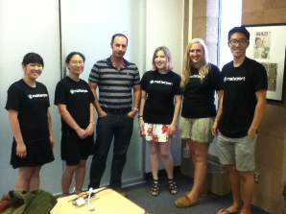
What is Clinic?
Sponsored capstone-project course (taken by all senior CS majors)
10+ hrs / student / week (1200-1500 hours in total)
Starts in September, ends in May
Sponsors own all IP
Team of 4-5 students, delivering on an open-ended project
Matterport: a custom-designed 3d game
Fluxergy: cellular image-processing

Slide 4
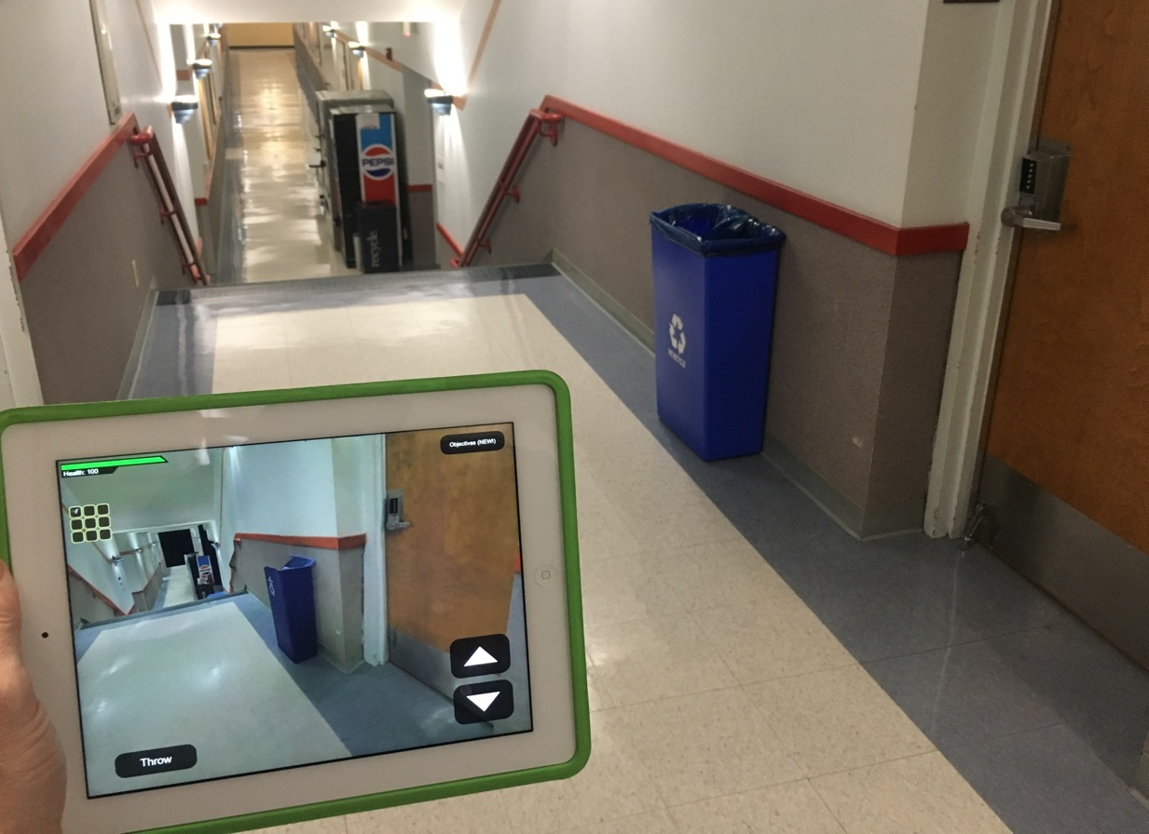
Example: Matterport
Innovative uses of 3d modeling: A real-world, first-person game

Slide 5
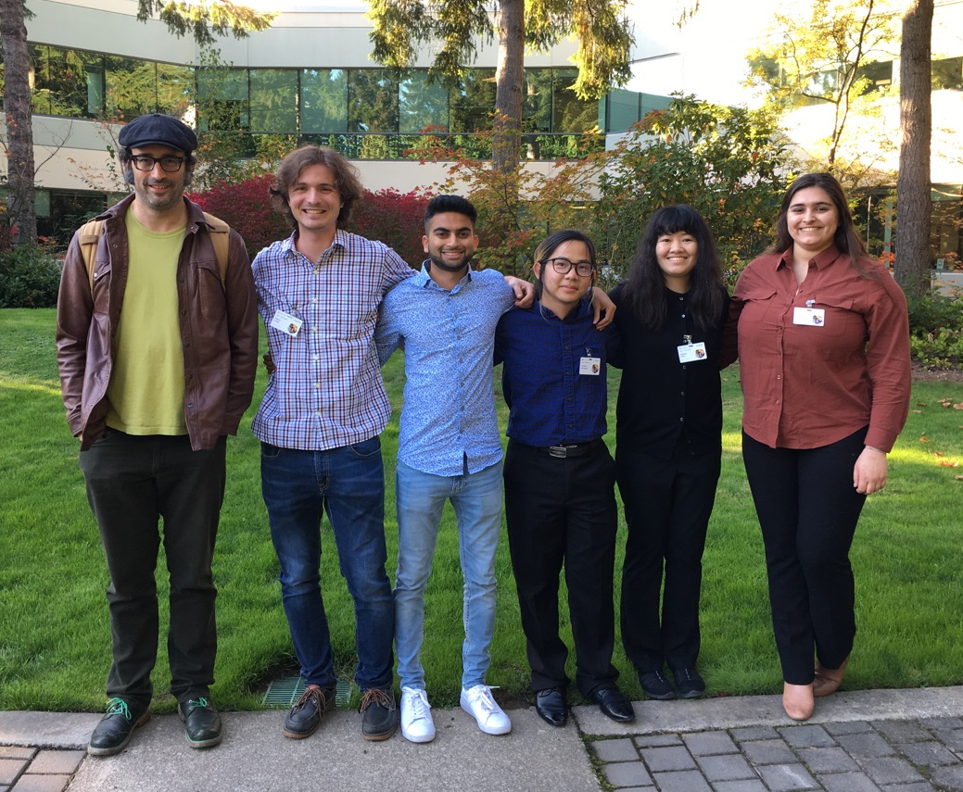
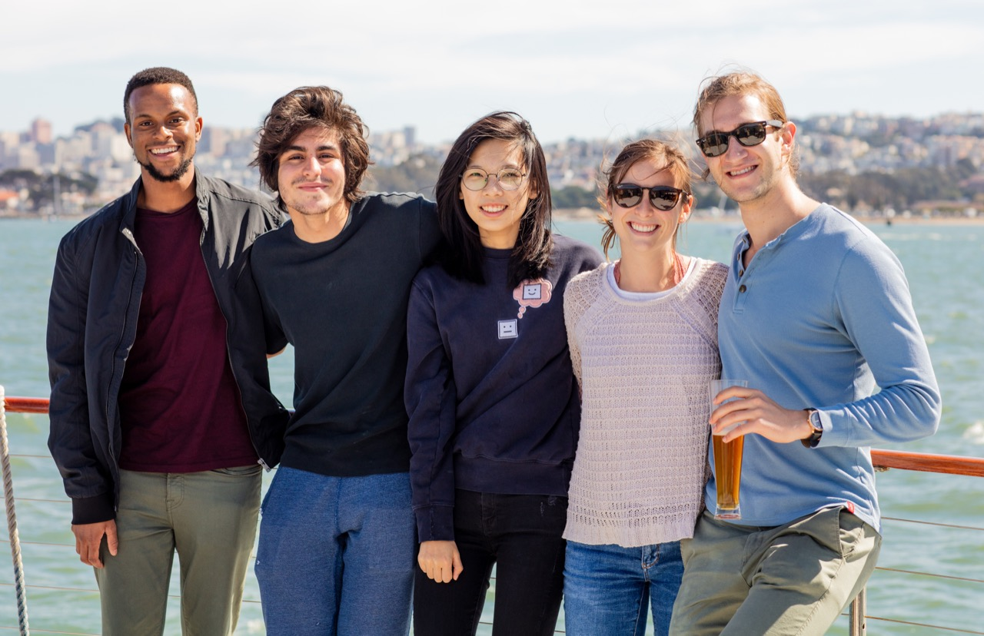
What is Clinic?
Sponsored capstone-project course (taken by all senior CS majors)
10+ hrs / student / week (1200-1500 hours in total)
Starts in September, ends in May
Sponsors own all IP
Team of 4-5 students, delivering on an open-ended project
Microsoft: confident reading, by everyone
Verkada: live-stream computer vision + ML

Slide 6
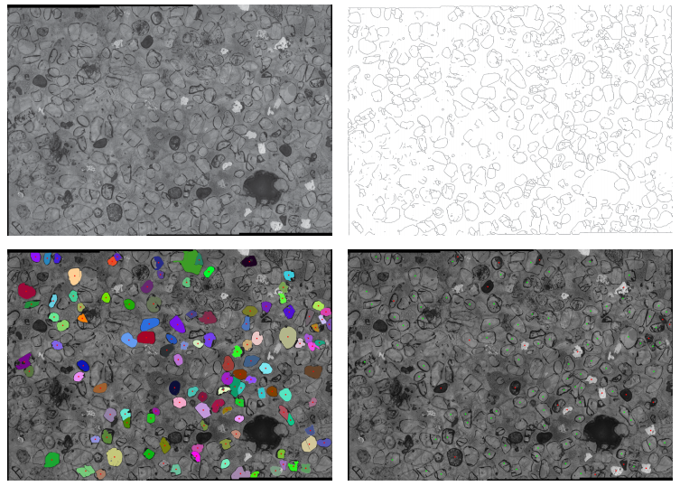
Example: Computer Vision
An energy- and geology-motivated application: finding ²³⁵U fission tracks in apatite crystals

Slide 7
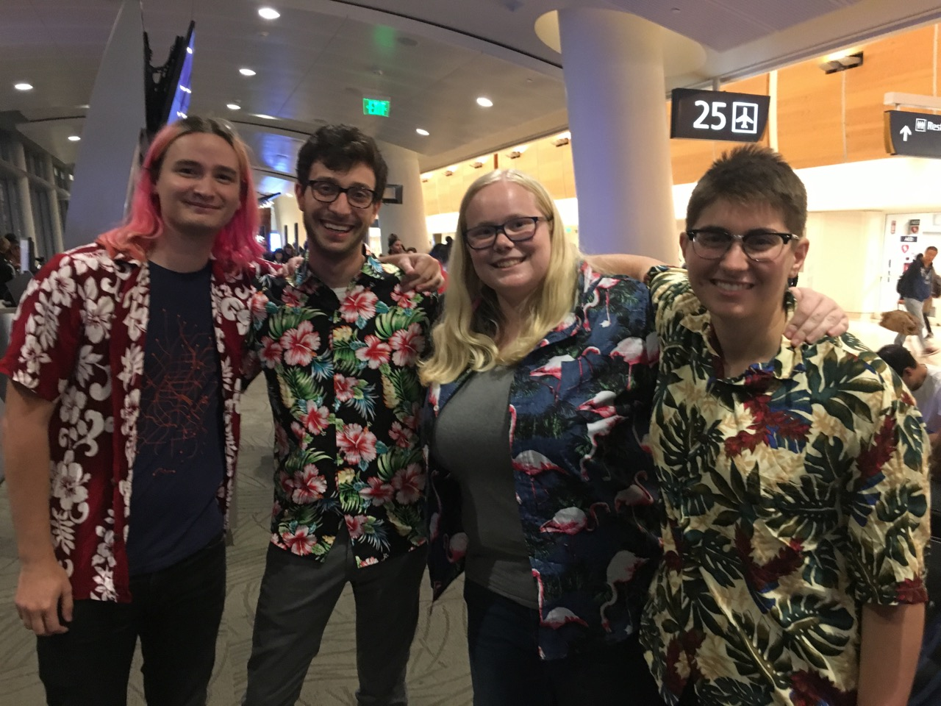
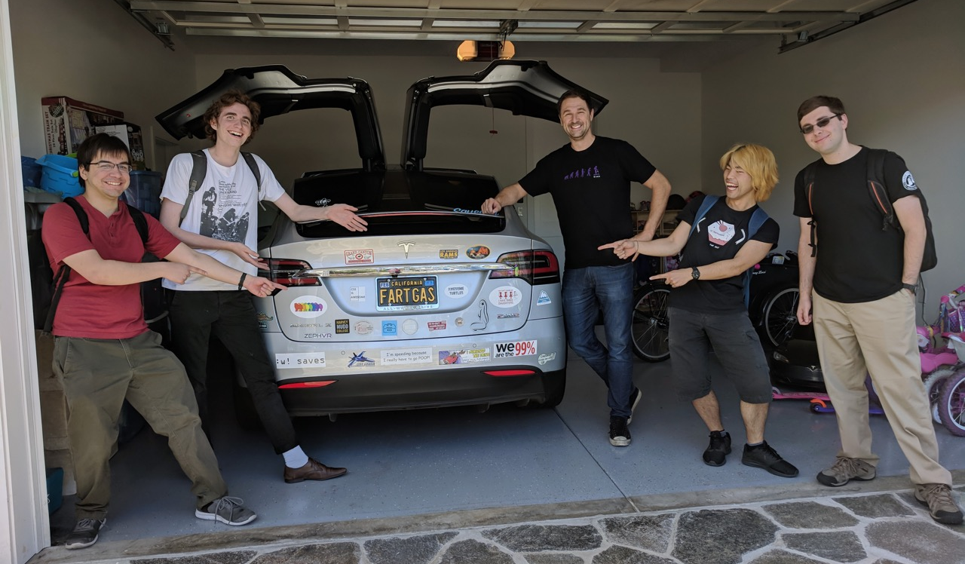
What is Clinic?
Sponsored capstone-project course (taken by all senior CS majors)
10+ hrs / student / week (1200-1500 hours in total)
Starts in September, ends in May
Sponsors own all IP
Team of 4-5 students, delivering on an open-ended project
Pure Storage: file-system capabilities
Jones Parking: targeted start-up-teaming

Slide 8
Clinic Sponsor Commitment
Project Statement
1-2 pages ~ sponsor, vision, problem, deliverables
Business Agreement
~3 pages, responsive, confidentiality as desired
Feedback
Liaison(s)
Approximately 1-2 hours per week ~ "Aligner"
Fee
$52,000 (divided into three payments)
Throughout. Externally, at the project’s end

Slide 9
Clinic Timeline Key Dates: 2019-2020
May 2019 Business Agreement Signed
Aug 1, 2019 Projects opened to students
Sep 5, 2019 Launch Day @ HMC
May 5, 2020 Projects Day @ HMC
Winter ~ Spring Project Statement developed
Notes:
Now-April Project statement
May-June Business Agreement
August Students rank projects; teams formed
September Launch Day
Spring Term Mid-term Reports
May Projects Day

Slide 10
Value to Sponsors
80% of 2017-18 clinic sponsors said that their project was “a success”
In 2018, 5 patent disclosures were reported by Clinic sponsors
More than 60% of 2017-18 sponsors estimated the value of their project to their company at $100,000 or more
highest ~ $1.5 m

Slide 11
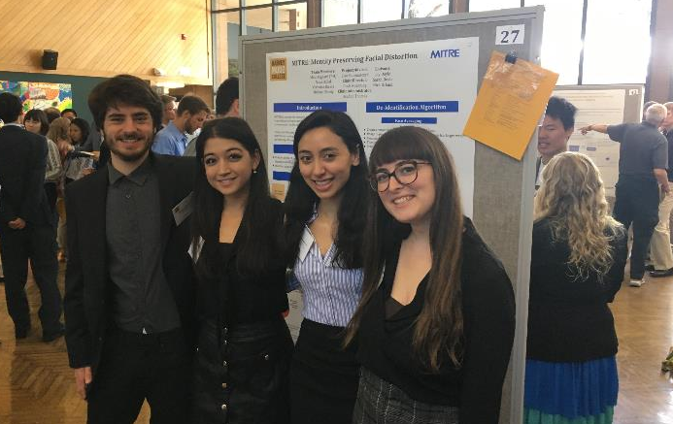
Value to Sponsors & Students
MITRE’s team and poster @ Projects Day. Recruiting / Re-visioning
Notes:
Michael Sheely: clinic sponsor (Google)
Nava Dalal: clinic sponsor (Laserfiche)
Veronica Rivera: UCSC
Madi Pignetti: clinic sponsor (Intuit)
MITRE: re-visioned and re-envisioned perifacial recognition – and did not hire any of these four, but hired an HMCer that year (Eric Harley)

Slide 12
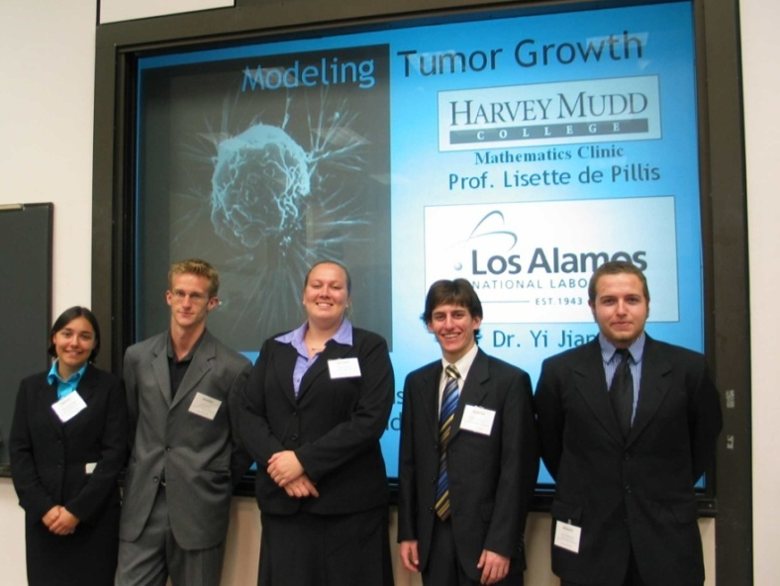
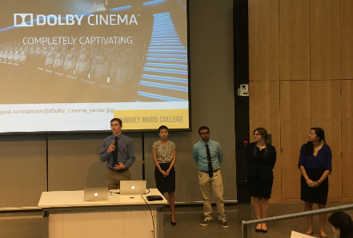
Value to Sponsors & Students
Final presentations @ Projects Day. Collaboration breadth
then (2006)
now

Slide 13
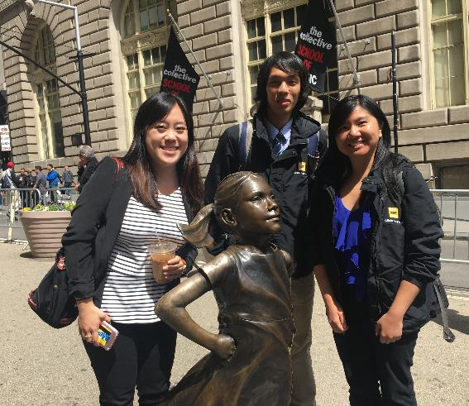
Value to Sponsors & Students
¾ of AmEx’s team @ NYC site visit
Experience + Engagement
Notes:
Christine Chen, Yacht Kitimoon, Alyssa Kubota (John!)

Slide 14
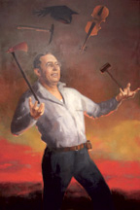
Mudders: bright, inventive, fearless
Highly Selective Liberal Arts College
886 students
87% of incoming students were top 10%
Competition: Stanford, MIT, Caltech
Siblings: CMC, Scripps, Pitzer, Pomona
30% of seniors go directly to graduate school
Ranked #2 for science + engineering Ph.D.s
Harvey S. Mudd mining engineer
Source: Office of Institutional Research and Effectiveness, Harvey Mudd College
Notes:
Highly Selective Liberal Arts College is the Carnegie Classification based on SATs/ACTs and other factors
92% graduation rate is the SIX year rate. FOUR year rate is 84%. I took this out as I don’t think it’s really relevant.
#2 ranking for PHD is from NCES – National Center for Education Statistics

Slide 15
Mudders: bright, inventive, fearless
U.S. News and World Report
#1 – Engineering ~ undergrad
#3 – Campus Ethnic Diversity
#18 – Liberal Arts Colleges
Princeton Review
#3 – “Students Study the Most”
#3 – “Most Accessible Professors”
Forbes 2018
#3 – Top 25 STEM Colleges
#5 – Top Liberal Arts Colleges

Slide 16
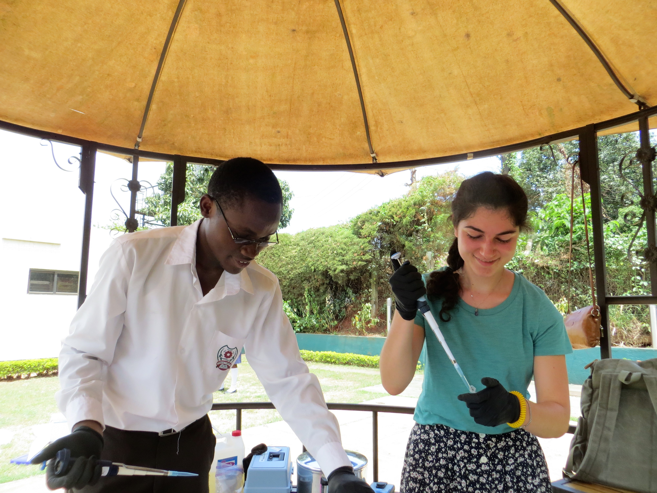
Engaged in the world
Global Clinic
1-2 projects per year
International partner (corporate/NGO)
Academic partner
Social Justice Clinics
New in 2018
Non-profit partners
Social impact through technology ~ with a clear understanding of the impact of their work on society
The CareFusion Clinic Team designed, built and tested a low-cost, high-performance IV infusion delivery system specifically targeting developing healthcare markets.

Slide 17
Past clinics ~ areas of focus
Explore, prototype & align new, emerging ideas
Computer Science
Engineering
Data science, modeling, analysis
User experience: UI/UX development
Machine Learning of all sorts
(Deep) NN and AI / Robotics
Image processing and Computer vision
Threat detection, Cybersecurity
Algorithm development and assessment
Domain-specific programming languages
Workflow and work-process
+ Streamlining, re-engineering
Investigative software engineering
Design & testing
Mechanical/Structural
Embedded Processing
Robotics
Systems & Signals, Controls
Biomedical
Aerospace, automotive
Manufacturing, process engineering
Materials
Chemical
Energy & Environment

Slide 18
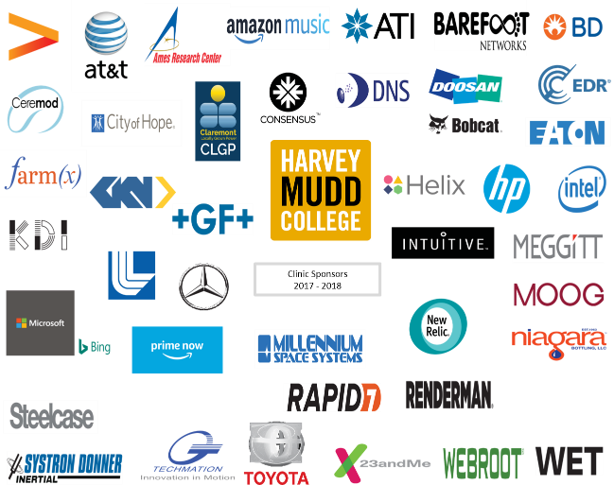
2017-2018 Sponsors
Clinic Sponsors
2017-2018

Slide 19
Projects … Possible Paths
Speculative unerased-whiteboard opportunities
" If we had one more FTE… or team ” (to manage)
Valuable, not critical-path
There’s no typical Clinic project:
" R + D for our R & D "
" Optimizing – along a new axis "
" Exploring hackathons’ 2-5% ideas "
" A start-up – internally incubated… "
Thoughts?

Slide 20
2017-2018 Sponsors
Clinic Sponsors
2017-2018

Slide 21
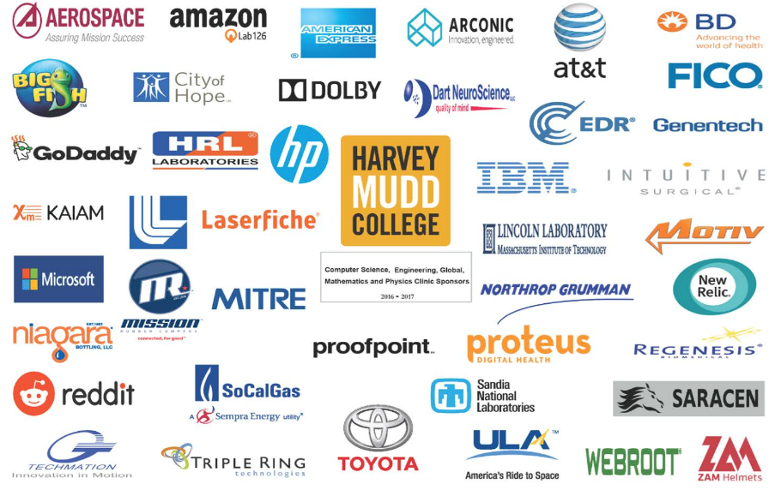
2016-2017 Sponsors

Slide 22
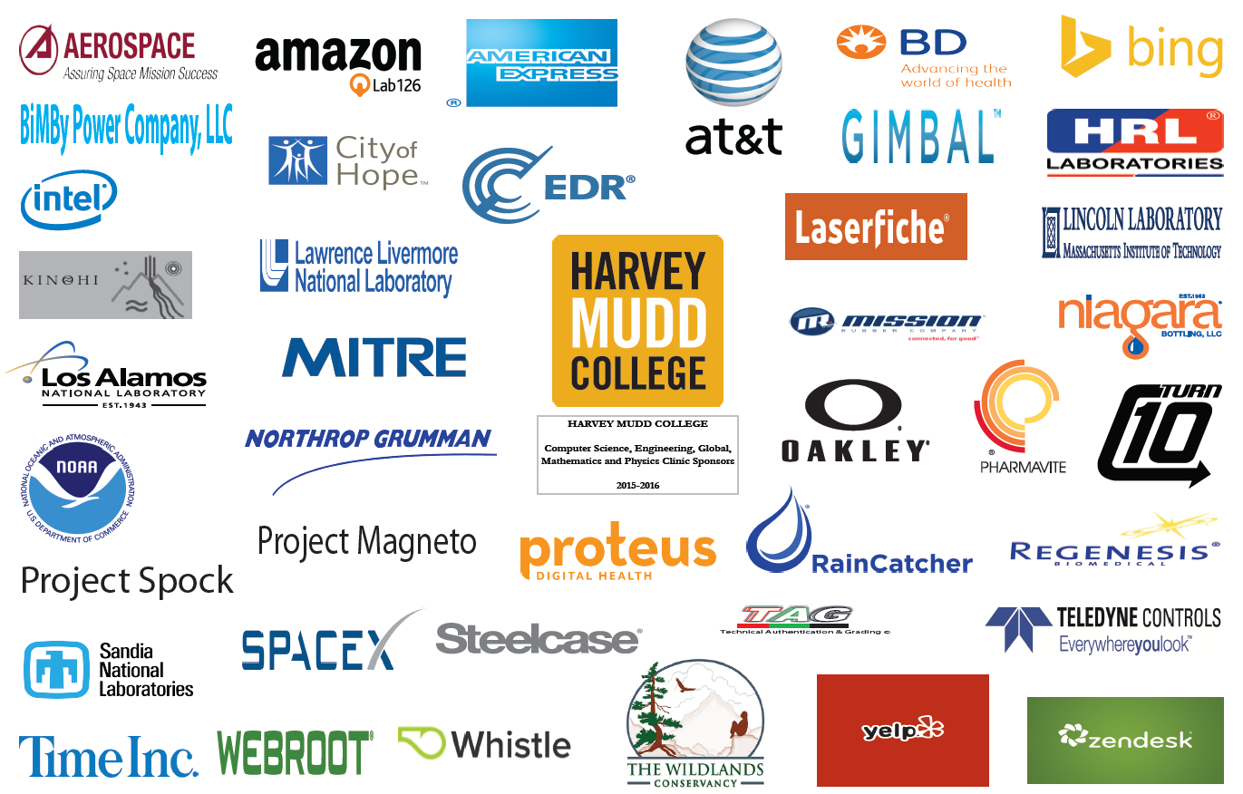
2015-2016 Sponsors

Slide 23
More information
hmc.edu/clinic
clinic@hmc.edu

Slide 24
The remaining slides provide additional context – they’re not part of our in-person presentations, unless they turn out to help…

Slide 25
The Year’s End: Projects Day
GoDaddy team’s presentation
Notes:
Statement of Work
- Defines scope of project and
deliverables.
Additionally, we encourage each Clinic team to visit the sponsor’s site early in the project to gain a better sense of the goals and purpose of the project.
Early in the spring semester, the Clinic Director, faculty advisor and project liaison meet via teleconference to discuss the progress of the team and the sponsor’s satisfaction with the project.

Slide 26
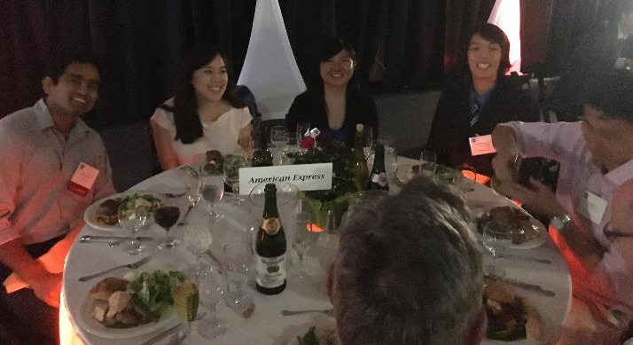
Year’s End: Projects Day
AmEx
team’s dinner
Notes:
Statement of Work
- Defines scope of project and
deliverables.
Additionally, we encourage each Clinic team to visit the sponsor’s site early in the project to gain a better sense of the goals and purpose of the project.
Early in the spring semester, the Clinic Director, faculty advisor and project liaison meet via teleconference to discuss the progress of the team and the sponsor’s satisfaction with the project.

Slide 27
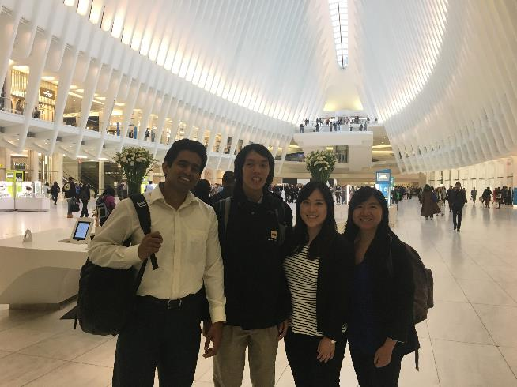
and beyond…
AmEx
team’s visit
Notes:
Statement of Work
- Defines scope of project and
deliverables.
Additionally, we encourage each Clinic team to visit the sponsor’s site early in the project to gain a better sense of the goals and purpose of the project.
Early in the spring semester, the Clinic Director, faculty advisor and project liaison meet via teleconference to discuss the progress of the team and the sponsor’s satisfaction with the project.

Slide 28
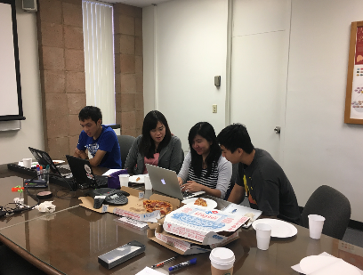
The Year’s Rhythms: Orientation Day
Liaisons invited to campus
Meet with Clinic Director
Strategies and tips
Meet with team and faculty advisor
Cover problem in detail
Discuss confidentiality
Establish communication routine
Email/Slack/other
Weekly teleconferences
Jumpstart the project, face-to-face
Recruiting / internship opportunity
inside a weekly telecon

Slide 29
Example clinic projects
MIT LL Imaging team
https://docs.google.com/presentation/d/1i1w64U9TUIs7Cu9DL54dSbwAYB_Dioh34CpD4KX3itE/edit#slide=id.g4ab22172e9_0_2

Slide 30
Mudd: depth, rigor, and breadth
Major requirements
10 HSA (Humanities, Social Sciences, and the Arts)
Common Core
HMC’s Common Core (semesters)
1 | Biology (+ associated lab)
1.5 | Chemistry (+ associated lab)
1++ | Computer Science
1 | Engineering
1 | Critical Inquiry (Humanities, Social Sciences, and the Arts)
3 | Mathematics
2.5 | Physics (+ associated lab)
.5 | Writing
Notes:
HSA requirements are not part of the Core

Slide 31
Past clinics: areas of focus
Mathematics
Physics and Biology
Process analytics
Data science
Neural networks
Pricing modeling and optimization
Data mining
Quantum processing
Nanoparticles
Optics
Photovoltaics

