Slide 1
Computer Systems
Introduction
CS 105
“Tour of the Black Holes of Computing!”
Geoff Kuenning
Spring 2022
Topics:
  Class Introduction
  Data Representation

Slide 2
Living on Zoom
Not again! Let’s hope it’s brief…
I try to keep the sessions as free as possible
  No waiting rooms so you can join early and talk to each other
PowerPoint and PDF versions of slides will be pre-posted
  Use them to take notes if you wish
  See calendar page on class site: https://www.cs.hmc.edu/~geoff/cs105
  Remind me at beginning of class if I forget (sometimes I do)
Please be visible and interactive!
  Sign in with your actual name
  Zoom discourages questions and chatting
    Please fight that tendency
    Avoid all those tempting distractions
  Seeing you helps me teach better
    I know some of you have bandwidth problems, but…

Slide 3
Course Theme
  Abstraction is good, but don’t forget reality!
Many CS Courses emphasize abstraction
  Abstract data types
  Asymptotic analysis
These abstractions have limits
  Especially in the presence of bugs
  Need to understand underlying implementations
Useful outcomes
  Become more effective programmers
    Able to find and eliminate bugs efficiently
    Able to tune program performance
  Prepare for later “systems” classes in CS
    Compilers, Operating Systems, File Systems, Computer Architecture, Robotics, etc.

Slide 4
Textbooks
Randal E. Bryant and David R. O’Hallaron,
  “Computer Systems: A Programmer’s Perspective”, 3rd Edition, Prentice Hall, 2015.
  Note: The “International Edition” is different. Watch out!
Brian Kernighan and Dennis Ritchie,
  “The C Programming Language, Second Edition”, Prentice Hall, 1988
Larry Miller and Alex Quilici
  The Joy of C, Wiley, 1997

Slide 5
Syllabus
  Syllabus on Web: https://www.cs.hmc.edu/~geoff/cs105
  Calendar defines due dates
    Also has links to slides and labs
  Labs: cs105submit for some, others have specific directions

Slide 6
Notes:
Work groups
  You must work in pairs on all labs
  Honor-code violation to work without your partner!
  Corollary: showing up late doesn’t harm only you
Handins
  Check calendar for due dates
  Electronic submissions only
Grading Characteristics
  Lab scores tend to be high
    Serious handicap if you don’t hand a lab in
  Tests & quizzes typically have a wider range of scores
    I.e., they’re have major effect on your grade
      …but not the ONLY one
  Do your share of lab work and reading, or bomb tests
  Do practice problems in book

Slide 7
Facilities
Assignments will use Intel computer systems
  Not all machines are created alike
    Performance varies (and matters sometimes in 105)
    Security settings vary and can matter
  Wilkes: x86/Linux specifically set up for this class
  Log in on a lab Mac, then ssh to Wilkes
    If you want fancy programs, start X11 first
    Directories are cross-mounted, so you can edit on Knuth or your Mac, and Wilkes will see your files
  …or ssh into Wilkes from wherever you are
  All programs must run on Wilkes: we grade there
  Have lecture slides (and textbook) available when working on labs!

Slide 8
CS 105
“Tour of the Black Holes of Computing”
Bits, Bytes, Integers
Topics
  Representing information as bits
  Bit-level manipulations
  Integers
    Representation, unsigned and signed
    Conversion, Casting
    Expanding, truncating
    Addition, negation, multiplication, shifting
  Representations in memory, pointers, strings
CS 105

Slide 9
Everything is bits
Each bit is 0 or 1
By encoding/interpreting sets of bits in various ways
  Computers determine what to do (instructions)
  … and represent and manipulate numbers, sets, strings, etc…
Why bits? Electronic implementation
  Easy to store with bistable elements
  Reliably transmitted on noisy and inaccurate wires
0
1
0
1.1V
0.9V
0.2V
0.0V

Slide 10
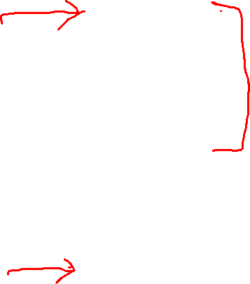
Encoding Byte Values
Byte = 8 bits
  Binary 000000002 to 111111112
  Decimal: 010 to 25510
  Hexadecimal 0016 to FF16
    Base 16 number representation
    Use characters ‘0’ to ‘9’ and ‘A’ to ‘F’
    Write FA1D37B16 in C as
      0xFA1D37B
      0xfa1d37b
Decimal
Hex
Binary
0
0
0000
1
1
0001
2
2
0010
3
3
0011
4
4
0100
5
5
0101
6
6
0110
7
7
0111
8
8
1000
9
9
1001
A
10
1010
B
11
1011
C
12
1100
D
13
1101
E
14
1110
F
15
1111

Slide 11
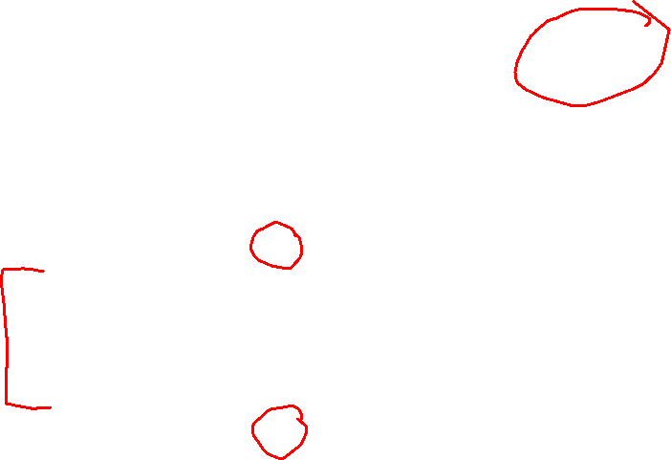
Example Data Sizes
C Data Type | Typical 32-bit | Typical 64-bit | x86-64
char | 1 | 1 | 1
short | 2 | 2 | 2
int | 4 | 4 | 4
long | 4 | 8 | 8
float | 4 | 4 | 4
double | 8 | 8 | 8
long double | − | − | 10/16
pointer | 4 | 8 | 8

Slide 12
Boolean Algebra
Developed by George Boole in 19th century
  Algebraic representation of logic
    Encode “True” as 1 and “False” as 0
And
A&B = 1 when both A=1 and B=1
Or
A|B = 1 when either A=1 or B=1
A B A&B
0 0 0
0 1 0
1 0 0
1 1 1
A B A|B
0 0 0
0 1 1
1 0 1
1 1 1
Not
~A = 1 when A=0
Exclusive-Or (Xor)
A^B = 1 when either A=1 or B=1, but not both
A ~A
0 1
1 0
A B A^B
0 0 0
0 1 1
1 0 1
1 1 0

Slide 13
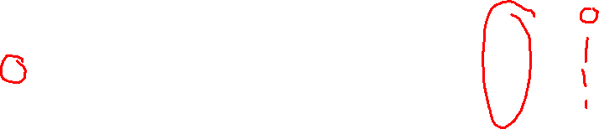
Fancier Boolean Algebra
What is A&~B?
How about ~(~A&~B)?
A B A&~B
0 0 0
0 1 0
1 0 1
1 1 0
A B ~A ~B (~A&~B) ~(~A&~B) A|B
0 0 1 1 1 0
0 1 1 0 0 1
1 0 0 1 0 1
1 1 0 0 0 1

Slide 14

Grouped Boolean Operations
Operate on bit vectors
  Operations applied bitwise
All of the properties of Boolean algebra apply
01101001
& 01010101
01000001
01101001
| 01010101
01111101
01101001
^ 01010101
00111100
~ 01010101
10101010
01000001
01111101
00111100
10101010
Notes:
This slide has an animation to bring up the answers one at a time.

Slide 15

Bit-Level Operations in C
Operations &, |, ~, ^ available in C
  Apply to any “integral” data type
    long, int, short, char, unsigned
  View arguments as bit vectors
  Operations applied bit-wise
Examples (char data type)
  ~0x41 → 0xBE
    ~010000012 → 101111102
  ~0x00 → 0xFF
    ~000000002 → 111111112
  0x69 & 0x55 → 0x41
    011010012 & 010101012 → 010000012
  0x69 | 0x55 → 0x7D
    011010012 | 010101012 → 011111012

Slide 16

Example: Representing & Manipulating Sets
Representation
  Width w bit vector represents subsets of {0, …, w–1}
  a_{j} = 1 if j ∈ A
    01101001 { 0, 3, 5, 6 }
    76543210
    01010101 { 0, 2, 4, 6 }
    76543210
Operations
  & Intersection 01000001 { 0, 6 }
  | Union 01111101 { 0, 2, 3, 4, 5, 6 }
  ^ Symmetric difference 00111100 { 2, 3, 4, 5 }
  ~ Complement 10101010 { 1, 3, 5, 7 }

Slide 17
Contrast: Logic Operations in C
Contrast to Logical Operators
  &&, ||, !
    View 0 as “False”
    Anything nonzero seen as “True”
    Always return 0 or 1
    Early termination
Examples (char data type)
  !0x41 → 0x00
  !0x00 → 0x01
  !!0x41 → 0x01
  0x69 && 0x55 → 0x01
  0x69 || 0x55 → 0x01
  p != 0 && *p (unreadably avoids null pointer access)

Slide 18
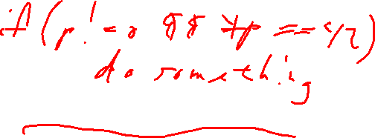
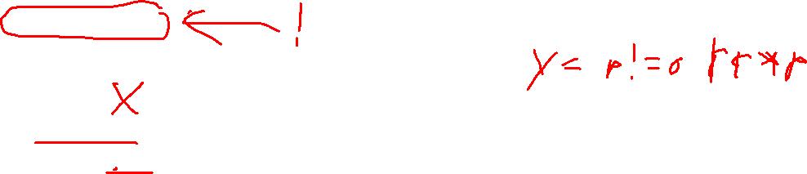
Contrast: Logic Operations in C
Watch out for && vs. &
(and || vs. |)…
One of the more common oopsies in
C programming
Contrast to Logical Operators
  &&, ||, !
    View 0 as “False”
    Anything nonzero as “True”
    ! always returns 0 or 1; && and || return last value evaluated
    Early termination
Examples (char data type)
  !0x41 → 0x00
  !0x00 → 0x01
  !!0x41 → 0x01
  0x69 && 0x55 → 0x01
  0x69 || 0x55 → 0x01
  p != 0 && *p (unreadably avoids null pointer access, used in conditionals)
    p != NULL && *p (very slightly better)
Notes:
This slide has an animation to bring up the “oopsies” balloon.

Slide 19
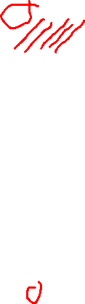
Shift Operations
Left Shift: x << y
  Shift bit-vector x left y positions
      Throw away extra bits on left
    Fill with 0’s on right
Right Shift: x >> y
  Shift bit-vector x right y positions
    Throw away extra bits on right
  Logical shift
    Fill with 0’s on left
  Arithmetic shift
    Replicate most significant bit on left
Undefined Behavior
  Shift amount < 0 or ≥ word size
Argument x
01100010
<< 3
00010000
00010000
00010000
Log. >> 2
00011000
00011000
00011000
Arith. >> 2
00011000
00011000
00011000
Argument x
10100010
<< 3
00010000
00010000
00010000
Log. >> 2
00101000
00101000
00101000
Arith. >> 2
11101000
11101000
11101000
Notes:
This slide has multiple animations; each first brings up the shifted bits and then the fill bits.

Slide 20
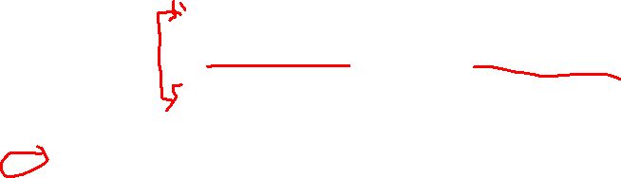
C Puzzles
  Taken from old exams
  Assume machine with 32-bit word size, two’s complement integers
  For each of the following C expressions, either:
    Argue that it is true for all argument values, or
    Give example where it is not true
x < 0 ⇒ ((x*2) < 0)
ux >= 0
x & 7 == 7 ⇒ (x<<30) < 0
ux > -1
x > y ⇒ -x < -y
x * x >= 0
x > 0 && y > 0 ⇒ x + y > 0
x >= 0 ⇒ -x <= 0
x <= 0 ⇒ -x >= 0
Initialization
int x = foo();
int y = bar();
unsigned ux = x;
unsigned uy = y;
Notes:
This slide has an animation that highlights the three true instances in light blue. Don’t explain them now.

Slide 21
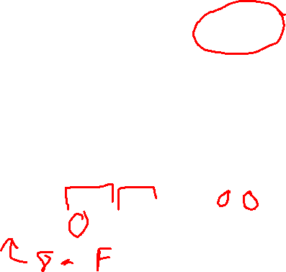
Encoding Integers
Unsigned
Two’s Complement
short int x = 15213;
short int y = -15213;
Sign Bit
  C short (2 bytes long)
Sign Bit
  For 2’s complement, most-significant bit indicates sign
    0 for nonnegative
    1 for negative

Slide 22

Encoding Integers (Cont.)
x = 15213: 00111011 01101101
y = -15213: 11000100 10010011

Slide 23
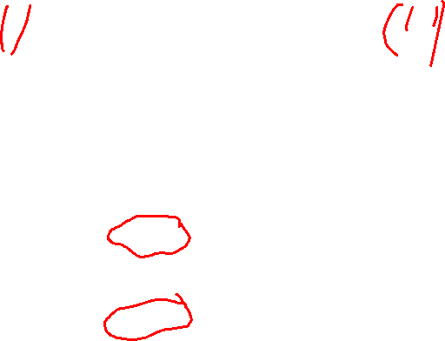
Numeric Ranges
Unsigned Values
  UMin = 0
    000…0
  UMax = 2^{w} – 1
    111…1
Two’s-Complement Values
  TMin = –2^{w–1}
    100…0
  TMax = 2^{w–1} – 1
    011…1
Other Values
  Minus 1
    111…1
Values for W = 16
Notes:
First day ended here

Slide 24
Values for Different Word Sizes
Observations
  |TMin | = TMax + 1
    Asymmetric range
  UMax = 2 * TMax + 1
C Programming
  #include <limits.h>
    K&R Appendix B11
  Declares constants, e.g.,
    ULONG_MAX
    LONG_MAX
    LONG_MIN
  Values platform-specific

Slide 25
A Critical Detail
No self-identifying data
  Looking at a bunch of bits doesn’t tell you what they mean
  Could be signed, unsigned integer
  Could be floating-point number
  Could be part of a string
Only the program (instructions) knows for sure!
  (To be fair, experienced humans can make good guesses—see Lab 2)
Notes:
Fall ‘19 stopped here on day 1.

Slide 26
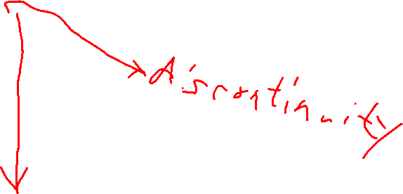
Unsigned & Signed Numeric Values
X
B2U(X)
B2T(X)
Equivalence
  Same encodings for nonnegative values
Uniqueness
  Every bit pattern represents unique integer value
  Each representable integer has unique bit encoding
0000
0
0
0001
1
1
0010
2
2
0011
3
3
0100
4
4
0101
5
5
0110
6
6
0111
7
7
1000
8
–8
1001
9
–7
1010
10
–6
1011
11
–5
1100
12
–4
1101
13
–3
1110
14
–2
1111
15
–1

Slide 27
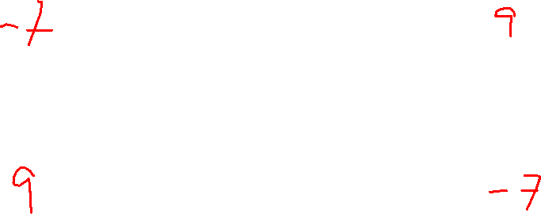
Mapping Between Signed & Unsigned
Mappings between unsigned and two’s complement numbers:
Keep bit representations and reinterpret
Two’s Complement
Unsigned
T2U
x
T2B
B2U
ux
X
Maintain Same Bit Pattern
Unsigned
U2T
Two’s Complement
ux
U2B
B2T
x
X
Maintain Same Bit Pattern

Slide 28
Mapping Signed ↔ Unsigned
Bits
0000
0001
0010
0011
0100
0101
0110
0111
1000
1001
1010
1011
1100
1101
1110
1111
Signed
0
1
2
3
4
5
6
7
-8
-7
-6
-5
-4
-3
-2
-1
Unsigned
0
1
2
3
4
5
6
7
8
9
10
11
12
13
14
15
T2U
U2T

Slide 29
Mapping Signed ↔ Unsigned
Bits
0000
0001
0010
0011
0100
0101
0110
0111
1000
1001
1010
1011
1100
1101
1110
1111
Signed
0
1
2
3
4
5
6
7
-8
-7
-6
-5
-4
-3
-2
-1
Unsigned
0
1
2
3
4
5
6
7
8
9
10
11
12
13
14
15
=
+/- 16

Slide 30

Relation Between Signed & Unsigned
Two’s Complement
Unsigned
T2U
x
T2B
B2U
ux
X
Maintain Same Bit Pattern
w–1
0
ux
+
+
+
• • •
+
+
+
x
-
+
+
• • •
+
+
+
Large negative weight
becomes
Large positive weight

Slide 31
Conversion Visualized
2’s Comp. → Unsigned
  Ordering Inversion
  Negative → Big Positive
UMax
UMax – 1
TMax + 1
Unsigned
Range
TMax
TMax
2’s Complement Range
0
0
–1
–2
TMin

Slide 32

Casting Signed to Unsigned
C Allows Conversions from Signed to Unsigned
Resulting Value
  No change in bit representation
  Nonnegative values unchanged
    ux = 15213
  Negative values change into (large) positive values!
    uy = 50323
short int x = 15213;
unsigned short int ux = (unsigned short) x;
short int y = -15213;
unsigned short int uy = (unsigned short) y;

Slide 33
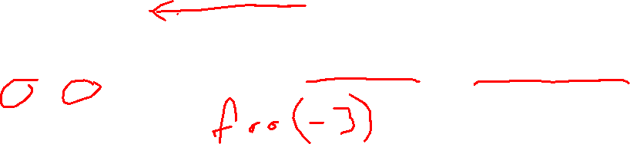
Signed vs. Unsigned in C
Integer Constants
  By default are considered to be signed integers
    Exception: unsigned, if too big to be signed but fit in unsigned
  Unsigned if have “U” as suffix
    0U, 4294967259u
Casting
  Explicit casting between signed & unsigned same as U2T and T2U
    int tx, ty;
    unsigned ux, uy;
    tx = (int)ux;
    uy = (unsigned)ty;
  Implicit casting also occurs via assignments and procedure calls
    tx = ux;
    uy = ty;
lowercase is better here

Slide 34
Casting Surprises
Expression Evaluation
  If you mix unsigned and signed in single expression, signed values are implicitly cast to unsigned
  Including comparison operations <, >, ==, <=, >=
  Examples for W = 32
Constant₁ Constant₂ Relation Evaluation
  0 0u
  -1 0
  -1 0u
  2147483647 -2147483648
  2147483647u -2147483648
  -1 -2
  (unsigned)-1 -2
  2147483647 2147483648u
  2147483647 (int)2147483648u

Slide 35
Casting Surprises
Expression Evaluation
  If you mix unsigned and signed in single expression, signed values are implicitly cast to unsigned
  Including comparison operations <, >, ==, <=, >=
  Examples for W = 32
Constant₁ Constant₂ Relation Evaluation
  0 0u
  -1 0
  -1 0u
  2147483647 -2147483648
  2147483647u -2147483648
  -1 -2
  (unsigned)-1 -2
  2147483647 2147483648u
  2147483647 (int)2147483648u
  == unsigned
  < signed
  > unsigned
  > signed
  < unsigned
  > signed
  > unsigned
  < unsigned
  > signed
Notes:
This slide has animations that bring up the answers one by one. The handout doesn’t have the answers.

Slide 36
Summary: Casting Signed ↔ Unsigned: Basic Rules
Bit pattern is maintained—but reinterpreted
Can have unexpected effects: adding or subtracting 2^{w}
In expression containing signed and unsigned int:
  int is cast to unsigned!!

Slide 37
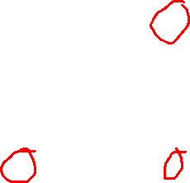
Sign Extension
Task:
  Given w-bit signed integer x
  Convert it to w+k-bit integer with same value
Rule:
  Make k copies of sign bit:
  X ′ = x_{w–1} ,…, x_{w–1} , x_{w–1} , x_{w–2} ,…, x₀
k copies of MSB
w
X
• • •
• • •
X ′
• • •
• • •
k
w

Slide 38
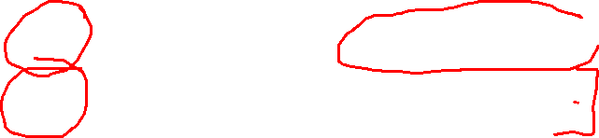
Sign Extension Example
short int x = 15213;
int ix = (int)x;
short int y = -15213;
int iy = (int)y;
  Converting from smaller to larger integer data type
  C automatically performs sign extension
Decimal
Hex
Binary
x
15213
3B 6D
00111011 01101101
ix
15213
00 00 3B 6D
00000000 00000000 00111011 01101101
y
-15213
C4 93
11000100 10010011
iy
-15213
FF FF C4 93
11111111 11111111 11000100 10010011

Slide 39

Negating with Complement & Increment
Claim: Following holds for 2’s complement
  ~x + 1 == -x
Complement
  Observation: ~x + x == 1111…11₂ == -1
Increment
  ~x + x + (-x + 1) == -1 + (-x + 1)
  ~x + 1 == -x
Warning: Be cautious treating int’s as integers
  OK here (associativity and commutativity hold)
x
1
0
0
1
1
1
0
1
+
~x
0
1
1
0
0
0
1
0
-1
1
1
1
1
1
1
1
1
Notes:
The cancellations (each), result, and warning are animated.

Slide 40
Unsigned Addition
u
Standard Addition Function
  Ignores carry output
Implements Modular Arithmetic
  s = UAdd_{w}(u , v) = u + v mod 2^{w}
Operands: w bits
• • •
+
v
• • •
True Sum: w+1 bits
u + v
• • •
Discard Carry: w bits
UAdd_{w}(u , v)
• • •

Slide 41

Two’s-Complement Addition
u
TAdd and UAdd have identical bit-level behavior
  Signed vs. unsigned addition in C:
  int s, t, u, v;
  s = (int) ((unsigned)u + (unsigned)v);
  t = u + v
  Will give s == t
Operands: w bits
• • •
+
v
• • •
True Sum: w+1 bits
u + v
• • •
Discard Carry: w bits
TAdd_{w}(u , v)
• • •

Slide 42
Detecting 2’s-Complement Overflow
Task
  Given s = TAdd_{w}(u , v)
  Determine if s = Add_{w}(u , v)
  Example
  int s, u, v;
  s = u + v;
Claim
  Overflow iff either:
    u, v < 0, s ≥ 0 (NegOver)
    u, v ≥ 0, s < 0 (PosOver)
2^{w}–1
PosOver
2^{w –1}
0
NegOver

Slide 43
A Fun Fact
Official C standard says overflow is “undefined”
  Intention was to let machine define what happens
Recently ISO C committee and compiler writers have decided “undefined” means “compiler gets to choose”
  Can generate 0, biggest integer, or anything else
  Or if compiler is sure it’ll overflow, it can optimize out completely
  Generates faster—but wrong!—code
  This can introduce some lovely bugs (e.g., it’s tricky to check for overflow)
Fight between compiler community and OS/security community over this issue
Notes:
Fall ‘19 finished Day 2 here
Different hardware algorithms are needed for signed and unsigned.

Slide 44

Multiplication
Computing exact product of w-bit numbers x, y
  Either signed or unsigned
Ranges
  Unsigned: 0 ≤ x * y ≤ (2^{w} – 1) ² = 2^{2w} – 2^{w+1} + 1
    Up to 2w bits
  Two’s complement min: x * y ≥ (–2^{w–1})*(2^{w–1}–1) = –2^{2w–2} + 2^{w–1}
    Up to 2w–1 bits (including 1 for sign)
  Two’s complement max: x * y ≤ (–2^{w–1}) ² = 2^{2w–2}
    Up to 2w bits, but only for (TMin_{w})²
Maintaining exact results
  Would need to keep expanding word size with each product computed
  Done in software by “arbitrary-precision” arithmetic packages
Notes:
(Slightly) different hardware algorithms are needed to get full-width products for signed and unsigned. But the same hardware can calculate truncated products.
Tmin*Tmin produces a product that needs 2w-1 bits (2w-1 bits can only represent 2**(2w-2)-1). You also need a bit for the sign, so 2w total.

Slide 45
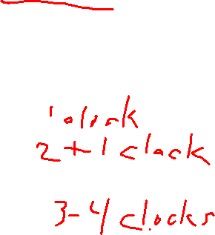
Power-of-2 Multiply by Shifting
Operation
  u << k gives u * 2^{k}
  Both signed and unsigned
Examples
  u << 3 == u * 8
  u << 5 - u << 3 == u * 24
  Most machines shift and add much faster than multiply
    Compiler generates this code automatically
k
u
• • •
Operands: w bits
*
2^{k}
0
•••
0
1
0
•••
0
0
True Product: w+k bits
u · 2^{k}
• • •
0
•••
0
0
Discard k bits: w bits
UMult_{w}(u , 2^{k})
•••
0
•••
0
0
TMult_{w}(u , 2^{k})

Slide 46
Unsigned Power-of-2 Divide by Shifting
Quotient of unsigned by power of 2
  u >> k gives ⎣ u / 2^{k} ⎦
  Uses logical shift
k
u
•••
•••
Binary Point
Operands:
/
2^{k}
0
•••
0
1
0
•••
0
0
Division:
u / 2^{k}
0
•••
•••
.
•••
Result:
⎣ u / 2^{k} ⎦
0
•••
•••

Slide 47
Arithmetic: Basic Rules
Addition:
  Unsigned/signed: Normal addition followed by truncate;
  same operation on bit level
  Unsigned: addition mod 2^{w}
    Mathematical addition + possible subtraction of 2^{w}
  Signed: modified addition mod 2^{w} (result in proper range)
    Mathematical addition + possible addition or subtraction of 2^{w}
Multiplication:
  Unsigned/signed: Normal multiplication followed by truncate; same operation on bit level
  Unsigned: multiplication mod 2^{w}
  Signed: modified multiplication mod 2^{w} (result in range -2^{w-1} to 2^{w-1}-1)

Slide 48
Why Should I Use Unsigned?
Don’t use without understanding implications
  Easy to make mistakes
    unsigned i;
    for (i = cnt - 2; i >= 0; i--)
    a[i] += a[i + 1];
  Can be very subtle
    #define DELTA sizeof(int)
    int i;
    for (i = CNT; i - DELTA >= 0; i -= DELTA)
    . . .
Notes:
The first loop creates suffix sums: a[0] = sum(A), a[1] = sum(A[1:]), etc.

Slide 49
Counting Down with Unsigned
Proper way to use unsigned as loop index
    unsigned i;
    for (i = cnt - 2; i < cnt; i--)
    a[i] += a[i + 1];
See Robert Seacord, Secure Coding in C and C++
  C Standard guarantees unsigned addition will behave like modular arithmetic
    0 – 1 → UMax
Even better
    #include <sys/types.h>
    size_t i;
    for (i = cnt - 2; i < cnt; i--)
    a[i] += a[i + 1];
  Data type size_t is unsigned value with length = word size
  Code will work even if cnt = UMax
  But what if cnt is signed and < 0?

Slide 50
Why Should I Use Unsigned? (cont.)
Do Use When Performing Modular Arithmetic
  Multiprecision arithmetic
Do Use When Using Bits to Represent Sets
  Logical right shift, no sign extension
Do Use for Very Large Arrays
  Signed index doesn’t have range
Do Use for Bit Fields
  Need Logical Right Shift
Notes:
Second day ended here

Slide 51
Byte-Oriented Memory Organization
Programs refer to data by address
  Conceptually, envision it as a very large array of bytes
    In reality it’s not, but can think of it that way
  An address is like an index into that array
    …and, a pointer variable stores an address
Note: system provides private address space to each “process”
  Think of a process as a program being executed
  So, a program can clobber its own data, but not that of others
00•••0
FF•••F
• • •

Slide 52
Machine Words
Any given computer has a “word size”
  Nominal size of integer-valued data
    …and of addresses
  Until about 2010, most machines used 32 bits (4 bytes) as word size
    Limits addresses to 4GB (2³² bytes)
  Now most “real” machines (even phones) have 64-bit word size
    Potentially, could have 18 PB (petabytes) of addressable memory
    That’s 18.4 X 10¹⁵
  Machines still support multiple data formats
    Fractions or multiples of word size
    Always integral number of bytes

Slide 53
Word-Oriented Memory Organization
32-bit
Words
64-bit
Words
Bytes
Addr.
Addresses specify byte locations
  Address of first byte in word
  Addresses of successive words differ by 4 (32-bit) or 8 (64-bit)
0000
Addr
=
??
0001
0000
0002
Addr
=
??
0003
0000
0004
Addr
=
??
0005
0004
0006
0007
0008
Addr
=
??
0009
0008
0010
Addr
=
??
0011
0008
0012
Addr
=
??
0013
0012
0014
0015

Slide 54
Byte Ordering
So, how are the bytes within a multi-byte word ordered in memory?
Conventions
  Big Endian: Sun, PPC Mac, Internet
    Most significant byte has lowest address
  Little Endian: x86, ARM processors running Android, iOS, and Windows
    Least significant byte has lowest address

Slide 55
Byte Ordering Example
Example
  Variable x has 4-byte value of 0x01234567
  Address given by &x is 0x100
Big Endian
0x100
0x101
0x102
0x103
01
23
45
67
01
23
45
67
Little Endian
0x100
0x101
0x102
0x103
67
45
23
01
67
45
23
01
This is what we use in 105
And it will drive you nuts!
Notes:
The two balloons are separately animated.

Slide 56
Representing Strings
char s[6] = "15213";
Strings in C
  Represented by array of characters
  Each character encoded in ASCII format
    Standard 7-bit encoding of character set
    Character “0” has code 0x30
      Digit i has code 0x30+i
  String should be null-terminated
    Final character = '\0'
Compatibility
  Byte ordering not an issue (yay!)
IA32
Sun
31
35
32
31
33
00
31
35
32
31
33
00
0x100

