Slide 1
Machine-Level Programming IV:
Structured Data
CS 105
“Tour of the Black Holes of Computing”
Topics
  Arrays
  Structs
  Unions
Notes:
Print full notes pages

Slide 2
Basic Data Types
Integral
  Stored & operated on in general registers
  Signed vs. unsigned depends on instructions used
    Intel GAS Bytes C
    byte b 1 [unsigned] char
    word w 2 [unsigned] short
    double word l 4 [unsigned] int
    quad word q 8 [unsigned] long
Floating Point
  Stored & operated on in floating-point registers (not covered in CS 105)
    Intel GAS Bytes C
    Single s 4 float
    Double l 8 double

Slide 3
Array Allocation
Basic Principle
  T A[L];
  Array of data type T and length L
  Contiguously allocated region of L * sizeof(T) bytes in memory
char string[12];
x
x + 12
int val[5];
x
x + 4
x + 8
x + 12
x + 16
x + 20
double a[3];
x
x + 8
x + 16
x + 24
char *p[3];
x
x + 8
x + 16
x + 24

Slide 4
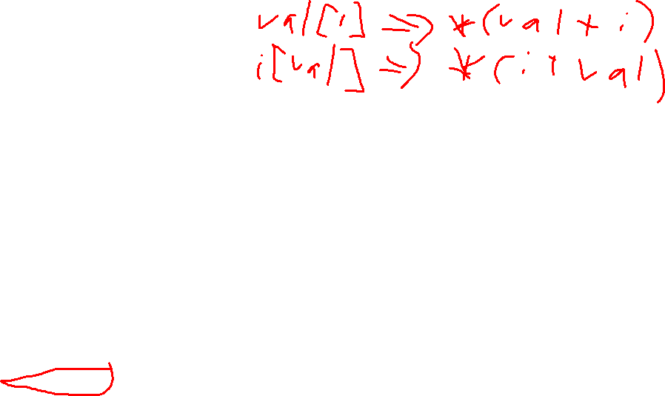
Array Access
Basic Principle
  T A[L];
  Array of data type T and length L
  Identifier A can be used as a pointer to array element 0
Reference Type Value
  val[4] int 3
  val int[5] x (acts like int *)
  val+1 int * x + 4
  &val[2] int * x + 8
  val[5] int ??
  *(val+1) int 5
  val + i int * x + 4 i
int val[5];
1
5
2
1
3
x
x + 4
x + 8
x + 12
x + 16
x + 20

Slide 5
Array Example
int cmu[5] = {1, 5, 2, 1, 3};
int mit[5] = {0, 2, 1, 3, 9};
int hmc[5] = {9, 1, 7, 1, 1};
int cmu[5];
1
5
2
1
3
16
20
24
28
32
36
int mit[5];
0
2
1
3
9
36
40
44
48
52
56
int hmc[5];
9
1
7
1
1
Note:
  Example arrays were allocated in successive 20-byte blocks
    Not guaranteed to happen in general
  Here, [5] could be written as [] because initializer implies size
56
60
64
68
72
76

Slide 6

Array Accessing Example
int cmu[5];
1
5
2
1
3
16
20
24
28
32
36
As argument, size of z doesn’t need to be specified
Register %rdi contains starting address of array
Register %rsi contains array index
Desired digit at %rdi + 4*%rsi
Use memory reference (%rdi,%rsi,4)
int get_digit(int z[], int digit)
{
return z[digit];
}
x86-64
# %rdi = z
# %rsi = digit
movl (%rdi,%rsi,4), %eax # z[digit]

Slide 7
Referencing Examples
int cmu[5];
1
5
2
1
3
16
20
24
28
32
36
int mit[5];
0
2
1
3
9
36
40
44
48
52
56
int hmc[5];
9
1
7
1
1
56
60
64
68
72
76
Code Does Not Do Any Bounds Checking!
Reference Address Value Guaranteed?
  mit[3] 36 + 4* 3 = 48 3
  mit[5] 36 + 4* 5 = 56 9
  mit[-1] 36 + 4*-1 = 32 3
  cmu[15] 16 + 4*15 = 76 ??
  Out-of-range behavior implementation-dependent
    No guaranteed relative allocation of different arrays
Yes
No
No
No
Notes:
Animation brings up answers one by one; answers aren’t on handout.

Slide 8
Referencing Examples
int cmu[5];
1
5
2
1
3
16
20
24
28
32
36
int mit[5];
0
2
1
3
9
36
40
44
48
52
56
int hmc[5];
9
1
7
1
1
56
60
64
68
72
76
Code Does Not Do Any Bounds Checking!
Reference Address Value Guaranteed?
  mit[3] 36 + 4* 3 = 48 3
  mit[5] 36 + 4* 5 = 56 9
  mit[-1] 36 + 4*-1 = 32 3
  cmu[15] 16 + 4*15 = 76 ??
  Out-of-range behavior implementation-dependent
    No guaranteed relative allocation of different arrays

Slide 9
Array Loop Example (-O0 on an old compiler)
void zincr(int z[5])
{
size_t i;
for (i = 0; i < 5; i++)
z[i]++;
}
# %rdi = z
movl $0, %eax # i = 0
jmp .L3 # goto middle
.L4: # loop:
addl $1, (%rdi,%rax,4) # z[i]++
addq $1, %rax # i++
.L3: # middle
cmpq $4, %rax # i:4
jbe .L4 # if <=, goto loop
rep; ret

Slide 10

Array Loop Example (-O1 on current gcc)
void zincr(int z[5])
{
size_t i;
for (i = 0; i < 5; i++)
z[i]++;
}
# %rdi = z
leaq 20(%rdi), %rax # t = &z[5]
.L2: # loop:
addl $1, (%rdi) # (*z)++
addq $4, %rdi # z++
cmpq %rax, %rdi # z : t
jne .L2 # if !=, goto loop
rep ret

Slide 11
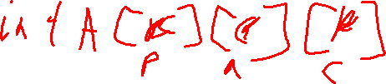
Multidimensional (Nested) Arrays
Declaration
  T A[R][C];
  2D array of data type T
  R rows, C columns
  Type T element requires K bytes
Array Size
  R * C * K bytes
Arrangement
  Row-Major Ordering
A[0][0]
• • •
A[0][C-1]
•
•
•
•
•
•
A[R-1][0]
• • •
A[R-1][C-1]
int A[R][C];
• • •
A
[0]
[0]
A
[0]
[C-1]
• • •
A
[1]
[0]
A
[1]
[C-1]
• • •
• • •
A
[R-1]
[0]
A
[R-1]
[C-1]
4*R*C Bytes
Notes:
Board: show 3D example: a[2][3][2] to illustrate the idea of row major as enumerating indices from right to left

Slide 12
Nested Array Example
#define PCOUNT 4
int pgh[PCOUNT][5] =
{{1, 5, 2, 0, 6},
{1, 5, 2, 1, 3 },
{1, 5, 2, 1, 7 },
{1, 5, 2, 2, 1 }};
1
5
2
0
6
1
5
2
1
3
1
5
2
1
7
1
5
2
2
1
int pgh[4][5];
76
96
116
136
156
Variable pgh: array of 4 elements, allocated contiguously
  Each element is an array of 5 int’s, allocated contiguously
“Row-Major” ordering of all elements in memory

Slide 13

Nested Array Row Access
Row Vectors
  A[i] is array of C elements
  Each element of type T requires K bytes
  Starting address A + i * (C * K)
int A[R][C];
A[0]
A[i]
A[R-1]
• • •
A
[0]
[0]
A
[0]
[C-1]
• • •
• • •
A
[i]
[0]
A
[i]
[C-1]
• • •
• • •
A
[R-1]
[0]
A
[R-1]
[C-1]
A
A+(i*C*4)
A+((R-1)*C*4)

Slide 14

Nested Array Element Access
Array Elements
  A[i][j] is element of type T, which requires K bytes
  Address A + i * (C * K) + j * K = A + (i * C + j) * K
int A[R][C];
A[0]
A[i]
A[R-1]
A
[0]
[0]
• • •
A
[0]
[C-1]
• • •
• • •
• • •
A
[i]
[j]
• • •
A
[R-1]
[0]
• • •
A
[R-1]
[C-1]
A
A+i*C*4
A+(R-1)*C*4
A+(i*C+j)*4

Slide 15
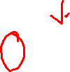
Strange Referencing Examples
1
5
2
0
6
1
5
2
1
3
1
5
2
1
7
1
5
2
2
1
int pgh[4][5];
76
96
116
136
156
Reference Address Value Guaranteed?
  pgh[3][3] 76+20*3+4*3 = 148 2
  pgh[2][5] 76+20*2+4*5 = 136 1
  pgh[2][-1] 76+20*2+4*-1 = 112 3
  pgh[4][-1] 76+20*4+4*-1 = 152 1
  pgh[0][19] 76+20*0+4*19 = 152 1
  pgh[0][-1] 76+20*0+4*-1 = 72 ??
  Code does not do any bounds checking
  Ordering of elements within array guaranteed
Yes
Yes
Yes
Yes
Yes
No
Notes:
Animations pop up answers one by one; handout doesn’t have answers.

Slide 16
Strange Referencing Examples
1
5
2
0
6
1
5
2
1
3
1
5
2
1
7
1
5
2
2
1
int pgh[4][5];
76
96
116
136
156
Reference Address Value Guaranteed?
  pgh[3][3] 76+20*3+4*3 = 148 2
  pgh[2][5] 76+20*2+4*5 = 136 1
  pgh[2][-1] 76+20*2+4*-1 = 112 3
  pgh[4][-1] 76+20*4+4*-1 = 152 1
  pgh[0][19] 76+20*0+4*19 = 152 1
  pgh[0][-1] 76+20*0+4*-1 = 72 ??
  Code does not do any bounds checking
  Ordering of elements within array guaranteed

Slide 17

Multi-Level Array Example
  Variable univ denotes array of 3 elements
  Each element is a pointer
    8 bytes
  Each pointer points to array of int’s
int cmu[] = {1, 5, 2, 1, 3};
int mit[] = {0, 2, 1, 3, 9};
int hmc[] = {9, 1, 7, 1, 1};
#define UCOUNT 3
int *univ[UCOUNT] = {mit, cmu, hmc};
cmu
1
5
2
1
3
univ
160
16
20
24
28
32
36
36
mit
168
0
2
1
3
9
16
hmc
36
40
44
48
52
56
176
56
9
1
7
1
1
56
60
64
68
72
76

Slide 18
Element Access in Multi-Level Array
int get_univ_digit(size_t index, size_t digit)
{
return univ[index][digit];
}
salq $2, %rsi # 4*digit
addq univ(,%rdi,8), %rsi # p = univ[index] + 4*digit
movl (%rsi), %eax # return *p
ret
Computation
  Element access Mem[Mem[univ+8*index]+4*digit]
  Must do two memory reads
    First get pointer to row array
    Then access element within array

Slide 19
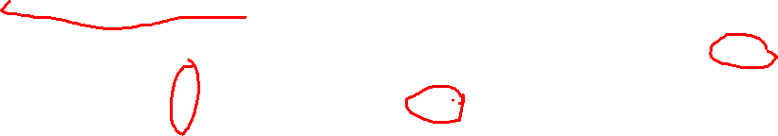
Array Element Accesses
  Similar C references
Nested Array
  Element at
  Mem[pgh+20*index+4*dig]
  Different address computation
Multi-Level Array
  Element at
  Mem[Mem[univ+4*index]+4*dig]
int get_pgh_digit
(int index, int dig)
{
return pgh[index][dig];
}
int get_univ_digit
(int index, int dig)
{
return univ[index][dig];
}
cmu
cmu
1
1
1
1
5
5
5
5
2
2
2
2
1
1
1
1
3
3
3
univ
3
univ
univ
16
16
16
20
20
20
24
24
24
28
28
28
32
32
32
36
36
160
36
160
mit
36
mit
36
36
0
0
0
0
2
2
2
2
1
1
1
1
3
3
3
3
9
9
9
168
16
9
16
16
36
36
36
40
40
40
44
44
44
48
48
48
52
52
52
56
56
ucb
56
176
56
hmc
56
56
9
9
9
9
4
4
4
1
7
7
7
7
2
2
2
1
0
0
0
1
56
56
56
60
60
60
64
64
64
68
68
68
72
72
72
76
76
76

Slide 20

Strange Referencing Examples
cmu
1
5
2
1
3
univ
160
16
20
24
28
32
36
36
mit
168
0
2
1
3
9
16
hmc
36
40
44
48
52
56
176
56
9
1
7
1
1
56
60
64
68
72
76
Reference Address Value Guaranteed?
  univ[2][3] 56+4*3 = 68 1
  univ[1][5] 16+4*5 = 36 0
  univ[2][-1] 56+4*-1 = 52 9
  univ[3][-1] ?? ??
  univ[1][12] 16+4*12 = 64 7
  Code does not do any bounds checking
  Ordering of elements in different arrays not guaranteed
Yes
No
No
No
No
Notes:
Again, answers one by one.

Slide 21
Strange Referencing Examples
cmu
1
5
2
1
3
univ
160
16
20
24
28
32
36
36
mit
168
0
2
1
3
9
16
hmc
36
40
44
48
52
56
176
56
9
1
7
1
1
56
60
64
68
72
76
Reference Address Value Guaranteed?
  univ[2][3] 56+4*3 = 68 1
  univ[1][5] 16+4*5 = 36 0
  univ[2][-1] 56+4*-1 = 52 9
  univ[3][-1] ?? ??
  univ[1][12] 16+4*12 = 64 7
  Code does not do any bounds checking
  Ordering of elements in different arrays not guaranteed

Slide 22

N x N Matrix Code
#define N 16
typedef int fix_matrix[N][N];
/* Get element a[i][j] */
int fix_ele(fix_matrix a,
size_t i, size_t j)
{
return a[i][j];
}
Fixed dimensions
  Know value of N at compile time
Variable dimensions, explicit indexing
  Traditional way to implement dynamic arrays
Variable dimensions, implicit indexing
  Now standard in C
#define IDX(n, i, j) ((i)*(n)+(j))
/* Get element a[i][j] */
int vec_ele(size_t n, int *a,
size_t i, size_t j)
{
return a[IDX(n, i, j)];
}
/* Get element a[i][j] */
int var_ele(size_t n, int a[n][n],
size_t i, size_t j) {
return a[i][j];
}

Slide 23
16 X 16 Matrix Access
Array Elements
  Address A + i * (C * K) + j * K
  C = 16, K = 4
/* Get element a[i][j] */
int fix_ele(fix_matrix a, size_t i, size_t j)
{
return a[i][j];
}
# a in %rdi, i in %rsi, j in %rdx
salq $6, %rsi # 64*i
addq %rsi, %rdi # a + 64*i
movl (%rdi,%rdx,4), %eax # M[a + 64*i + 4*j]
ret

Slide 24

N x N Matrix Access
Array Elements
  Address A + i * (C * K) + j * K
  C = n, K = 4
  Must perform integer multiplication
/* Get element a[i][j] */
int var_ele(size_t n, int a[n][n], size_t i, size_t j) {
return a[i][j];
}
# n in %rdi, a in %rsi, i in %rdx, j in %rcx
imulq %rdx, %rdi # n*i
leaq (%rsi,%rdi,4), %rax # a + 4*n*i
movl (%rax,%rcx,4), %eax # a + 4*n*i + 4*j
ret

Slide 25
Structure Representation
r
struct rec {
int a[4];
size_t i;
struct rec *next;
};
a
i
next
0
16
24
32
Structure represented as block of memory
  Big enough to hold all of the fields
Fields ordered according to declaration
  Even if another ordering could yield more compact representation
Compiler determines overall size + positions of fields
  Machine-level program has no understanding of the structures in the source code

Slide 26
Generating Pointer to Structure Member
r
r+4*idx
struct rec {
int a[4];
size_t i;
struct rec *next;
};
a
i
next
0
16
24
32
Generating Pointer to Array Element
  Offset of each structure member determined at compile time
  Compute as r + 4*idx
int *get_ap(struct rec *r, size_t idx)
{
return &r->a[idx];
}
# r in %rdi, idx in %rsi
leaq (%rdi,%rsi,4), %rax
ret

Slide 27

Following Linked List
struct rec {
int a[4];
long i;
struct rec *next;
};
C Code
r
void set_val(struct rec *r, int val)
{
while (r != NULL) {
int i = r->i;
r->a[i] = val;
r = r->next;
}
}
a
i
next
0
16
24
32
Element i
Register | Value
%rdi | r
%rsi | val
.L11: # loop:
movq 16(%rdi), %rax # i = M[r+16]
movl %esi, (%rdi,%rax,4) # M[r+4*i] = val
movq 24(%rdi), %rdi # r = M[r+24]
testq %rdi, %rdi # Test r
jne .L11 # if !=0 goto loop

Slide 28
Alignment Principles
Aligned Data
  Primitive data type requires K bytes
  Address must be multiple of K
  Required on some machines; advised on x86-64
Motivation for Aligning Data
  Memory accessed by (aligned) chunks of 4 or 8 bytes (system-dependent)
    Inefficient to load or store datum that spans quad word boundaries
    Virtual memory trickier when datum spans 2 pages
Compiler
  Inserts gaps in structure to ensure correct alignment of fields

Slide 29

Structures & Alignment
Unaligned Data
Aligned Data
  Primitive data type requires K bytes
  Address must be multiple of K
struct S1 {
char c;
int i[2];
double v;
} *p;
c
i[0]
i[1]
v
p
p+1
p+5
p+9
p+17
c
3 bytes
i[0]
i[1]
4 bytes
v
p+0
p+4
p+8
p+16
p+24
Multiple of 4
Multiple of 8
Multiple of 8
Multiple of 8

Slide 30
Specific Cases of Alignment (x86-64)
1 byte: char, …
  no restrictions on address
2 bytes: short, …
  lowest 1 bit of address must be 02
4 bytes: int, float, …
  lowest 2 bits of address must be 002
8 bytes: double, long, char *, …
  lowest 3 bits of address must be 0002
16 bytes: long double (GCC on Linux)
  lowest 4 bits of address must be 00002

Slide 31
Satisfying Alignment Within Structures
Within structure:
  Must satisfy each element’s alignment
  requirement
Overall structure placement
  Each structure has alignment requirement K
    K = Largest alignment of any element
  Initial address & structure length must be multiples of K
Example:
  K = 8, due to double element
struct S1 {
char c;
int i[2];
double v;
} *p;
c
3 bytes
i[0]
i[1]
4 bytes
v
p+0
p+4
p+8
p+16
p+24
Multiple of 4
Multiple of 8
Multiple of 8
Multiple of 8

Slide 32
Meeting Overall Alignment Requirement
For largest alignment requirement K
Overall structure must be multiple of K
struct S2 {
double v;
int i[2];
char c;
} *p;
 | v |  |  |  |  |  |  | i[0] |  |  |  | i[1] |  |  |  | c | 7 bytes
p+0 |  |  |  |  |  |  | p+8 |  |  |  |  |  |  |  | p+16 |  |  |  |  |  |  |  | p+24
Multiple of K=8

Slide 33
Arrays of Structures
Overall structure length multiple of K
Satisfy alignment requirement for every element
struct S2 {
double v;
int i[2];
char c;
} a[10];
 | a[0] |  |  |  |  | a[1] |  |  |  |  | a[2] |  |  |  |  | • • •
a+0 |  |  |  |  | a+24 |  |  |  |  | a+48 |  |  |  |  | a+72
 | v |  |  |  |  |  |  | i[0] |  |  |  | i[1] |  |  |  | c | 7 bytes
a+24 |  |  |  |  |  |  | a+32 |  |  |  |  |  |  |  | a+40 |  |  |  |  |  |  |  | a+48

Slide 34
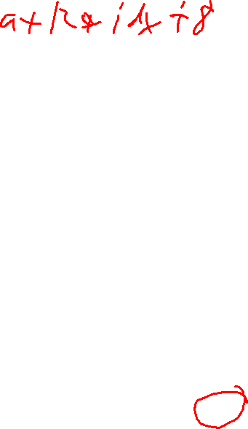
Accessing Array Elements
Compute array offset 12*idx
  sizeof(struct S3), including alignment spacers
Element j is at offset 8 within structure
Assembler gives offset a+8
  Resolved during linking
struct S3 {
short i;
float v;
short j;
} a[10];
 | a[0] |  |  |  |  | • • • |  |  |  | a[idx] |  |  |  | • • |  |  | •
a+0 |  |  |  |  | a+12 |  |  |  | a+12*idx
 |  |  |  |  | i | 2 bytes |  | v |  |  | j | 2 bytes
 |  |  |  | a+12*idx |  |  |  |  |  | a+12*idx+8
short get_j(int idx)
{
return a[idx].j;
}
# %rdi = idx
leaq (%rdi,%rdi,2),%rax # 3*idx
movzwl a+8(,%rax,4),%eax

Slide 35
Saving Space
Put large data types first
Effect (K=4)
struct S4 {
char c;
int i;
char d;
} *p;
struct S5 {
int i;
char c;
char d;
} *p;
c
3 bytes
i
d
3 bytes
i
c
d
2 bytes

Slide 36
Union Allocation
Allocate according to largest element
Can only use one field at a time
union U1 {
char c;
int i[2];
double v;
} *up;
 | c
 | i[0] |  |  |  | i[1]
 | v
up+0 |  |  | up+4 |  |  |  |  | up+8
struct S1 {
char c;
int i[2];
double v;
} *sp;
 | c | 3 bytes |  |  | i[0] |  |  |  | i[1] |  |  |  | 4 bytes |  |  | v
sp+0 |  |  |  | sp+4 |  |  |  | sp+8 |  |  |  |  |  |  | sp+16 |  |  |  |  |  | sp+24

Slide 37

Using Union to Access Bit Patterns
typedef union {
float f;
unsigned int u;
} bit_float_t;
 | u
 | f
0 |  |  |  | 4
float bit2float(unsigned u) {
bit_float_t arg;
arg.u = u;
return arg.f;
}
unsigned float2bit(float f) {
bit_float_t arg;
arg.f = f;
return arg.u;
}
Same as (float) u ?
Same as (unsigned) f ?

Slide 38
Byte Ordering Revisited
Idea
  Short/long/quad words (x86 terminology; C: short/int/long) stored in memory as 2/4/8 consecutive bytes
  Which byte is most (least) significant?
  Can cause problems when exchanging binary data between machines
Big Endian
  Most significant byte has lowest address
  MIPS; Internet
Little Endian
  Least significant byte has lowest address
  Intel x86, ARM Android and IOS
Bi Endian
  Can be configured either way
  ARM

Slide 39
Byte Ordering Example
union {
unsigned char c[8];
unsigned short s[4];
unsigned int i[2];
unsigned long l[1];
} dw;
32-bit
c[0] | c[1] | c[2] | c[3] | c[4] | c[5] | c[6] | c[7]
s[0] |  | s[1] |  | s[2] |  | s[3]
i[0] |  |  |  | i[1]
l[0]
64-bit
c[0] | c[1] | c[2] | c[3] | c[4] | c[5] | c[6] | c[7]
s[0] |  | s[1] |  | s[2] |  | s[3]
i[0] |  |  |  | i[1]
l[0]

Slide 40
Byte Ordering Example (Cont).
int j;
for (j = 0; j < 8; j++)
dw.c[j] = 0xf0 + j;
printf("Characters 0-7 == [0x%x,0x%x,0x%x,0x%x,0x%x,0x%x,0x%x,0x%x]\n",
dw.c[0], dw.c[1], dw.c[2], dw.c[3],
dw.c[4], dw.c[5], dw.c[6], dw.c[7]);
printf("Shorts 0-3 == [0x%x,0x%x,0x%x,0x%x]\n",
dw.s[0], dw.s[1], dw.s[2], dw.s[3]);
printf("Ints 0-1 == [0x%x,0x%x]\n",
dw.i[0], dw.i[1]);
printf("Long 0 == [0x%lx]\n",
dw.l[0]);

Slide 41
Byte Ordering on Sun
Big Endian
f0 | f1 | f2 | f3 | f4 | f5 | f6 | f7
c[0] | c[1] | c[2] | c[3] | c[4] | c[5] | c[6] | c[7]
s[0] |  | s[1] |  | s[2] |  | s[3]
i[0] |  |  |  | i[1]
l[0]
MSB
LSB
MSB
LSB
Print
Output on Sun:
Characters 0-7 == [0xf0,0xf1,0xf2,0xf3,0xf4,0xf5,0xf6,0xf7]
Shorts 0-3 == [0xf0f1,0xf2f3,0xf4f5,0xf6f7]
Ints 0-1 == [0xf0f1f2f3,0xf4f5f6f7]
Long 0 == [0xf0f1f2f3]

Slide 42
Byte Ordering on x86-64, ARM, MIPS
Little Endian
f0 | f1 | f2 | f3 | f4 | f5 | f6 | f7
c[0] | c[1] | c[2] | c[3] | c[4] | c[5] | c[6] | c[7]
s[0] |  | s[1] |  | s[2] |  | s[3]
i[0] |  |  |  | i[1]
l[0]
LSB
MSB
Print
Output on x86-64:
Characters 0-7 == [0xf0,0xf1,0xf2,0xf3,0xf4,0xf5,0xf6,0xf7]
Shorts 0-3 == [0xf1f0,0xf3f2,0xf5f4,0xf7f6]
Ints 0-1 == [0xf3f2f1f0,0xf7f6f5f4]
Long 0 == [0xf7f6f5f4f3f2f1f0]

Slide 43
Summary of Compound Types in C
Arrays
  Contiguous allocation of memory
  Aligned to satisfy every element’s alignment requirement
  Pointer to first element
  No bounds checking
Structures
  Allocate bytes in order declared
  Pad in middle and at end to satisfy alignment
Unions
  Overlay declarations
  Designed to support polymorphic structures
  Way to circumvent type system

