Slide 1


Chapter 3
Transport Layer
A note on these slides:
The slides used in this class were derived from ones provided by Jim Kurose and Keith Ross, authors of the textbook for the course.
I would like to thank the authors for making the slides available. They retain copyright in all of the original material.
Computer Networking: A Top Down Approach
Copyright 1996-2016
J.F Kurose and K.W. Ross, All Rights Reserved
7th edition
Jim Kurose, Keith Ross
Pearson/Addison Wesley
April 2016

Slide 2
Chapter 3: Transport Layer
our goals:
understand principles behind transport layer services:
  multiplexing, demultiplexing
  reliable data transfer
  flow control
  congestion control
learn about Internet transport layer protocols:
  UDP: connectionless transport
  TCP: connection-oriented reliable transport
  TCP congestion control

Slide 3
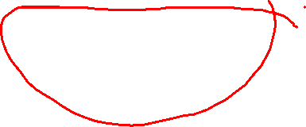
Chapter 3 outline
3.1 transport-layer services
3.2 multiplexing and demultiplexing
3.3 connectionless transport: UDP
3.4 principles of reliable data transfer
3.5 connection-oriented transport: TCP
  segment structure
  reliable data transfer
  flow control
  connection management
3.6 principles of congestion control
3.7 TCP congestion control

Slide 4


















Transport services and protocols
application
transport
network
data link
physical
provide logical communication between app processes running on different hosts
transport protocols run in end systems
  send side: breaks app messages into segments, passes to network layer
  receive side: reassembles segments into messages, passes to app layer
more than one transport protocol available to apps
  Internet: TCP and UDP
logical end-end transport
application
transport
network
data link
physical

Slide 5
Transport vs. network layer
network layer: logical communication between hosts
transport layer: logical communication between processes
  relies on, enhances, network layer services
household analogy:
12 kids in Mei’s house sending letters to 12 kids in Boris’s house:
hosts = houses
processes = kids
app messages = letters in envelopes
transport protocol = Mei and Boris, who demux to in-house siblings
network-layer protocol = postal service

Slide 6
Internet transport-layer protocols
reliable, in-order delivery (TCP)
  congestion control
  flow control
  connection setup
unreliable, unordered delivery: UDP
  no-frills extension of “best-effort” IP
services not available:
  delay guarantees
  bandwidth guarantees
application
transport
network
data link
physical
network
data link
physical
network
data link
physical
network
data link
physical
logical end-end transport
network
data link
physical
network
data link
physical
network
data link
physical
network
data link
physical
application
transport
network
data link
physical

Slide 7
Chapter 3 outline
3.1 transport-layer services
3.2 multiplexing and demultiplexing
3.3 connectionless transport: UDP
3.4 principles of reliable data transfer
3.5 connection-oriented transport: TCP
  segment structure
  reliable data transfer
  flow control
  connection management
3.6 principles of congestion control
3.7 TCP congestion control

Slide 8

Multiplexing/demultiplexing
multiplexing at sender:
handle data from multiple
sockets, add transport header (later used for demultiplexing)
demultiplexing at receiver:
use header info to deliver
received segments to correct
socket
application
application
P1
P2
application
socket
P3
transport
P4
process
transport
network
transport
network
link
network
link
physical
link
physical
physical
Notes:
This slide has two animations.

Slide 9
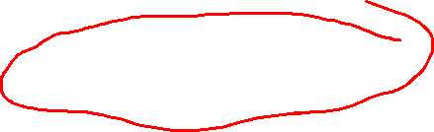
How demultiplexing works
host receives IP datagrams
  each datagram has source IP address, destination IP address
  each datagram carries one transport-layer segment
  each segment has source, destination port number
host uses IP addresses & port numbers to direct segment to appropriate socket
32 bits
source port #
dest port #
other header fields
application
data
(payload)
TCP/UDP segment format

Slide 10
Connectionless demultiplexing
recall: when creating datagram to send into UDP socket, must specify
  destination IP address
  destination port #
recall: created socket has host-local port #:
DatagramSocket mySocket1 = new DatagramSocket(12534);
when host receives UDP segment:
  checks destination port # in segment
  directs UDP segment to socket with that port #
IP datagrams with same dest. port #, but different source IP addresses or source port numbers will be directed to same socket at dest
Notes:
The bottom of this slide is animated.

Slide 11
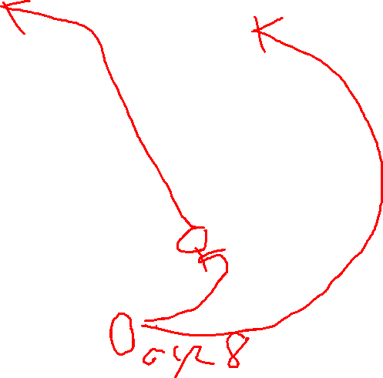
Connectionless demux: example
DatagramSocket serverSocket = new DatagramSocket
(6428);
DatagramSocket mySocket2 = new DatagramSocket
(9157);
DatagramSocket mySocket1 = new DatagramSocket (5775);
application
application
P1
application
P3
P4
transport
transport
network
transport
network
link
network
link
physical
link
physical
physical
source port: 6428
dest port: 9157
source port: ?
dest port: ?
source port: 9157
dest port: 6428
source port: ?
dest port: ?
Notes:
This slide has six animations. Q for class: what are source/destination ports on the right?

Slide 12
Connection-oriented demux
TCP socket identified by 4-tuple:
  source IP address
  source port number
  dest IP address
  dest port number
demux: receiver uses all four values to direct segment to appropriate socket
server host may support many simultaneous TCP sockets:
  each socket identified by its own 4-tuple
e.g. Web servers have different sockets for each connecting client
  non-persistent HTTP will have different socket for each request

Slide 13
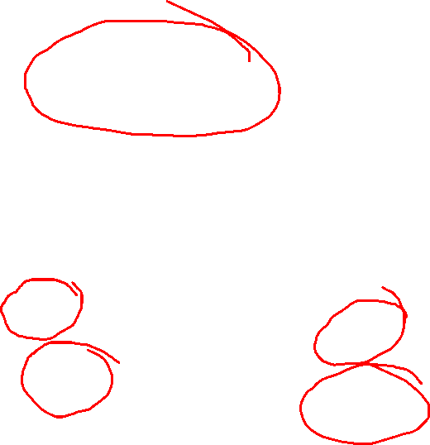
Connection-oriented demux: example
application
application
P4
P5
P6
application
P3
P2
P3
transport
transport
network
transport
network
link
network
link
physical
link
physical
server: IP address B
physical
host: IP address A
source IP,port: B,80
dest IP,port: A,9157
host: IP address C
source IP,port: C,5775
dest IP,port: B,80
source IP,port: A,9157
dest IP, port: B,80
source IP,port: C,9157
dest IP,port: B,80
three segments, all destined to IP address: B,
dest port: 80 are demultiplexed to different sockets
Notes:
This slide has one animation to bring up the message at the bottom. Note that the server can be threaded so that each connection is served by its own thread.

Slide 14
Connection-oriented demux: example
threaded server
application
application
application
P4
P3
P3
P2
transport
transport
network
transport
network
link
network
link
physical
link
physical
server: IP address B
physical
host: IP address A
source IP,port: B,80
dest IP,port: A,9157
host: IP address C
source IP,port: C,5775
dest IP,port: B,80
source IP,port: A,9157
dest IP, port: B,80
source IP,port: C,9157
dest IP,port: B,80

Slide 15
Chapter 3 outline
3.1 transport-layer services
3.2 multiplexing and demultiplexing
3.3 connectionless transport: UDP
3.4 principles of reliable data transfer
3.5 connection-oriented transport: TCP
  segment structure
  reliable data transfer
  flow control
  connection management
3.6 principles of congestion control
3.7 TCP congestion control

Slide 16

UDP: User Datagram Protocol [RFC 768]
“no frills,” “bare bones” Internet transport protocol
“best effort” service; UDP segments may be:
  lost
  delivered to app out of order
connectionless:
  no handshaking between UDP sender, receiver
  each UDP segment handled independently of others
UDP use:
  streaming multimedia apps (loss tolerant, rate-sensitive)
  DNS
  SNMP
reliable transfer over UDP:
  add reliability at application layer
  application-specific error recovery!

Slide 17
UDP: segment header
length, in bytes of UDP segment, including header
32 bits
source port #
dest port #
length
checksum
why is there a UDP?
no connection establishment (which can add delay)
simple: no connection state at sender, receiver
small header size
no congestion control: UDP can blast away as fast as desired
application
data
(payload)
UDP segment format
Notes:
Note that “no congestion control” can be problematic.

Slide 18
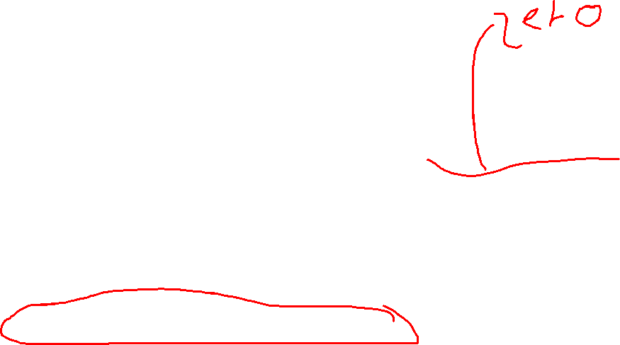
UDP checksum
Goal: detect “errors” (e.g., flipped bits) in transmitted segment
sender:
treat segment contents, including header fields, as sequence of 16-bit integers
checksum: addition (one’s complement sum) of segment contents
sender puts complement of checksum value into UDP checksum field
receiver:
compute checksum of received segment
check if computed checksum equals checksum field value:
  NO—error detected
  YES—no error detected. But maybe errors nonetheless? More later ….
Note: This is a primitive and lousy way to detect errors
Notes:
The check for equality can be done by including the UDP checksum field in the sum; then the sum should be zero.

Slide 19
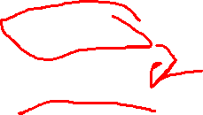
Internet checksum: example
example: add two 16-bit integers
1 1 1 1 0 0 1 1 0 0 1 1 0 0 1 1 0
1 1 1 0 1 0 1 0 1 0 1 0 1 0 1 0 1
1 1 0 1 1 1 0 1 1 1 0 1 1 1 0 1 1
1 1 0 1 1 1 0 1 1 1 0 1 1 1 1 0 0
1 0 1 0 0 0 1 0 0 0 1 0 0 0 0 1 1
wraparound
sum
checksum
Note: when adding numbers, a carryout from the most significant bit needs to be added to the result
* Check out the online interactive exercises for more examples: http://gaia.cs.umass.edu/kurose_ross/interactive/
Notes:
Textbook forgot to say anything about wrapping the carry and adding it to low order bit.

Slide 20
Chapter 3 outline
3.1 transport-layer services
3.2 multiplexing and demultiplexing
3.3 connectionless transport: UDP
3.4 principles of reliable data transfer
3.5 connection-oriented transport: TCP
  segment structure
  reliable data transfer
  flow control
  connection management
3.6 principles of congestion control
3.7 TCP congestion control

Slide 21
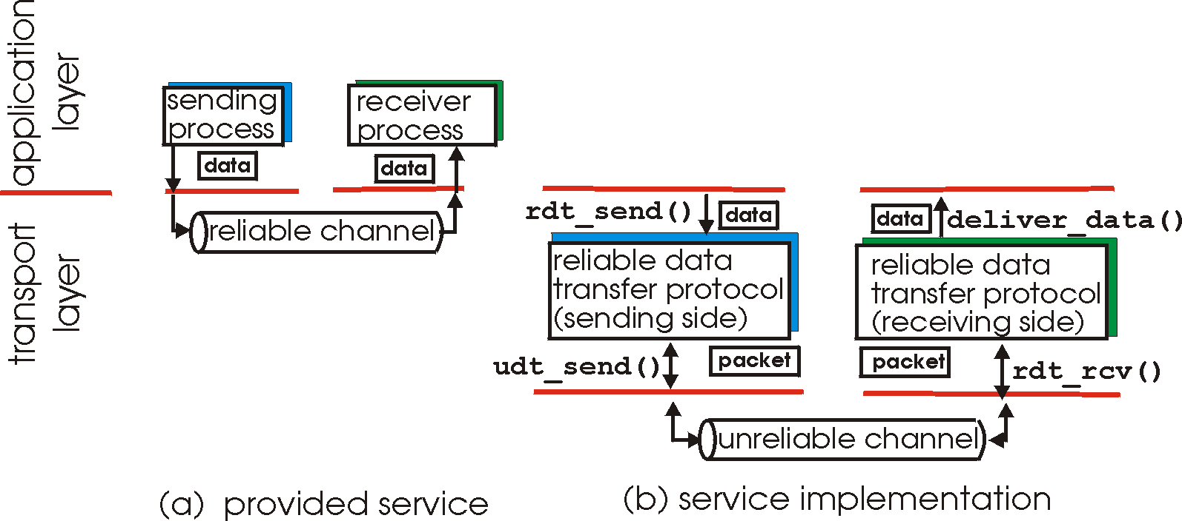
Principles of reliable data transfer
important in application, transport, link layers
  top-10 list of important networking topics!
characteristics of unreliable channel will determine complexity of reliable data transfer protocol (rdt)

Slide 22
Principles of reliable data transfer
important in application, transport, link layers
  top-10 list of important networking topics!
characteristics of unreliable channel will determine complexity of reliable data transfer protocol (rdt)

Slide 23

Principles of reliable data transfer
important in application, transport, link layers
  top-10 list of important networking topics!
characteristics of unreliable channel will determine complexity of reliable data transfer protocol (rdt)
Notes:
This slide has two animations

Slide 24
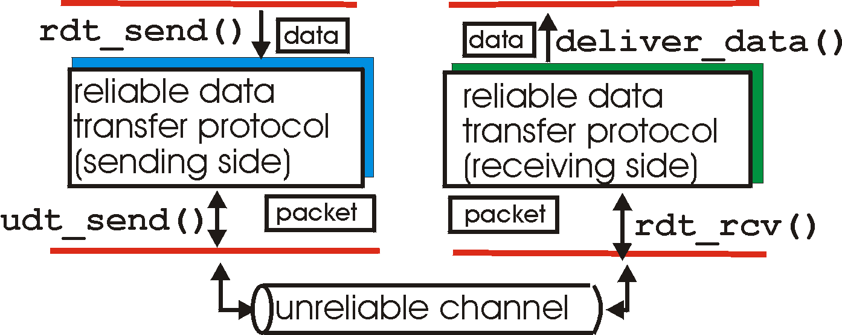
Reliable data transfer: getting started
rdt_send(): called from above, (e.g., by app.). Passes data to
deliver to receiver upper layer
deliver_data(): called by rdt to deliver data upwards
send
side
receive
side
udt_send(): called by rdt,
to transfer packet over
unreliable channel to receiver
rdt_rcv(): called when packet arrives on rcv side of channel
Notes:
This slide has four animations

Slide 25
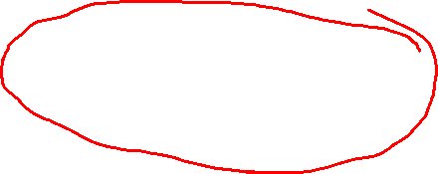
Reliable data transfer: getting started
We’ll:
incrementally develop sender, receiver sides of reliable data transfer protocol (rdt)
consider only unidirectional data transfer
  but control information will flow on both directions!
use finite state machines (FSM) to specify sender, receiver
event causing state transition
actions taken on state transition
state: when in this “state,” next state uniquely determined by next event
state
1
state
2
event
actions

Slide 26
rdt1.0: reliable transfer over a reliable channel
underlying channel perfectly reliable
  no bit errors
  no loss of packets
  no out-of-order packets
separate FSMs for sender, receiver:
  sender sends data into underlying channel
  receiver reads data from underlying channel
Wait for call from above
rdt_send(data)
Wait for call from below
rdt_rcv(packet)
extract (packet,data)
deliver_data(data)
packet = make_pkt(data)
udt_send(packet)
sender
receiver

Slide 27
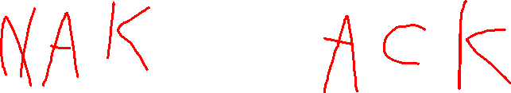
rdt2.0: channel with bit errors
underlying channel may flip bits in packet
  checksum to detect bit errors
the question: how to recover from errors:
  acknowledgements (ACKs): receiver explicitly tells sender that pkt received OK
  negative acknowledgements (NAKs): receiver explicitly tells sender that pkt had errors
  sender retransmits pkt on receipt of NAK
new mechanisms in rdt2.0 (beyond rdt1.0):
  error detection
  receiver feedback: control msgs (ACK,NAK) rcvr->sender
How do humans recover from “errors”
during conversation?
Notes:
Humans use both acks and naks. Naks are common: “Can you repeat that?” Acks are also common: “Yes, I see.”

Slide 28
rdt2.0: channel with bit errors
underlying channel may flip bits in packet
  checksum to detect bit errors
the question: how to recover from errors:
  acknowledgements (ACKs): receiver explicitly tells sender that packet received OK
  negative acknowledgements (NAKs): receiver explicitly tells sender that packet had errors
  sender retransmits packet on receipt of NAK
new mechanisms in rdt2.0 (beyond rdt1.0):
  error detection
  feedback: control messages (ACK, NAK) from receiver to sender

Slide 29
rdt2.0: FSM specification
rdt_send(data)
sndpkt = make_pkt(data, checksum)
udt_send(sndpkt)
receiver
rdt_rcv(rcvpkt) &&
isNAK(rcvpkt)
Wait for call from above
Wait for ACK or NAK
rdt_rcv(rcvpkt) &&
corrupt(rcvpkt)
udt_send(sndpkt)
udt_send(NAK)
rdt_rcv(rcvpkt) && isACK(rcvpkt)
Λ
Wait for call from below
sender
rdt_rcv(rcvpkt) &&
notcorrupt(rcvpkt)
extract(rcvpkt,data)
deliver_data(data)
udt_send(ACK)
Notes:
The lambda on the sender side means “take no action, just change states.” In practice, sndpkt has to be freed.

Slide 30
rdt2.0: operation with no errors
rdt_send(data)
sndpkt = make_pkt(data, checksum)
udt_send(sndpkt)
rdt_rcv(rcvpkt) &&
isNAK(rcvpkt)
Wait for call from above
Wait for ACK or NAK
rdt_rcv(rcvpkt) &&
corrupt(rcvpkt)
udt_send(sndpkt)
udt_send(NAK)
rdt_rcv(rcvpkt) && isACK(rcvpkt)
Wait for call from below
Λ
rdt_rcv(rcvpkt) &&
notcorrupt(rcvpkt)
extract(rcvpkt,data)
deliver_data(data)
udt_send(ACK)
Notes:
This slide has 6 animations.

Slide 31
rdt2.0: error scenario
rdt_send(data)
sndpkt = make_pkt(data, checksum)
udt_send(sndpkt)
rdt_rcv(rcvpkt) &&
isNAK(rcvpkt)
Wait for call from above
Wait for ACK or NAK
rdt_rcv(rcvpkt) &&
corrupt(rcvpkt)
udt_send(sndpkt)
udt_send(NAK)
rdt_rcv(rcvpkt) && isACK(rcvpkt)
Wait for call from below
Λ
rdt_rcv(rcvpkt) &&
notcorrupt(rcvpkt)
extract(rcvpkt,data)
deliver_data(data)
udt_send(ACK)
Notes:
This slide has 10 animations.

Slide 32

rdt2.0 has a fatal flaw!
what happens if ACK/NAK corrupted?
sender doesn’t know what happened at receiver!
Can’t just retransmit: possible duplicate
handling duplicates:
sender retransmits current pkt if ACK/NAK corrupted
sender adds sequence number to each pkt
receiver discards (doesn’t deliver up) duplicate pkt
stop and wait
sender sends one packet,
then waits for receiver
response
Notes:
This slide has three animations, one for each “box”.

Slide 33
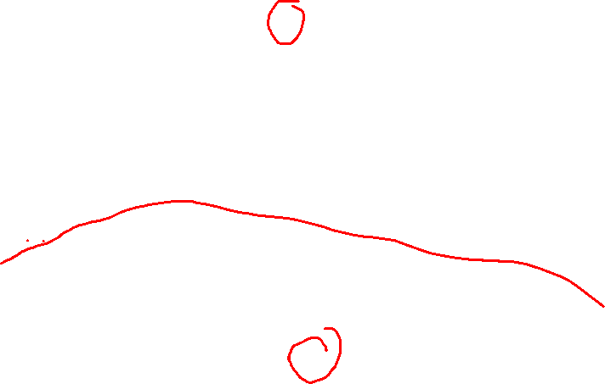
rdt2.1: sender, handles garbled ACK/NAKs
rdt_send(data)
sndpkt = make_pkt(0, data, checksum)
udt_send(sndpkt)
rdt_rcv(rcvpkt) &&
(corrupt(rcvpkt) ||
isNAK(rcvpkt))
Wait for call 0 from above
Wait for ACK or NAK 0
udt_send(sndpkt)
rdt_rcv(rcvpkt)
&& notcorrupt(rcvpkt)
&& isACK(rcvpkt)
rdt_rcv(rcvpkt)
&& notcorrupt(rcvpkt)
&& isACK(rcvpkt)
Λ
Λ
Wait for ACK or NAK 1
Wait for
call 1 from above
rdt_rcv(rcvpkt) &&
(corrupt(rcvpkt) ||
isNAK(rcvpkt))
rdt_send(data)
udt_send(sndpkt)
sndpkt = make_pkt(1, data, checksum)
udt_send(sndpkt)

Slide 34
rdt2.1: receiver, handles garbled ACK/NAKs
rdt_rcv(rcvpkt) && notcorrupt(rcvpkt)
&& has_seq0(rcvpkt)
extract(rcvpkt,data)
deliver_data(data)
ackpkt = make_pkt(ACK, chksum)
udt_send(ackpkt)
rdt_rcv(rcvpkt) && (corrupt(rcvpkt)
rdt_rcv(rcvpkt) && (corrupt(rcvpkt)
nakpkt = make_pkt(NAK, chksum)
udt_send(nakpkt)
nakpkt = make_pkt(NAK, chksum)
udt_send(nakpkt)
Wait for
0 from below
Wait for
1 from below
rdt_rcv(rcvpkt) &&
not corrupt(rcvpkt) &&
has_seq1(rcvpkt)
rdt_rcv(rcvpkt) &&
not corrupt(rcvpkt) &&
has_seq0(rcvpkt)
ackpkt = make_pkt(ACK, chksum)
udt_send(ackpkt)
ackpkt = make_pkt(ACK, chksum)
udt_send(ackpkt)
rdt_rcv(rcvpkt) && notcorrupt(rcvpkt)
&& has_seq1(rcvpkt)
extract(rcvpkt,data)
deliver_data(data)
ackpkt = make_pkt(ACK, chksum)
udt_send(ackpkt)

Slide 35

rdt2.1: discussion
sender:
seq # added to packet
two seq. #s (0,1) will suffice. Why?
must check if received ACK/NAK corrupted
twice as many states
  state must “remember” whether “expected” packet should have seq # of 0 or 1
receiver:
must check if received packet is duplicate
  state indicates whether 0 or 1 is expected packet seq #
note: receiver cannot know if its last ACK/NAK was received OK at sender

Slide 36
rdt2.2: a NAK-free protocol
same functionality as rdt2.1, using ACKs only
instead of NAK, receiver sends ACK for last packet received OK
  receiver must explicitly include seq # of packet being ACKed
duplicate ACK at sender results in same action as NAK: retransmit current packet

Slide 37
rdt2.2: sender, receiver fragments
rdt_send(data)
sndpkt = make_pkt(0, data, checksum)
udt_send(sndpkt)
rdt_rcv(rcvpkt) &&
(corrupt(rcvpkt) ||
isACK(rcvpkt,1))
Wait for call 0 from above
Wait for ACK
0
udt_send(sndpkt)
sender FSM
fragment
rdt_rcv(rcvpkt)
&& notcorrupt(rcvpkt)
&& isACK(rcvpkt,0)
rdt_rcv(rcvpkt) &&
(corrupt(rcvpkt) ||
has_seq1(rcvpkt))
Λ
Wait for
0 from below
receiver FSM
fragment
udt_send(ackpkt)
rdt_rcv(rcvpkt) && notcorrupt(rcvpkt)
&& has_seq1(rcvpkt)
extract(rcvpkt,data)
deliver_data(data)
ackpkt = make_pkt(ACK1, chksum)
udt_send(ackpkt)
Notes:
The bottom half of this slide is animated.

Slide 38
rdt3.0: channels with errors and loss
new assumption: underlying channel can also lose packets (data, ACKs)
  checksum, seq. #, ACKs, retransmissions will be of help…but not enough
approach: sender waits “reasonable” amount of time for ACK
retransmits if no ACK received in this time
if pkt (or ACK) just delayed (not lost):
  retransmission will be duplicate, but seq. #s already handle this
  receiver must specify seq # of packet being ACKed
requires countdown timer
Notes:
The right-hand side of this slide is animated.
Countdown timers are readily available in the kernel.

Slide 39
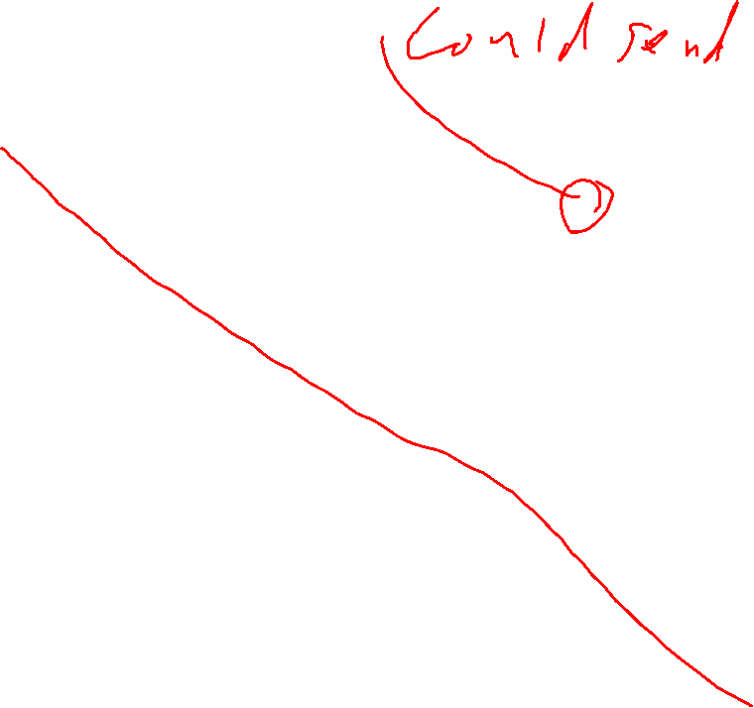
rdt3.0 sender
rdt_send(data)
rdt_rcv(rcvpkt) &&
(corrupt(rcvpkt) ||
isACK(rcvpkt,1))
sndpkt = make_pkt(0, data, checksum)
udt_send(sndpkt)
start_timer
rdt_rcv(rcvpkt)
Λ
Λ
Wait for
call 0 from above
Wait for ACK0
timeout
udt_send(sndpkt)
start_timer
rdt_rcv(rcvpkt)
&& notcorrupt(rcvpkt)
&& isACK(rcvpkt,1)
rdt_rcv(rcvpkt)
&& notcorrupt(rcvpkt)
&& isACK(rcvpkt,0)
stop_timer
stop_timer
Wait for ACK1
Wait for
call 1 from above
timeout
udt_send(sndpkt)
start_timer
rdt_rcv(rcvpkt)
rdt_send(data)
Λ
rdt_rcv(rcvpkt) &&
(corrupt(rcvpkt) ||
isACK(rcvpkt,0))
sndpkt = make_pkt(1, data, checksum)
udt_send(sndpkt)
start_timer
Λ
Receiver is the same as before!
Notes:
Previously, if we received ACK1 in the upper-right corner, we had to retransmit or otherwise the receiver would never send us an ACK0. Now, the timeout handles that case.

Slide 40

rdt3.0 in action
sender
receiver
sender
receiver
send pkt0
pkt0
send pkt0
pkt0
rcv pkt0
rcv pkt0
ack0
send ack0
ack0
send ack0
rcv ack0
rcv ack0
send pkt1
pkt1
send pkt1
pkt1
rcv pkt1
X
ack1
send ack1
loss
rcv ack1
send pkt0
pkt0
rcv pkt0
timeout
resend pkt1
ack0
send ack0
pkt1
rcv pkt1
ack1
send ack1
rcv ack1
send pkt0
pkt0
(a) no loss
rcv pkt0
ack0
send ack0
(b) packet loss
Notes:
This slide has 6 animations. Some of them have multiple fades.

Slide 41
rdt3.0 in action
sender
receiver
sender
receiver
send pkt0
pkt0
send pkt0
pkt0
rcv pkt0
rcv pkt0
ack0
send ack0
send ack0
rcv ack0
ack0
send pkt1
pkt1
rcv ack0
rcv pkt1
send pkt1
pkt1
send ack1
rcv pkt1
ack1
send ack1
ack1
X
loss
timeout
resend pkt1
pkt1
rcv pkt1
timeout
resend pkt1
rcv ack1
pkt1
rcv pkt1
pkt0
(detect duplicate)
send pkt0
send ack1
ack1
(detect duplicate)
ack1
rcv pkt0
rcv ack1
send ack1
rcv ack1
ack0
send ack0
pkt0
send pkt0
pkt0
send pkt0
rcv pkt0
rcv pkt0
ack0
(detect duplicate)
ack0
send ack0
send ack0
(c) ACK loss
(d) premature timeout/ delayed ACK
Notes:
This slide has 6 animations. The last shows all the packets after the premature timeout in a single animation.

Slide 42
Performance of rdt3.0
rdt3.0 is correct, but performance stinks
e.g.: 1 Gbps link, 15 ms prop. delay, 8000 bit packet:
L
8000 bits
D_{trans} =
=
=
8 microseconds
R
10⁹ bits/sec
  U_{sender}: utilization—fraction of time sender busy sending
  if RTT = 30 msec, 1KB packet sent every 30 msec, then get 33kB/sec throughput over 1 Gbps link
network protocol limits use of physical resources!

Slide 43
rdt3.0: stop-and-wait operation
sender
receiver
first packet bit transmitted, t = 0
last packet bit transmitted, t = L / R
first packet bit arrives
RTT
last packet bit arrives, send ACK
ACK arrives, send next
packet, t = RTT + L / R

Slide 44
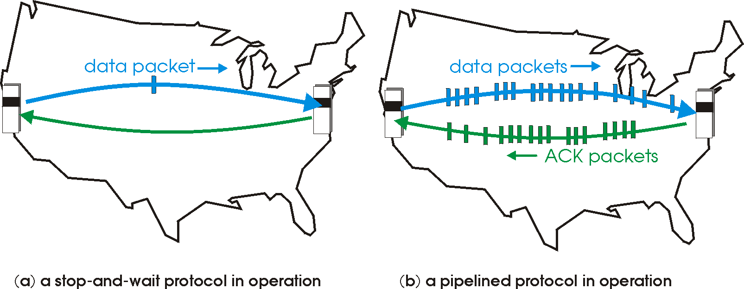

Pipelined protocols
pipelining: sender allows multiple, “in-flight”, yet-to-be-acknowledged packets
  range of sequence numbers must be increased
  buffering at sender or receiver
two generic forms of pipelined protocols: go-Back-N and selective repeat

Slide 45
Pipelining: increased utilization
sender
receiver
first packet bit transmitted, t = 0
last bit transmitted, t = L / R
first packet bit arrives
RTT
last packet bit arrives, send ACK
last bit of 2nd packet arrives, send ACK
last bit of 3rd packet arrives, send ACK
ACK arrives, send next
packet, t = RTT + L / R
3-packet pipelining increases
utilization by a factor of 3!

Slide 46
Pipelined protocols: overview
Go-back-N:
sender can have up to N unacked packets in pipeline
receiver only sends cumulative ack
  Doesn’t ack packet if there’s a gap
sender has timer for oldest unacked packet
  when timer expires, retransmit all unacked packets
Selective Repeat:
sender can have up to N unack’ed packets in pipeline
receiver sends individual ack for each packet
sender maintains timer for each unacked packet
  when timer expires, retransmit only that unacked packet
Notes:
In go-back-N, sender actually needs a timer for every packet. Why?

Slide 47
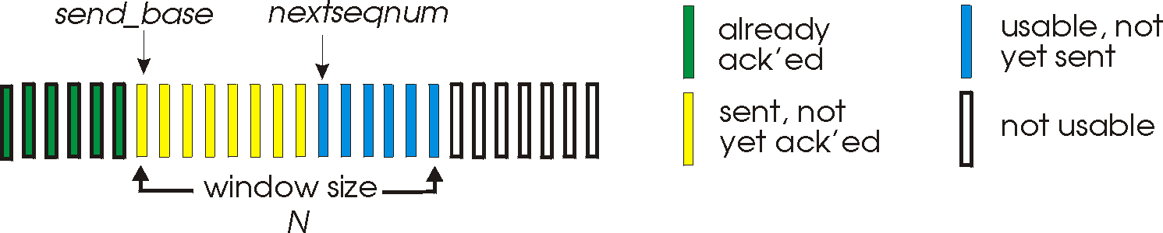
Go-Back-N: sender
k-bit sequence # in packet header
“window” of up to N consecutive unack’ed packets allowed
ACK(n): ACKs all packets up to and including seq # n—“cumulative ACK”
  may receive duplicate ACKs (see receiver)
timer for oldest in-flight pkt
timeout(n): retransmit packet n and all higher-numbered packets in window

Slide 48
Go-Back-N: sender extended FSM
rdt_send(data)
if (nextseqnum < base+N) {
sndpkt[nextseqnum] = make_pkt(nextseqnum,data,chksum)
udt_send(sndpkt[nextseqnum])
if (base == nextseqnum)
start_timer
nextseqnum++
}
else
refuse_data(data)
Λ
base=1
nextseqnum=1
timeout
Wait
start_timer
udt_send(sndpkt[base])
udt_send(sndpkt[base+1])
…
udt_send(sndpkt[nextseqnum-1])
rdt_rcv(rcvpkt)
&& corrupt(rcvpkt)
Λ
rdt_rcv(rcvpkt) &&
notcorrupt(rcvpkt)
base = getacknum(rcvpkt)+1
If (base == nextseqnum)
stop_timer
else
start_timer
Notes:
Note that (implicitly) the packets from the receiver don’t just have to be ACKs; they just need to contain an ACK number.

Slide 49
Go-Back-N: receiver extended FSM
default
udt_send(ackpkt)
rdt_rcv(rcvpkt)
&& notcorrupt(rcvpkt)
&& hasseqnum(rcvpkt, expectedseqnum)
Λ
Wait
extract(rcvpkt,data)
deliver_data(data)
ackpkt = make_pkt(expectedseqnum,ACK,chksum)
udt_send(ackpkt)
expectedseqnum++
expectedseqnum=1
ackpkt =
make_pkt(0,ACK,chksum)
ACK-only: always send ACK for correctly-received packet with highest in-order seq #
  may generate duplicate ACKs
  need only remember expectedseqnum
out-of-order packet:
  discard (don’t buffer): no receiver buffering!
  re-ACK packet with highest in-order seq #

Slide 50

Go-Back-N in action
sender window (N=4)
sender
receiver
0 1 2 3 4 5 6 7 8
send pkt0
send pkt1
send pkt2
send pkt3
(wait)
0 1 2 3 4 5 6 7 8
receive pkt0, send ack0
receive pkt1, send ack1
receive pkt3, discard,
(re)send ack1
0 1 2 3 4 5 6 7 8
X
0 1 2 3 4 5 6 7 8
loss
0 1 2 3 4 5 6 7 8
rcv ack0, send pkt4
rcv ack1, send pkt5
0 1 2 3 4 5 6 7 8
receive pkt4, discard,
(re)send ack1
ignore duplicate ACK
receive pkt5, discard,
(re)send ack1
pkt 2 timeout
0 1 2 3 4 5 6 7 8
send pkt2
send pkt3
send pkt4
send pkt5
0 1 2 3 4 5 6 7 8
0 1 2 3 4 5 6 7 8
rcv pkt2, deliver, send ack2
rcv pkt3, deliver, send ack3
rcv pkt4, deliver, send ack4
rcv pkt5, deliver, send ack5
0 1 2 3 4 5 6 7 8
Notes:
This slide has six clicks of animation.

Slide 51
Selective repeat
receiver individually acknowledges all correctly received packets
  buffers packets, as needed, for eventual in-order delivery to upper layer
sender only resends packets for which ACK not received
  sender timer for each unACKed packet
sender window
  N consecutive sequence #s
  limits sequence #s of sent, unACKed packets

Slide 52
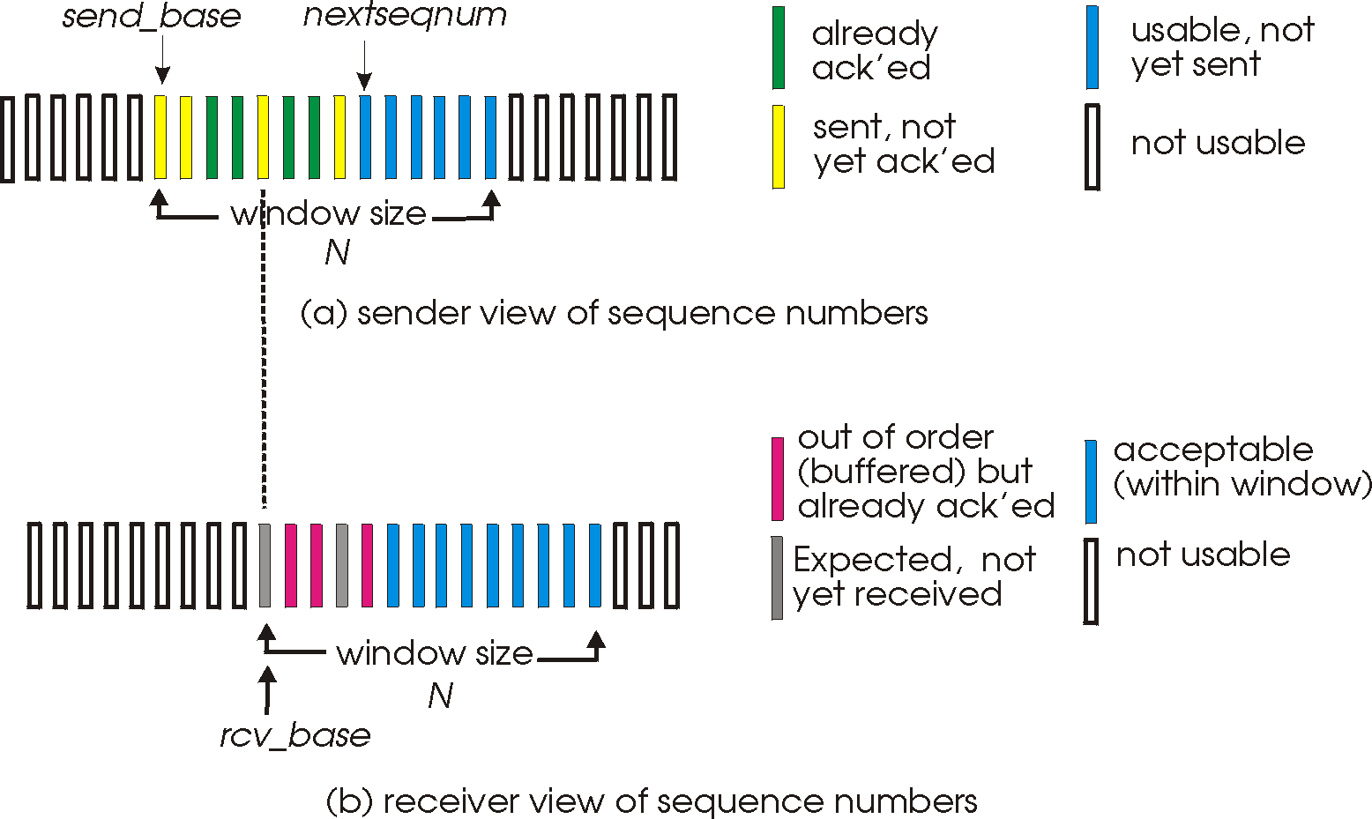
Selective repeat: sender, receiver windows

Slide 53
Selective repeat
sender
receiver
data from above:
if next available sequence # is in window, send packet
timeout(n):
resend packet n, restart timer
ACK(n) in [sendbase,sendbase+N]:
mark packet n as received
if n is smallest unACKed packet, advance window base to next unACKed sequence #
packet n is in [rcvbase, rcvbase+N-1]
send ACK(n)
out-of-order: buffer
in-order: deliver (also deliver earlier buffered, in-order packets), advance window to next not-yet-received packet
packet n is in [rcvbase-N, rcvbase-1]
ACK(n)
otherwise:
ignore

Slide 54
Selective repeat in action
sender window (N=4)
sender
receiver
0 1 2 3 4 5 6 7 8
send pkt0
send pkt1
send pkt2
send pkt3
(wait)
0 1 2 3 4 5 6 7 8
receive pkt0, send ack0
receive pkt1, send ack1
receive pkt3, buffer,
send ack3
0 1 2 3 4 5 6 7 8
X
0 1 2 3 4 5 6 7 8
loss
0 1 2 3 4 5 6 7 8
rcv ack0, send pkt4
rcv ack1, send pkt5
0 1 2 3 4 5 6 7 8
receive pkt4, buffer,
send ack4
record ack3 arrived
receive pkt5, buffer,
send ack5
pkt 2 timeout
0 1 2 3 4 5 6 7 8
send pkt2
0 1 2 3 4 5 6 7 8
record ack4 arrived
0 1 2 3 4 5 6 7 8
rcv pkt2; deliver pkt2,
pkt3, pkt4, pkt5; send ack2
record ack5 arrived
0 1 2 3 4 5 6 7 8
Q: what happens when ack2 arrives?
Notes:
This slide has multiple animations.

Slide 55

Selective repeat: dilemma
sender window
(after receipt)
receiver window
(after receipt)
0 1 2 3 0 1 2
pkt0
0 1 2 3 0 1 2
pkt1
0 1 2 3 0 1 2
example:
seq #s: 0, 1, 2, 3
window size=3
0 1 2 3 0 1 2
pkt2
0 1 2 3 0 1 2
0 1 2 3 0 1 2
0 1 2 3 0 1 2
pkt3
X
0 1 2 3 0 1 2
pkt0
will accept packet
with seq number 0
receiver sees no difference in two scenarios!
duplicate data accepted as new in (b)
Q: what relationship between sequence # size and window size is needed to avoid problem in (b)?
(a) no problem
receiver can’t see sender side;
receiver behavior identical in both cases!
something’s (very) wrong!
0 1 2 3 0 1 2
pkt0
0 1 2 3 0 1 2
pkt1
0 1 2 3 0 1 2
0 1 2 3 0 1 2
pkt2
0 1 2 3 0 1 2
X
0 1 2 3 0 1 2
X
timeout
retransmit pkt0
X
0 1 2 3 0 1 2
pkt0
will accept packet
with seq number 0
(b) oops!
Notes:
This slide has three animations.
The sequence number space has to be at least twice the window size.

Slide 56
Chapter 3 outline
3.1 transport-layer services
3.2 multiplexing and demultiplexing
3.3 connectionless transport: UDP
3.4 principles of reliable data transfer
3.5 connection-oriented transport: TCP
  segment structure
  reliable data transfer
  flow control
  connection management
3.6 principles of congestion control
3.7 TCP congestion control

Slide 57

TCP: Overview RFCs: 793,1122,1323, 2018, 2581
point-to-point:
  one sender, one receiver
reliable, in-order byte steam:
  no “message boundaries”
pipelined:
  TCP congestion and flow control set window size
full duplex data:
  bi-directional data flow in same connection
  MSS: maximum segment size
connection-oriented:
  handshaking (exchange of control messages) initializes sender, receiver state before data exchange
flow-controlled:
  sender will not overwhelm receiver

Slide 58

TCP segment structure
32 bits
URG: urgent data
(generally not used)
counting
by bytes
of data
(not segments!)
source port #
dest port #
sequence number
ACK: ACK #
valid
acknowledgement number
PSH: push data now
(roughly equivalent
to Enter key)
head
len
not
used
U
receive window
A
P
R
S
F
# bytes
receiver is willing to accept
checksum
Urg data pointer
RST, SYN, FIN:
connection estab
(setup, teardown
commands)
options (variable length)
application
data
(variable length)
Internet
checksum
(as in UDP)
Notes:
This slide animates each field.
PSH is set at application request and typically means “I’m not going to send anything more for a while”. Used, e.g., at end of command in ssh/telnet or end of request in HTTP.

Slide 59
TCP sequence numbers, ACKs
outgoing segment from sender
sequence numbers:
  byte stream “number” of first byte in segment’s data
acknowledgements:
  sequence # of next byte expected from other side
  cumulative ACK
Q: how does receiver handle out-of-order segments?
  A: TCP specification doesn’t say—up to implementor
source port #
dest port #
sequence number
acknowledgement number
rwnd
checksum
urg pointer
window size
N
  sender sequence number space
sent
ACKed
sent, not-yet ACKed
(“in-flight”)
usable
but not
yet sent
not
usable
incoming segment to sender
source port #
dest port #
sequence number
acknowledgement number
A
rwnd
checksum
urg pointer
Notes:
This slide has two animations highlighting the sequence number and then the ack number.

Slide 60
TCP sequence numbers, ACKs
Host A
Host B
User
types ‘C’
Seq=42, ACK=79, data = ‘C’
host ACKs
receipt of ‘C’, echoes
back ‘C’
Seq=79, ACK=43, data = ‘C’
host ACKs
receipt
of echoed ‘C’
Seq=43, ACK=80
simple ssh scenario

Slide 61
TCP round trip time, timeout
Q: how to set TCP timeout value?
longer than RTT
  but RTT varies!
too short: premature timeout, unnecessary retransmissions
too long: slow reaction to segment loss
Q: how to estimate RTT?
SampleRTT: measured time from segment transmission until ACK receipt
  ignore retransmissions
SampleRTT will vary; want estimated RTT to be “smoother”
  average several recent measurements, not just current SampleRTT

Slide 62

TCP round trip time, timeout
EstimatedRTT = (1- α)*EstimatedRTT + α*SampleRTT
“exponentially weighted moving average”
influence of past sample decreases exponentially fast
typical value: α = 0.125
RTT: gaia.cs.umass.edu to fantasia.eurecom.fr
RTT (milliseconds)
SampleRTT
EstimatedRTT
time (seconds)

Slide 63

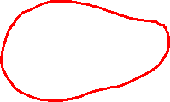
TCP round trip time, timeout
timeout interval: EstimatedRTT plus “safety margin”
  large variation in EstimatedRTT ⇒ larger safety margin
estimate SampleRTT deviation from EstimatedRTT:
DevRTT = (1-β)*DevRTT +
β*|SampleRTT-EstimatedRTT|
(typically, β = 0.25)
TimeoutInterval = EstimatedRTT + 4*DevRTT
estimated RTT
“safety margin”
* Check out the online interactive exercises for more examples: http://gaia.cs.umass.edu/kurose_ross/interactive/

Slide 64
Chapter 3 outline
3.1 transport-layer services
3.2 multiplexing and demultiplexing
3.3 connectionless transport: UDP
3.4 principles of reliable data transfer
3.5 connection-oriented transport: TCP
  segment structure
  reliable data transfer
  flow control
  connection management
3.6 principles of congestion control
3.7 TCP congestion control

Slide 65
TCP reliable data transfer
TCP creates rdt service on top of IP’s unreliable service
  pipelined segments
  cumulative acks
  single retransmission timer
retransmissions triggered by:
  timeout events
  duplicate acks
Let’s initially consider simplified TCP sender:
  ignore duplicate acks
  ignore flow control, congestion control

Slide 66
TCP sender events:
data received from app:
create segment with sequence #
sequence # is byte-stream number of first data byte in segment
start timer if not already running
  think of timer as for oldest unacked segment
  expiration interval: TimeOutInterval
timeout:
retransmit segment that caused timeout
restart timer
ack received:
if ack acknowledges previously unacked segments
  update what is known to be ACKed
  start timer if there are still unacked segments

Slide 67
TCP sender (simplified)
data received from application above
create segment, sequence #: NextSeqNum
pass segment to IP (i.e., “send”)
NextSeqNum = NextSeqNum + length(data)
if (timer currently not running)
start timer
Λ
NextSeqNum = InitialSeqNum
SendBase = InitialSeqNum
wait
for
event
timeout
retransmit not-yet-acked segment with smallest sequence #
start timer
ACK received, with ACK field value y
if (y > SendBase) {
SendBase = y
/* SendBase–1: last cumulatively ACKed byte */
if (there are any not-yet-acked segments)
start timer
else stop timer
}

Slide 68
TCP: retransmission scenarios
Host A
Host B
Host A
Host B
SendBase=92
Seq=92, 8 bytes of data
Seq=92, 8 bytes of data
timeout
timeout
Seq=100, 20 bytes of data
ACK=100
X
ACK=100
ACK=120
Seq=92, 8 bytes of data
Seq=92, 8
bytes of data
SendBase=100
SendBase=120
ACK=100
ACK=120
SendBase=120
lost ACK scenario
premature timeout
Notes:
The right-hand side of this slide is a popup.

Slide 69
TCP: retransmission scenarios
Host A
Host B
Seq=92, 8 bytes of data
Seq=100, 20 bytes of data
timeout
ACK=100
X
ACK=120
Seq=120, 15 bytes of data
cumulative ACK

Slide 70
TCP ACK generation [RFC 1122, RFC 2581]
event at receiver
arrival of in-order segment with
expected seq #. All data up to
expected seq # already ACKed
arrival of in-order segment with
expected seq #. One other
segment has ACK pending
arrival of out-of-order segment
with higher-than-expected seq. #.
Gap detected
arrival of segment that
partially or completely fills gap
TCP receiver action
delayed ACK. Wait up to 500ms
for next segment. If no next segment,
send ACK
immediately send single cumulative
ACK, ACKing both in-order segments
immediately send duplicate ACK,
indicating seq. # of next expected byte
immediately send ACK, provided that
segment starts at lower end of gap

Slide 71
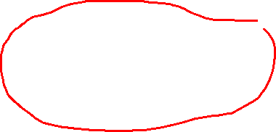
TCP fast retransmit
time-out period often relatively long:
  long delay before resending lost packet
detect lost segments via duplicate ACKs.
  sender often sends many segments back-to-back
  if segment is lost, there will likely be many duplicate ACKs.
TCP fast retransmit
if sender receives 3 ACKs for same data (“triple duplicate ACKs”), resend unacked segment with smallest seq #
  likely that unacked segment was lost, so don’t wait for timeout

Slide 72
TCP fast retransmit
Host A
Host B
Seq=92, 8 bytes of data
Seq=100, 20 bytes of data
X
ACK=100
timeout
ACK=100
ACK=100
ACK=100
Seq=100, 20 bytes of data
fast retransmit after sender
receipt of triple duplicate ACK

Slide 73
Chapter 3 outline
3.1 transport-layer services
3.2 multiplexing and demultiplexing
3.3 connectionless transport: UDP
3.4 principles of reliable data transfer
3.5 connection-oriented transport: TCP
  segment structure
  reliable data transfer
  flow control
  connection management
3.6 principles of congestion control
3.7 TCP congestion control

Slide 74
TCP flow control
application
process
application may
remove data from
TCP socket buffers ….
application
TCP socket
receiver buffers
OS
… slower than TCP
receiver is delivering
(sender is sending)
TCP
code
flow control
IP
code
receiver controls sender, so sender won’t overflow receiver’s buffer by transmitting too much, too fast
from sender
receiver protocol stack
Notes:
The “flow control” box is animated.

Slide 75

TCP flow control
receiver “advertises” free buffer space by including rwnd value in TCP header of receiver-to-sender segments
  RcvBuffer size set via socket options (typical default is 4096 bytes)
  many operating systems auto-adjust RcvBuffer
sender limits amount of unacked (“in-flight”) data to receiver’s rwnd value
guarantees receive buffer will not overflow
to application process
RcvBuffer
buffered data
rwnd
free buffer space
TCP segment payloads
receiver-side buffering

Slide 76
Chapter 3 outline
3.1 transport-layer services
3.2 multiplexing and demultiplexing
3.3 connectionless transport: UDP
3.4 principles of reliable data transfer
3.5 connection-oriented transport: TCP
  segment structure
  reliable data transfer
  flow control
  connection management
3.6 principles of congestion control
3.7 TCP congestion control

Slide 77
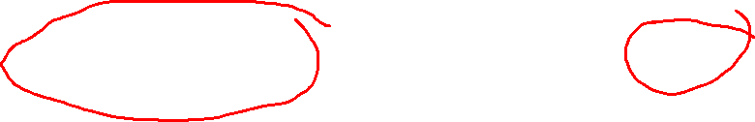
Connection Management
before exchanging data, sender & receiver “handshake”:
agree to establish connection (each knowing the other is willing to do so)
agree on connection parameters
application
application
connection state: ESTAB
connection variables:
  seq # client-to-server
  server-to-client
  rcvBuffer size
  at server,client
connection state: ESTAB
connection Variables:
  seq # client-to-server
  server-to-client
  rcvBuffer size
  at server,client
network
network
Socket clientSocket =
newSocket("hostname","port number");
Socket connectionSocket = welcomeSocket.accept();

Slide 78



Agreeing to establish a connection
2-way handshake:
Q: will 2-way handshake always work in network?
variable delays
retransmitted messages (e.g. req_conn(x)) due to message loss
message reordering
Can’t “see” other side
Let’s talk
ESTAB
OK
ESTAB
choose x
req_conn(x)
ESTAB
acc_conn(x)
ESTAB

Slide 79
Agreeing to establish a connection
2-way handshake failure scenarios:
choose x
choose x
req_conn(x)
req_conn(x)
ESTAB
ESTAB
retransmit
req_conn(x)
acc_conn(x)
retransmit
req_conn(x)
acc_conn(x)
ESTAB
ESTAB
data(x+1)
accept
data(x+1)
req_conn(x)
retransmit
data(x+1)
connection
x completes
connection
x completes
client terminates
server
forgets x
client terminates
server
forgets x
req_conn(x)
ESTAB
data(x+1)
ESTAB
half open connection!
(no client!)
accept
data(x+1)
Notes:
This slide has four animations.
Both scenarios assume that the retransmission is extremely delayed by the Internet, so that the entire conversation can take place before the retransmission arrives.

Slide 80

TCP 3-way handshake
client state
server state
READY
LISTEN
choose init seq num, x
send TCP SYN msg
SYNSENT
SYNbit=1, Seq=x
choose init seq num, y
send TCP SYNACK
msg, acking SYN
SYN RCVD
SYNbit=1, Seq=y
ACKbit=1; ACKnum=x+1
received SYNACK(x)
indicates server is live;
send ACK for SYNACK;
this segment may contain
client-to-server data
ESTAB
ACKbit=1, ACKnum=y+1
received ACK(y)
indicates client is live
ESTAB
Notes:
This slide has three animations.

Slide 81
TCP 3-way handshake: FSM
closed
Socket connectionSocket = welcomeSocket.accept();
Λ
Socket clientSocket =
newSocket("hostname", "port number");
newSocket.connect();
SYN(x)
SYNACK(seq=y, ACKnum=x+1)
create new socket for
communication back to client
listen
SYN(seq=x)
SYN
rcvd
SYN
sent
SYNACK(seq=y, ACKnum=x+1)
ACK(ACKnum=y+1)
ESTAB
ACK(ACKnum=y+1)
Λ
Notes:
The listen path is the “passive” path followed by a server. The right-hand path is taken when a client creates a socket and runs connect().

Slide 82
TCP: closing a connection
client, server each close their side of connection
  send TCP segment with FIN bit = 1
respond to received FIN with ACK
  on receiving FIN, ACK can be combined with own FIN
simultaneous FIN exchanges can be handled

Slide 83
TCP: closing a connection
client state
server state
ESTAB
ESTAB
clientSocket.close()
FIN_WAIT_1
can no longer
send but can
receive data
FINbit=1, seq=x
CLOSE_WAIT
ACKbit=1; ACKnum=x+1
can still
send data
FIN_WAIT_2
wait for server
close
LAST_ACK
FINbit=1, seq=y
TIMED_WAIT
can no longer
send data
ACKbit=1; ACKnum=y+1
timed wait
for 2*max
segment lifetime
CLOSED
CLOSED
Notes:
This slide has four animations.
Port is unusable during TIMED_WAIT; can avoid that if closing process has set SO_REUSEADDR.

Slide 84
Chapter 3 outline
3.1 transport-layer services
3.2 multiplexing and demultiplexing
3.3 connectionless transport: UDP
3.4 principles of reliable data transfer
3.5 connection-oriented transport: TCP
  segment structure
  reliable data transfer
  flow control
  connection management
3.6 principles of congestion control
3.7 TCP congestion control

Slide 85
Principles of congestion control
congestion:
informally: “too many sources sending too much data too fast for network to handle”
different from flow control!
manifestations:
  lost packets (buffer overflow at routers)
  long delays (queueing in router buffers)
    worsened by bufferbloat
a top-10 problem!

Slide 86

Causes & costs of congestion: scenario 1
original data: λ_{in}
throughput: λ_{out}
two senders, two receivers
one router, infinite buffers
output link capacity: R
no retransmission
Host A
unlimited shared output link buffers
Host B
R/2
λ_{out}
delay
λ_{in}
R/2
λ_{in}
R/2
maximum per-connection throughput: R/2
large delays as arrival rate, λ_{in}, approaches capacity

Slide 87
Causes & costs of congestion: scenario 2
one router, finite buffers
sender retransmission of timed-out packet
  application-layer input = application-layer output: λ_{in} = λ_{out}
  transport-layer input includes retransmissions : λ_{in} λ_{in}
‘
λ_{in} : original data
λ'_{in}: original data, plus retransmitted data
λ_{out}
Host A
finite shared output link buffers
Host B

Slide 88
Causes & costs of congestion: scenario 2
R/2
idealization: perfect knowledge
sender sends only when router buffers available
λ_{out}
λ_{in}
R/2
λ_{in} : original data
copy
λ'_{in}: original data, plus retransmitted data
λ_{out}
A
free buffer space!
finite shared output link buffers
Host B
Notes:
This slide has two animations. The first animates the packet (slowly); the second brings up the graph.

Slide 89

Causes & costs of congestion: scenario 2
idealization: known loss packets can be lost, dropped at router due to full buffers
sender only resends if packet known to be lost
λ_{in} : original data
copy
λ'_{in}: original data, plus retransmitted data
λ_{out}
A
no buffer space!
Host B
Notes:
This slide has one animation.

Slide 90
Causes & costs of congestion: scenario 2
Idealization: known loss packets can be lost, dropped at router due to full buffers
sender only resends if packet known to be lost
R/2
when sending at R/2, some packets are retransmissions but asymptotic goodput is still R/2 (why?)
λ_{out}
λ_{in}
R/2
λ_{in} : original data
λ'_{in}: original data, plus retransmitted data
λ_{out}
A
free buffer space!
Host B
Notes:
This slide animates the retransmission and then the graph.
Asymptotic goodput is R/2 because senders limit themselves to R/2 so on average there are no dropped packets.

Slide 91


Causes & costs of congestion: scenario 2
Realistic: duplicates
packets can be lost, dropped at router due to full buffers
sender times out prematurely, sending two copies, both of which are delivered
R/2
when sending at R/2, some packets are retransmissions including duplicates that are delivered!
λ_{out}
λ_{in}
R/2
λ_{in}
copy
λ'_{in}
λ_{out}
timeout
A
free buffer space!
Host B
Notes:
This slide has two animations showing the packet paths and then the graph.

Slide 92
Causes & costs of congestion: scenario 2
Realistic: duplicates
packets can be lost, dropped at router due to full buffers
sender times out prematurely, sending two copies, both of which are delivered
R/2
when sending at R/2, some packets are retransmissions including duplicated that are delivered!
λ_{out}
λ_{in}
R/2
“costs” of congestion:
more work (retransmissions) for given “goodput”
unneeded retransmissions: link carries multiple copies of packet
  decreasing goodput

Slide 93
Causes & costs of congestion: scenario 3
'
Q: what happens as λ_{in} and λ_{in} increase?
four senders
multihop paths
timeout/retransmit
A: as red λ_{in} increases, all arriving blue pkts at upper queue are dropped; blue throughput g 0
'
Host A
λ_{in} : original data
λ_{out}
Host B
λ'_{in}: original data, plus retransmitted data
finite shared output link buffers
Host D
Host C
Notes:
This slide has one animation showing the answer to the question.

Slide 94
Causes & costs of congestion: scenario 3
C/2
λ_{out}
λ_{in}’
C/2
another “cost” of congestion:
when packet dropped, any “upstream” transmission capacity used for that packet was wasted!

Slide 95
Chapter 3 outline
3.1 transport-layer services
3.2 multiplexing and demultiplexing
3.3 connectionless transport: UDP
3.4 principles of reliable data transfer
3.5 connection-oriented transport: TCP
  segment structure
  reliable data transfer
  flow control
  connection management
3.6 principles of congestion control
3.7 TCP congestion control

Slide 96
TCP congestion control: additive increase multiplicative decrease
approach: sender increases transmission rate (window size), probing for usable bandwidth, until loss occurs
  additive increase: increase cwnd by 1 maximum segment size (MSS) every RTT until loss detected
  multiplicative decrease: cut cwnd in half after loss
additively increase window size …
…. until loss occurs (then cut window in half)
AIMD saw tooth
behavior: probing
for bandwidth
cwnd: TCP sender
congestion window size
time
Notes:
MSS = maximum segment size
This slide has three clicks of animation.

Slide 97
TCP Congestion Control: details
sender sequence number space
TCP sending rate:
roughly: send cwnd bytes, wait RTT for ACKS, then send more bytes
cwnd
last byte
ACKed
last byte sent
sent, not-yet ACKed
(“in-flight”)
rate
cwnd
sender limits transmission:
cwnd is dynamic, function of perceived network congestion
~
bytes/sec
~
RTT
LastByteSent-
LastByteAcked
cwnd
<

Slide 98
TCP Slow Start
Host A
Host B
when connection begins, increase rate exponentially until first loss event:
  initially cwnd = 1 MSS
  double cwnd every RTT
  done by incrementing cwnd for every ACK received
summary: initial rate is slow but ramps up exponentially fast
one segment
RTT
two segments
four segments
time

Slide 99
TCP: detecting, reacting to loss
loss indicated by timeout:
  cwnd set to 1 MSS;
  window then grows exponentially (as in slow start) to threshold, then grows linearly
loss indicated by 3 duplicate ACKs: TCP Reno
  dup ACKs indicate network capable of delivering some segments
  cwnd is cut in half; window then grows linearly
TCP Tahoe always sets cwnd to 1 (timeout or 3 duplicate acks)

Slide 100
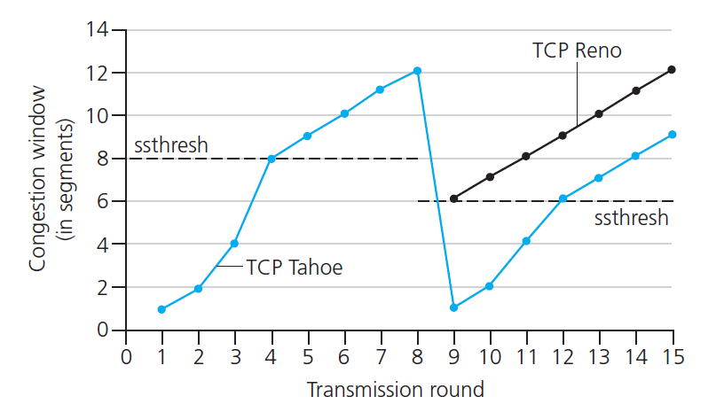
TCP: switching from slow start to CA
Q: when should the exponential increase switch to linear?
A: when cwnd gets to 1/2 of its value before timeout.
Implementation:
variable ssthresh
on loss event, ssthresh is set to 1/2 of cwnd just before loss event
* Check out the online interactive exercises for more examples: http://gaia.cs.umass.edu/kurose_ross/interactive/
Notes:
CA = congestion avoidance

Slide 101


Summary: TCP Congestion Control
New
ACK!
New
ACK!
.
duplicate ACK
new ACK
dupACKcount++
new ACK
cwnd = cwnd + MSS (MSS/cwnd)
dupACKcount = 0
transmit new segment(s), as allowed
cwnd = cwnd+MSS
dupACKcount = 0
transmit new segment(s), as allowed
Λ
cwnd = 1 MSS
ssthresh = 64 KB
dupACKcount = 0
cwnd > ssthresh
slow
start
Λ
congestion
avoidance
timeout
ssthresh = cwnd/2
cwnd = 1 MSS
dupACKcount = 0
retransmit missing segment
duplicate ACK
timeout
dupACKcount++
ssthresh = cwnd/2
cwnd = 1 MSS
dupACKcount = 0
retransmit missing segment
timeout
New
ACK!
ssthresh = cwnd/2
cwnd = 1
dupACKcount = 0
retransmit missing segment
New ACK
dupACKcount == 3
cwnd = ssthresh
dupACKcount = 0
dupACKcount == 3
ssthresh= cwnd/2
cwnd = ssthresh + 3 *MSS
retransmit missing segment
ssthresh= cwnd/2
cwnd = ssthresh + 3*MSS
retransmit missing segment
fast
recovery
duplicate ACK
cwnd = cwnd + MSS
transmit new segment(s), as allowed
Notes:
This slide has a bunch of animations.
CA increases cwnd by MSS*(MSS/cwnd) because MSS/cwnd is the fraction of cwnd represented by one segment; after cwnd/MSS worth of packets the window will have gone up by one MSS.

Slide 102

TCP throughput
avg. TCP thruput as function of window size, RTT?
  ignore slow start, assume always data to send
W: window size (measured in bytes) where loss occurs
  avg. window size (# in-flight bytes) is ¾ W
  avg. thruput is 3/4W per RTT
avg TCP thruput =
3
W
4
RTT
bytes/sec
W
W/2

Slide 103
TCP Futures: TCP over “long, fat pipes”
example: 1500 byte segments, 100ms RTT, want 10 Gbps throughput
requires W = 83,333 in-flight segments!
  not clear sender can keep that many un-acked segments
throughput in terms of segment loss probability, L [Mathis 1997]:
  ➜ to achieve 10 Gbps throughput, need a loss rate of
  L = 2·10⁻¹⁰ – a very small loss rate!
new versions of TCP for high speed
1.22
.
MSS
TCP throughput =
RTT
L

Slide 104
TCP Fairness
fairness goal: if K TCP sessions share same bottleneck link of bandwidth R, each should have average rate of R/K
TCP connection 1
bottleneck
router
capacity R
TCP connection 2

Slide 105
Why is TCP fair?
two competing sessions:
additive increase gives slope of 1, as throughout increases
multiplicative decrease decreases throughput proportionally
R
equal bandwidth share
loss: decrease window by factor of 2
congestion avoidance: additive increase
Connection 2 throughput
loss: decrease window by factor of 2
congestion avoidance: additive increase
Connection 1 throughput
R

Slide 106
Fairness (more)
Fairness and UDP
multimedia apps often do not use TCP
  do not want rate throttled by congestion control
instead use UDP:
  send audio/video at constant rate, tolerate packet loss
Fairness & parallel TCP connections
application can open multiple parallel connections between two hosts
web browsers do this
e.g., link of rate R with 9 existing connections:
  new app asks for 1 TCP, gets rate R/10
  new app asks for 9 TCPs, gets R/2
Notes:
The new app gets R/2 because there are already 9 existing connections. So they each get R/18; the new app gets R/2!

Slide 107
Explicit Congestion Notification (ECN)
network-assisted congestion control:
two bits in IP header (ToS field) marked by network router to indicate congestion
congestion indication carried to receiving host
receiver (seeing congestion indication in IP datagram) ) sets ECE bit on receiver-to-sender ACK segment to notify sender of congestion
source
TCP ACK segment
destination
application
transport
network
link
physical
ECE=1
application
transport
network
link
physical
ECN=00
ECN=11
IP datagram
Notes:
ECE = ECN Notifcation Echo

Slide 108
Chapter 3: summary
principles behind transport layer services:
  multiplexing, demultiplexing
  reliable data transfer
  flow control
  congestion control
instantiation, implementation in the Internet
  UDP
  TCP
next:
leaving the network “edge” (application, transport layers)
into the network “core”
two network layer chapters:
  data plane
  control plane

