Slide 1
CCSC Showcase
Welcome
Mike Erlinger
mike@cs.hmc.edu
https://www.cs.hmc.edu/~mike
Program Director:
July 2014 to July 2016 ERH-DUE
Professor:
Harvey Mudd College, July 1918-January 2020
Retired:

Slide 2
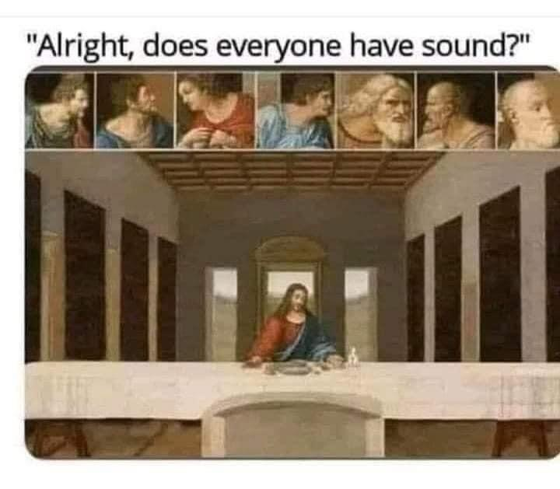

Slide 3
Outline
Welcome
NSF Overview
IPA
PI Experience
Choosing the Right Funding Opportunity
Preparing a Competitive Proposal
Questions
3
Notes:
•Welcome & Introductions - 15 minutes
•NSF Overview - 10 minutes
•NSF Merit Review Criteria - 15 minutes
•Merit Review Exercise - 15 minutes
Questions - 15 minutes
•Proposal Submission and Processing - 15 minutes
(90 minutes)
Break
•Mock One-Pager Review - 30 minutes – 45 minutes
•Preparing a Competitive Proposal - 15 minutes
•Choosing the Right Funding Opportunity - 15 minutes
Questions
•Wrap-up & Closing Remarks

Slide 4
And a word from my sponsor….
All information provided here represents the opinions of individual current and former NSF Program Officers and Principal Investigators
The only official source for NSF policy is NSF published materials
http://nsf.gov/

