Slide 1

NSF - Where Discoveries Begin
CCSC Showcase
NSF
Photo Credit: Maria Barnes, NSF

Slide 2
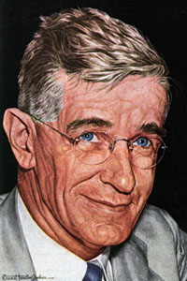
OSRD (1941-1947)
The Office of Scientific Research and Development (OSRD) was an agency of the United States federal government.
  Coordinate scientific research for military purposes during World War II.
Created by Franklin Roosevelt by Executive Order 8807 on June 28, 1941.
Directed by Vannevar Bush, who reported only to the President.
2

Slide 3
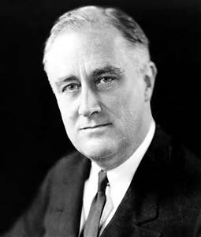
Postwar Planning
"New frontiers of the mind are before us, and if they are pioneered with the same vision, boldness, and drive with which we have waged this war we can create a fuller and more fruitful employment and a fuller and more fruitful life.“
FRANKLIN D. ROOSEVELT
November 17, 1944
FDR asks V. Bush
  What can we make known?
  How can we continue the work?
  What can the government do to aid research?
  Can an effective program be proposed for discovering and developing scientific talent in American youth?

Slide 4
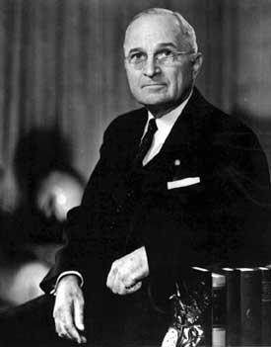
NSF is Established (May 10, 1950)
Bush created 4 committees; final report of each combined to form his final report
Final Report summary:
Calls for a permanent federal agency to help support basic research in academia, oversee medical and military research and provide funding for science education at the undergraduate and graduate levels.
“I have just signed the National Science Foundation Act of 1950. This act is of tremendous importance, because it will add to our knowledge in every branch of science. I am confident that it will help us to develop the best scientific brains in the Nation. It will enable the United States to maintain its leadership in scientific matters, and to exert a more vital force for peace.“
HARRY S. TRUMAN, May 10, 1950

Slide 5
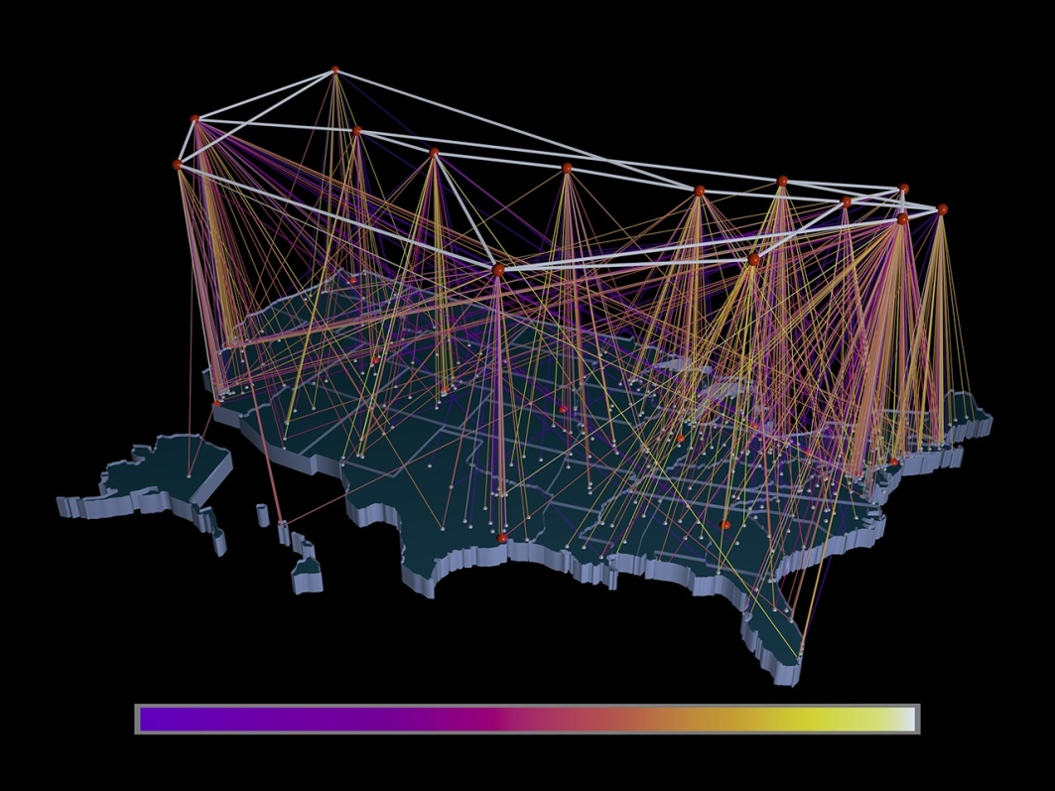
What Has the NSF Done for Me?
Bar Codes
Internet
Internet Search
Public-key Cryptography
Speech Recognition
Supercomputers
Reading Rainbow
Nova
NPR
Student Scholarships
CS Principles

Slide 6
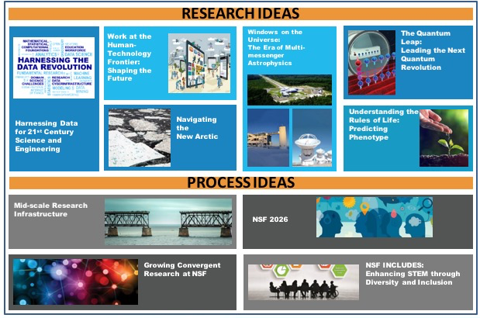
Ten Big Ideas for Future NSF Investments
X
X
Notes:
Since 2017, NSF has been building a foundation for the Big Ideas through pioneering research and pilot activities. In 2019, NSF will invest $30 million in each Big Idea and continue to identify and support emerging opportunities for U.S. leadership in Big Ideas that serve the Nation's future.

Slide 7

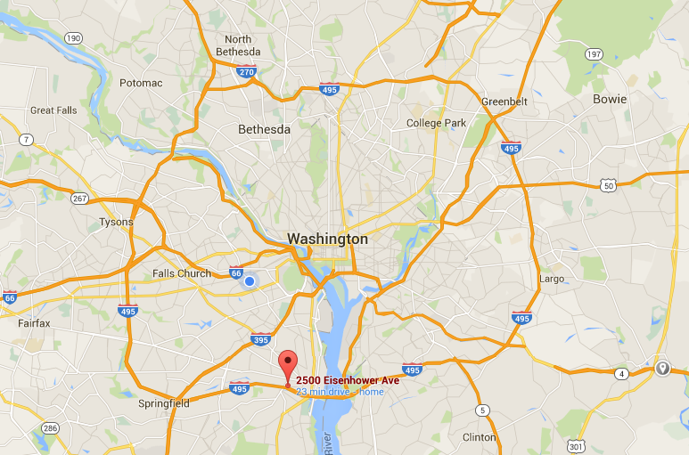
New NSF Headquarters

Slide 8

Dr. Sethuraman "Panch" Panchanathan
The new director of the NSF is Dr. Sethuraman "Panch" Panchanathan
Degrees
  BS - Physics & Electrical Comm. Engineering
  MS - Electrical Engineering
  Ph.D. in Electrical and Computer Engineering
Research interests
  Human-centered multimedia computing
  Haptic user interfaces
  Person-centered tools and ubiquitous computing technologies for enhancing the quality of life for individuals with disabilities
  AI and machine learning for multimedia applications.

Slide 9

NSF Directorates and Offices
X
9
X

Slide 10
NSF Workforce
Consists of approximately
  1,478 Federal employees (includes staff of the National Science Board Office and the Office of the Inspector General);
  179 Non-Federal Intergovernmental Personnel Act (IPA) assignees coming from research institutions;
  450 contract workers – mostly IT
Unlike other science agencies, NSF does not maintain its own research laboratories.
Notes:
Updated from end of FY 2013 data from FPPS.

Slide 11



By the Numbers
Most numbers shown are based on FY 2018 activities.
93%
funds research,
education and
related activities
$8.1B
FY 2019
Enacted
50,000
proposals
evaluated
2,000
NSF-funded
institutions
11,000
awards
funded
359,000
people NSF
supported
$1.2B
STEM
education
$100M
to seed
public/private
partnerships
236
NSF-funded
Nobel
Prize winners
11

Slide 12
NSF support as a percentage of total federal support for basic academic research
Source: NSF/NCSES, “Survey of Federal Funds for Research and Development.” In FY20 NSF Budget Request to Congress

Slide 13
NSF STEM Goals
Develop the STEM/STEM-related workforce
Advance science
Broaden participation in STEM
Educate a STEM-literate populace
Build capacity in higher education
Improve K-12 STEM education
Encourage life-long learning

Slide 14
Directorate for Education and Human Resources
EHR
Office of the Assistant Director
Division of Research on Formal and Informal Settings (DRL)
Division of Graduate Education (DGE)
Division of Undergraduate Education (DUE)
Division of Human Resource Development (HRD)

Slide 15
EHR Goals
Prepare the next generation of STEM professionals and attract/retain more Americans to STEM careers
Develop a robust research community that can conduct rigorous research and evaluation to support excellence in STEM education
Increase the technological, scientific and quantitative literacy of all Americans
Broaden participation and close achievement gaps in all STEM fields

Slide 16
Directorate for Computer & Information Science & Engineering
CISE
Office of the Assistant Director
Computing and Communication Foundations (CCF)
Computer and Network Systems (CNS)
Information and Intelligent Systems (IIS)
Advanced Cyberinfrastructure (OAC)

Slide 17
CISE Goals
To enable the U.S. to uphold a position of world leadership in computing, communications, and information science and engineering
To promote understanding of the principles and uses of advanced computing, communications and information systems in service to society
To support and provide advanced cyberinfrastructure to enable and accelerate discovery and innovation across all disciplines
To contribute to universal, transparent and affordable participation in an information-based society.

Slide 18
NSF STEM Workforce Priorities
Prepare students to be leaders, teachers, and innovators in emerging and rapidly changing STEM fields
Develop a scientifically literate populace
Both depend on the nature and quality of the undergraduate education experience

Slide 19

Questions?

Slide 20
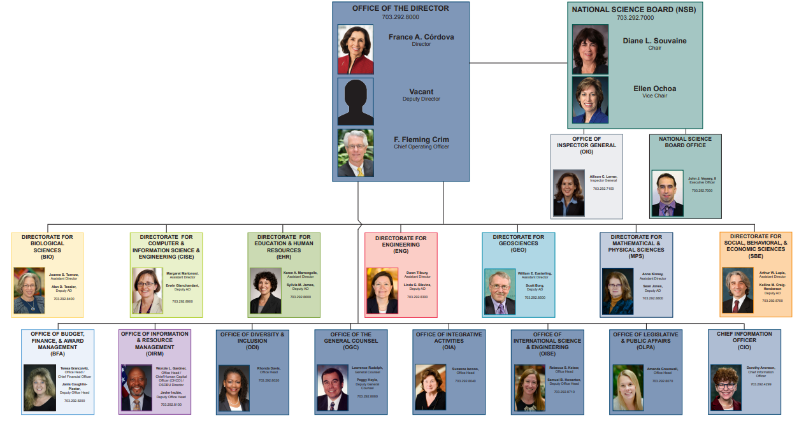
NSF Organizational Chart
20
20
Notes:
Margaret Martonosi
Sethuraman Panchanathan

Slide 21


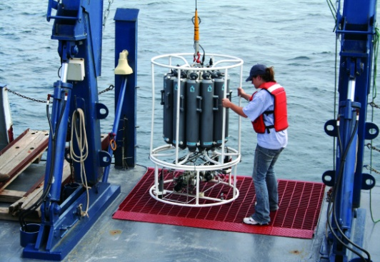
NSF’s Strategic Goals
Transform the Frontiers of Science and Engineering.
Stimulate Innovation and Address Societal Needs through Research and Education
Excel as a Federal Science Agency
Notes:
Strategic goals updated (May 26, 2011) from http://www.nsf.gov/news/strategicplan/
Image description 1: Crowd of people walking.
Image description 2: Silhouette of a man looking at a computer.
Image description 3: Researcher working with equipment on a ship.

Slide 22
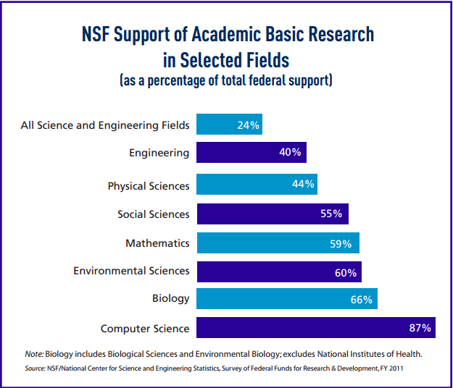
NSF : Share of Total Federal Support
With an annual budget of about $7 billion, NSF funds approximately 25 % of all federally supported basic research conducted by U.S. colleges and universities.
Notes:
Data based on FY15 budget request.

