Slide 1
CCSC Showcase NSF Rotators

Slide 2
What is a NSF Rotator?
A Faculty member from some institution who is on loan – A Rotator - to NSF for a year, then maybe a second, maybe a third, and in unusual circumstances a fourth.
Rotator Types:
VSEE – Visiting Scientist, Engineer and Educator
IPA – Intergovernmental Personnel Act
2

Slide 3
What is a VSEE?
Individual from some institution who is on a non-paid leave of absence from their institution.
Appointment Length – one year at a time
Salary – Government determination
Lost Consulting while on loan – NSF May compensate
Per Diem – on paper same as IPA
Benefits – a little messy depending on state law
Leaves – follow federal guidelines.
3

Slide 4
What is an IPA?
Individual (faculty) from some institution who is on TDY (Temporary Duty) to NSF. Still Employee of Institution
Appointment Length – one year at a time, up to 4 years
Salary – 100% of 12 month salary (9 month salary plus summer support)
IRD Supported (30-50 days per year)
Create plan: Travel to home institution, conferences
Per Diem – on paper same as VSEE
Benefits – All institution benefits continue
Leaves – Applicable leave provisions of the home institution
4

Slide 5
Why be a Rotator?
Be involved in national policy, research directions
Service to the Profession
Service to your Institution
Build expertise for future Proposals
Want a break from institutional life
Want to be in DC
5

Slide 6
IPA Life?
JOB: NSF Program Officer – PO
Manage Programs
Process proposals: ~120 a year
Prepare Program meetings (PI meetings)
Outreach to faculty and schools
Funding recommendations
Constant flood of visitors
Fantastic lectures
6

Slide 7
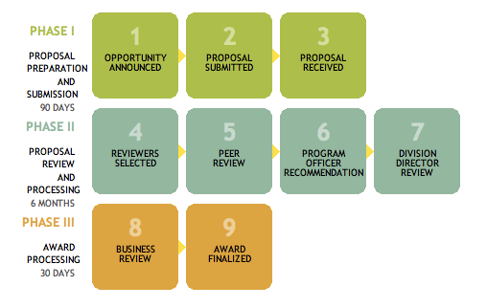
NSF Merit Review Process
Rotators involved
in steps 1-7
Notes:
Program Directors make a recommendation to award or decline based on the input from merit review
Division Directors agree or not with this recommendation
Grants Officers make awards to organizations.
Committee of Visitors looks at the details of the Program process and outcomes and makes recommendations for improvement if needed
Image description: NSF Merit Review Process: Phase I consists of steps for proposal preparation and submission within 90 days; Phase II consists of steps for proposal review and processing within 6 months; and Phase III consists of steps for award processing within 30 days.

Slide 8
Rotator Issues
Relationship with institution
Hiring Process involves NSF and Institution
On leave ? NO
How does time count towards sabbatical and promotion?
How is 12 month salary paid? Office? Merit Review?
IR&D Support
Students, Research Lab, etc.

Slide 9
To apply for positions at NSF
Go to http://www.nsf.gov/about/
Click on “Career Opportunities” then “Job Openings”
Then select “Scientific/Engineering/Education”
Select your Directorate of Choice from the dropdown menu, click on the green arrow, and open your desired position.
Contact the relevant NSF program office
Contact the Division of Human Resource Management
For more information about rotator opportunities at NSF, visit: http://www.nsf.gov/careers/rotator/

