Slide 1
EHR mission, structure, programs…
Notes:
TUES Program

Slide 2


The EHR Mission
The mission of EHR is to achieve excellence in U.S. STEM education
at all levels and in all settings to
support the development of a diverse and well-prepared workforce and
well-informed citizenry.
2

Slide 3
EHR Areas of Investment
Experiential learning
Assessment/metrics of learning and practice
Scholarships
Foundational education research
Professional development
Institutional change
Formal and informal learning environments
Undergraduate disciplinary research

Slide 4
EHR Organization
Office of the Assistant Director for EHR
Assistant Director: Joan Ferrini-Mundy
Graduate Education
(DGE)
Research on Learning in Formal and Informal Settings
(DRL)
Undergraduate Education
(DUE)
DD: ??
Human Resource Development
(HRD)
4

Slide 5
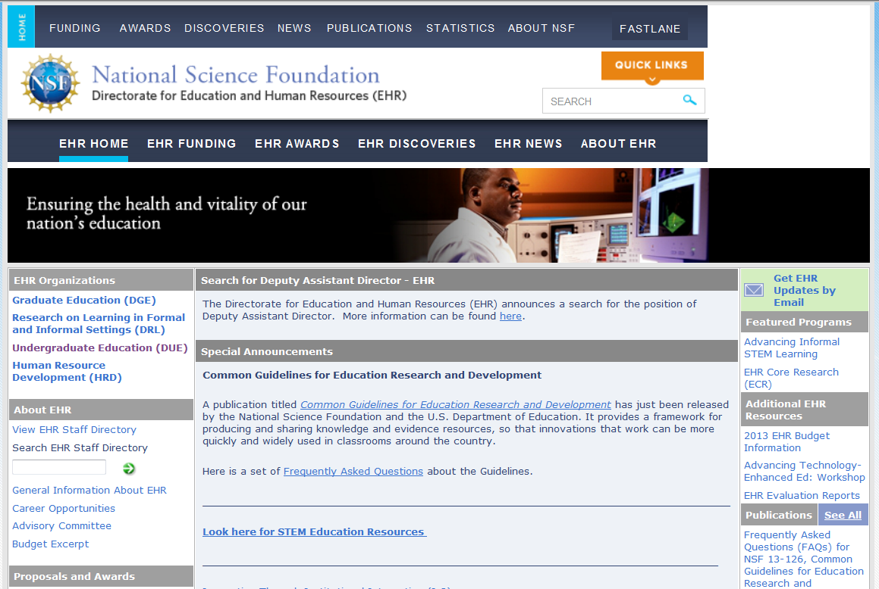
EHR Home Page
STEM

Slide 6
DUE mission, structure, programs…
Notes:
TUES Program

Slide 7
NSF Division of Undergraduate Education (DUE)
DUE Mission: To promote excellence in undergraduate science, technology, engineering, and mathematics (STEM) education for all students.
Potentially Tra
ormative Education R&D

Slide 8
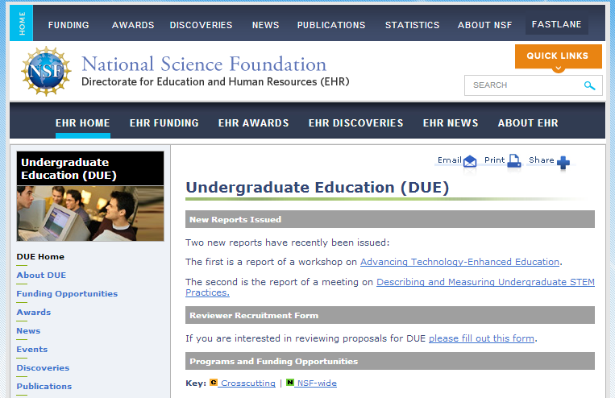
DUE Home Page
DUE Programs
STEM

Slide 9
DUE programs that support undergraduate computer science education:
  Improving Undergraduate STEM Education (IUSE)
  Advanced Technological Education (ATE)
  Scholarships in Science, Technology, Engineering, and Mathematics Education (S-STEM)
  Robert Noyce Teacher Scholarship (Noyce)
EHR-wide: Innovation Corps for Learning (I-Corps L)
EHR-wide: EHR Core Research (ECR) program
NSF-wide: Research Experiences for Undergraduates (REU) and Faculty Early Career Development (CAREER) programs
CISE – Broadening Participation, CS for All, CUE

Slide 10
Advanced Technological Education (ATE) Program
Supports the education of science and engineering technicians for the high-tech fields that drive the nation’s economy
Three tracks: Projects, Centers, & Targeted Research
Education/industry partnerships are a hallmark
Community and technical colleges must be in leadership rolesl
Proposal deadline: Oct

Slide 11
IUSE Program
Two Program Tracks
Engaged Student Learning
Institutional and Community
Transformation
Two Tiers
Two Tiers
Exploration
(smaller scope)
Design and
Development
(larger scope)
Exploration
(smaller scope)
Design and
Development
(larger scope)
Up to $300k, 2 yrs
Up to $300k, 2 years
Nov
Level I: Up to $600k, 3 yrs
Level II: $601k to $2M, 5 yrs
Nov
Up to $3M, 5 yrs
Jan.
Jan.
Focuses on design, development, implementation of and research on STEM learning models, approaches, and tools
Focus on approaches to increase the propagation of highly effective methods of STEM teaching and learning

Slide 12
NSF Scholarships in STEM (S-STEM) Program
Supports institutional scholarship programs for full-time, academically-talented students with financial need
Strong proposals develop programs for cohorts of students that address local needs, and effectively mentor and support students to enable them to enter the STEM workforce or graduate school
Up to 40% for student support
Proposal deadline: Fall and Spring

Slide 13
Robert Noyce Teacher Scholarship Program
  Noyce Scholarship Track: supports institutional scholarships and programs for talented undergraduate STEM majors to become K-12 teachers who commit to teach in high-needs school districts
  Capacity-Building Track: supports the establishment of infrastructure and partnerships for a future Noyce project

Slide 14
Joint Programs
CyberCorps© Scholarships for Service (SFS)
Secure and Trustworthy Cyberspace (SaTC)
STEM+C Partnerships (STEM+Computing)
EHR Core Research (ECR) Program

Slide 15
ECR Undergraduate STEM Education Portfolio
17%
3%
8%
22%
11%
17%
67%
17%
19%
19%

Slide 16
EHR Core Research (ECR) Program
Solicitation NSF 19-508
Project Types:
  Level I: $500K, 3 years
  Level II: $1.5M, 3 years
  Level III: $2.5M, 5 years
  Literature synthesis: $300K, 2 years
  Conferences and workshops
Proposal deadlines: 2nd Thursday in September
  September 8, 2016

Slide 17
EHR Core Research (ECR) Program
Supports fundamental research in the three core areas:
  STEM learning and learning environments (L/LE)
  STEM workforce development (WD)
  Broadening participation in STEM (BP)
    special interest areas: research in disabilities and gender education
ECR projects focus on developing, building upon and refining the essential foundational knowledge to enhance STEM education for all.
Research contexts include all levels of education (childhood to adulthood) and all settings (both formal or informal learning environments).

Slide 18
ECR
DUE: Creating and propagating high impact, inclusive STEM learning environments, any time and anywhere, for all undergraduates.
IUSE
Goal: Advance theory and develop the knowledge base in STEM education
Approach: Basic research (100%)
Role of theory: Advance theoretical base of the field
STEM learners: Pre-K to gray
Outcomes:
Intellectual core for STEM education as a robust, field
STEM education becomes an integrated, collaborative field, leveraging the full range of methodological approaches
High quality findings that can be applied to solving education challenges
Goal: Design, develop, understand, test, and propagate high-impact, evidence-based STEM learning environments
Approach: Applied research (75%), Basic research (25%)
Role of theory: Leverages and refines theory
STEM learners: Undergraduates
STEM ready and STEM savvy workforce (STEM literate populace
Outcomes:
High impact, undergraduate STEM learning, persistence, and success
Evidence-based institutional transformation (system-level change)

Slide 19
Faculty Early Career Development
(CAREER) Program [NSF-wide]
  Supports junior faculty early in their independent research careers who exemplify the role of teacher-scholar
  EHR CAREER research may focus on research to understand chemistry learning and education
  Five-year integrated research and education plan, with minimum total budget request of $400,000
  DUE programs that accept CAREER proposals include:
    Improving Undergraduate STEM Education (IUSE)
    EHR Core Research (ECR)
STEM

Slide 20
Research Experiences for Undergraduates
(REU) Program [Sites; NSF-wide]
  Supports programs that facilitate active research participation by undergraduate students in any of the research areas funded by NSF
    for EHR REU proposals, undergraduate student research focuses on STEM learning and education
  High-quality support and mentoring programs are important components of successful proposals
STEM

Slide 21
HBCU UP
TCUP
ADVANCE
LSAMP
Institutional transformation
ITEST
ECR
IUSE:EHR
S-STEM
NRT
Comm. college success +
REU
SFS
Industry partners
Pre-service teacher learning
IUSE Family:
RED, GEOPATHS, RCN:UBE
Cybersecurity
DRK12
NOYCE
CTE teachers
ATE
2 to 4 year transfer
STEM + C

Slide 22
Most Critical Concern for ALL EHR Programs
Has led to ‘professional’ evaluators
Education Research Questions formal part of grant request

Slide 23

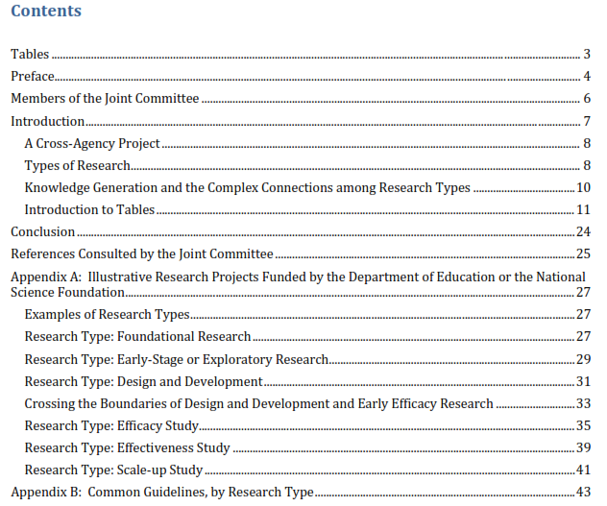
  NSF/IES guidelines “intended to improve the quality, coherence, and pace of knowledge development in STEM education”
2013

Slide 24
Common Guidelines
  The Common Guidelines describe the roles of different types of R & D projects in generating evidence about strategies and interventions for enhancing student learning
For each type of R & D, the Common Guidelines describe:
  Purpose
  Empirical and theoretical justifications
  Types of project outcomes
  Quality of evidence
  Missing ??

Slide 25
Common Guidelines
STEM education R & D projects that contribute to core knowledge
  Type #1: Foundational
    test, develop, or refine models of learning or teaching
    generate fundamental understandings related to learning and education
  Type #2: Early stage/exploratory
    examine relationships among constructs to establish logical connections that may form the basis for future interventions to improve education outcomes

Slide 26
Common Guidelines
  Type #3: Design and development
    draw on existing models and theories
    iteratively design, develop, and test interventions (new curricula, approaches to teaching and learning, applications of technology, practices, policies)

Slide 27
Common Guidelines
Impact Studies: assess impacts of fully-developed intervention on education-related outcome(s)
  Type #4: Efficacy studies: estimate the impacts under “ideal” conditions (e.g., developer involvement, higher levels of support than typical)
  Type #5: Effectiveness studies: examine implementation and estimate impacts similar to routine practice but on a limited scale
  Type #6: Scale-up studies: explore implementation and estimate impacts under conditions that prevail under wide-scale adoption

Slide 28
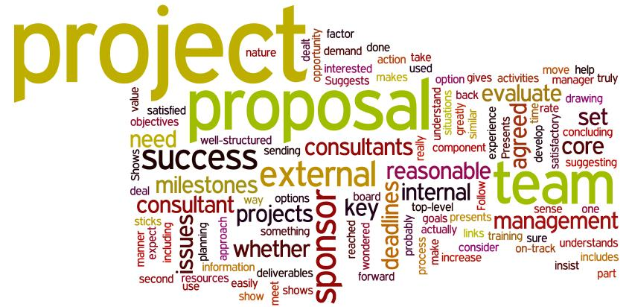
Questions?

Slide 29



EHR is committed to a healthy and vital national STEM enterprise.
$866
million FY 2016 estimation
701
awards funded
All S&E disciplines funded
funds research, education and related activities
481
EHR-funded
Institutions
Funds research into STEM
education
97%
4,049
proposals
145,000
EHR-supported individuals
42 former GRF fellows received Nobel Prize
Other than the FY 2015 estimation, numbers shown are based on FY 2014 activities.
Notes:
Numbers have been updated with BFA figures 1/13/15

