Slide 1
Working at NSF

Slide 2
NSF Appointment Types
Excepted Service (Temporary or Permanent)
Usually short term, e.g., bring in former PO to assist
Intergovernmental Personnel Act Assignments (IPAs)
Usual appointment for Faculty Members
General NSF program activities
Visiting Scientists, Engineers and Educators (VSEEs)
Specific scientific information, capability

Slide 3
What is an IPA?
A member of some institution who is on loan – A Rotator - to NSF for a year, then maybe a second, maybe a third, and in unusual circumstances a fourth.
NSF Grant to Institution includes:
100% of 12 month salary (9 month salary plus summer support) plus per diem (~22k)*
IRD Supported (30-50 days per year)
Travel to home institution
Support personal research & students
Conferences
Conference Attendance Also Supported per program
3

Slide 4
Science and Engineering Onboard Counts
Notes:
Science / Engineering Only (about 40% of the NSF’s total workforce of 1532 employees in FY11)
Excludes NSB and OIG
FY11: 360 permanent, 159 IPAs, 40 VSEEs, 90 other
Data is of September for each fiscal year.
“Other” includes student, federal temporary, and other non-VSEE/IPA temporary appointments
Job family counts may differ from previous iterations of these charts due to updates to the job family field.

Slide 5
Why be a IPA/Rotator?
Be involved in national policy, research directions
Want a break from institutional life
Want to be in DC
Early career, Mid career, or Ending career
Service to the Profession
Service to the Institution
Inside knowledge
Influence institutional direction
Flexibility in funding
EAGERS
Workshops
5

Slide 6
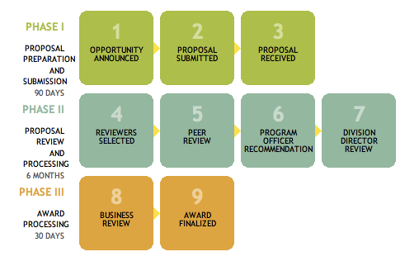
NSF Merit Review Process & IPA/PO
PO
I
N
V
O
L
V
E
D
Notes:
Program Directors make a recommendation to award or decline based on the input from merit review
Division Directors agree or not with this recommendation
Grants Officers make awards to organizations.
Committee of Visitors looks at the details of the Program process and outcomes and makes recommendations for improvement if needed
Image description: NSF Merit Review Process: Phase I consists of steps for proposal preparation and submission within 90 days; Phase II consists of steps for proposal review and processing within 6 months; and Phase III consists of steps for award processing within 30 days.

Slide 7
IPA Life
Get to live in DC!!
Choice: YMCA living to Four Seasons, your choice
DC Metro, Zipcar, (not sure exists) etc. remove need for car
Great museums, food, etc.
JOB: NSF Program Officer – PO
Manage Programs:
Process/review proposals – manage review panels
Write/Rewrite solicitations
Make Funding Recommendation
Deal with 100 to 125 unique proposals per year, 2-4 programs
Outreach to institutions and faculty
Workshops
Interesting community of IPAs and Permanent PO
Lots of Research talks
7

Slide 8
Life as an IPA
Example
Rented a two bedroom apartment in Balston
Wife with me, kids gone, dogs gone
Started with having a car: monthly fee, street parking impossible, dumped car
Got Metro passes
Walked to work, 2 blocks
Tend to work on weekends, did much of my reviewing
DUE interesting collection of people, institutions, etc.
Returned to HMC with a different view on grants, etc.

Slide 9
Rotator Issues
Relationship with institution
On leave ? Actually NO
How does time count towards sabbatical and promotion? Institutional Decision
How is 12 month salary paid? Summer Salary or Monthly Increase, institutional Decision
Office? NSF Says Yes, still member of home Institution
Merit Review? Institutional Decision
IR&D Support
Students, Research Lab, etc.
Off All NSF Projects

Slide 10
Becoming an IPA
How does it work?
Find a Position
Online
Current IPAs – Sigcse table or call
Convince your institution
What happens:
TDY – still Full Time voting member of faculty
Full Salary + Summary Salary + PerDiem
NSF Interview Process

Slide 11
To apply for positions at NSF
Go to http://www.nsf.gov/about/
Click on “Career Opportunities” then “Job Openings”
Then select “Scientific/Engineering/Education”
Select your Directorate of Choice from the dropdown menu, click on the green arrow, and open your desired position.
Contact the relevant NSF program office
Contact the Division of Human Resource Management
Check http://www.usajobs.gov
For more information about rotator opportunities at NSF, please visit: http://www.nsf.gov/careers/rotator/

Slide 12
Questions?

Slide 13
IPAs Intergovernmental Personnel Act
Notes:
TUES Program

