Slide 1

NSF Overview
Mike Erlinger
Program Director: July 2014 to July 2016
NSF Division of Undergraduate Education (DUE)
Education and Human Resources Directorate (EHR)

Slide 2
Important!
All information provided here represents the opinions of an (current or former) individual Program Officer and is based on a particular experience
The ONLY official source for NSF policy is published materials
http://nsf.gov/

Slide 3
Who Are We?
National Science Foundation
  An independent federal agency created by Congress in 1950 "to promote the progress of science; to advance the national health, prosperity, and welfare; to secure the national defense…“
Part of the executive branch
Very important – controlled/managed by both the executive branch and congress (money)

Slide 4
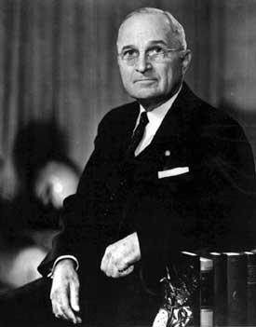
NSF is Established (May 10, 1950)
“I have just signed the National Science Foundation Act of 1950. This act is of tremendous importance, because it will add to our knowledge in every branch of science. I am confident that it will help us to develop the best scientific brains in the Nation. It will enable the United States to maintain its leadership in scientific matters, and to exert a more vital force for peace.“
HARRY S. TRUMAN, May 10, 1950

Slide 5
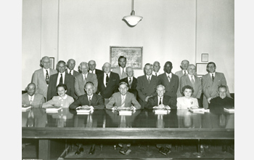
NSF Mission (1950)
To promote the progress of science; to advance the national health, prosperity and welfare; to secure the national defense.
NSF Vision (2014-2018)
A Nation that creates and exploits new concepts in science and engineering and provides global leadership in research and education.
NSF-3
Notes:
5
Image description: Members of the National Science Board of 1950.

Slide 6
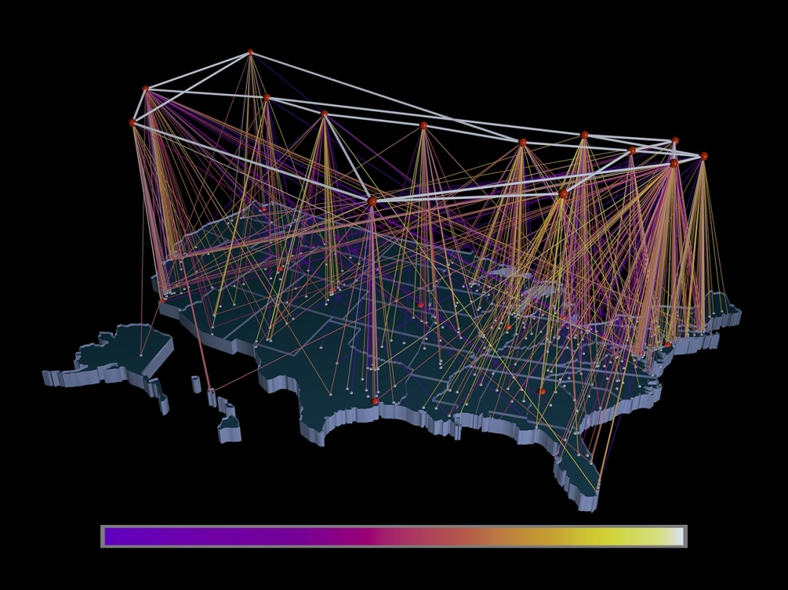
What Has the NSF Done for Me?
Bar Codes
Internet
Internet Search
Public-key Cryptography
Speech Recognition
Supercomputers
Reading Rainbow
Nova
NPR
Student Scholarships, graduate & undergraduate

Slide 7

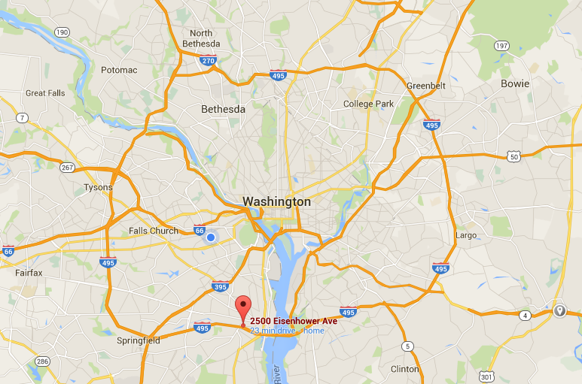
New NSF Headquarters

Slide 8


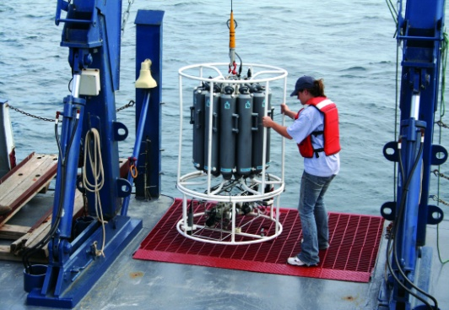
NSF’s Strategic Goals
Transform the Frontiers of Science and Engineering.
Stimulate Innovation and Address Societal Needs through Research and Education
Excel as a Federal Science Agency
Notes:
Strategic goals updated (May 26, 2011) from http://www.nsf.gov/news/strategicplan/
Image description 1: Crowd of people walking.
Image description 2: Silhouette of a man looking at a computer.
Image description 3: Researcher working with equipment on a ship.

Slide 9
NSF STEM Goals
Develop the STEM/STEM-related workforce
Advance science
Broaden participation in STEM
  CISE, EHR
Educate a STEM-literate populace
  CS Majors or CS+X
Build capacity in higher education
Improve K-12 STEM education
  AP CS Principles (~95k exams 2019)
Encourage life-long learning

Slide 10
NSF STEM Workforce Priorities
Prepare students to be leaders, teachers, and innovators in emerging and rapidly changing STEM fields
Develop a scientifically literate populace
Both depend on the nature and quality of the undergraduate education experience, but go beyond undergraduates

Slide 11



11,000
awards funded
All S&E disciplines funded
$7.3
billion FY 2015 estimation
funds research, education and related activities
1,826
NSF-funded
Institutions
Funds research into STEM
education
94%
48,100
proposals
320,900
NSF-supported researchers
214 Nobel Prize winners
NSF by the numbers
Other than the FY 2015 estimation, numbers shown are based on FY 2014 activities.

Slide 12
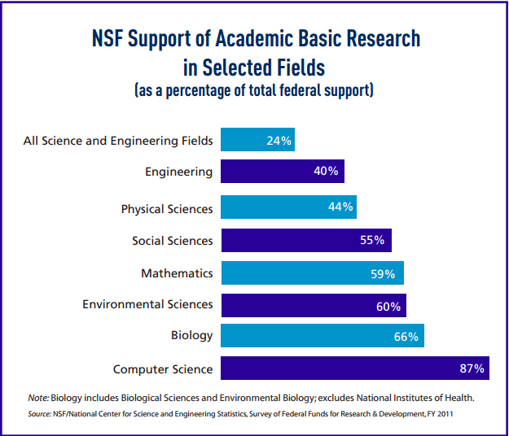
NSF : Share of Total Federal Support
With an annual budget of about $7 billion, NSF funds approximately 25 % of all federally supported basic research conducted by U.S. colleges and universities.
Notes:
Data based on FY15 budget request.

Slide 13
Board
(National Science NSB)
Director
Deputy Director
Office of the General Counsel
Office of International and
Integrative Activities
Office of Diversity and Inclusion
Office of the
Inspector General
(OIG)
Office of Legislative &
Public Affairs
NSF Organizational Chart
Office of Polar Programs
Biological
Sciences
(BIO)
Computer &
Information
Science &
Engineering
(CISE)
Engineering
(ENG)
Geosciences
(GEO)
Mathematical
& Physical
Sciences
(MPS)
Social,
Behavioral
& Economic
Sciences
(SBE)
Education
& Human
Resources
(EHR)
Budget, Finance
& Award
Management
(BFA)
Information
& Resource
Management
(IRM)

Slide 14
NSF Workforce
Consists of approximately
  1,478 Federal employees (includes staff of the National Science Board Office and the Office of the Inspector General);
  179 Non-Federal Intergovernmental Personnel Act (IPA) assignees coming from research institutions;
  450 contract workers.
Unlike other science agencies, NSF does not maintain its own research laboratories.
Notes:
Updated from end of FY 2013 data from FPPS.

Slide 15
NSF Work:
Programs & The Merit Review Process

Slide 16
What is a Program?
A well-defined grant-giving function, usually with a well-defined budget
Usually means an individual investigator grant program, but could also refer to a facilities program (e.g., National Radio Astronomy Observatory), a center program or fellowship program for students.
New programs (directions) and refinements ongoing
Programs are the implementation arm of NSF.
16

Slide 17
What do Program Directors do?
Program Directors (Officer) oversee the National Science Foundation’s “gold standard” merit review process.
Program directors have the opportunity to be involved with a broad spectrum of national scientific programs and initiatives that ultimately increase intellectual awareness and enhance professional growth.

Slide 18
What is NSF’s Merit Review Process?
The review process ensures that proposals submitted to NSF are reviewed in a fair, transparent, and in-depth manner;
NSF proposals receive an external review by experts;
Program Officers make funding recommendations based on the input received from reviewers.
NSF receives approximately 49,000 proposals each year for research, education and training projects, of which approximately 10,800 are funded.
Notes:
Updated March 10, 2014 with recommendations from BFA’s Jeremy Leffler.

Slide 19
Merit Review Criteria Guiding Principles
All NSF projects should be of the highest quality and have the potential to advance, if not transform, the frontiers of knowledge.
NSF projects, in the aggregate, should contribute more broadly to achieving societal goals.
Meaningful assessment and evaluation of NSF funded projects should be based on appropriate metrics, keeping in mind the likely correlation between the effect of broader impacts and the resources provided to implement projects.

Slide 20
Merit Review Criteria
When evaluating NSF proposals, reviewers consider what the proposers want to do, why they want to do it, how they plan to do it, how they will know if they succeed, and what benefits would accrue if the project is successful. These issues apply both to the technical aspects of the proposal and the way in which the project may make broader contributions. To that end, reviewers are asked to evaluate all proposals against two criteria:
Intellectual Merit: The Intellectual Merit criterion encompasses the potential to advance knowledge; and
Broader Impacts: The Broader Impacts criterion encompasses the potential to benefit society and contribute to the achievement of specific, desired societal outcomes.

Slide 21
Five Review Elements
The following elements are considered in the review for both Intellectual Merit and Broader Impacts:
1. What is the potential for the proposed activity to:
a. advance knowledge and understanding within its own field or across different fields (Intellectual Merit); and
b. benefit society or advance desired societal outcomes (Broader Impacts)?
2. To what extent do the proposed activities suggest and explore creative, original, or potentially transformative concepts?
3. Is the plan for carrying out the proposed activities well-reasoned, well-organized, and based on a sound rationale? Does the plan incorporate a mechanism to assess success?
4. How well qualified is the individual, team, or institution to conduct the proposed activities?
5. Are there adequate resources available to the PI (either at the home institution or through collaborations) to carry out the proposed activities?
Notes:
The five review elements apply to both criteria

Slide 22
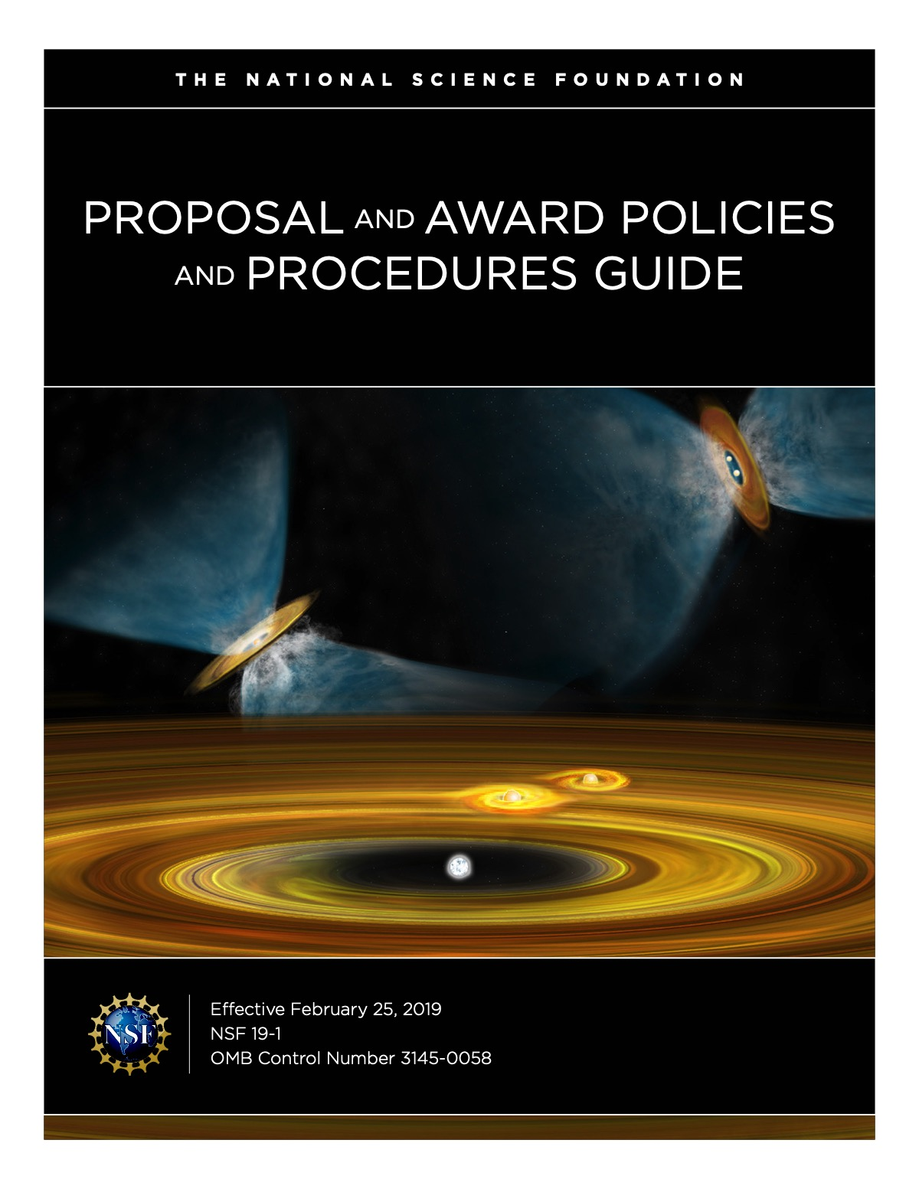

Slide 23
NEW: Proposal and Award Policies and Procedures Guide (PAPPG, NSF 19-1)
Effective February, 2019!
https://www.nsf.gov/pubs/policydocs/pappg19_1/index.jsp
Name change: No more GPG and AAG.
Strict e-enforcement of submission deadline,
5 p.m. local time
Letters of collaboration – Supplementary Docs
Biosketches must be submitted as PDF
Many significant changes from previous editions

Slide 24
From previous revisions:
You must specifically address Intellectual Merit and Broader Impacts in the Project Summary AND in the Project Description.

Slide 25
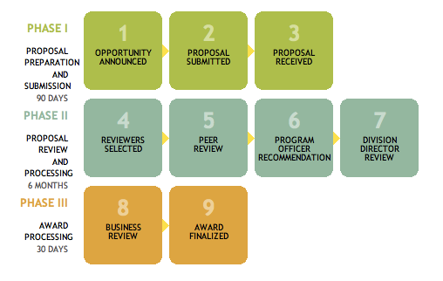
NSF Merit Review Process
Minimum 90 Days
Maximum 6 months
1 Month
Notes:
Program Directors make a recommendation to award or decline based on the input from merit review
Division Directors agree or not with this recommendation
Grants Officers make awards to organizations.
Committee of Visitors looks at the details of the Program process and outcomes and makes recommendations for improvement if needed
Image description: NSF Merit Review Process: Phase I consists of steps for proposal preparation and submission within 90 days; Phase II consists of steps for proposal review and processing within 6 months; and Phase III consists of steps for award processing within 30 days.

Slide 26

Questions?

Slide 27
Legislation authorizes NSF to …
Initiate and support scientific and engineering research, including applied research, at academic and other nonprofit institutions and, at the direction of the President, support applied research at other organizations.
Recommend and encourage the pursuit of national policies for the promotion of basic research and education in the sciences and engineering. Strengthen research and education innovation in the sciences and engineering, including independent research by individuals, throughout the United States.
Support activities designed to increase the participation of women and minorities and others underrepresented in science and technology.

Slide 28
