Slide 1

NSF
Merit Review
Proposal creation
Mike Erlinger
Program Director: July 2014 to July 2016
NSF Division of Undergraduate Education (DUE)
Education and Human Resources Directorate (EHR)

Slide 2
Important!
All information provided here represents the opinions of individuals
The only official source for NSF policy is published materials
http://nsf.gov/

Slide 3
Merit Review of
Proposals
Notes:
TUES Program

Slide 4
Merit Review
Two Criteria Specified
  Intellection Merit
  Broader Impacts
Others in Play
  Ed Research in DUE
  Solicitation specific Requirements
Well Defined Evaluation Process
  Diverse Panels
  PO Comments
  Review by management

Slide 5
Useful Resources
NSF: www.nsf.gov
Guide to Program:
www.nsf.gov/funding/browse_all_funding.jsp
Award Information: www.nsf.gov/awardsearch
FastLane: www.fastlane.nsf.gov
Broader Impacts: www.nsf.gov/pubs/gpg/broaderimpacts.pdf
Data Management Plan: www.nsf.gov/bfa/dias/policy/dmp.jsp
Funding Opportunities: www.nsf.gov/funding
Education Research: www.nsf.gov/pubs/2013/nsf13126/nsf13126.pdf
Program Web Page

Slide 6

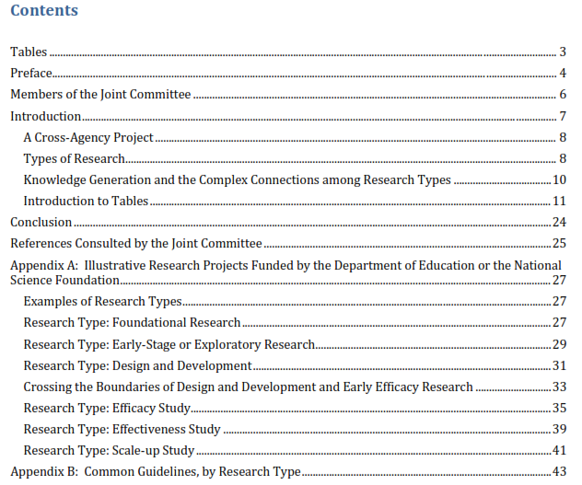
  NSF/IES guidelines “intended to improve the quality, coherence, and pace of knowledge development in STEM education”
2013

Slide 7
Common Guidelines
  The Common Guidelines describe the roles of different types of R & D projects in generating evidence about strategies and interventions for enhancing student learning
For each type of R & D, the Common Guidelines describe:
  Purpose
  Empirical and theoretical justifications
  Types of project outcomes
  Quality of evidence
  Missing ??

Slide 8
The Review Process

Slide 9
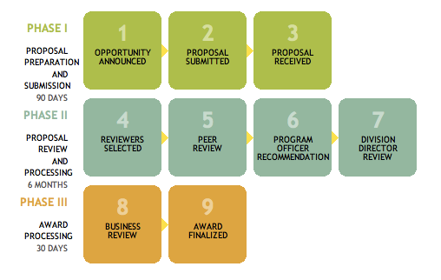
NSF Merit Review Process
Notes:
Program Directors make a recommendation to award or decline based on the input from merit review
Division Directors agree or not with this recommendation
Grants Officers make awards to organizations.
Committee of Visitors looks at the details of the Program process and outcomes and makes recommendations for improvement if needed
Image description: NSF Merit Review Process: Phase I consists of steps for proposal preparation and submission within 90 days; Phase II consists of steps for proposal review and processing within 6 months; and Phase III consists of steps for award processing within 30 days.

Slide 10
NSF Peer Review Process
Reviewers are invited by program directors
  Number of proposals determines the number of panels
  Panels types: Face to face or virtual
  5-6 reviewers/panel
  12-14 proposals/panel
Reviewers write individual reviews and assign ratings for all assigned proposals before the panel convenes
Panels typically meet over a 2 day period

Slide 11
Overview of the Review
The review expresses the reviewers expert opinions about the quality of the proposed projects
Use the rating to indicate overall evaluation of the proposal
Organize review into sections for IM and BI
For each section (IM and BI) use the text to
  Describe the evidence supporting the rating
  Identify concerns
  Provide suggestions for improvement

Slide 12
Review Material
The entire proposal is used to inform reviewers
  Project Summary Project Description
  Biographical sketches
  Budget
  Supplementary documentation, etc
But Summary & Description are focus of Review
Notes:
12
During talk need to give the appropriate directive relative to the need to read or use Supplementary Documentation

Slide 13
Parts of the Review
Rating
  Excellent, Very Good, Good, Fair, and Poor
Text - evidence supporting the rating presented in terms of
  Intellectual Merit (IM)
  Broader Impacts (BI)

Slide 14
Panel Review Meeting
Program officer facilitates the panel
Proposals are discussed individually
Each proposal will have at least 3, typically 4, reviews
A “scribe” is designated to capture all of the points brought up in discussion and produce a summary review – called the “Panel Summary”
The scribe will often start the discussion
All reviewers return on day 2 to review and approve the Panel Summaries

Slide 15
Panel Summary
Purpose
  to capture thoughts not expressed in individual reviews
  to indicate areas of general agreement and disagreement
Summary does not contain a rating

Slide 16
Practical Aspects of Review Process
Reviewers have:
Many proposals (ten or more from several areas)
Limited time for each proposal
Different experiences in review process
  Veterans to novices
Different levels of knowledge in proposal area
  Experts to outsiders
Discussions of proposals’ merits at panel meeting
  Share expertise and experience

Slide 17
Audience for Reviews
NSF program directors
  Informs recommendations relative to funding
  Guides pre-award negotiations
Applicants
  If proposal is funded:
    Provides suggestions for improving project
  If proposal is not funded:
    Provides information to guide a revision of the proposal

Slide 18
The Proposer Receives…
NATIONAL SCIENCE FOUNDATION
4201 Wilson Boulevard
Arlington, Virginia 22230
Dear Dr. Doe,
The National Science Foundation hereby awards a grant of...
NATIONAL SCIENCE FOUNDATION
4201 Wilson Boulevard
Arlington, Virginia 22230
Dear Dr. Doe,
I regret to inform you that the National Science Foundation is unable to support your proposal referenced above...
$
&
Reviews
Panel Summary
(if applicable)
Context statement
&
Award/Declination letter

Slide 19
Confidentiality
What you read and discuss as panelists
  do not quote or use
  leave all proposals behind
  do not discuss outside of panel
Don’t reveal your identity to the PIs
  they receive anonymous copies of all reviews
  don’t discuss reviews once you leave

Slide 20
Proposal Creation
Obvious Commandments
Notes:
TUES Program

Slide 21

Don’t Wait!!

Slide 22
Remember This!!!
Write to the solicitation
Grant writing is not an exercise in creative writing!!
MERGE Solicitation Specs with Your Project
Change your Project NOT Solicitation!!!

Slide 23
Guidelines: Proposal Structure
Follow the solicitation and PPAPG Adhere to page, font size, and margin limitations
    Use allotted space but don’t pad the proposal
    NOW Auto Checked!!!
  Follow suggested (or implied) organization
  Use appendices sparingly (check solicitation to see if allowed)
  Include letters showing commitments from others
    Avoid form letters

Slide 24
Guidelines: Writing
Use good style (clarity, organization, etc.)
  Be concise, but complete
  Write simply but professionally
  Avoid jargon and acronyms
  Check grammar and spelling - Fastlane
  Use sections, headings, short paragraphs & bullets (Avoid dense, compact text)
  Provide appropriate level of detail
  Poorly formatted proposals are hard to read

Slide 25
Guidelines: Proposal Writing
Reinforce your ideas
    Summarize; highlight with judicious use of bolding, italics
Give examples
Use tables, figures – where it makes sense – Write to the Figure!!!
Reference your referencs

Slide 26
Guidelines: Your Audience
Community: About 5 reviewers
  Usually in your discipline (not always your field)
  Do not assume they are experts in what you are proposing to do
  You need to provide enough detail for them to understand what you want to do
NSF: Program Officer
Public: Funded Proposals

Slide 27
Guidelines: First (Second?) Page
The first page of your proposal is the most important
Must sell your audience on your idea and get them excited about it
If you lose them they will spend their time looking for ways to ding you

Slide 28
Project Summary
Pay special attention to Project Summary
  Plainly state what you plan to do
  Summarize goals, rationale, methods, and evaluation and dissemination plans
  Address intellectual merit and broader impacts
    Explicitly and independently
  Three paragraphs with headings:
    “Summary”
    “Intellectual Merit”
    “Broader Impacts”

Slide 29
Mike’s Commandments
Notes:
TUES Program

Slide 30
Me:
READ the solicitation
MANY Solicitations have specific REQUIREMENTS
HIDDEN!

Slide 31
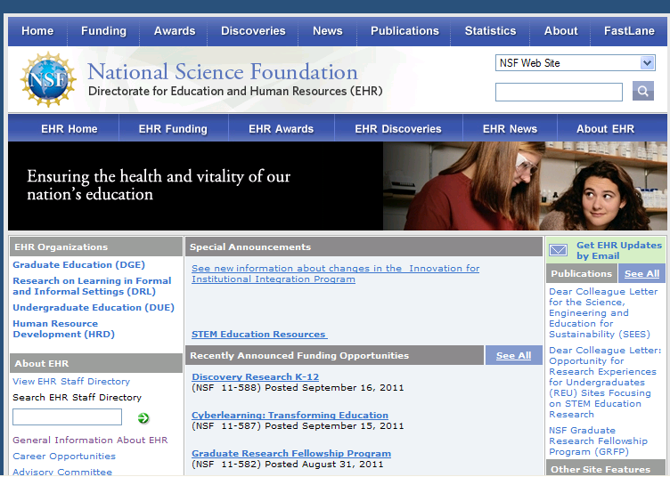
ME: Review Funded Projects
Abstracts of Recent Awards

Slide 32
ME: Build on Past Projects
Use Google!!!
You have done the literature search, make sure to use it. Most good ideas are based on past ideas and maybe even the same idea. Find the references.
Make sure you project reflects any Best Practices, e.g., any K12 in service PD requires X hours to be of value.
Look for references with proven approaches and evidence.
If your approach is new or better, explain why. Ed Research is the new emphasis of DUE. Figure out what it means for what you want to do. Find and READ, “Common Guidelines for Education Research and Development”

Slide 33
ME: It Is All Research
NSF Motto says:
  Supporting Education and Research across all the fields of Science, Mathematics and Technology.
The NSF has made it clear that Education must including validation of learning based on Educational Research. This requires a good Ed Research justification for any new proposal, i.e., no more anecdotal ‘good idea’

Slide 34
ME: Education Research Question
In DUE Always required. You cannot just gather data, rather you need to have a purpose for that data and then be able to show some learning progress.
This is probably the most important feature of new proposals. Creating such a question is something that probably goes beyond the technical PI.
Ed Research is the primary concern of EHER/DUE (Division of Education).
  Figure out what it means for what you want to do.
  Find and READ, “Common Guidelines for Education Research and Development”

Slide 35
Common Guidelines for Ed Research
Developed by the Department of Education and the NSF
Search
  Common Guidelines for Education Research and Development
Defines 6 types of research
Reading will put you in the proper “mindset”

Slide 36
ME: Second Reader
The largest mistake that I have noticed in my ‘rejected’ proposals is the lack of a internal ‘2nd Reader’. Proposal writers do NOT get someone in their department or field to read their proposal nor do they get someone outside their particular emphasis to read their proposal.
Panel summaries of rejected proposals almost always refer to the lack of clarity.
  The classic is: “very interesting concept, no idea what is actually being proposed”
Also, someone needs to catch the grammar and spelling issues, etc. - FastLane HATES smart quotes!!!

Slide 37
ME: This is Research So Treat it as Such
Read the Literature, Determine Adequate References
Define Hypotheses based on literature and your ideas
Design an experiment to test Hypothesis, i.e., your Proposal
Independently, Determine assessment questions
Gather Data
Analyze Outcomes
Tell the world

Slide 38
ME: Turn in Reports from Prior Awards
You cannot have new money if you owe reports on old money. True of the PI and any CoPI, and now institutions.
Realize it may take some time for a program officer to approve a report, so last minute Reports are an issue.

Slide 39
ME: Write to the Figure
Figures and tables are powerful, but the text needs to match the figure. After you insert the figure make sure that the text really does go along with the figure.

Slide 40
ME: Commitment Letter not Support Letters
The classic prewritten letter for numerous people to say they like your proposal is useless. Letters need to show some level of commitment. Usually such letters will show program sustainment after NSF support, institution support, etc. NSF NOW HAS SPECIFIC WORDING

Slide 41
ME: Project Goals, Objectives, Management and Sustainability
Make CLEAR. Leave no doubt about what will be accomplished; who will accomplish what; and what happens when NSF goes away
The schedule needs to be defined and detailed enough that reviewers can follow your plan. Tables are good, but be sure to reference and clarify them in the text.
Reviews like a table showing responsibilities and schedule

Slide 42
ME: Support for Sustainability, Institution, Department, Others…
Are you alone? Is your department and institution going to support you? Are there others who will assist in your project. Saying the institution will sustain a project without some letter from the institution to that effect is an issue.
Sustainability (what happens when NSF $ is gone) is important. Institution support reflecting sustainability is important.

Slide 43
ME: Details of Prior Support
If there is prior support, make sure to provide details of success or failure. If this is a continuation, make sure to show how it continues the previous effort. Sentence saying “Our previous project was fantastic” does not cut it.

Slide 44
ME: Broader Impacts should be Broad
...should contribute more broadly to achieving societal goals...
May be accomplished through the research itself, through activities directly related to the research, or through activities that are supported by and complementary to the research.
Historically in Computer Science, Broader Impacts have meant underrepresented groups, but while necessary that idea is limiting. Consider, Citizen Science, Workforce Development, etc. Think Globally

Slide 45
ME: Volunteer for Panel Reviews
Panels are an important way to learn how the review process works. Also they are a way to learn about NSF. You get paid. More panels are moving to Virtual which reduces travel, but also panel interaction.

Slide 46
ME: Evaluation
The NSF has moved quickly through the steps:
  from: no evaluation requirement
  to : you need to have an evaluation or assessment
  to : you need an evaluator outside your department
  to: you should (must) have external evaluation which includes both evaluation and an Ed Research question.
For many of the large continuing Solicitations, e.g., STEM+C, NSF supports an outside firm to act as a source of evaluation and data management activities. So far these companies are ‘voluntary’ for PIs, but the future is clearly non-voluntary. In some cases, NSF may soon tell you the evaluation instruments (at a minimum) to be used.

Slide 47
ME: Data Management Plan Needs to be Real
Long term use of data should be part of preparation, e.g., someone may want to look at an evaluation of all the CS Principles courses. NSF wants to get your data for future use.
This could be accomplished in a number of ways, but you need to know that data management is extremely important to be able to justify the $s being spent, e.g.,
  http://www5.hmc.edu/ITNews/?p=2322
  http://libguides.libraries.claremont.edu/dmp

Slide 48
ME: No Tricky Titles
Congress is ever present with features like: Waste Book.
Catchy titles like ‘penetration testing’ for a security proposal are not going to fly.

Slide 49
ME: Who is the PI?
A technical proposal requires technical expertise from the start. Think about who should be on the cover as PI and CoPi.

Slide 50
ME: Dissemination
More than a web site!!! NSF has supported the development of a vast number of teaching improvements, ed research, etc. How will the world know what you have done?
eBooks are a new approach gaining traction.

Slide 51
ME: Common Review Panel Comments…
Failure to reference existing ed research and learning references
Failure to reference existing similar technical projects
Failure to adequately address evaluation and assessment
Over 50% of my declines said: “Prior to submitting any future proposal, you might consult the NSF documents, ‘Common Guidelines for Education Research and Development’ and ‘Grant Proposal Guide’”.
Many declines also said: “It is not clear why the approach advocated here is preferable or fundamentally different (more learning) than similar existing projects.”

Slide 52
Summary

Slide 53
What makes a good proposal?
A good idea that is a significant improvement
A capable person or team to do the project
Time, equipment, technical support to carry out the project
Preliminary work helps
Knowing the literature -- what has been done elsewhere -- and building on it

Slide 54
What makes a good proposal?
Put the project in context -- local and national
Be specific about what is to be done and who will do it
Describe what the project will accomplish - products
Describe evaluation and dissemination appropriate to the project
Relate the budget to what is to be done

Slide 55
To Become a Reviewer
The best way to learn how to write a great proposal is review proposals, i.e., serve on a review panel
  Let NSF PO know you are interested in reviewing
  Mention the specific program(s) you wish to review for
  Each program maintains its own list of interested reviewers

Slide 56
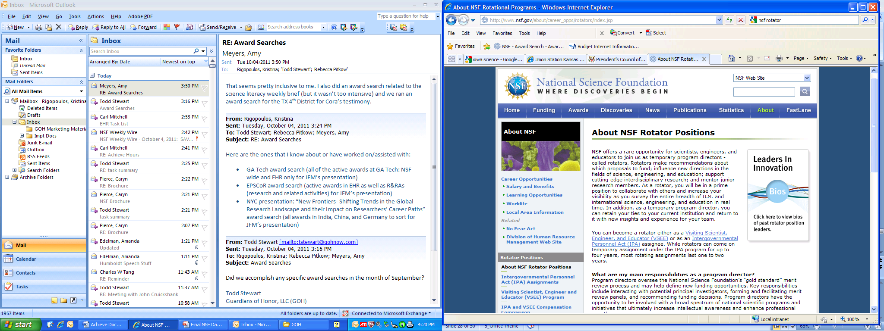
Stay Connected
Submit Proposals
Serve as Reviewers and Panelists
Be Active as Workshop Participants
and Organizers
Consider Being a Rotator
http://www.nsf.gov/about/career_opps/rotators/index.jsp
For information on a particular EHR division and program, go to the EHR website and choose a division.
http://www.nsf.gov/dir/index.jsp?org=EHR
Contact NSF Program Directors for questions and suggestions.

Slide 57
Additional Information
NSF Proposal Processing and Review (includes Review Criteria) http://www.nsf.gov/pubs/policydocs/pappguide/nsf11001/gpg_3.jsp
Merit Review http://nsf.gov/bfa/dias/policy/meritreview/
Merit Review Facts http://nsf.gov/bfa/dias/policy/meritreview/facts.jsp

Slide 58
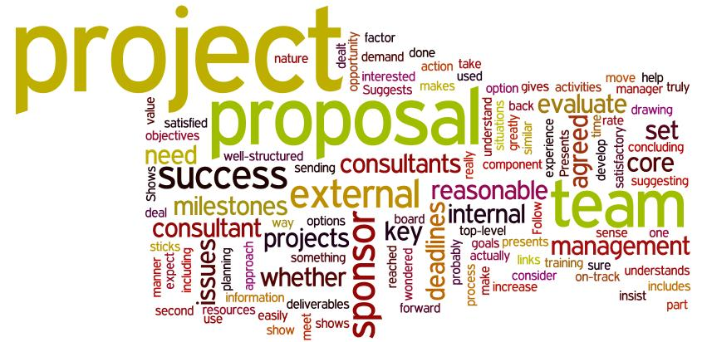
Questions?

Slide 59
Most Critical Concern for ALL EHR Programs

Slide 60
Proposal Development and Processing Timeline
NSF
Proposal
Generating
Document
Minimum
of three reviews
required
Award via DGA
Ad hoc
Program Officer
Analysis &
Recommendation
Organization
submits
via
FastLane
Division
Director
Concur
Panel
Proposal
Processing
Unit
Both
Decline
NSF Program Officer
Returned as Inappropriate/
Withdrawn
Research &
Education
Community
Organization
Div. Dir. Concur
Div. Dir. Concur
Award
Proposal received by NSFNSF
Award
90 Days
6 months
30 days
Proposal Preparation Time
Proposal Preparation Time
Review of Proposal
PO Recommend
PO Recommend
DGA Review &
Processing of Award

Slide 61
Common Guidelines
STEM education R & D projects that contribute to core knowledge
  Type #1: Foundational
    test, develop, or refine models of learning or teaching
    generate fundamental understandings related to learning and education
  Type #2: Early stage/exploratory
    examine relationships among constructs to establish logical connections that may form the basis for future interventions to improve education outcomes

Slide 62
Common Guidelines
  Type #3: Design and development
    draw on existing models and theories
    iteratively design, develop, and test interventions (new curricula, approaches to teaching and learning, applications of technology, practices, policies)

Slide 63
Common Guidelines
Impact Studies: assess impacts of fully-developed intervention on education-related outcome(s)
  Type #4: Efficacy studies: estimate the impacts under “ideal” conditions (e.g., developer involvement, higher levels of support than typical)
  Type #5: Effectiveness studies: examine implementation and estimate impacts similar to routine practice but on a limited scale
  Type #6: Scale-up studies: explore implementation and estimate impacts under conditions that prevail under wide-scale adoption

Slide 64
Helpful Hints
Read the Program Solicitation (several times)
Work on projects you care deeply about
Build on what others have done

Slide 65
Helpful Hints (continued)
Think global - act local and global
Have measurable goals and objectives
Think teamwork

Slide 66
Helpful Hints (continued)
Use Good Management Skills
Evaluation is impact and effectiveness
Spread the word
Pay back time

Slide 67
10 Fatal Flaws
Assume deadlines are not enforced
Assume page limits and font size restrictions don’t matter
Substitute flowery rhetoric for good examples
Don’t check your speeling nore you’re grammer
Assume program guidelines have not changed, or better yet, ignore them.

Slide 68
10 Fatal Flaws (continued)
Assert evaluation will be ongoing and consist of a variety of methods
Assume a website is sufficient for dissemination
Assume your past accomplishments are well known
Provide “support” rather than “commitment” letters
Inflate your budget to allow for negotiations

Slide 69
Last words...
Think beyond the material, to affect and the broader implications of what we do.
Study whether our innovations are effective, and share them with others

