Slide 1
NSF DUE PROGRAMS
Mike Erlinger
Former NSF DUE PO
NSF Division of Undergraduate Education (DUE)
Education and Human Resources Directorate (EHR)
Caution:
All the information included in this presentation represents the opinions of the individual program officer and not an official NSF position.
Notes:
Warn the audience that there will be some redundancy with yesterday’s workshop!
NSF History in a Nutshell
The National Science Foundation (NSF) is an independent federal agency created by Congress in 1950 "to promote the progress of science; to advance the national health, prosperity, and welfare; to secure the national defense…"
With an annual budget of $7.5 billion (FY 2017), we are the funding source for approximately 24 percent of all federally supported basic research conducted by America's colleges and universities. In many fields such as mathematics, computer science and the social sciences, NSF is the major source of federal backing.

Slide 2
Selected STEM Education Programs
DUE Programs
  Advanced Technological Education (ATE)
  Improving Undergraduate STEM Education (IUSE:EHR)
  Robert Noyce Teacher Scholarship Program (Noyce)
  Scholarships in Science, Technology, Engineering, and Mathematics Education (S-STEM)
EHR-Wide Programs
  EHR Core Research (ECR)
  Improving Undergraduate STEM Education: Hispanic-Serving Institutions (HSI Program)
Cross-Directorate Programs
  Research Experiences for Undergraduates (REU: EHR)
  Faculty Early Career Development (CAREER) Programs
  Research Coordination Networks for Undergraduate Biology education (RCN: UBE)
  INCLUDES and other Programs
Notes:
NSF INCLUDES (Inclusion across the Nation of Communities of Learners of Underrepresented Discoverers in Engineering and Science) is designed to create paths to STEM for underrepresented populations, expanding the nation's leadership and talent pools.

Slide 3
DUE’s Mission:
To promote excellence in undergraduate science, technology, engineering, and mathematics (STEM) education for all students.

Slide 4

Projects
Transformative activity involves ideas, discoveries, or tools that radically change our understanding of an important existing scientific or engineering concept or educational practice or leads to the creation of a new paradigm or field of science, engineering, or education. Such research challenges current understanding or provides pathways to new frontiers.
Transformative activity results often do not fit within established models or theories and may initially be unexpected or difficult to interpret; their transformative nature and utility might not be recognized until years later.
Transformative Activity
Challenges conventional wisdom
Leads to unexpected insights that enable new techniques or methodologies
Redefines the boundaries of science, engineering, or education
Notes:
An important component of both the Intellectual Merit and the Broader Impacts criteria is whether the proposed research is potentially transformative.

Slide 5
ATE
Advanced Technological Education
Solicitation: NSF 17-568
Due Date: October 4, 2018
October 3, 2019
Notes:
Emphasis on 2-yr colleges
Program focuses on the education of technicians for the high-technology fields that drive our nation's economy (workforce prep)

Slide 6
Advanced Technological Education (ATE) Program
NSF 17-568
ATE focuses on the education of technicians to meet workforce demands in existing and emerging advanced technological fields.
Colleges that award two-year degrees and their faculty must play a leadership role on all projects.
Program Solicitation
Requires partnerships between two-year colleges and business and industry, along with secondary schools, four-year colleges and universities, and government, as appropriate.
Must respond to hiring needs for highly-skilled technical workforce in the service area of the proposing institution(s).
Must address sustainability.
Read the program solicitation for more detailed information.
Due 1st Thursday in October
Notes:
Education of science and engineering technicians for high-technology fields that drive the nation’s economy
Projects, Centers, and Targeted Research on Technician Education
Community and technical colleges must be in leadership roles
Grades 7-12, two-year and four-year institutions (pathways)
Education / Industry partnerships are a hallmark of ATE

Slide 7
ATE: Three Program Tracks
Projects Centers Targeted Research
Up to $600k, up to 3-yrs on Technician Education
except From $150K, up to 2-yrs
Small/New to ATE ($225K) to $800K, up to 3-yrs
Adapt & Implement ($300-300K)
Instrumentation Acquisition
($400-500K) Two Types
    Center Resource Center
up to $5 million, 5-yrs up to $600K, 3-yrs
One renewal possible One renewal possible

Slide 8
ATE Project Focus Areas
Program Development and Improvement
Curriculum and Educational Materials Development
Professional Development for Educators
Leadership Capacity Building for Faculty
Teacher Preparation
Business and Entrepreneurial Skills Development for Students
ATE Coordination Networks
Small Grants for Institutions New to the ATE Program**
Adaptation and Implementation
Instrument Acquisition with Curricular Modifications to Support the Instrumentation
See ATE solicitation NSF 17-568 for more details!
Notes:
7. Small-new:
no ATE award initiated in last 7 years (based upon start date)
get started and positioned for being competitive for larger projects
needs to be for INITIATING SOMETHING NEW
Additional project focus areas in
Adaptation and Implementation
and
Instrumentation Acquisition
have been added.

Slide 9
ATE Program Impact
Over 1500 awards since 1994
632 distinct institutions have received awards
65% of awards have gone directly to 2-year institutions
Over $1 billion awarded since 1994
In 2016, collaborators provided approximately $27 million in monetary and in-kind support

Slide 10




Improving Undergraduate STEM Education (IUSE: EHR)
Improve STEM Learning & Learning Environments
Build the Professional STEM Workforce for Tomorrow
Broaden Participation & Institutional Capacity for STEM Learning
Proposals should describe projects that build on available evidence and theory, and that will generate evidence and build knowledge.
NSF 17-590
D&I due 2nd Tuesday in Dec, E&D no deadline

Slide 11
IUSE: EHR
Two Program Tracks
Engaged Student Learning
Institutional and Community
Transformation
Focus on designing, developing, and implementing research on STEM learning models, approaches, and tools
Focus on increasing the propagation of highly effective methods of STEM teaching and learning
Two Approaches
Two Approaches
Exploration
& Design
(smaller scale)
Development
& Implementation
(larger scale)
Exploration
& Design
(smaller scale)
Development
& Implementation
(larger scale)
Up to $300K
Up to 3 yrs
Level I:
Up to $600K, Up to 3 yrs
Level II:
$600K to $2M, Up to 5 yrs
Up to $300K
Up to 3 yrs
Up to $3M
Up to 5 yrs
Submission Window: Oct. 01, 2017 –
Oct. 01, 2018
Submission Window: Oct. 01, 2017 –
Oct. 01, 2018
Due Date: Dec. 12, 2017
Due Date: Dec. 12, 2017

Slide 12
Improving Undergraduate STEM Education: Hispanic-Serving Institutions
HSI Program
SOLICITATION: NSF 18-524
Due: March 6, 2018

Slide 13
HSI Tracks
Track 1: Building Capacity
$500K to $1.5M up to 5 years
Resource Hub
Up to $3M for up to five years
Up to $250K for up to 3 years
Track 2: New to NSF
Critical Transitions
Innovative Cross-Sector Partnerships
Research on Broadening Participation in STEM

Slide 14
S-STEM
Scholarships in STEM
SOLICITATION: NSF 17-527
Due Date: March 28, 2018
Last Wednesday in March, Annually Thereafter

Slide 15
Mission of the S-STEM Program
To provide scholarships
  to academically talented, low-income students
  with demonstrated financial need
  to increase STEM degree attainment and
  to enhance the homegrown STEM workforce
  ensuring the competitiveness of the US in the global workforce market.
Notes:
. The overarching purpose of the S-STEM program has remained constant. We are focused on providing scholarships to academically talented low-income students with demonstrated financial need to improve the STEM workforce with the intent of ensuring that the United States is competitive in the global workplace.
There are still three criteria for awarding scholarships to students.
Students must be academically talented (or have the potential to become so).
Students must be low-income and demonstrate financial aid needs as determined by your financial aid office evaluating a student’s FAFSA or GAANN form.
Students must be U.S. citizens and nationals of the United States (as defined in section 101(a) of the Immigration and Nationality Act), aliens admitted as refugees under section 207 of the Immigration and Nationality Act, or aliens lawfully admitted to the United States for permanent residence.
Note that the funding mechanism for S-STEM is different than for most other NSF programs. It is funded by H-1B visa fees. Corporations pay a visa fee to bring in a high-tech worker from another country and those funds are then used to further development of our own pool of high-tech workers.

Slide 16
The S-STEM Program: Brief Summary
Funding
  At least 60% of the funds must be used for scholarships (direct financial support to students)
  Up to 40% of funds may be used for other components: support structures, research, recruitment, mentoring, etc.
Required Elements
  Provide faculty mentors for S-STEM Scholars
  Develop a cohort experience for the scholarship recipients.
  Generate knowledge about “what works” for S-STEM Scholars
  Evaluate and disseminate what your project did
Notes:
In the new solicitation at least 60% of the funds must be used for student scholarships. This allows more funds to go into supporting high quality extant curricular and co-curricular activities, studies on the recruitment and retention of students, and the effectiveness of support structures.
So why has this changed? Providing students with scholarship support helps then overcome financial obstacles in their path to obtaining a STEM degree. However research has shown that scholarships alone are not sufficient to ensure that low-income academically talented students with demonstrated financial need complete degrees. It has become clear that scholarships along with participation in academic and student support activities result in retention and graduation in STEM fields. The additional funds now available allow PIs to provide more academic and student services support. They also will enable S-STEM awardees to gather systematic information and disseminate the “lessons learned” about how and what support structures or factors affect student outcomes in different circumstances.
The S-STEM program makes it possible for PIs to implement and adapt high-quality and effective extant curricular and co-curricular activities for recruiting and support structures to tackle unique challenges at their schools. It allows for the adaptation of effective programmatic elements and encourages PIs to study the effects of their implementation and disseminate that information to the broader community.

Slide 17
S-STEM Program Summary
Deadline: March 28, 2018
NSF Solicitation 17-527
Three Program Tracks
Institutional Capacity Building
Design and Development
Two Tracks
(Track 1)
Single
Institution
(Track 2)
Single
Institution
(Track 3)
Multi-institutional
Consortia
Up to $650K
Up to 5 yrs
Up to $1M
Up to 5 yrs
Up to $5M
Up to 5 yrs
For institutions with limited experience in implementing effective curricular/ co-curricular activities and no previous S-STEM awards
Seeks to leverage S-STEM funds with institutional efforts and infrastructure to increase and understand impacts

Slide 18
All tracks…
At least 60% of total amount requested must be requested for scholarships
Increase recruitment, retention, student success, transfer, if appropriate, and completion of STEM degrees by talented students with demonstrated financial need, and their entry into the workforce or graduate studies

Slide 19
Research Programs
Research Experiences for Undergraduates
Facilitating Research at Primarily Undergraduate Institutions
NSF Graduate Research Fellowship

Slide 20
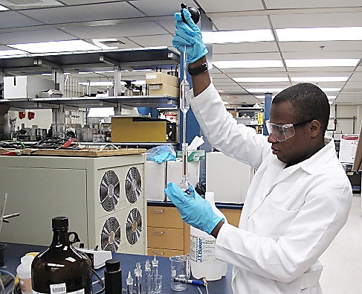
Research Experiences for Undergraduates (REU)
NSF 13-542
Supports active research participation by undergraduate students
REU Sites - based on independent proposals to initiate and conduct projects that engage a number of students in research
REU Supplements may be included as a component of proposals for new or renewal NSF grants or cooperative agreements or may be requested for ongoing NSF-funded research projects
Antarctica: Due 4th Friday in May
Others: Due 4th Wednesday in August

Slide 21
REU Budget
Summer REU projects
  $1,200 per student per week (generally)
  Including all direct costs and indirect costs--is generally expected not to exceed $1,200 per student per week.
Academic-year REU projects
  comparable on a pro rata basis
Projects that involve exceptional circumstances may exceed this limit.

Slide 22
Education and Human Resources Core Research
(ECR)
SOLICITATION: NSF 17-509
Due: Second Thursday in September

Slide 23
ECR: Fundamental Research in STEM Ed
STEM Learning
STEM Learning Environments
STEM Workforce Development
Broadening Participation
STEM

Slide 24


NSF 15-509
EHR Core Research (ECR) Program
Addresses persistent challenges in STEM:
Interest
Education
Partici-pation
Under-stand
Build theory to explain
Learning
Suggest interventions and innovations
by emphasizing accumulation of robust evidence to inform efforts to:
Notes:
Emphasizes the accumulation of robust evidence to inform efforts to
understand,
build theory to explain, and
suggest interventions and innovations to address persistent challenges in STEM interest, education, learning, and participation.

Slide 25

NSF 15-509
EHR Core Research (ECR) Program
Funding Levels/Types
  Level I proposals: up to $500,000 for up to 3 years
  Level II proposals: up to $1.5M for up to 3 years
  Level III proposals: up to $2.5M for up to 5 years
  Synthesis proposals: up to $300,000 for up to 2 years
  Conferences and Workshops: generally $25,000 to $100,000

Slide 26
Other Programs
CyberCorps(R) Scholarship for Service: Defending America's Cyberspace (SFS): NSF 15-584
  addresses
    cybersecurity education
    workforce development
  Scholarship track
  Capacity track
CyberLearning: NSF 17-520
  understand how people learn with the context of cyber innovation, learning innovation, how people learning in technology-rich environments

Slide 27
Louis Stokes Alliances for Minority Participation (LSAMP)
SOLICITATION: NSF 17-579
Due Dates:
Bridge to the Doctorate (BD) Activity: 1st Friday in November
STEM Pathways and Research Alliances: 3rd Friday in November
New and Renewal LSAMP Pre-Alliance Planning, Bridge to the Baccalaureate (B2B), STEM Pathways Implementation-Only Projects: 3rd Friday in November
Louis Stokes Regional Centers of Excellence in Broadening Participation: Last Friday in January

Slide 28

LSAMP emphasizes UG STEM education for unrepresented students
Ultimately results in the graduation
  of well-prepared, highly-qualified students
  from underrepresented groups
  who pursue graduate studies or careers in STEM
Enable successful transfer of students from 2-yr to 4-yr institutions;
Increase undergraduate access to high-quality research experiences; and
Facilitate seamless transition of students into graduate programs
Notes:
The LSAMP program supports comprehensive, evidence-based, and sustained approaches to broadening participation of students from racial and ethnic groups historically underrepresented in STEM (African Americans, Hispanic Americans, American Indians, Alaska Natives, Native Hawaiians, and Native Pacific Islanders) primarily at the undergraduate level. These approaches facilitate the production of well-prepared students highly-qualified and motivated to pursue graduate education or careers in STEM. Support is available for Alliances (including Bridge to the Baccalaureate), Bridge to the Doctorate grants, Pre-Alliance Planning grants, and other funding opportunities.
Emphasis is placed on transforming undergraduate STEM education for underrepresented students through:
innovative, evidence-based recruitment and retention strategies;
Enable successful transfer of students from 2-yr to 4-yr institutions;
Increase undergraduate access to high-quality research experiences; and
Facilitate seamless transition of students into graduate programs

Slide 29
Louis Stokes Alliances for Minority Participation (LSAMP)
Authorized by Congress and established in 1991.
Supports comprehensive, evidence-based, innovative, and sustained strategies
Broadens participation of primarily undergraduate students from racial and ethnic groups historically underrepresented in STEM
  African Americans Hispanic Americans
  American Indians Alaska Natives
  Native Hawaiians Native Pacific Islanders
Notes:
The LSAMP program supports comprehensive, evidence-based, and sustained approaches to broadening participation of students from racial and ethnic groups historically underrepresented in STEM (African Americans, Hispanic Americans, American Indians, Alaska Natives, Native Hawaiians, and Native Pacific Islanders) primarily at the undergraduate level. These approaches facilitate the production of well-prepared students highly-qualified and motivated to pursue graduate education or careers in STEM. Support is available for Alliances (including Bridge to the Baccalaureate), Bridge to the Doctorate grants, Pre-Alliance Planning grants, and other funding opportunities.
Emphasis is placed on transforming undergraduate STEM education for underrepresented students through:
innovative, evidence-based recruitment and retention strategies;
Enable successful transfer of students from 2-yr to 4-yr institutions;
Increase undergraduate access to high-quality research experiences; and
Facilitate seamless transition of students into graduate programs

Slide 30
LSAMP (cont.)
  Support is available for Alliances:
    Bridge to the Baccalaureate
    Bridge to the Doctorate grants
    Pre-Alliance Planning grants
    and other funding opportunities.
Notes:
The LSAMP program supports comprehensive, evidence-based, and sustained approaches to broadening participation of students from racial and ethnic groups historically underrepresented in STEM (African Americans, Hispanic Americans, American Indians, Alaska Natives, Native Hawaiians, and Native Pacific Islanders) primarily at the undergraduate level. These approaches facilitate the production of well-prepared students highly-qualified and motivated to pursue graduate education or careers in STEM. Support is available for Alliances (including Bridge to the Baccalaureate), Bridge to the Doctorate grants, Pre-Alliance Planning grants, and other funding opportunities.
Emphasis is placed on transforming undergraduate STEM education for underrepresented students through:
innovative, evidence-based recruitment and retention strategies;
Enable successful transfer of students from 2-yr to 4-yr institutions;
Increase undergraduate access to high-quality research experiences; and
Facilitate seamless transition of students into graduate programs

Slide 31
NSF has TWO Merit Review Criteria
Intellectual Merit
  What will we learn?
  How will it advance knowledge?
Broader Impacts
  What will the impact be on society?
  How will it make the nation a better place?
Educationally focused projects often have a hard time disentangling these, but you need to separate them out in your proposal.

Slide 32
Elements of the Merit Review Criteria
What is the potential for the proposed activity to make a difference?
By advancing knowledge and understanding within its own field or across different fields (Intellectual Merit); and
By benefitting society or advancing desired societal outcomes (Broader Impacts)?
To what extent do the proposed activities suggest and explore
creative, original, or potentially transformative concepts?
Is the plan for carrying out the proposed activities well-reasoned, well organized, and based on a sound rationale?
Does the plan incorporate a mechanism to assess success?
How qualified is the individual, team, or institution to conduct the proposed activities?
Are there adequate resources available to the PI (either at the home institution or through collaborations) to carry out the proposed activities?

Slide 33

Useful Resources: NSF Policies
PAPPG
NSF 18-1

Slide 34
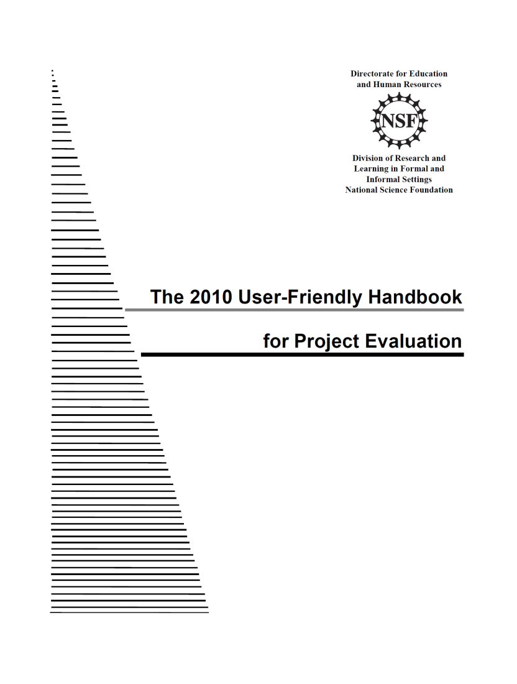
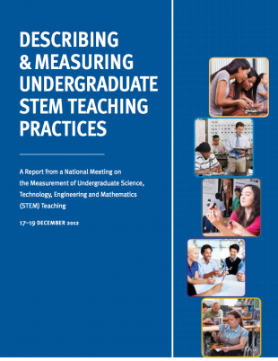
Useful Resources: Evaluation
Describing and Measuring
User-friendly Handbook

Slide 35
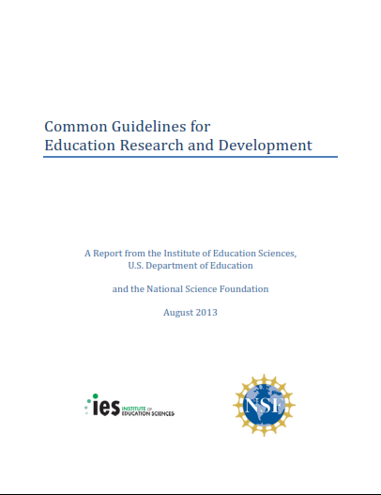
Useful Resource: Education Research
Common Guidelines
NSF 13-126

Slide 36
References
[1] Mervis, J., NSF director unveils big ideas, Science, 352 (6287), 755-756, 13 May 2016. DOI: 10.1126/science.352.6287.755
[2] Institute of Education Sciences and National Science Foundation. Common guidelines for education research and development. 2013. https://www.nsf.gov/pubs/2013/nsf13126/nsf13126.pdf.
[3] August.S.E., NSF PROGRAM OFFICER'S VIEWS: Common guidelines for conducting education research, ACM Inroads 8, 1 (February 2017), 35-36. DOI: https://doi.org/10.1145/3029346

