Slide 1
NCWIT Programs and Resources for Recruiting and Retaining Undergraduates Lecia Barker National Center for Women & Information Technology

Slide 2
NCWIT’s mission: to significantly increase girls’ and women’s meaningful and influential participation in computing
Notes:
Convene, equip, unite; systemic change

Slide 3
NCWIT Academic Alliance Meetings, Collaborations
600+ members
Meetings at annual NCWIT Summit
SIGCSE Receptions (Friday!)
Meeting at Hopper
Partners in resource development

Slide 4
NCWIT Academic Alliance Programs, Initiatives

Slide 5
NCWIT Academic Alliance Seed Funds

Slide 6
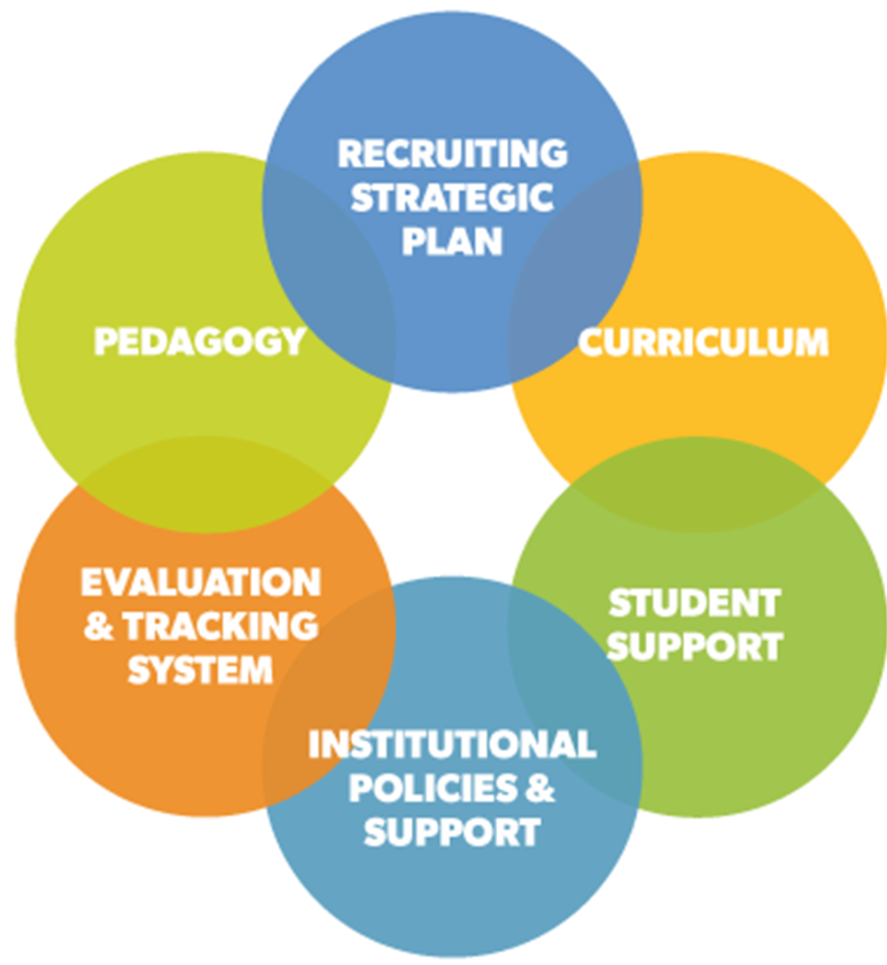
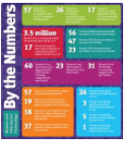
Resources for Taking Action
Talking Points
Top 10 Ways and Tips
NCWIT Promising Practices: Research and Case Studies
Self-guided course
Statistics, Articles, and Summaries

Slide 7
Resources for Taking Action
NCWIT Programs-in-a-Box, Guides, and Workbooks
Collection of Intro CS teaching resources (EngageCSEdu)
Webinars
Evaluation
Kits and Guides, Surveys, NCWIT Tracking Tool

Slide 8
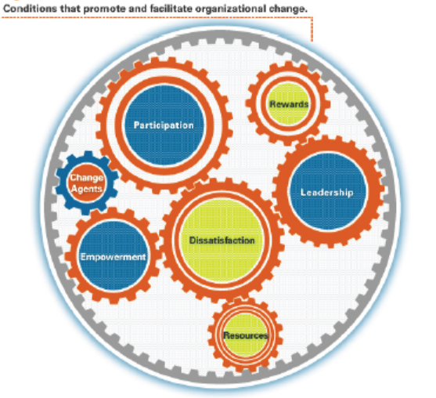
Resources for Engaging Colleagues
Gearing up for Change
Communicating for Change
Research on adoption of teaching practices

Slide 9
Resource Highlight: Framing Classroom Climate for Student Success (Thanks Melissa O’Neill)
Notes:
9

Slide 10
Classroom
Instructor
Students
A social setting where learning occurs
Convey concepts and topics we want students to know
Hope these end up in students’ heads in a usable form
Facilitate learning experiences
Concerns about being seen as intelligent and socially “fit” (or at minimum: avoid shame)
Some show off, some shut down
Desire to belong

Slide 11
Faculty can…
Design the social experience through framing
Preempt
Experiences that trigger beliefs that one doesn’t belong or lacks the qualities needed for success
Stereotype threat

Slide 12
Notes:
The nip denotes the bite, but is not interpreted as the bite

Slide 13
Framing Creating a context or perspective that strongly influences interpretation of events

Slide 14
Framing up front, then throughout term
Before beginning of term: Survey
First day/week: Present survey results
Throughout term: In-class and lab experiences
“trading cards” for randomly calling on individual students, pairs, or groups
think-pair-share / group problem solving
collaborative learning (e.g., pair programming)

Slide 15
Survey Question: Prior Experience

Slide 16
Explain: Learn and display more/less learning

Slide 17
Survey Question: Tendency to Speak Up
Notes:
Requests that students go outside of their comfort zone: speak less/more

Slide 18
Explain: Leave comfort zone
Notes:
Requests that students go outside of their comfort zone: speak less/more

Slide 19
Survey Question: Making Mistakes

Slide 20
Explain: Learn thru Trial and Error

Slide 21
Survey: Feedback Style
Notes:
But this conversation points out that there are choices and differences, among students; it’s not personal.

Slide 22
Explain: Instructor will try to adjust
Notes:
But this conversation points out that there are choices and differences, among students; it’s not personal.

Slide 23
Survey Question: Imply Excitement

Slide 24
Explain: Situate excitement in field and knowledge needed

Slide 25
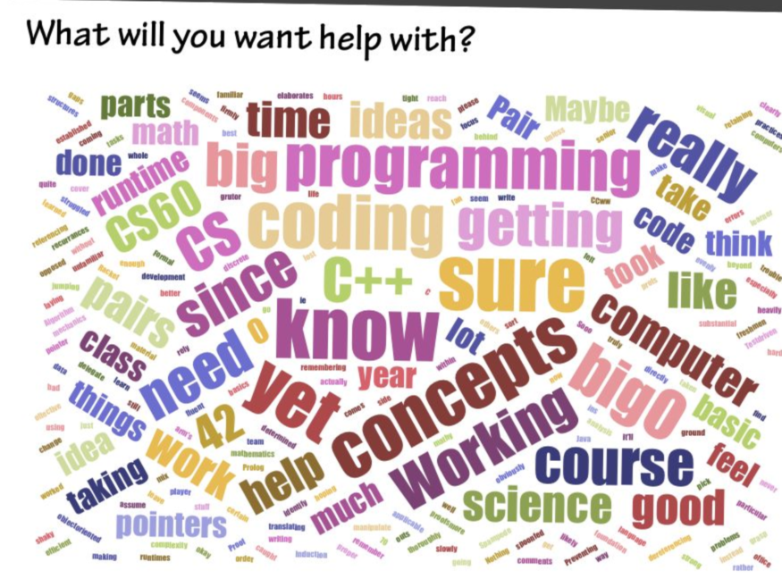
Survey: What Help is Needed?

Slide 26
Explain: Not alone in trepidations

Slide 27
Controlling, reinforcing the frame
Adjust classroom dynamics with think/pair/share, small group problem solving
Use collaborative learning in lab to reinforce belief that students can and should learn from each other
Avoid favoring the most vocal students by random selection with “trading cards”

Slide 28
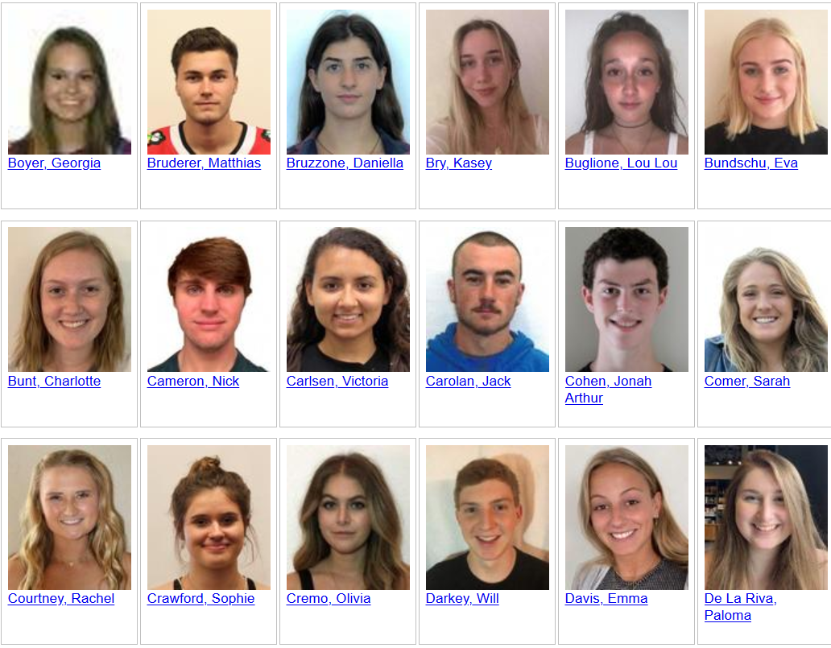
Trading cards rules
Ask question first
Turn over card
Students can partially answer
Ask a question of their own
Pass (card goes back in the deck)

Slide 29
More Info
Search: NCWIT How do you retain women through inclusive pedagogy? Framing a supportive classroom climate.
https://www.ncwit.org/resources/how-do-you-recruit-or-retain-women-through-inclusive-pedagogy/framing-supportive-classroom
Barker, Lecia, O’Neill, Melissa, Kazim, Nida. (2014). Framing classroom climate for student learning and retention in computer science. Proceedings of the 45th ACM Technical Symposium on Computer Science Education (pp. 319–324). doi:10.1145/2538862.2538959

Slide 30
THANK YOU!

